Slide 1
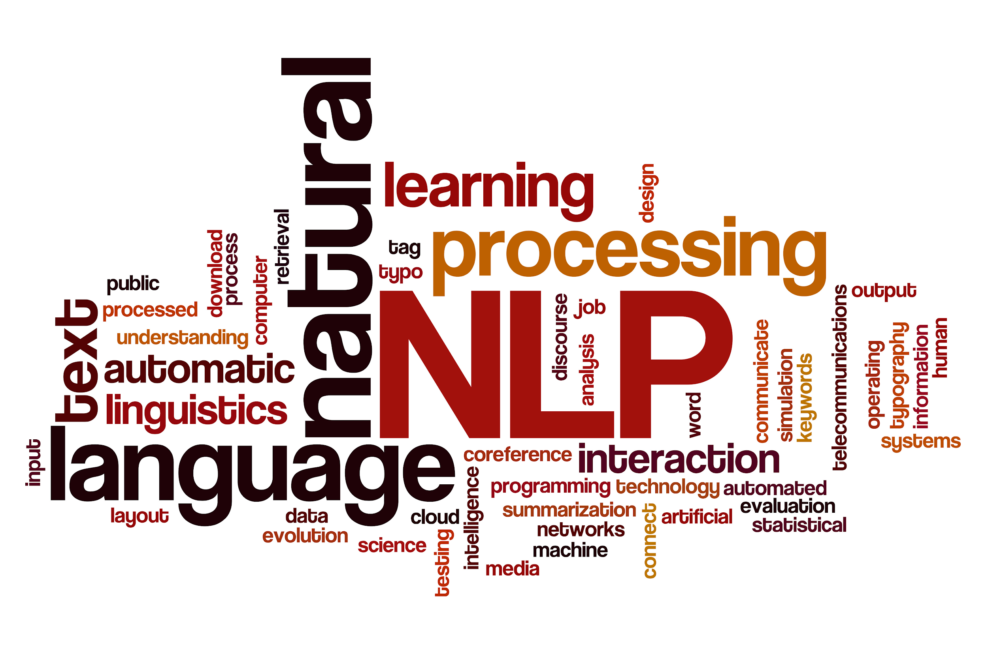
Processing Text in NLP
Shivangi Singhal
PhD @ IIIT-Delhi, India

Slide 2
Who am I?
Shivangi Singhal
IInd Year PhD Student @IIIT-Delhi, India
On an Internship in NII, Japan
Works in area of Multimodal Fake News Detection on Social Media

Slide 3

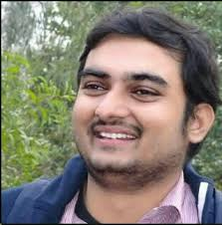




My Supervisors and Labs
Supervisor Co-Supervisor Mentor
Rajiv Ratn Shah
Tanmoy Chakraborty
Ponnurangam Kumaraguru

Slide 4

What is a Natural Language Processing?
A field of computer science, artificial intelligence and computational linguistics concerned with the interactions between computers and human (natural) languages.

Slide 5


Data pre-processing
Also known as data wrangling, Data Cleaning
Process of converting data from the initial raw form into another format, in order to prepare data for further analysis.
pre-processing
Raw data
Processed data

Slide 6
Importance of Data pre-processing
Advantage:
Make data consistent to generate good analytics results
Disadvantage:
converting anything into a format for machine learning reduces it to a generalized state which means losing some of the fidelity of the data along the way.

Slide 7
Basic Terminologies
Corpus (plural corpora)
Corpus refers to a collection of texts.
Such collections may be formed of a single language of texts, or can span multiple languages -- there are numerous reasons for which multilingual corpora (the plural of corpus) may be useful
Corpora may also consist of themed texts (historical, Biblical, etc.).

Slide 8
Normalization
Normalization generally refers to a series of related tasks meant to put all text on a level playing field:
• converting all text to the same case (upper or lower)
•removing punctuation
• expanding contractions
• converting numbers to their word equivalents, and so on

Slide 9
Time to do some Installation

Slide 10
Create Virtual Environment for project
conda create -n WWC_part1 python=3.7 anaconda
To activate this environment, use:
source activate WWC_part1
To deactivate an active environment, use:
source deactivate

Slide 11
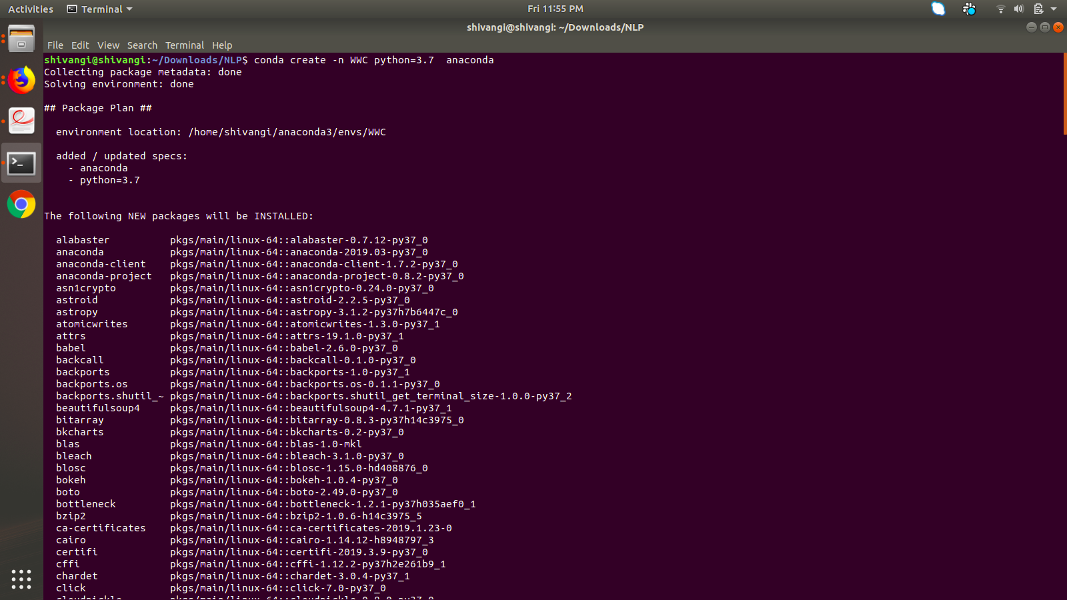

Slide 12
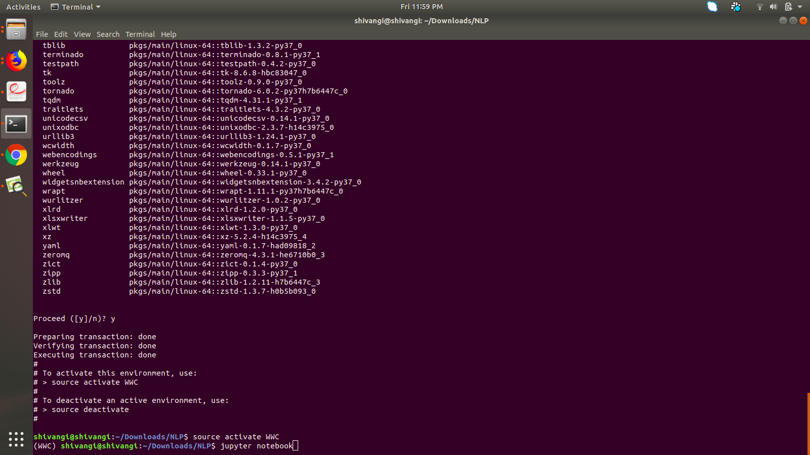

Slide 13
Set Kernel in Jupyter notebook
python -m ipykernel install --user --name myenv --display-name "Python (myenv)"

Slide 14
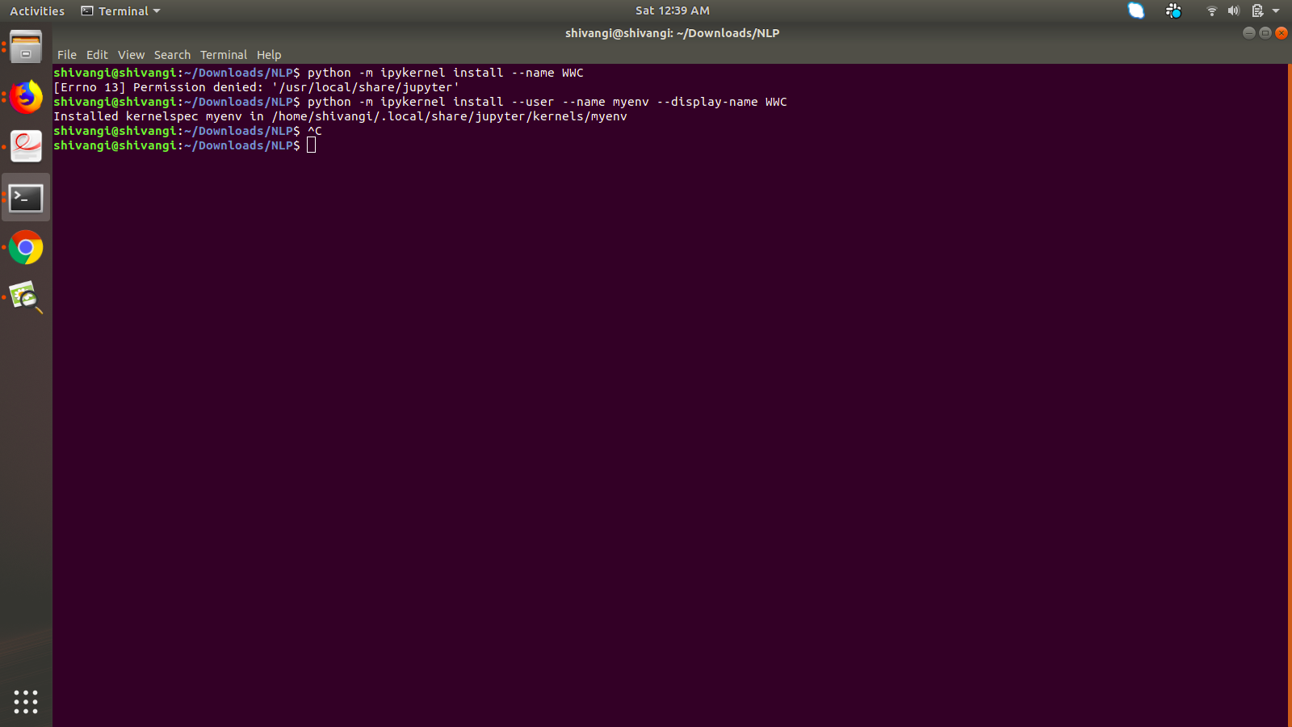

Slide 15
Git Clone the repository
https://github.com/shiivangii/NLP_Tutorial

Slide 16
Medium Blog
https://medium.com/@shiivangii/processing-text-data-in-natural-language-processing-84e4b94b002c?postPublishedType=initial

