Slide 1

GOEL INSTITUTE OF TECHNOLOGY &
MANAGEMENT, LUCKNOW
Project Presentation
In Partial Fulfillment of the Requirement for the Degree of
BACHELOR OF TECHNOLOGY
In
COMPUTER SCIENCE & ENGINEERING
Prseented By –
Muskan Maurya (2003600100067)
Anand Gupta (2003600100019)
Raj Chaudhary (2003600100080)
Harsh Vishwakarma(2003600100051)

Slide 2
ENVORIOR
Alone, we can do so little; together, we can do so much !!!!!!!!

Slide 3
WHAT IS ENVORIOR ?
This project is a web application project with the help of which we can represent our social work in front of people. We can also collect rewards/points according to our social work.
The person with the most points will receive a Appreciation Certificate or reward from the leader of his society.
People will be able to hire workers for their shops or small businesses.
We have something that we don't need, but if it is needed by
someone, we can donate it.

Slide 4


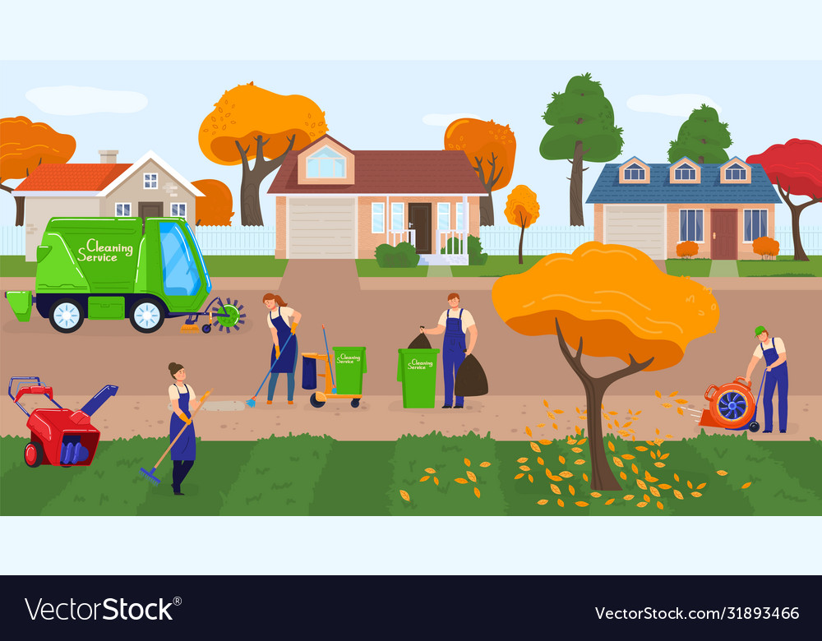
OBJECTIVES
People can upload jobs for their shop.
People can make complaints related to cleanliness in their area without hiding their identity.
Donate system, through which people can donate such things which are not necessary for them but which are necessary for others.
People who participate the most in social work should be appreciated so that they work more diligently.

Slide 5

PROBLEM STATEMENT
Appreciation of social work
Job Opportunities
Providing Helping Hands
No appreciations of different social work such as plantation,recycle,etc.
Jobs for those who are in need are not provided.
There is no one for support of those who are in need.

Slide 6
PERSPECTIVE SOLUTION
Appreciation for social workers.
Complains
Job Opportunities
Appreciations for different social work with acknowledgment .
Complaints regarding cleanliness in their area without hiding their identity.
People can post for need of job and get job from different locations.

Slide 7
Hardware Requirements
Hard Disk
RAM
Operating System:
Monitor
2
4
1
3
40 GB
2 GB
Dual Core
15 VGA Color

Slide 8
Software Requirements
Front-End
Framework
Operating System
Back-End
2
4
1
3
HTML, CSS and JS
Bootstrap and Django
Windows OS
Python, MYSQL

Slide 9
Project Modules
There are four modules in this project and each has their own modules.
General Zone
Public zone
Servant zone
Supervisor zone

Slide 10
General Zone
Registration Page
Login Page
The General Zones Contains the Registration and login Module
1
2

Slide 11
Public zone
Add/Remove social work image
Dashboard
Donate something(Book/Cloths/Other useful things)
Give Digital Rewards(Points)
Public Zone are for users the several modules for public zone are as follows
1
2
3
4

Slide 12
Public zone
Add/remove job
Get Gifts
Get Job
Add/Remove Complain
Public Zone are for users the several modules for public zone are as follows
5
6
7
8

Slide 13
Servant zone
View Complain
Add Events/News
View top socialized people
The Servant zone is for the leader of society or care taker of society
1
2
3

Slide 14
Supervisor zone
View top socialized people
View Unsolved Complain
Add Events/News
ALL ANSWERS ARE RIGHT
This zone is for the head of the leader care taker of society
1
2
3
4

Slide 15
FEATURES OF THIS WEB APPLICATION
Donation
Virtual coins
01
02
Complain
Rewards
03
04
Donate your things.
Get virtual coins on every good deeds.
Write your problems.
Certificate and rewards for maintaining nature.

Slide 16
01
REFERENCES
02
03
Django Documentation (https://docs.djangoproject.com/en/4.2/)
Bootstrap (https://getbootstrap.com/docs/5.3/)
W3schools (https://www.w3schools.com/)

Slide 17
CONCLUSION
This section discusses potential future improvements to the nature.This project is a web application project with the help of which we can represent our social work in front of people. We can also collect rewards/points according to our social work.

Slide 18
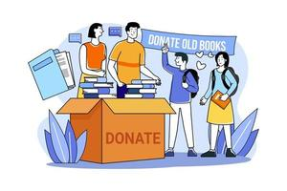
THANK YOU

