Slide 1
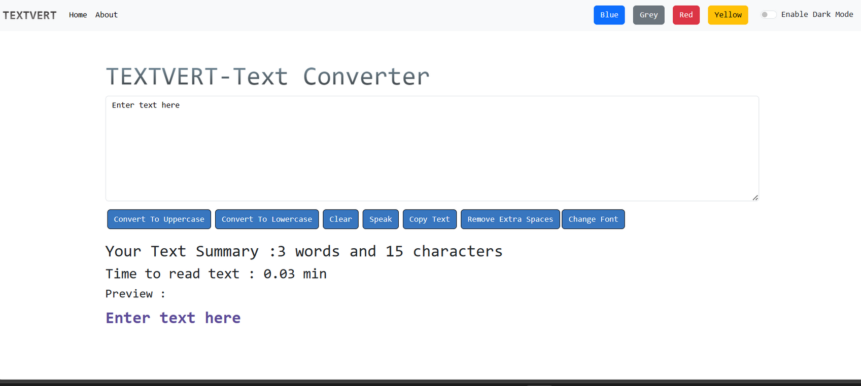
THE
TEXTVERT-TEXT CONVERTER APP
By
Muskan Garg

Slide 2

ABOUT THE APP
The Text Converter App is a web application built using the React library, designed to convert text between various formats. This report provides an overview of the app, its features, development process, and potential future enhancements. A React text converter app is a useful tool for content creators, writers, and anyone needing to convert text from one format to another while maintaining a real-time preview and user-friendly experience. It can be further enhanced by adding additional text format conversion options and improving the app's user interface.
2

Slide 3

LINK
Github Link :
https://github.com/Muskan-garg-23/TextVert-Text-Converter
3

Slide 4

THE FEATURES
Text Format Conversion: Users can input text in various formats and convert it to a different format of their choice.
Real-Time Preview: The app provides a real-time preview of the converted text, allowing users to see the results as they type or make changes.
Copy to Clipboard: Users can easily copy the converted text to their clipboard with a single click, making it convenient for further use.
4

Slide 5
TECH STACKS
React: The app is built on the React library, which is a popular JavaScript library for building user interfaces
JavaScript: JavaScript is used to add interactivity and functionality to the app.
Bootstrap: This framework used for structuring and styling the app.
React Libraries: Various React libraries and components are utilized to enhance the app's functionality and user experience
5

Slide 6
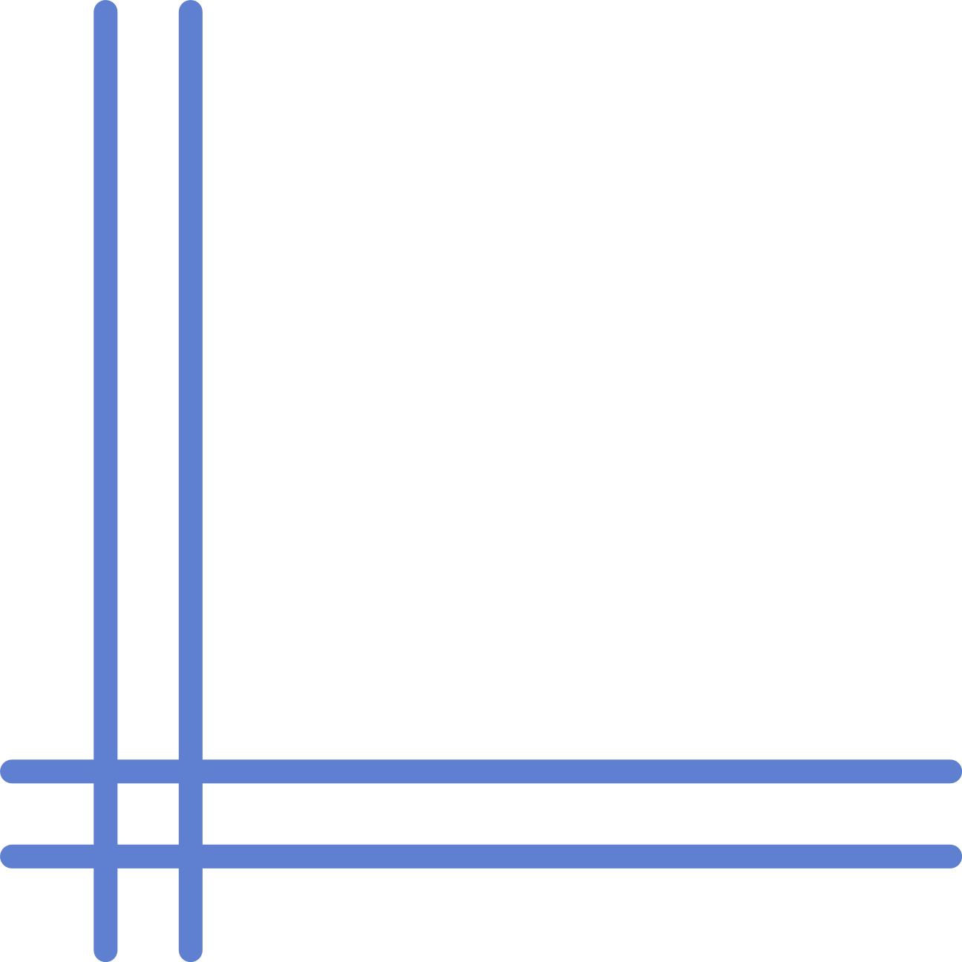
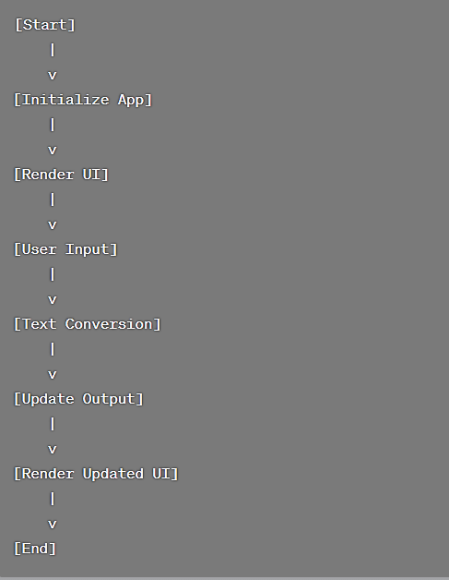
FLOW CHART
6

Slide 7
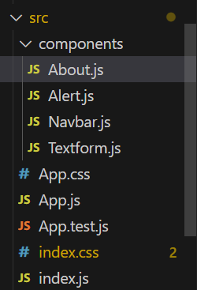
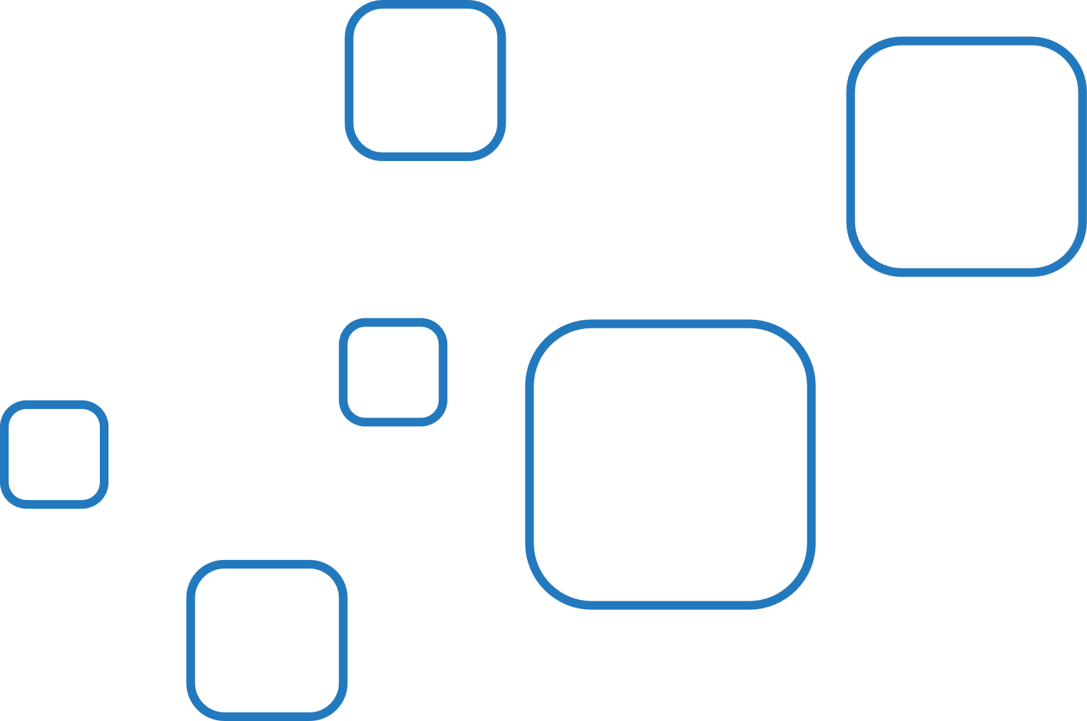
FOLDER
STRUCTURE
The 'components' folder contains various components that are used to build the user interface and functionality of the application. Here I divided my app into navbar, textform and about
6

Slide 8
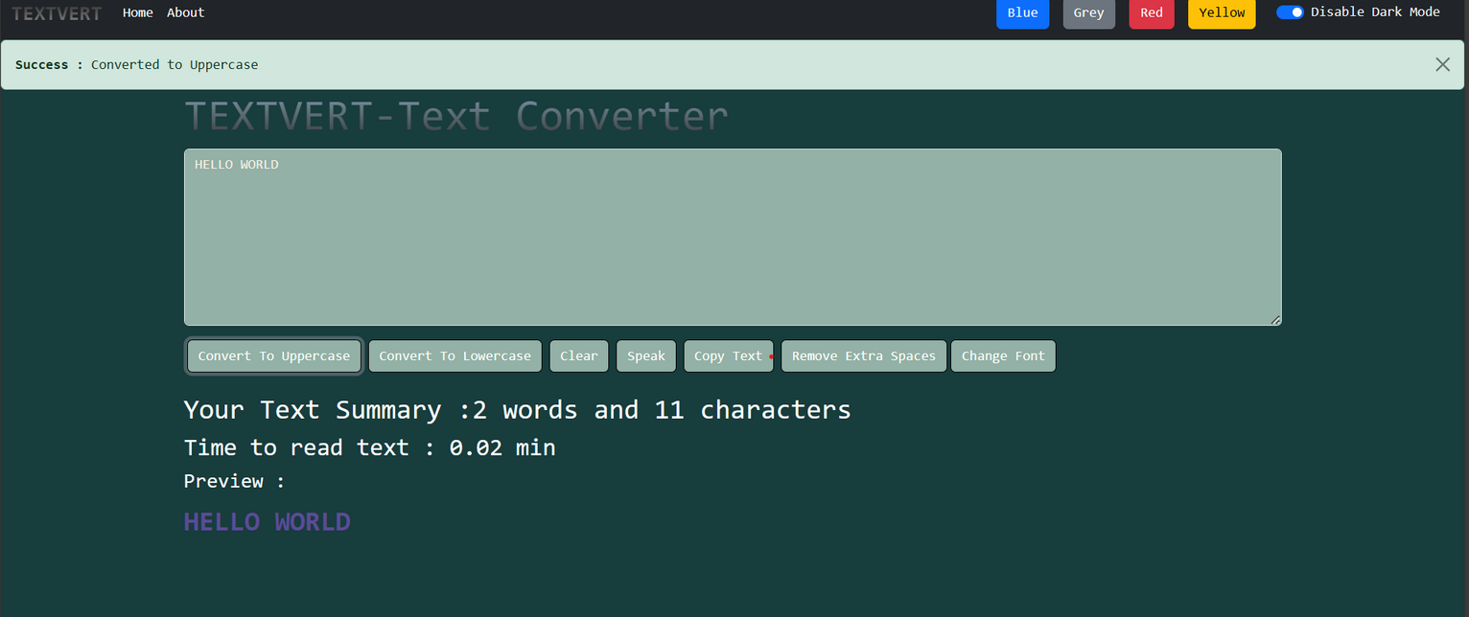
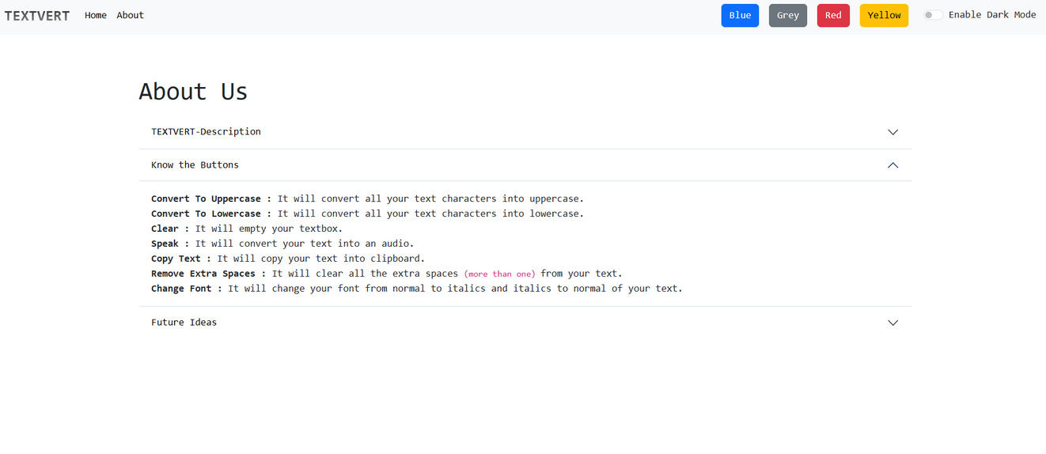

Slide 9
The Text Converter App, built with React, provides a user-friendly way to convert text between various formats. Its real-time preview and copy-to?clipboard functionality make it a useful tool for content creators and writers. With potential future enhancements, it can become even more versatile and user-centric
CONCLUSION

