Slide 1

Institute of Engineering and Technology
Devi Ahilya Vishwavidyalaya
Guided By – Manoj Pawaiya Sir
Group members:
Hritik Sahu(18C7120)
Muskan Sharma(18C7130)
Vikalp Rusia(18C7163)
Branch - Computer Engineering
Section - B
Minesweeper

Slide 2

Contents
Introduction
Problem Domain
Literature Survey
Solution Domain
Technology Stack
Use case Diagram
Database Design
Conclusion

Slide 3
Introduction
Minesweeper is a single-player puzzle video game. The objective of the game is to clear a rectangular board containing hidden "mines" or bombs without detonating any of them, with help from clues about the number of neighboring mines in each field.
There are some benefits of playing games like minesweeper:
Using Games to Teach Cognitive Skills – The use of games to attempt to teach cognitive skills goes back to ancient times. For ex- Go, Chess.
The Value of Logical Hypothetical Thinking - Hypothetical reasoning is a central topic in cognitive science. and is a major component of what is known in Dual Processing Theory as Type 2 Processing done by our brains.

Slide 4
Problem
Domain

Slide 5
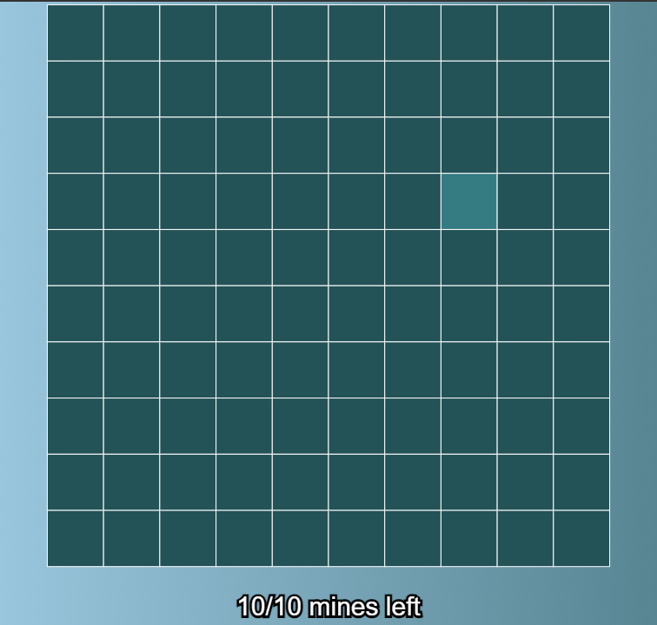
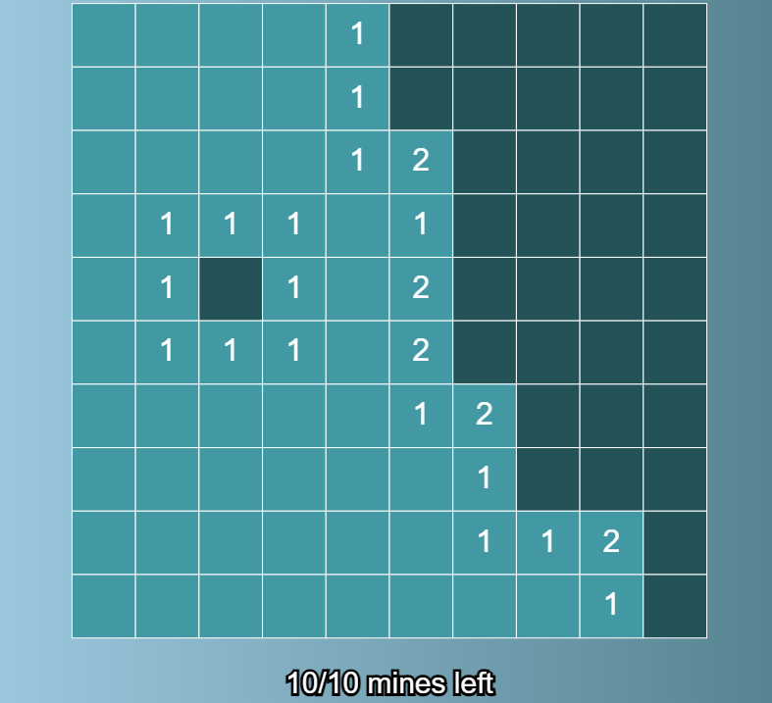
Minesweeper is a simple one−player computer game. The game consists of a 2-dimensional rectangular playing field (or board) where known numbers of mines are hidden.
Initially, all the squares on the board are "covered up" and no information is given to indicate the location of the mines.
The player’s job is to either deduce or guess which board squares are clear of mines and step there to reveal a number.
If successful, this number will indicate the number of mines to be found in the squares adjacent to the square with the number.

Slide 6
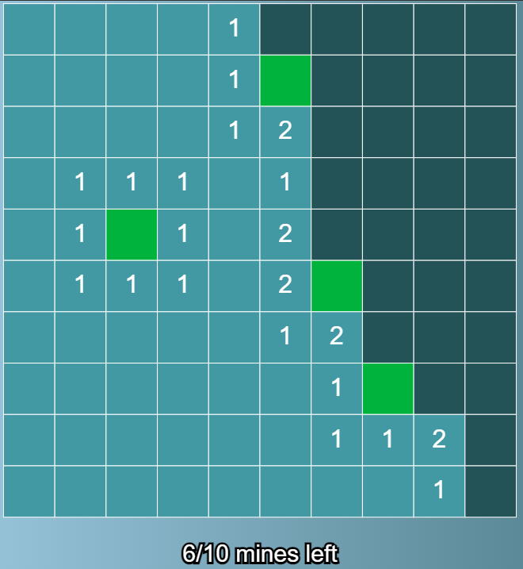
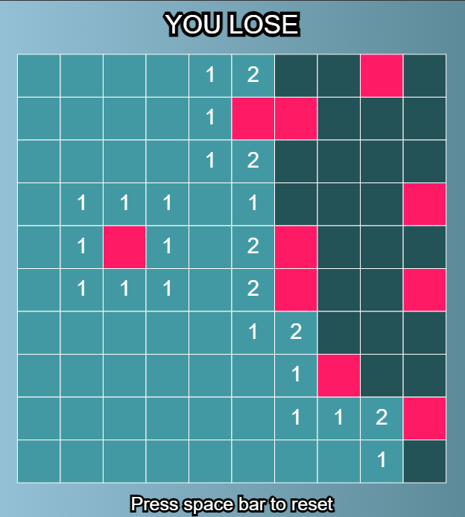
Obviously, the first move of the game must be a guess because no information has been provided. Since the board is a rectangular grid, each interior square has exactly 8 neighboring squares, edge squares have 5 neighbors, and corner squares have 3 neighbors.
Therefore, the number found under any given square will be in the range of 0 to 8 (inclusive).
Game play continues until the player has uncovered (or "stepped" on) each square that does not hide a mine, while avoiding all the mines. If the player can do this, they are considered to have won the game.
However, if at any point the player attempts to uncover a square that contains a mine, the game immediately ends, and the player is said to have lost.

Slide 7
Literature
Survey

Slide 8
Minesweeper is under rated game as only 2 sites are currently serving minesweeper.
First site is hosted by google which has descent UI, but the game is not customizable as well as there is no leaderboard.
Second site is hosted by minesweeper.online which has poor UI as compared to the growing power of UI in current world.
Currently players cannot upload their avatar as well as there is no community to chat.
They are not able to retain people because of this.

Slide 9
Solution
Domain

Slide 10
UI redesigned from scratch to meet up the current world requirements. UI is a lot interactive to retain player. User gets lot of option.
Though there are no themes for now but in future releases they have a reserved spot.
Profile page contains dynamic data to update the profile of user from password to username as well as avatar. Leaderboard contains data for separate levels.
To improve upon the game-
There are several features that could be added. For example, adjusting the program to ensure that a bomb could not be uncovered on the first tap.
This could be done by generating the random row and column coordinates of the bomb locations in the gameboard array after the first touch had been recorded on the touch screen.

Slide 11
An if statement could be used in the code to prevent a bomb from being randomly placed in the location that corresponds to a location that was already touched by the user on the screen.
By generating the location of the bombs after the first touch has been made by the user, there is no way that the user could touch a bomb on the first touch. Then, the remaining logic of the code could still be applied.
Another recommendation for the game is that flags could be added to the game. this would involve adding a button board that could be used to select locations on the board that the user suspects to have a bomb.
Then, the user could tap these locations and a shape could be printed to that desired location. An if statement could be used to allow for the user to tap the space again to remove the shape. These changes could be implemented with more time.

Slide 12
Java
Spring(Back-End)
HTML, CSS, JavaScript, JSON (Front-End)
MySQL(database)
Hibernate(ORM model) and JDBC (database connectivity)
C3p0 (database thread pooling)
Technology Stack

Slide 13
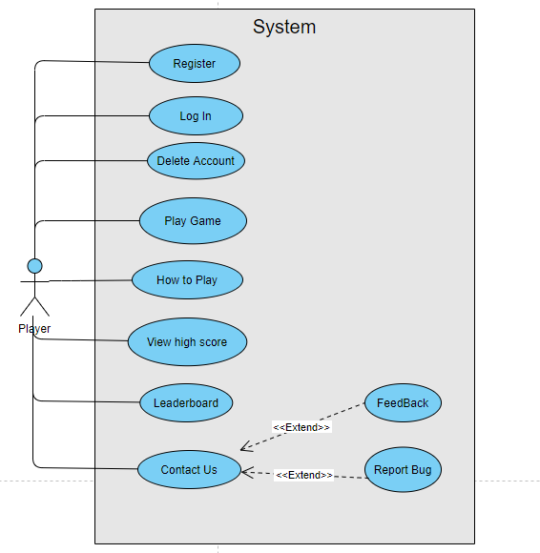
Use - Case Diagram

Slide 14
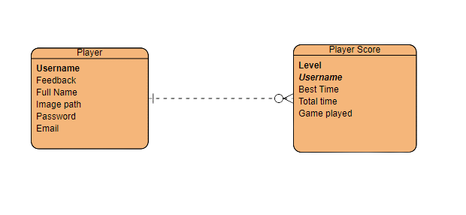
Database Design

Slide 15
Conclusion
Difficulties faced-
Default theme selection for whole website which includes – font size, color but is not limited to this only.
JavaScript fetch, beacon queries and how to capture them at backend.
Configuring backend for logging server state and client state.
Using web URL encoding for integrating spring form with fetch queries.
Future releases include-
Theme selection
Captcha validation to avoid DNS attack
Email verification
Contact us (in website)
Using Jtoken for validation
Delete Account

Slide 16
References
Andrew Adamatzky. How cellular automaton plays minesweeper. Applied Mathematics and Computation, 85(2–3):127–137, 1997.
Kasper Pedersen. The complexity of minesweeper and strategies for game playing. Project report, univ. Warwick, 2004.
Lourdes Pe˜na Castillo and Stefan Wrobel. Learning minesweeper with multi relational learning. In IJCAI, pages 533–538, August 2003.
Minesweeper as a Constraint Satisfaction Problem
Minesweeper and Hypothetical Thinking Action Research & Pilot Study (ed.gov)
https://en.wikipedia.org/wiki/Minesweeper_(video_game)
https://www.google.com/fbx?fbx=minesweeper
https://www.pcworld.com/article/482195/how-to-play-minesweeper-like-a-pro.html

Slide 17
Thank You

