Slide 1
Thornquist Outfitters
A governed data lake on AWS
CCGC 5506 midterm | AWS Learner Lab
Muskan and David Beharry
Notes:
Hi, I'm Muskan, and this is David. Our project is a data lake for a made-up outdoor retailer called Thornquist Outfitters. The idea is simple: sales data comes in from different places in different shapes, and we built a pipeline on AWS that keeps everything, checks it, cleans it, and only lets trusted data reach the analysts. I'll cover how the data gets in and gets converted. David will cover the quality gate, the analytics, and governance.

Slide 2



Three messy sources
POS files
Online orders
Customer list
CSV, 40 stores
JSON, web and app
Pipe-delimited file
One file per day, 14 days
Bad dates, duplicates, zero prices
2 broken files: one empty, one header only
1,128 orders, 1,899 items
Items sit inside each order
Two snapshots: 479 and 505 rows
A weekly extract, not daily
The data is synthetic. We added problems on purpose to test the pipeline.
Goal: keep every file, check it, clean it, and let only trusted data reach analysts.
Notes:
Here's what we're working with. The data is synthetic, and we added problems on purpose to test the pipeline. First, POS files: a CSV per day from 40 stores, with bad dates, duplicates and zero prices, and two broken files, one completely empty and one with only a header. Second, online orders as JSON from the web and the app, with the items nested inside each order. Third, a customer list as a pipe-delimited file, with two snapshots. So three formats and plenty of mess. The goal is a lake that keeps every file, checks it, cleans it, and only lets trusted data through to analysts.

Slide 3
The architecture
PART 1 SOURCES AND UPLOAD
PART 2 LANDING TO RAW
1
2
3
4
5
Sources
POS, web/app, customers
Upload script
pos_upload.py
S3 Landing
everything as sent
Lambda
checks each file
S3 Raw
passed files; bad ones to quarantine/
PART 4 QUALITY GATE AND ANALYTICS
PART 3 RAW TO TRUSTED
10
9
8
7
6
Athena + dashboard
analysts read here
S3 Curated
rows that passed
Quality gate
5 rules, Athena SQL
S3 Trusted
typed, shared schema
Glue ETL jobs
convert to Parquet
Glue Data Catalog describes raw and trusted (labels only, no data)
CloudFormation: three stacks build all of it
Lake Formation: planned, not built (Learner Lab blocks it)
Notes:
This is the whole pipeline on one page, in order from 1 to 10. Part 1: three sources go through one upload script into the landing bucket. Part 2: a Lambda function checks each file and either copies it to raw or moves it to a quarantine folder. Part 3: Glue jobs convert the raw files into Parquet with proper types, and put them in the trusted bucket. Part 4 is David's: the quality gate, the curated bucket, and Athena with the dashboard. Each zone is its own S3 bucket and data only moves forward. Landing keeps exactly what was sent. Raw has only the files that passed the checks. Trusted has proper types in one shared schema, but it is not quality checked yet. Curated has only rows that passed all five rules. Underneath, the Glue Data Catalog describes what is in raw and trusted. CloudFormation builds all of it in three stacks: one for the buckets and Lambda, one for the catalog and Athena, and one for the Glue jobs and trusted catalog, all in the repo so anyone can rebuild it from the runbook. The dashed box is Lake Formation, which we planned but the Learner Lab blocks, and David will explain that.

Slide 4



Getting the data in
One upload script
Our POS run
pos_upload.py handles all three sources with a format flag. It flags a broken file in the log but still uploads it.
16 uploaded
A Lambda checks every file
2 flagged
Is it empty? Right header? Header only? Valid JSON? It runs on every upload.
The empty file and the header-only file. The Lambda moved both to quarantine/pos/. The other 14 are in raw.
Good to raw, bad to quarantine
A bad file keeps its original and gets a reject-reason label.
Notes:
Getting the data in. I wrote one upload script, pos_upload.py, for all three sources, and I just change a format flag. The script checks each file, but it never rejects anything. If a file looks broken, it logs a warning and still uploads it, because landing is supposed to keep everything exactly as it was sent. The Lambda is the real gate. It fires on every upload and checks for an empty file, a wrong header, a header with no rows, or invalid JSON. Good files are copied to raw, bad ones go to a quarantine folder with a reject reason. In our run, 16 POS files were uploaded and 2 were flagged, the empty one and the header-only one. The Lambda quarantined both, so raw has the other 14. We'll see this live in the demo.

Slide 5
Raw to trusted
A crawler describes the raw files so Athena can read them
Glue jobs convert them to Parquet with real types
Sales job runs on demand. Customers job runs weekly
Bad values are caught, not dropped: 51 dates and 13 prices became parse errors
4,633 sales rows in trusted
505 customers in the customers table.
Notes:
Now raw to trusted. A Glue crawler first describes the raw files so Athena can read them. Then two Glue jobs convert the data: a sales job that runs on demand, and a customers job on a weekly schedule. They write Parquet, which is a compact column format, with real types, so dates are dates and prices are numbers. One word to explain is conform. It means every source ends up in the same shape. It does not mean the data is good. If a date or price can't be read, the job doesn't drop the row. It records the problem as a parse error, 51 dates and 13 prices in our data. The result is 4,633 sales rows, 2,734 from stores, 974 from the app and 925 from the web, plus 505 customers.

Slide 6
The quality gate
4,633
Items flagged per rule (one item can fail several)
rows in
4,381
to curated (94.6%)
252
to quarantine, with reasons
Failed rows are kept with their reasons. Nothing is deleted.
Notes:
[David] The quality gate reads the trusted table and applies five rules written as Athena SQL: duplicate sale IDs, an invalid sale date, a price of zero or less, a quantity of zero or less, and a blank or unknown category. Of 4,633 rows, 4,381 passed and went to the curated bucket, 94.6 percent. 252 failed and went to quarantine, each with the reasons it failed. One row can fail more than one rule, so the per-rule counts add up to more than 252. The important point is that nothing is deleted. Failed rows are kept and labelled.

Slide 7
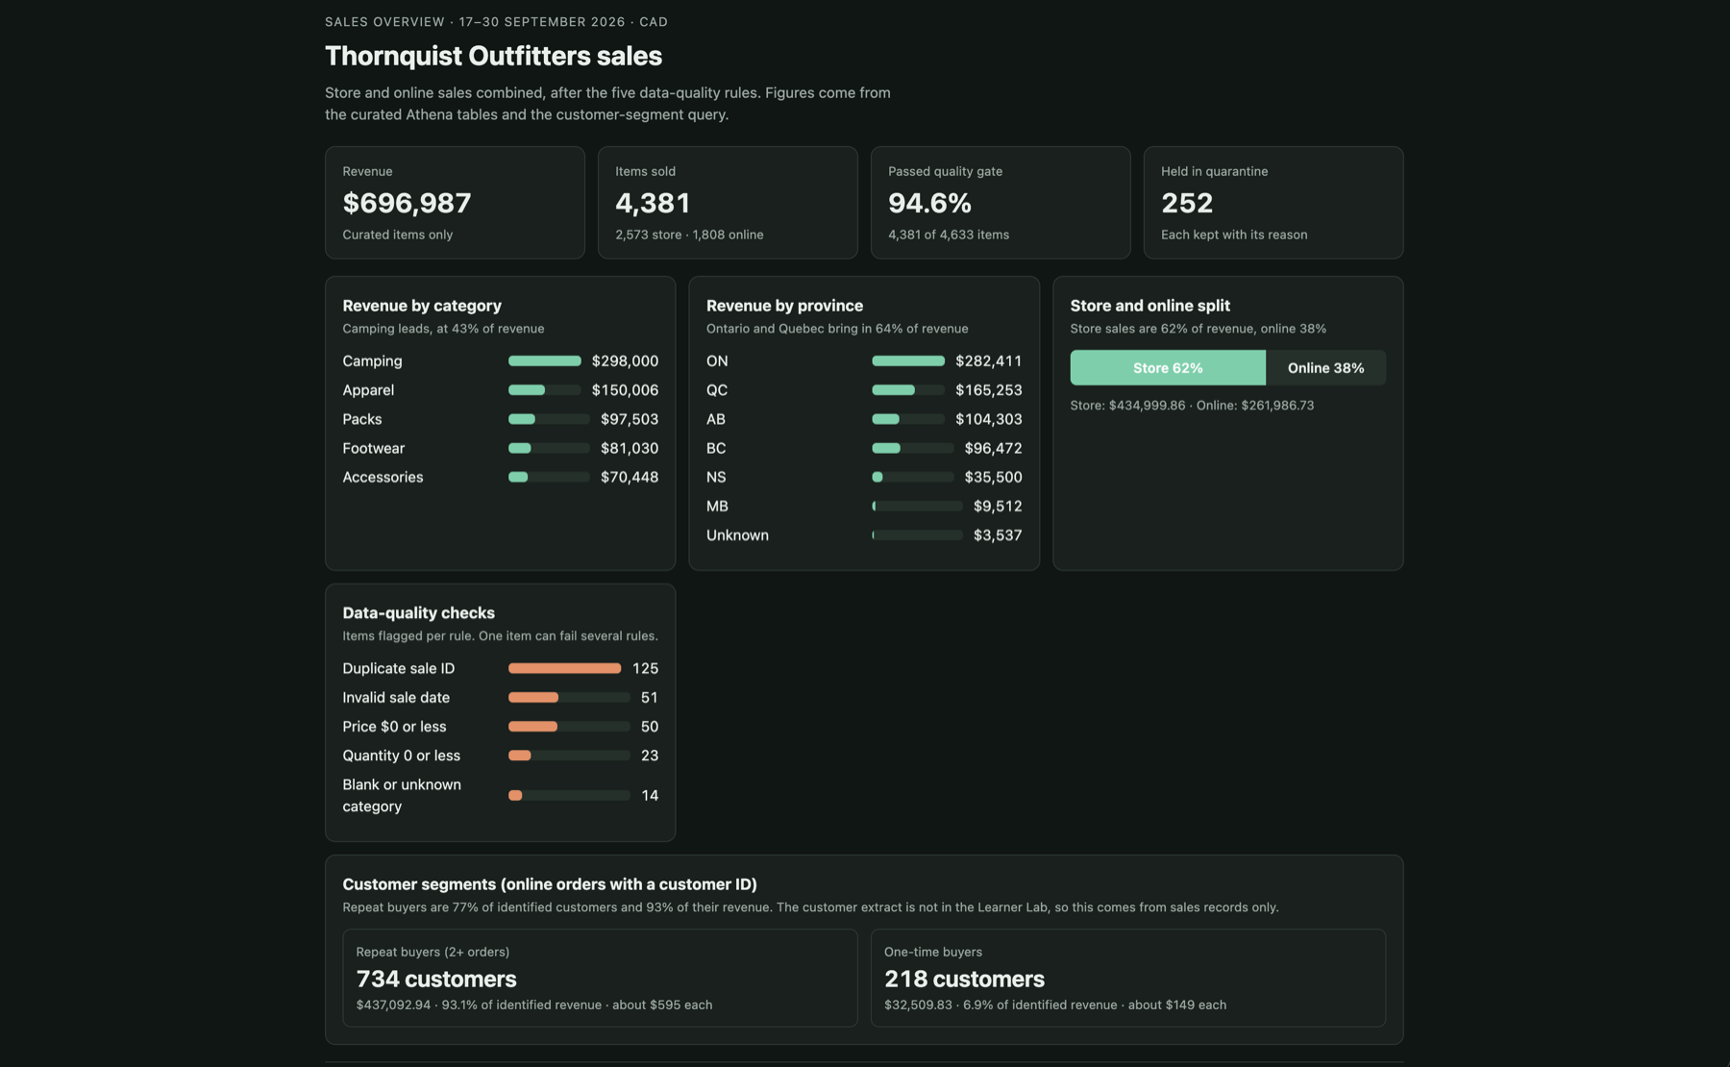
What analysts see
$696,987
CAD revenue (USD at 1.425)
43%
of revenue is Camping
64%
comes from Ontario and Quebec
Notes:
[David] Analysts query the curated tables in Athena, and the dashboard is built from those queries. It only shows rows that passed the gate. Revenue is 696,987 dollars Canadian. Online orders are in US dollars and are converted at 1.425, the average Bank of Canada rate for 5 to 9 October. Camping is 43 percent of revenue, and Ontario and Quebec bring in 64 percent. The dashboard also shows how many items each rule flagged, so the quality story is visible to the business.

Slide 8



Governance
Built
Planned: Lake Formation
Bucket policies
Analysts would get SELECT and DESCRIBE on the curated table only
Landing, raw, trusted and quarantine: no access
Not built: the Learner Lab role gets AccessDenied on Lake Formation
The permission set is written up in the repo
Deny access to upstream zones and quarantine, except the pipeline role
Analyst IAM policy
Curated data only, in one Athena workgroup
Scan limit
The workgroup caps each query at 1 GB
Notes:
[David] For governance, the rule is that analysts only see curated data. What we built is bucket policies that deny access to the upstream zones and quarantine except for the pipeline role, an IAM policy for the analyst limited to curated data and one Athena workgroup, and a 1 gigabyte scan limit on that workgroup. We also planned Lake Formation, which would give column-level permissions on the curated table. We could not build it, because the Learner Lab role gets an AccessDenied error on Lake Formation. We documented the permission set in the repo and used the policies above as the fallback. So the design is complete, but that last piece is a plan, not a working system.

Slide 9
Demo, then questions
A broken file lands and the Lambda quarantines it
Run the raw crawler, then the Glue jobs, live
Query the trusted tables in Athena
Notes:
That's the design. Now I'll show it running: I'll drop in a broken file and show the Lambda quarantining it, run the raw crawler and the Glue jobs live, and then query the trusted tables in Athena. After that we'll take questions.

