Slide 1
TRADING BEHAVIOR AND MARKET SENTIMENT BEHAVIOR ANALYSIS
--BY MUSKAN SINGH

Slide 2
TABLE OF CONTENTS
DATE (TIMESTAMP)
COIN
CLASSIFICATION
SIZE_TOKENS
EXECUTION PRICE
HOUR
SIZE_USD
SIDE
CLOSED_PNL

Slide 3
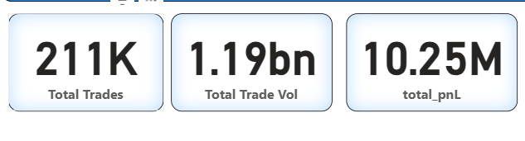
Total number of buy and sell transactions executed during the analysis period is 211K.
Overall quantity/value of assets traded is 1.19bn.
Net profit and loss generated from all completed trades is 10.25M.

Slide 4
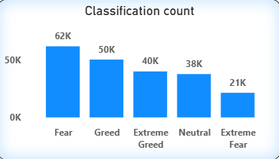
Fear and Greed together account for 112K trades, dominating market sentiment.
KEYPOINTS
Fear: 62K trades
Highest sentiment category, indicating cautious trading behavior
Extreme Greed: 40K trades
Represents high-risk, aggressive trading activity.
Extreme Fear: 21K trades
Lowest count, showing limited panic-driven trades.

Slide 5
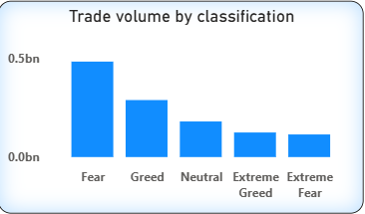
High volume during Fear suggests traders actively react to market uncertainty.
KEYPOINTS
Fear: ~0.5 Billion volume
Highest trading volume, indicating heavy activity during uncertain market conditions.
Greed: ~0.3 Billion volume
Strong volume driven by profit-seeking behavior.
Extreme Greed: ~0.12 Billion volume
Lower volume despite aggressive risk-taking.
Extreme Fear: ~0.1 Billion volume
Lowest volume, showing limited participation during panic situations.

Slide 6
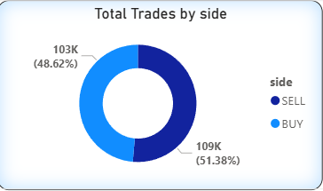
Despite mixed sentiment, buying and selling activity remains evenly distributed.
KEYPOINTS
Sell Trades: 109K (51.38%)
Slightly higher number of sell orders, indicating profit booking or cautious market behavior.
Buy Trades: 103K (48.62%)
Strong buying participation, showing continued trader interest in the market.

Slide 7
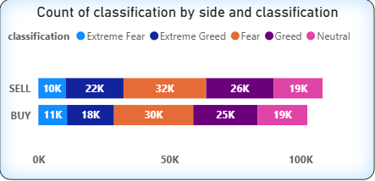
Buying dominates during Extreme Fear, while selling dominates during Extreme Greed.
KEYPOINTS
Fear: Buy 30K, Sell 32K
High activity on both sides reflects uncertainty and frequent position adjustments.
Greed: Buy 25K, Sell 26K
Nearly balanced trades, showing stable participation during optimistic sentiment.
Extreme Fear: Buy 11K, Sell 10K
Slightly higher buying indicates traders entering positions at perceived low prices.
Extreme Greed: Buy 18K, Sell 22K
Higher sell activity suggests profit booking during over-optimistic market conditions.

Slide 8
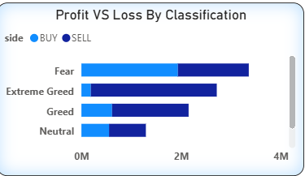
PnL peaks during Fear (~3.8M) and Extreme Greed (~3.0M), with buying stronger in fear and selling dominating in greed.
KEYPOINTS
Fear:
Total PnL is ~3.8M, with Buy ~2.2M and Sell ~1.6M.
This shows heavy trading activity as traders actively react to uncertain market conditions.
Extreme Greed:
Total PnL is ~3.0M, mainly driven by Sell ~2.7M, while Buy ~0.3M.
Indicates strong profit booking when the market becomes over-optimistic.

Slide 9
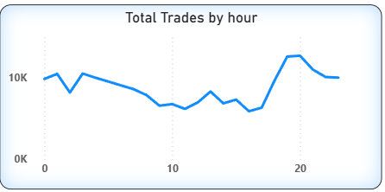
Trading activity is lowest during mid-day and peaks in the evening (~12K–13K trades), indicating higher trader participation during late market hours.
KEYPOINTS
Trading starts strong from 12:00 AM and in the early hours at around 9K–10K trades.
Activity gradually declines during mid-day, reaching a low of ~6K–7K trades.
A sharp increase is observed in the evening, peaking at ~12K–13K trades around 19–20 hours.

Slide 10
CONCLUSION
The market shows high participation with 211K total trades and 1.19B trade volume, indicating strong liquidity.
Fear (62K trades) and Greed (50K trades) dominate market sentiment, showing that trading decisions are highly emotion-driven.
Fear-based trading generates the highest volume (~0.5B) and the highest PnL (~3.8M), highlighting strong reactions during uncertainty.
Buy and Sell trades are nearly balanced (Buy 48.62%, Sell 51.38%), indicating an efficient and active market.
Buying increases during Extreme Fear, while selling dominates during Extreme Greed, aligning with typical trader psychology.
Profitability is highest during emotionally charged market phases (Fear and Extreme Greed) and lowest during Neutral conditions.
Trading activity peaks in the evening hours (19–20 hrs.) with ~12K–13K trades, suggesting higher trader engagement during this period.

Slide 11
SUGGESTION SLIDE
Traders can consider buying opportunities during Fear phases, as higher volumes and better profit potential are observed.
Profit booking is advisable during Greed and Extreme Greed, where sell-side profits dominate.
Mid-day hours show lower activity; traders may avoid aggressive strategies during this period.
Evening hours can be targeted for active trading strategies due to peak participation.
Monitoring sentiment indicators can help traders align strategies with market psychology for improved decision-making.

