Slide 1
AI Resume Career Advisor Using n8n and Artificial Intelligence
An AI-Powered Resume Analysis, Job Matching and Career Guidance Automation System
Student Details
Institutional Details
Student Name: Muskan
Roll Number: 2400300100255
Course: B.Tech Computer Science Engineering
College/University: Inderprastha Engineering College
Department: Computer Science and Engineering
Project Guide: Mr. Arun Bashambu
Academic Year: 2026-2027

Slide 2

ACADEMIC PROJECT REPORT
Abstract
This project demonstrates the practical application of AI, prompt engineering, and workflow automation to create an intelligent, scalable career advisory system suitable for students, fresh graduates, and job seekers.
The Problem
System Outputs
Job seekers struggle to objectively assess their qualifications against target positions, identify skill gaps, and develop structured preparation plans. Traditional resume screening tools provide generic feedback without job-specific personalization.
Resume Match Score
Quantified compatibility rating
The Solution
The proposed system automates resume analysis, job description processing, and career guidance through an integrated workflow combining n8n workflow automation with artificial intelligence.
Skill Gap Analysis
Matching, missing, and weak skills
3-Month Learning Plan
Structured career roadmap
Email Report Delivery
Automated assessment dispatch

Slide 3






SECTION 2
Introduction
Resumes are critical gatekeepers in modern recruitment. Yet candidates consistently lack objective, role-specific feedback on how well their profile aligns with target positions. This project addresses six foundational challenges in career advisory:
Resume Importance
Job Description Challenge
Resumes are critical gatekeepers in recruitment, yet candidates often lack objective feedback on alignment with specific roles.
Job descriptions contain complex, varied terminology that candidates struggle to map against their own skills.
Skill Gap Problem
Preparation Difficulty
Candidates frequently cannot identify which specific technical skills, tools, or certifications they lack for target positions.
Without structured guidance, candidates lack systematic learning roadmaps and prioritization strategies.
AI in Career Guidance
Workflow Automation Value
Artificial intelligence enables objective, scalable, personalized career assessment at scale.
Automation eliminates repetitive manual tasks, enabling rapid, consistent analysis across multiple candidates.

Slide 4
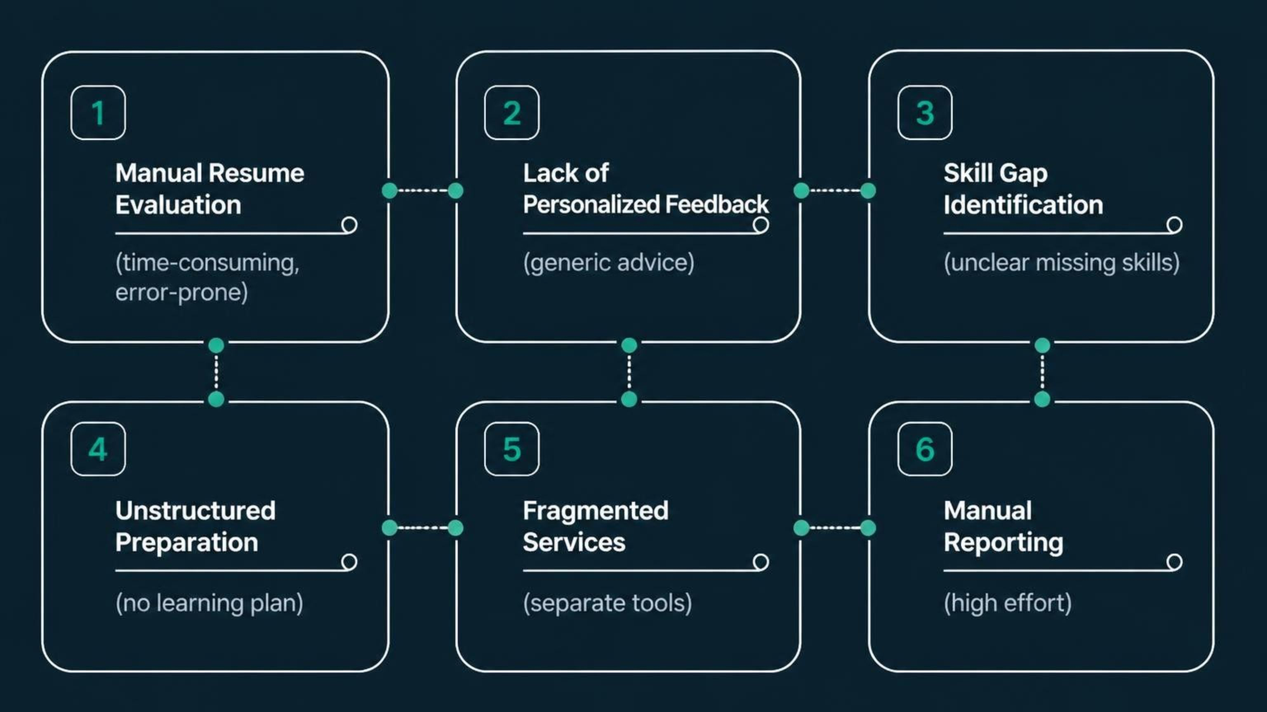

Problem Statement
A structured analysis of the core challenges facing modern job seekers and career advisory systems
These six problem areas collectively represent the gap that the AI Resume Career Advisor system is designed to bridge through integrated automation and intelligence.

Slide 5


PROBLEM AREA 4.1 – 4.2
Manual Evaluation & Lack of Personalized Feedback
4.1 Manual Resume Evaluation
4.2 Lack of Personalized Feedback
Candidates manually compare resumes with job descriptions — a time-consuming, error-prone process
No standardized methodology for assessing resume-job fit exists in conventional approaches
Subjective evaluation leads to inconsistent results and missed opportunities for qualified candidates
Generic resume tools provide standard suggestions applicable to all users regardless of target role
Feedback does not address specific target job requirements or industry context
Candidates receive generic advice rather than actionable, role-specific guidance
Generic feedback is not just unhelpful — it can actively mislead candidates into optimizing for the wrong skills.
Generic Feedback
Tool provides non-specific, non-actionable advice.
Manual Review
Candidate compares resume to JD subjectively.

Slide 6
PROBLEM AREAS 4.3 – 4.6
Skill Gaps, Preparation, and Fragmentation
1
Skill Gap Identification
2
Unstructured Preparation
Candidates lack clarity on which technical skills, tools, or qualifications are missing relative to their target job description. This ambiguity leads to unfocused self-improvement efforts.
Even when gaps are identified, candidates lack systematic learning plans or prioritization frameworks. Without structure, preparation becomes ad hoc and inefficient.
3
Fragmented Services
4
Manual Reporting
Resume analysis, recommendations, skill-gap analysis, and learning plans are typically offered as separate, disconnected services — requiring candidates to navigate multiple platforms.
Creating detailed career assessments requires significant manual effort from both the advisor and the candidate, making scalable personalized guidance economically impractical.

Slide 7

The Integrated Solution
The proposed AI Resume Career Advisor addresses all identified problems through an integrated, automated workflow that combines resume analysis, job matching, skill-gap identification, personalized recommendations, and structured learning plans into a single, scalable system.
Input Collection
AI Processing
Report Generation
Automated Delivery
🎯 Unified Platform
⚡ Scalable
🤖 AI-Powered
All advisory services consolidated into one automated workflow
Handles multiple candidates simultaneously without manual intervention
Objective, consistent, and personalized analysis for every submission

Slide 8

Objectives & Proposed System
A comprehensive set of technical and functional goals guiding the design and implementation of the AI Resume Career Advisor
1
2
Automate Analysis
Compatibility Score
Automate resume and job description analysis end-to-end
Generate AI-based resume compatibility scores for target roles
3
4
Skill Identification
Gap Analysis
Identify matching, missing, and weak skills with precision
Perform comprehensive skill-gap analysis against job requirements
1
2
Career Recommendations
Learning Plan
Provide personalized career recommendations and resume improvement suggestions
Generate structured 3-month practice and learning plans tailored to identified gaps
3
4
Assessment Reports
Email Delivery
Produce detailed, professional career assessment reports automatically
Automatically deliver comprehensive reports via email to the candidate

Slide 9
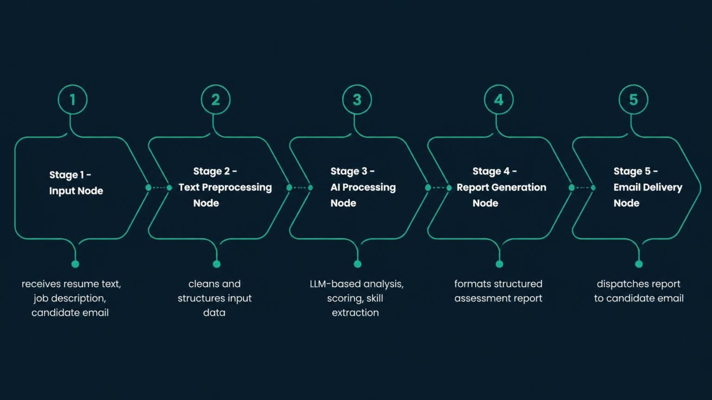
SYSTEM DESIGN
n8n Workflow Architecture
The system is built on an n8n workflow automation backbone, orchestrating data flow between input collection, AI processing, report generation, and email delivery nodes in a seamless pipeline.
Core AI Capabilities
Automation Benefits
Prompt Engineering: Carefully crafted prompts guide the AI to produce structured, consistent outputs
Skill Extraction: AI identifies and categorizes technical and soft skills from both resume and job description
Scoring Logic: Compatibility scoring based on weighted skill matching and qualification alignment
Consistency: Every candidate receives the same rigorous analytical framework
Speed: Full analysis and report delivery completed in minutes, not hours
Scalability: Workflow handles concurrent submissions without degradation in quality

Slide 10

B.TECH CSE PROJECT REPORT
Project Summary & Academic Contribution
What This Project Demonstrates
Key Technical Areas
This project presents a complete, end-to-end implementation of an AI Resume Career Advisor that integrates n8n workflow automation with large language model capabilities to solve a real-world career advisory problem.
The system serves as a practical demonstration of how prompt engineering, workflow orchestration, and AI-driven analysis can be combined to create scalable, intelligent advisory systems — a core competency in modern Computer Science Engineering.
Workflow Automation (n8n)
Artificial Intelligence Integration
Prompt Engineering
Natural Language Processing
Automated Report Generation
Email Delivery Automation
Target Beneficiaries
Final-year students preparing for campus placements
Fresh graduates entering competitive job markets
Career changers seeking role-specific guidance
Job seekers requiring structured preparation plans
Academic Value
Demonstrates integration of AI, automation, and software engineering principles in a production-ready system architecture.
This project fulfills the B.Tech CSE requirement of demonstrating practical application of computer science principles to solve real-world problems through innovative system design and implementation.

