Slide 1



SCAMSHIELD
The Great Scam Escape – Level Up Against Fraud
Our goal is to gamify financial literacy and help users recognize scams before they happen. Let’s dive into our solution
GITHUB LINK :- https://github.com/Muskan2512/FinanceProject
TEAM NUMBER - 17
TEAM NAME - CTRL + ALT + GIRLS

Slide 2

PROBLEM STATEMENT
THE GROWING THREAT OF FINANCIAL SCAMS
Key Points:
The rise of phishing, vishing, and identity theft scams.
Statistics on financial fraud (e.g., "In 2023, financial scams caused losses of over $10 billion globally").
Common reasons why people fall for scams: lack of awareness, psychological manipulation, and digital illiteracy.
The gap in engaging educational resources to teach scam prevention.
How traditional scam awareness methods (text-heavy articles, static videos) fail to engage users effectively.

Slide 3


SOLUTION OVERVIEW
TO ADDRESS THIS ISSUE, WE HAVE BUILT A WEB-BASED FINANCIAL LITERACY GAMIFICATION PLATFORM USING THE MERN STACK. OUR PLATFORM EDUCATES USERS ABOUT PHISHING, VISHING, AND IDENTITY THEFT THROUGH TUTORIALS, INTERACTIVE GAMES FOR GUIDANCE. WE ALSO TRACK USER PROGRESS TO MEASURE LEARNING OUTCOMES

Slide 4



TECH STACK
Node.js
and Express.js
React JS
(FRONTEND)
MongoDB
(DATABASE)
PostMan
Use for the backend , managing game logic and API request
For the seamless user interface
To store user data, progress and quiz result
For API texting and validation

Slide 5
FUTURE BREAKDOWN
Our platform includes several key features:
Home Interface: Users can access tutorials, games, login/signup.
Tutorials: Provide scam awareness and digital hygiene tips.
Games: Hangman and a quiz that test scam detection skills.
Progress Tracking: Measures user improvement and engagement.

Slide 6
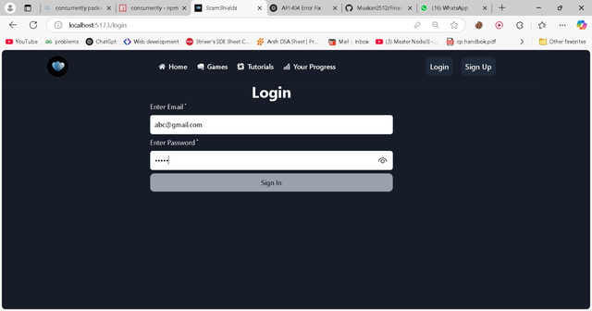

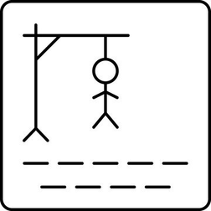
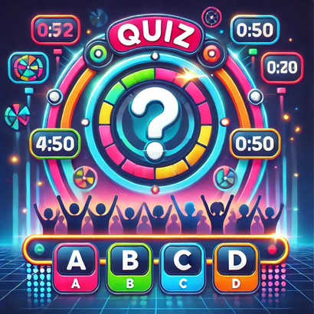

DEMO FLOW
SIGN UP / LOGIN
Tutorials
Hangman Game
Quiz
Progress Tracking
The user signs up or logs in to get started with the website.
The user has a choice for learning or implementing. They can choose from tutorials
Hint based game to aware user about scams while playing.
A multiple choice Quiz game for users to test their knowledge with timing constraints.
Progress Tracking helps user see their improvement over time.

Slide 7
FUTURE ENHANCEMENT
MOVING FORWARD, WE AIM TO:
02
04
Introduce multiplayer fraud-awareness challenges.
Implement advanced analytics to measure user behavior and engagement.
01
03
Develop an
AI-powered
chatbot that can simulate scam conversations.
Expand into a mobile app for better accessibility.

