Slide 1

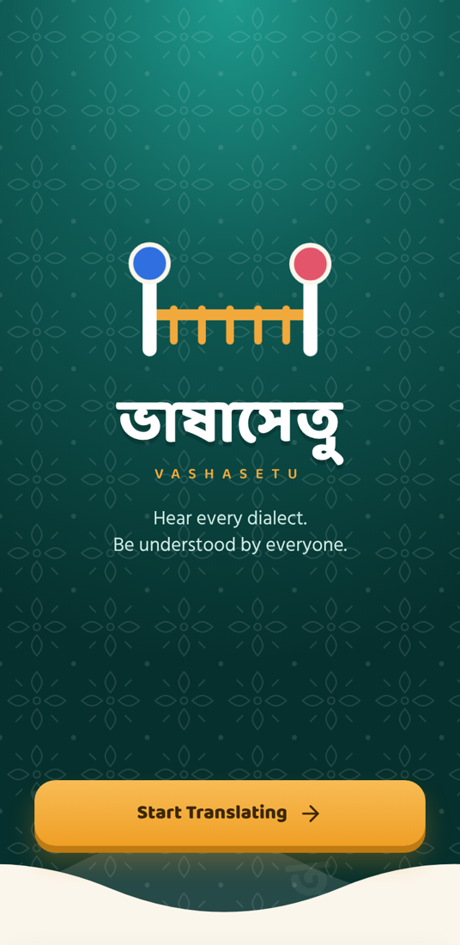
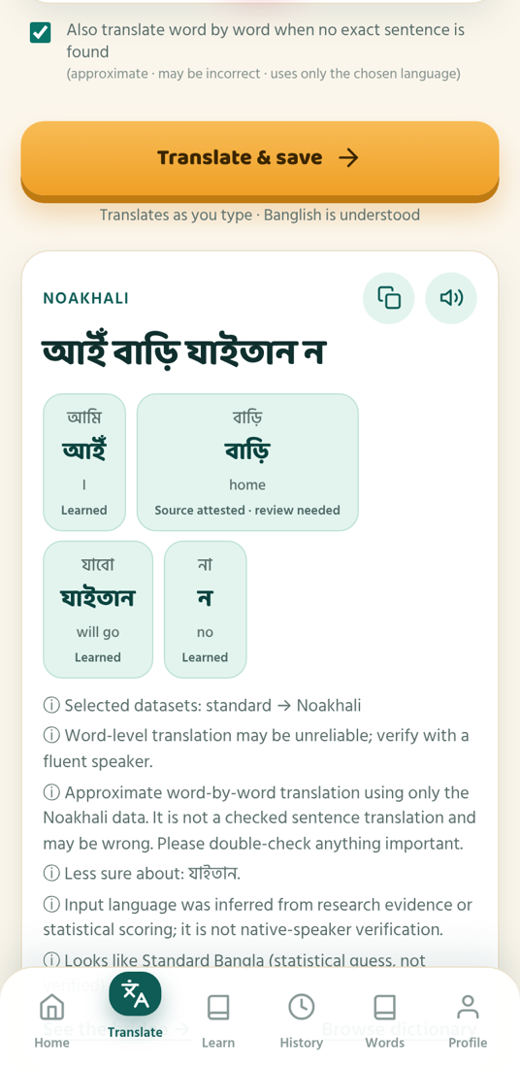
UNIVERSITY OF INFORMATION TECHNOLOGY & SCIENCES
ভাষাসেতু
V A S H A S E T U
A Regional Bangla Dialect Translator and Learning App
Shobnom Sultana Muskan 0432320005101142
Sadia Akter Liza 0432320005101110
CSE 416 · Software Project Design and Development · Autumn 2026
Submitted to: Dr. Mahfida Amjad Dipa
Assistant Professor, Dept. of CSE, UITS
Notes:
Good morning. We are Shobnom Sultana Muskan and Sadia Akter Liza. Our CSE 416 project is Vashasetu — "ভাষাসেতু", a language bridge — an app that translates and teaches regional Bangla dialects.

Slide 2
Contents
YOUR LEARNING PATH THROUGH THIS TALK
Introduction
Problem
Objectives
Related Works
Methodology
Architecture & Data
Tools
1
2
3
4
5
6
7
14
13
12
11
10
9
8
References
Demo
Future Work
Conclusion
Contribution
Results
Impact
Notes:
Like the learning path in our app, this talk goes stop by stop: the problem and our goals, how we built Vashasetu, what it achieves, and a live demo.

Slide 3
Introduction
ONE SENTENCE, MANY BANGLAS
STANDARD BANGLA
আমি ভাত খাবো
ভাষা (language) + সেতু (bridge)
A free, installable web app that translates regional Bangla dialects, explains every word and teaches them.
CHATTOGRAM
আঁই ভাত খাইয়ুম
NOAKHALI
আইঁ ভাত খামু
Type · Speak · Scan
Bangla, Banglish, English, voice and photo
Garo (indigenous): আং মি চা'জক = আমি ভাত খেয়েছি
Notes:
"I will eat rice" sounds very different across Bangladesh: আমি ভাত খাবো in Standard, আঁই ভাত খাইয়ুম in Chattogram, আইঁ ভাত খামু in Noakhali — and indigenous languages like Garo differ even more. Vashasetu, "language bridge", translates these, explains every word and teaches them; you can type, speak or scan.

Slide 4
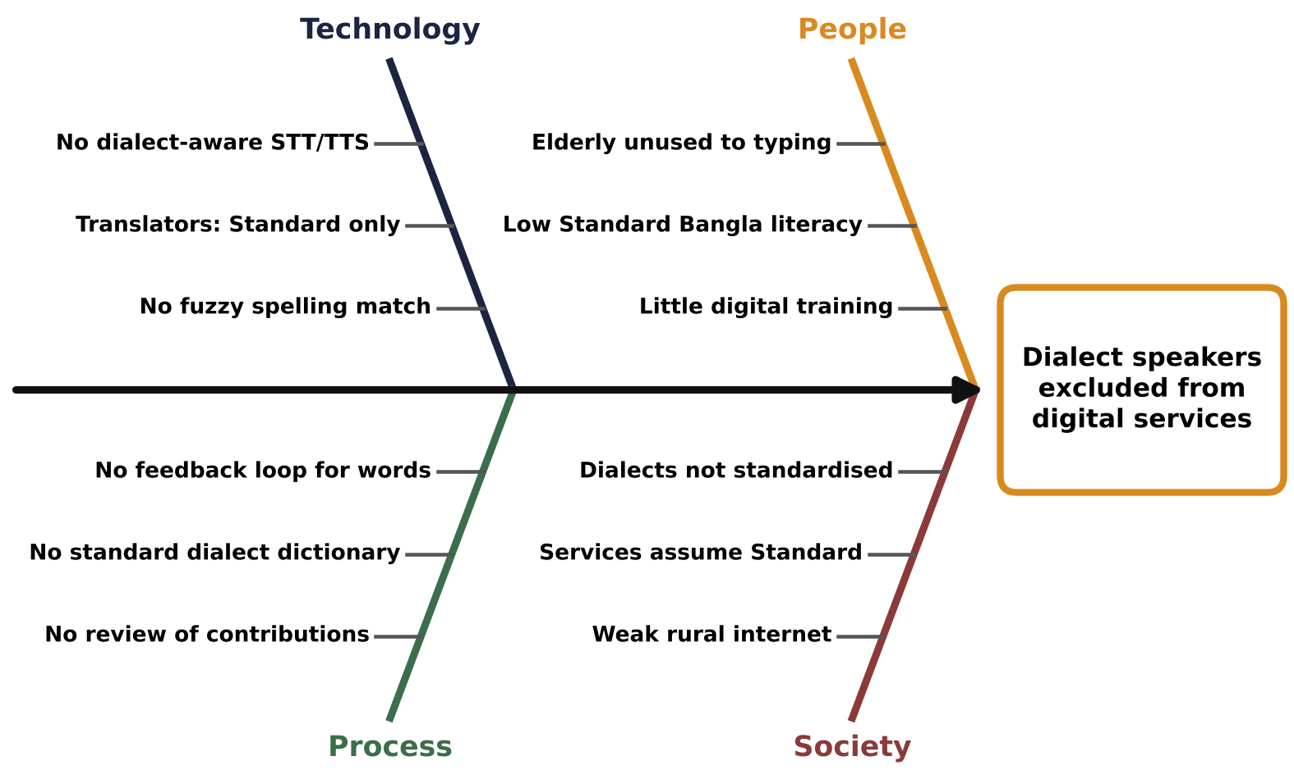
Problem Statement
A NOAKHALI SPEAKER TYPES
আইঁ ভাত খাইতান ন
General translator
reads it as Standard – meaning lost
Vashasetu
আমি ভাত খাবো না “I will not eat rice”
01
No tool for ordinary people
Dialect corpora exist only as research spreadsheets.
02
No word-level help
Users cannot see which word means what, or how sure the system is.
03
Indigenous learners left out
They must first learn the Bangla script.
Fig. 1 Root causes of the problem (fishbone diagram)
Notes:
Here is the problem in one example. A Noakhali speaker types আইঁ ভাত খাইতান ন. A general translator treats it as Standard Bangla and loses the meaning; Vashasetu returns আমি ভাত খাবো না, "I will not eat rice". Beyond that, dialect data exists only for research, users get no word-level help, and indigenous learners are left out. Our fishbone diagram shows the root causes in four areas: technology, people, process and society.

Slide 5
Objectives
Translate both ways
Standard ↔ 6+ dialects, dialect ↔ dialect
Explain every word
meaning + reliability in a word box
Learning path
sounds → letters → words → sentences
Safe deployment
HTTPS, installable, hardened
O1
O2
O3
O4
O5
O6
O7
Every input
Bangla, Banglish, English, voice, photo
Editable dictionary
every edit logged and reversible
≥ 75% accuracy
word level, dialect → Standard
Notes:
Our seven objectives, O1 to O7, are milestones on one road: two-way translation, every input type, word explanations, an editable dictionary, a learning path, at least 75 percent word accuracy, and a secure deployment. We check each of them in the results.

Slide 6
Related Works
WHAT IS MISSING — AND WHAT VASHASETU ADDS
Google
Research
Vashasetu
RECENT DIALECT DATASETS
Regional dialects
✗
data only
✓
Vashantor 2024
ONUBAD 2024
Kothon Chattogram · Sylhet
Dwadash 12 variations
ChatgaiyyaAlap Chattogram
BD-Dialect 2026
MELD Chakma · Marma · Garo
Dialect ↔ dialect
✗
✗
✓
Explains each word
✗
✗
✓
Speakers can correct
suggest
✗
✓
Learning module
✗
✗
✓
Banglish · voice · photo
partly
✗
✓
Table 1 Existing solutions compared with Vashasetu
Notes:
Recent research produced several dialect datasets — Vashantor, ONUBAD, Kothon, Dwadash, ChatgaiyyaAlap, BD-Dialect, and MELD for Chakma, Marma and Garo. But no existing tool lets ordinary users translate dialects both ways, see each word explained, correct the data, or learn — which is exactly what Vashasetu adds.

Slide 7
Methodology
FOLLOW ONE SENTENCE THROUGH THE ENGINE · STANDARD → NOAKHALI
1 INPUT (BANGLISH)
2 NORMALISE
Exact native sentence?
5 RESULT
yes
ami bhat khabo na
আমি ভাত খাবো না
আইঁ ভাত খাইতান ন
no
3 WORD ENGINE
curated + native-speaker words + 125,787 learned pairs (IBM Model 1)
4 NATIVE RULES
খাবো না → খাইতান ন
Every word gets a word box →
আমি
ভাত
খাবো না
আইঁ
ভাত
খাইতান ন
I
rice
will not eat
Fig. 2 Translation pipeline, shown with a real sentence from the app
Native speaker
Native speaker
Native speaker
Iterative development: build → test → native-speaker review → fix, in short cycles.
Notes:
Here is one sentence going through the engine. Banglish "ami bhat khabo na" is normalised to আমি ভাত খাবো না. The engine first looks for an exact sentence checked by a native speaker — here it finds one — and returns আইঁ ভাত খাইতান ন. If not, it builds the sentence word by word from curated, native and learned word pairs and applies native rules such as খাবো না → খাইতান ন. Every word then gets a word box. We built this iteratively with native speakers reviewing each version.

Slide 8
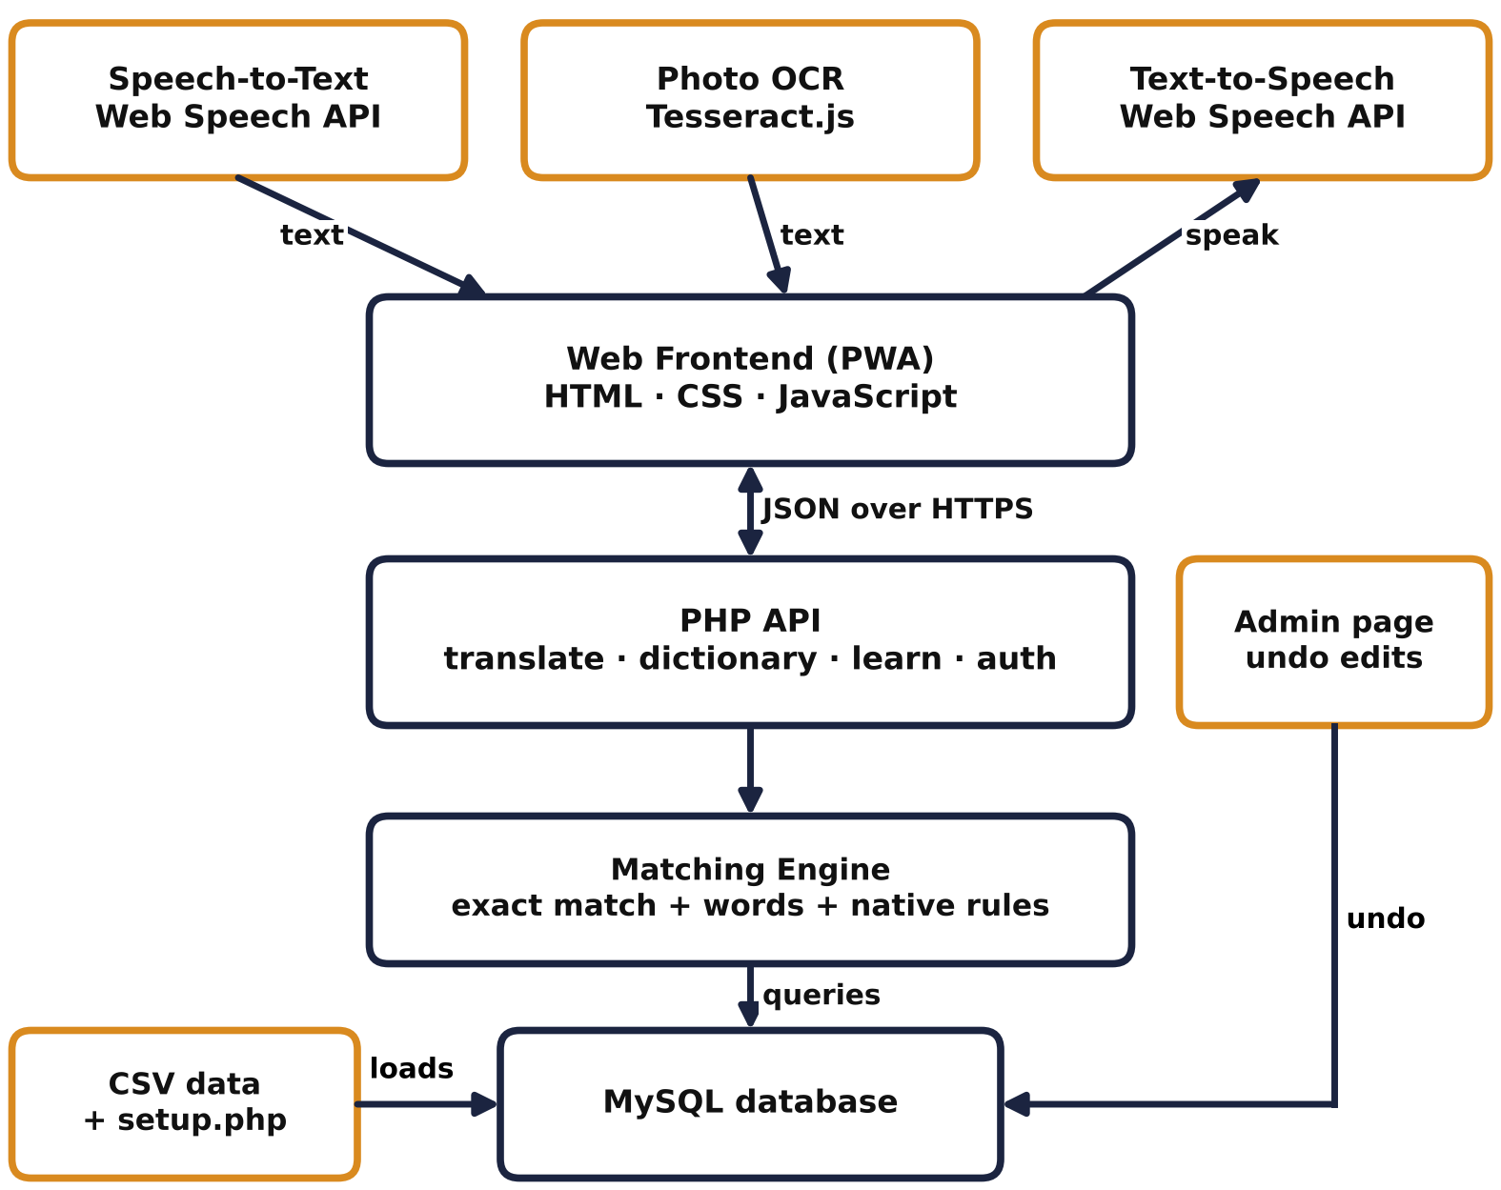
Data Collection / System Architecture
1
Browser (PWA)
HTML · CSS · JS, voice and photo input
2
PHP API
translate · dictionary · learn · auth
3
Matching engine
exact match → words → native rules
4
MySQL
loaded from versioned CSV by setup.php
73k+
125,787
11 + 3
4
sentence pairs
learned word pairs
dialects + indigenous
native-reviewed word lists
Fig. 3 Component diagram (system architecture)
Notes:
The browser app sends JSON requests to PHP endpoints, which use the matching engine and the MySQL data. The data is loaded from versioned CSV files: more than 73,000 sentence pairs from nine research datasets, 125,787 learned word pairs, 11 regional dialects and 3 indigenous languages, with the Noakhali, Chattogram, Barishal and Garo word lists checked by native speakers.

Slide 9
Use of Tools
Quality
PHPUnit · Playwright · axe-core · PCOV
PHONE / BROWSER
Progressive Web App · installs, works offline
FRONT END
HTML5 · CSS3 · JS · Web Speech · Tesseract.js
Delivery
Git · GitHub Actions · Cloudflare Tunnel (HTTPS)
Software and hardware, from the phone down to the database
BACK END
PHP 8 on Apache (XAMPP) · matching engine
Design
Figma · draw.io · Graphviz
DATA
MySQL / MariaDB · Python data scripts
AI assistant
Claude Opus 5.5 · every output checked by us
Hardware a Windows laptop runs XAMPP as the server; Android phones were used for testing; the Cloudflare tunnel gives a public HTTPS link.
Notes:
Our stack, from the phone down: a progressive web app in plain HTML, CSS and JavaScript with the browser speech API and Tesseract OCR; PHP 8 on Apache through XAMPP; and MySQL, filled by Python scripts. Quality came from PHPUnit, Playwright and axe-core; delivery from Git, GitHub Actions and a Cloudflare tunnel; and design from Figma, draw.io and Graphviz. The AI assistant Claude Opus 5.5 helped refine code and tests; we checked every output, as listed in the tool usage log of the report. A Windows laptop is the server and Android phones were used for testing.

Slide 10
Outcome / Impact of the Project
৳0
14
0 GPU
ECONOMIC
SOCIAL & SUSTAINABILITY
ENVIRONMENTAL
Free for every user and built with zero budget: open data, free tools, free HTTPS. No app-store fees.
Languages and dialects included. Native speakers correct the dictionary, keeping dialect words alive; data stays open as CSV.
No model training on GPUs and no big servers: runs on an existing laptop and low-cost phones; the app shell works offline.
Notes:
The impact in three numbers. Zero taka: it is free to use and was built with no budget. Fourteen languages and dialects are included, and native speakers keep the dictionary alive. Zero GPUs: it needs no model training or big servers and runs on existing laptops and cheap phones.

Slide 11
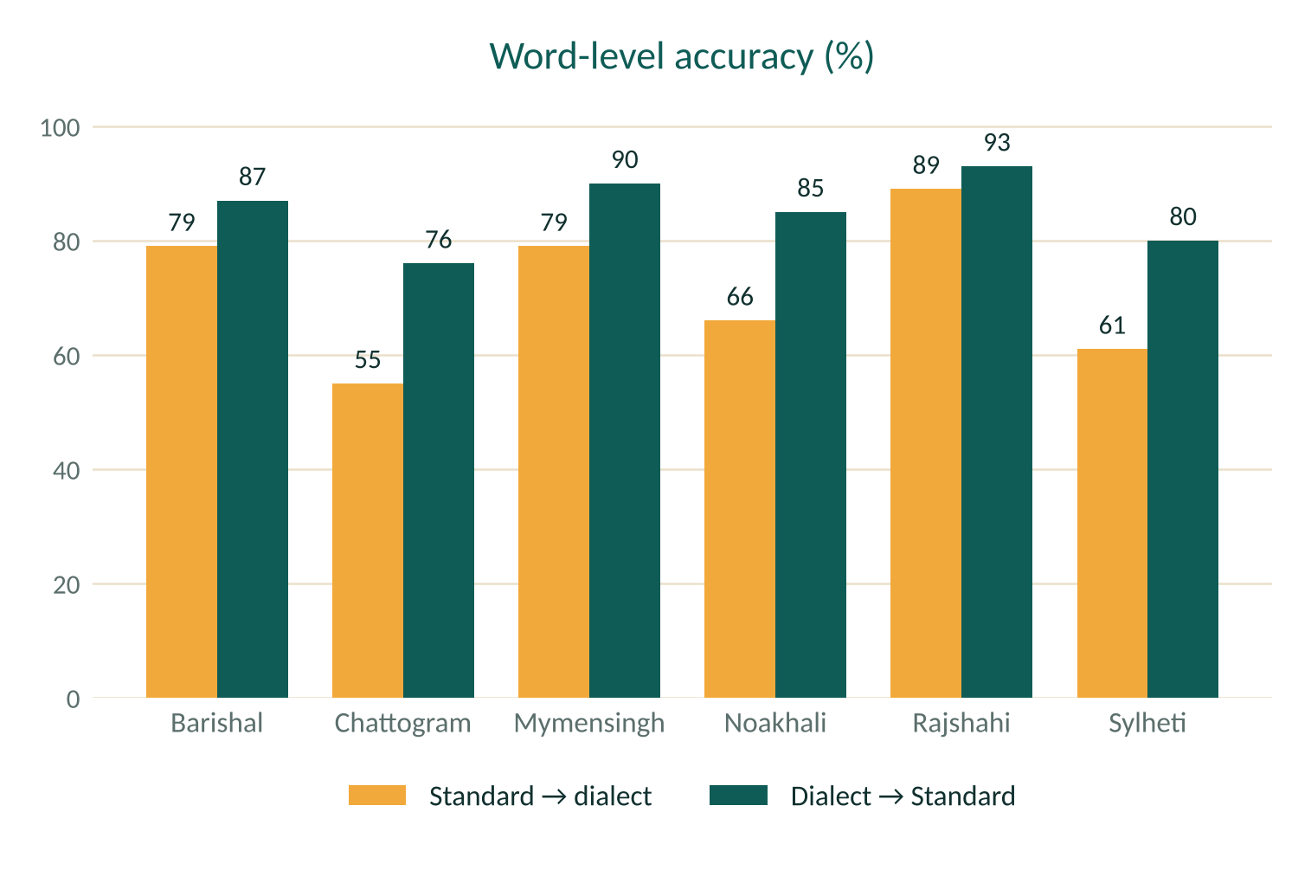

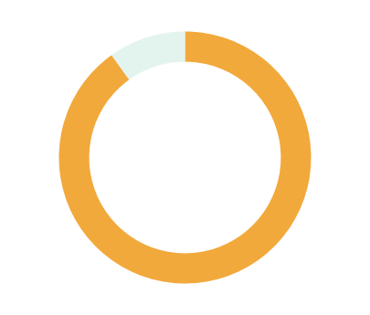
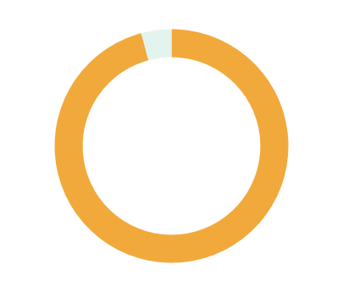

Result Analysis
SOFTWARE TEST REPORT
test cases pass
code covered
83/84
90%
planted bugs caught
security tests
23/24
48/48
Fig. 4 Accuracy on held-out corpus sentences (150 per dialect)
O6 met for 5 of 6 dialects (Dialect → Standard 76–93%). Open issue: speed with 100 users at once (D34).
Notes:
From dialect to Standard Bangla, word accuracy is 76 to 93 percent, so our 75 percent target is met for five of six dialects. Standard to dialect is harder because one Standard word has many dialect spellings. In the full software test, 83 of 84 test cases pass, 90 percent of the PHP code is covered, all 48 security tests pass, and 23 of 24 planted bugs were caught. The one open issue is speed with 100 users at once, defect D34.

Slide 12
Contribution
Table 2 Contribution of each member
Member | ID | Contribution
Shobnom Sultana Muskan | 0432320005101142 | Translation engine, dictionary and data (back end) Voice and photo input; all screens and API integration (front end) Automated testing, security review and deployment Requirements analysis and SRS System design: UML, ER and UI models
Sadia Akter Liza | 0432320005101110 | Manual testing of the app on phones Project proposal and system model (CSE 355) Requirements analysis and SRS System design: UML, ER and UI models
Notes:
Muskan built the translation engine, dictionary and data, the voice and photo input, all screens and API integration, and did the testing, security and deployment. Liza did the manual testing of the app on phones and co-wrote the CSE 355 project proposal and system model. Both of us did the requirements analysis, the SRS and the system design.

Slide 13
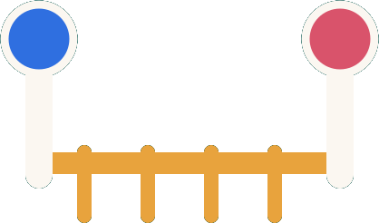
Conclusion
Vashasetu brings regional Bangla dialects into the digital world: a free app, checked by native speakers, that anyone can use to understand, translate and learn them.
Translates
Explains
Corrects
Teaches
11 dialects, Standard, English, dialect ↔ dialect
a word box for every word
native speakers edit; every edit undoable
in the learner’s own language
Notes:
To conclude: Vashasetu brings regional Bangla dialects into the digital world. It is a free app, checked by native speakers, that anyone can use to understand, translate and learn them. It translates, explains every word, lets native speakers correct it, and teaches in the learner’s own language.

Slide 14
Future Work
More native reviews
4 lists done; next the top 1,000 words of the other dialects
Smoother sentences
small neural model, checked by word boxes
Permanent hosting
fixed domain, code review on GitHub
1
2
3
4
5
6
NOW
Real voices
native recordings for Listen and lessons
Safer editing
login and reviewer roles; backups
Indigenous partners
Chakma, Marma, Garo, Mro lessons with communities
Notes:
Our roadmap: four word lists are already reviewed, so next native speakers review the most common words of the other dialects; add real voice recordings, try a small neural model for smoother sentences, add reviewer roles and backups, move to permanent hosting, and build indigenous-language lessons with community partners.

Slide 15
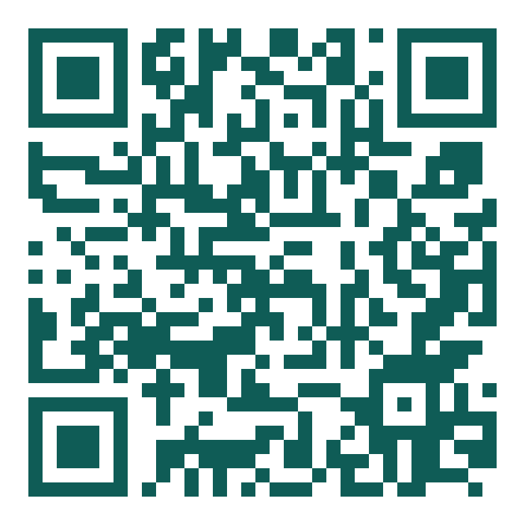
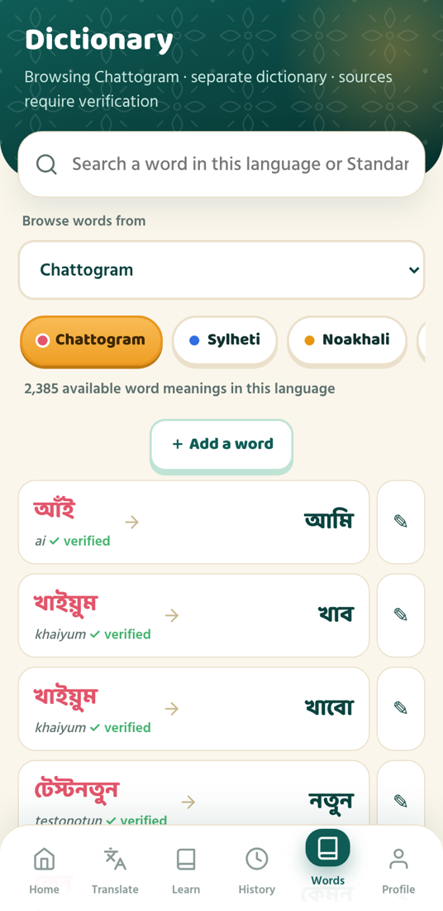
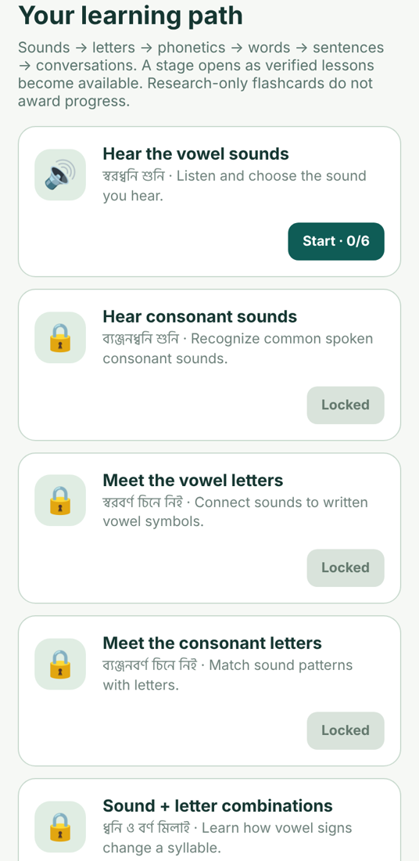
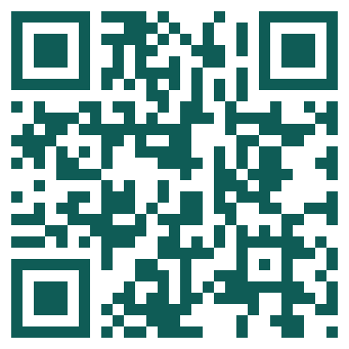
Demonstration
Live on a phone
through our HTTPS link
Scan to try the app
1
Noakhali sentence → word boxes
2
Noakhali → Chattogram + Bridge
3
Edit a word in the dictionary
Code on GitHub
4
Learning path for a Garo learner
App link
shape-joint-sells-today.trycloudflare.com/vashasetu/
Notes:
Now a short live demo on the phone: a Noakhali sentence with its word boxes, Noakhali to Chattogram with the Bridge view, editing a word in the dictionary, and the learning path for a Garo learner. Scan the first QR code to try the app yourself; the second opens our code on GitHub.

Slide 16
References
[1]
Vashantor: Bangla regional dialect parallel corpus
Mendeley Data, 2024, doi: 10.17632/bj5jgk878b.2
[2]
ONUBAD: Bangla regional dialect to Standard Bangla parallel corpus
Mendeley Data, 2024, doi: 10.17632/6ft99kf89b.2
[3]
Kothon: Machine translation of Chittagonian and Sylheti into Standard Bangla
Mendeley Data
[4]
Dwadash: Multi-dialectal translation across twelve Bengali variations
Mendeley Data
[5]
BD-Dialect: A multiregional Bangla language dataset
Mendeley Data, v2, 2026, doi: 10.17632/k769s4vk5z.2
[6]
MELD: Chakma, Marma and Garo phrase dataset
Mendeley Data, v4, 2025, doi: 10.17632/dy5dyfygbp.4
[7]
P. F. Brown et al., The mathematics of statistical machine translation: Parameter estimation
Computational Linguistics, 19(2), 263–311, 1993
[8]
R. Smith, An overview of the Tesseract OCR engine
Proc. 9th ICDAR, 629–633, 2007
Notes:
These are the datasets and methods we used: six dialect and indigenous-language datasets, IBM Model 1 for learning word pairs, and Tesseract for reading text from photos.

Slide 17
ধন্যবাদ
Thank you
Any Questions?
Notes:
Thank you. We are happy to take your questions.

