Slide 1

MID-TERM
PRESENTATION
(Internship
At Quantazone)
-MUSKAN AHUJA

Slide 2

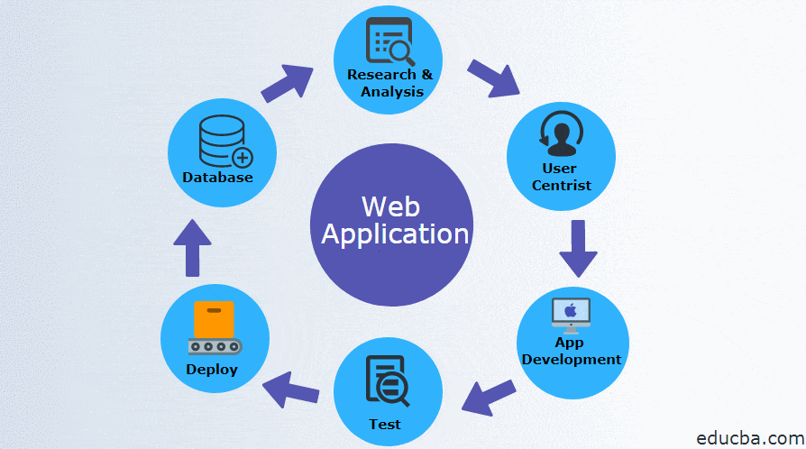
WORDPRESS BLOGGING, SEO AND WEB APP DEVELOPMENT

Slide 3
Project Objectives:
Better-Understanding of Content & SEO
Enable me to write blogs
Make me familiar to various features available in JS and PHP
Better understanding of PHP and Javascript.
Learn Techniques and tools to build a web app
Learn Multidisciplinary skills
Gain industry experience

Slide 4
TASKS
COMPLETED
PROBLEM STATEMENT #1:
We aimed at writing blogs for the Quantazone website on Wordpress and complete its SEO.
PROBLEM STATEMENT #2:
Complete various courses present in the training module provided by Quantazone.
PROBLEM STATEMENT #3:
We aim to develop a web application for registering a student for the admission process it included a register, login, fill form, upload image and payment gateway with session, I am done with register form its validation , and login session.

Slide 5

PROBLEM STATEMENT #1:
WORDPRESS BLOGGING AND SEO
Did blogging on Wordpress, set its SEO and did courses about SEO on Yoast.

Slide 6

WHY IS WORDPRESS BLOGGING USEFUL?
There are hundreds of theme marketplace for WordPress.
WordPress plugins help a lot to optimize your on-site SEO, and, dashboard makes it easier.
By default WordPress is more SEO friendly than BlogSpot and other Blogging platforms.
A Self-hosted blog (in this case it is WordPress), is not only considered serious but it is more likely that people will have a firm belief in the reliability of information.

Slide 7
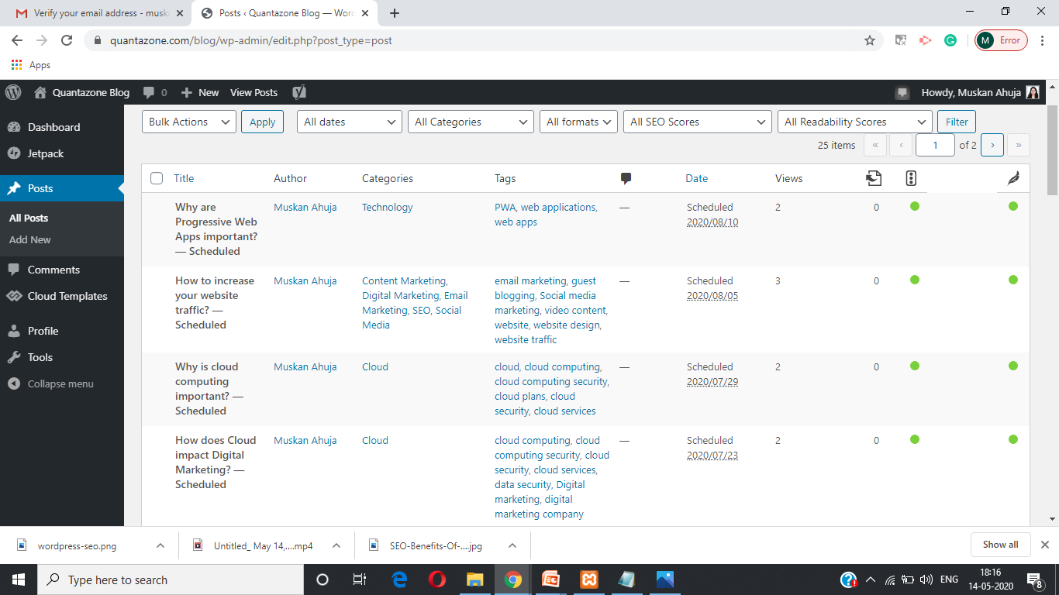
EXAMPLE OF A WORDPRESS DASHBOARD

Slide 8
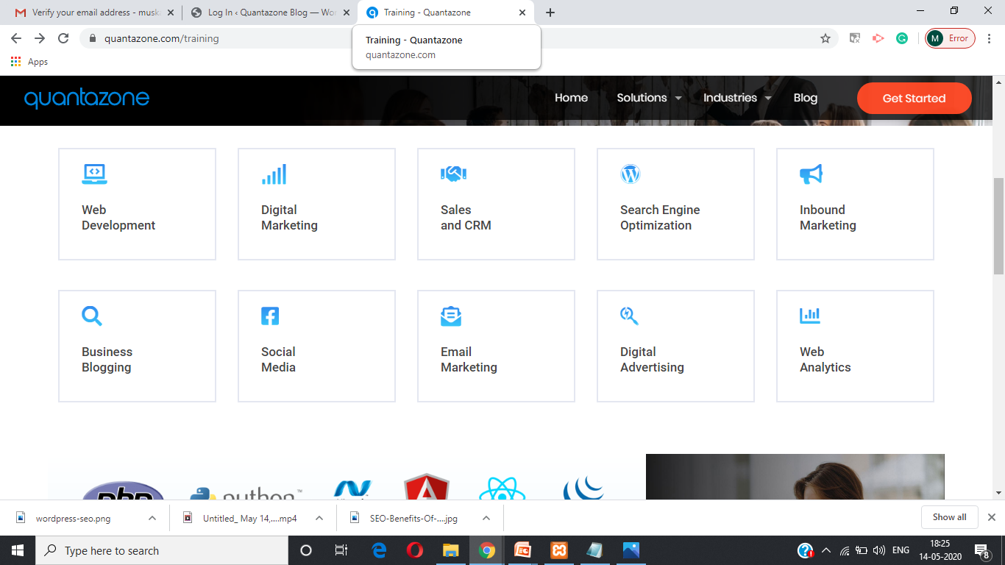
PROBLEM STATEMENT #2:
COMPLETE VARIOUS COURSES
Complete some courses present on training module of Quantazone

Slide 9

WHAT IS SEO
AND WHY IS IT
IMPORTANT?
SEO stands for Search Engine Optimization.
It is the practice of increasing the quantity and quality of traffic to your website through organic search engine results.
SEO is not only about search engines but good SEO practices improve the user experience and usability of a web site.
SEO is good for the social promotion of your web site.
SEO can put you ahead of the competition. If two web sites are selling the same thing, the search engine optimized website is more likely to have more customers and make more sales.

Slide 10

WHAT IS
GOOGLE MY
BUSINESS?
It is a free and easy-to-use tool for businesses and organizations to manage their online presence across Google.
It includes Search and Maps.
If you verify and edit your business information, you can both help customers find your business and tell them your story.
It helps to manage your information, understand your customers and expand your business.

Slide 11
PROBLEM STATEMENT #3:
WEB APPLICATION DEVELOPMENT
Register
Email Verification
Login (Session created)
Flow of Webapp (until now):

Slide 12

Entire Flow(Until Now)

Slide 13
NEW LEARNINGS:
Swift Mailer

Slide 14

Swift Mailer
It is a library that provides several classes that allow you to send emails from within your PHP scripts or web applications.
It works for PHP 5.2 or higher.
Swift_SmtpTransport uses the SMTP protocol to communicate with a service to deliver an email message.
Swift_Mailer is the one that actually sends the email using send().
Swift_Message is used to specify the receiver, the subject, the body and so on.

Slide 15
ACTION PLAN FOR REMAINING PERIOD OF INTERNSHIP
IMPLEMENT THE REMAINING WEB APPLICATION.
LEARN HOW TO DEPLOY THE APPLICATION.
LEARN ABOUT ANGULAR
WORK ON THE WEB APP USING ANGULAR.
WORK MORE ON CONTENT MARKETING.

Slide 16
THANK YOU

