Slide 1
MnS- MTE PROJECT BY:- MUSKAN GUPTA (2K19/SE/077)
TOPIC-
Vehicle Scheduling Simulation

Slide 2
PROBLEM OVERVIEW
A vehicle schedule defines a schedule of goods deliveries by vehicles (or trucks) from a distribution centre (DC) to a net of shops or supermarkets.
The model is aimed to simulate utilization of trucks in order to determine their usage and idle times.
Here, the vehicle idle time is defined as a sum of time periods when truck is waiting for next trip in the parking place.

Slide 3
INPUT DATA
Input Data is defined by a set of trips, constraints, the average time for vehicle to move from one point to the next one and the average loading time for each vehicle in DC and the average unloading time for each shop in the route are defined. Constraints may include truck capacity constraints and delivery time constraints.
OUTPUT DATA
The model also has to generate Gantt chart representing the vehicle schedule to be further analyzed by a planner. It also has to generate a statistical report denoting vehicle utilization and idle time.
CONCLUSION
The visualization of vehicle and distribution centre utilization combined with statistical data can be used by expert to redefine vehicle schedule.

Slide 4
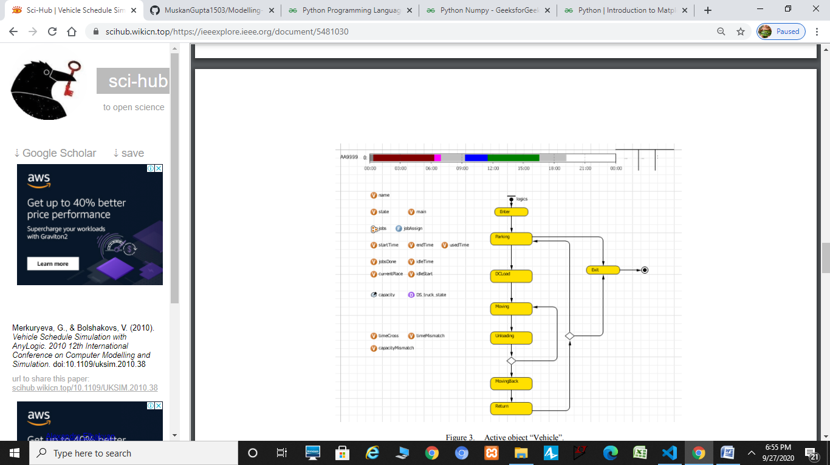
DIFFERENT STATES OF VEHICLES
Enter
Parking
Loading
Moving
Unloading
Moving Back
Return
Exit
COLOR CODES ARE:
GREY- IDLE, BLUE- MOVING, GREEN- LOADING, UNLOADING- MAROON/RED

Slide 5
MY WORK TILL NOW
Learnt basics of python and it’s various libraries like Matplotlib, NumPy etc.
Coded a program to generate Gantt Chart in python for different schedules of vehicles for comparative analysis and simulation study. Code for python Program for creating models and Gantt Charts:-https://github.com/MuskanGupta1503/Modelling-and-Simulation
Implemented it too on MS Excel and prepared my models and Gantt chart there too.

Slide 6
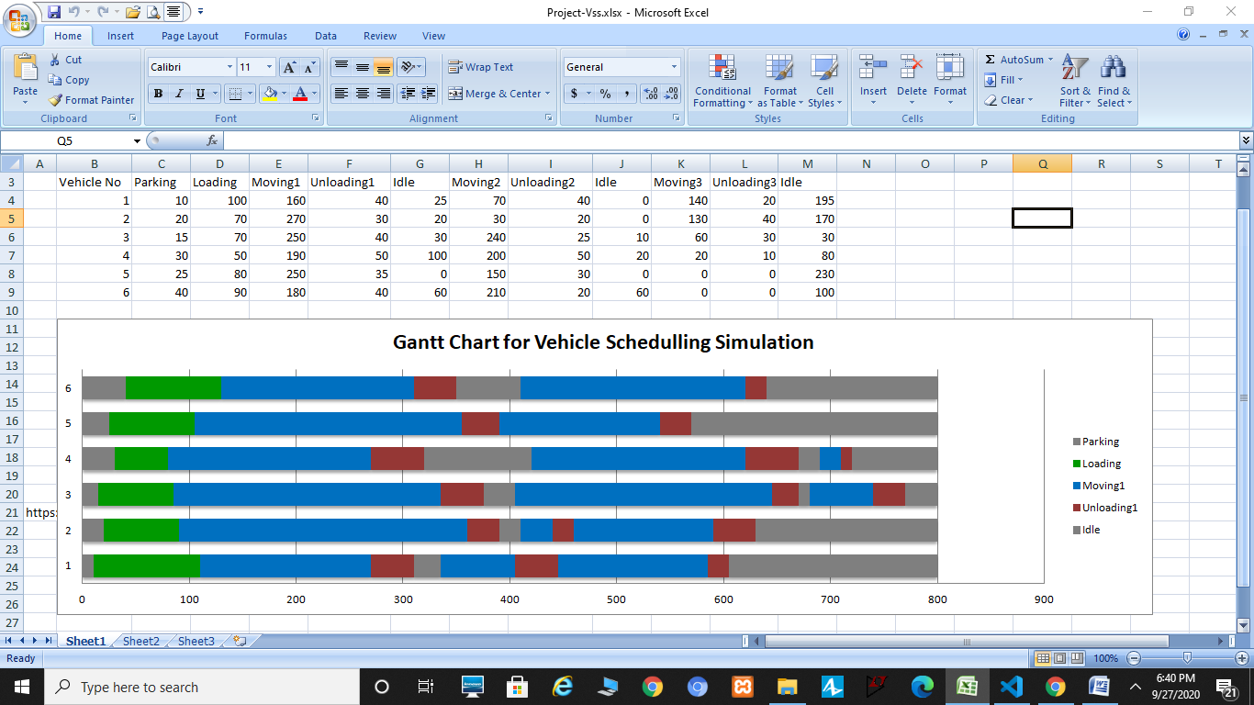
SCREENSHOTS OF OUTPUT

Slide 7
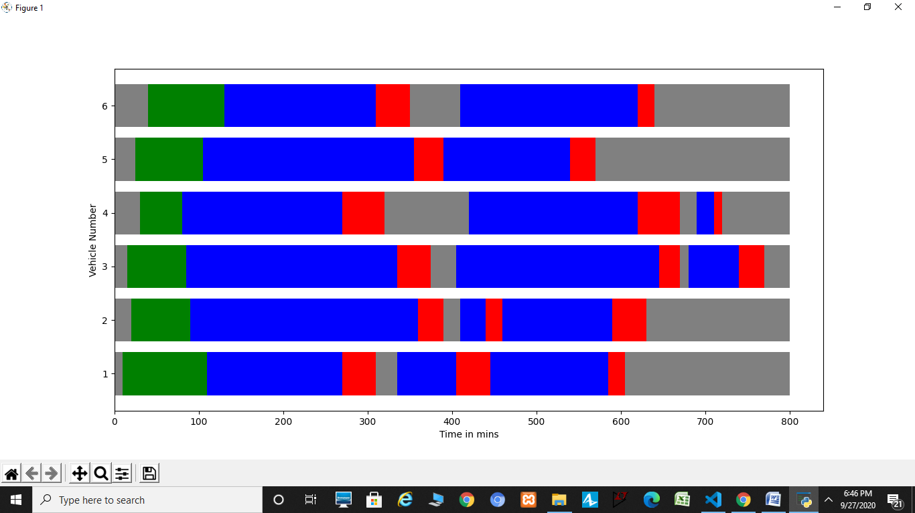
CONTINUE

Slide 8
FUTURE WORK
Improving and increasing input data and trying to include more data and constraints like different types of goods, services, trips, shops, constraints and there different categories in order to make it as close to real world scenarios.
Trying to learn new and improved technologies for making this model better.
Most importantly, preparing statistical report which provides aggregated information about vehicle utilization and idling, this is not shown in model window most probably using python and its libraries.

