Slide 1
MnS- MTE PROJECT BY:- MUSKAN GUPTA (2K19/SE/077)
TOPIC-
Vehicle Scheduling Simulation

Slide 2
PROBLEM OVERVIEW
A vehicle schedule defines a schedule of goods deliveries by vehicles (or trucks) from a distribution centre (DC) to a net of shops or supermarkets.
The model is aimed to simulate utilization of trucks in order to determine their usage and idle times.
Here, the vehicle idle time is defined as a sum of time periods when truck is waiting for next trip in the parking place.

Slide 3
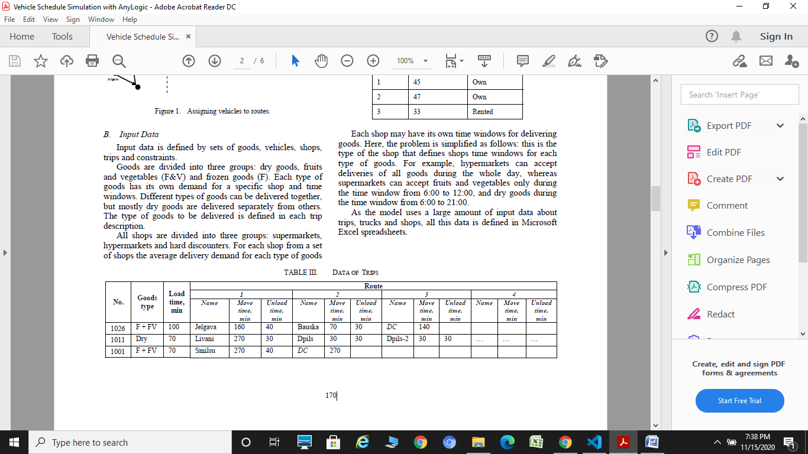
INPUT DATA
Input Data is defined by a set of trips, constraints, the average time for vehicle to move from one point to the next one and the average loading time for each vehicle in DC and the average unloading time for each shop in the route are defined. Constraints may include truck capacity constraints and delivery time constraints.
Sample Input Data

Slide 4
OUTPUT DATA
The model also has to generate Gantt chart representing the vehicle schedule to be further analyzed by a planner. It also has to generate a statistical report denoting vehicle utilization and idle time.
MODEL DIMENSION
For simplification, the task dimension in the paper is reduced. The number of vehicles is equal to 6

Slide 5
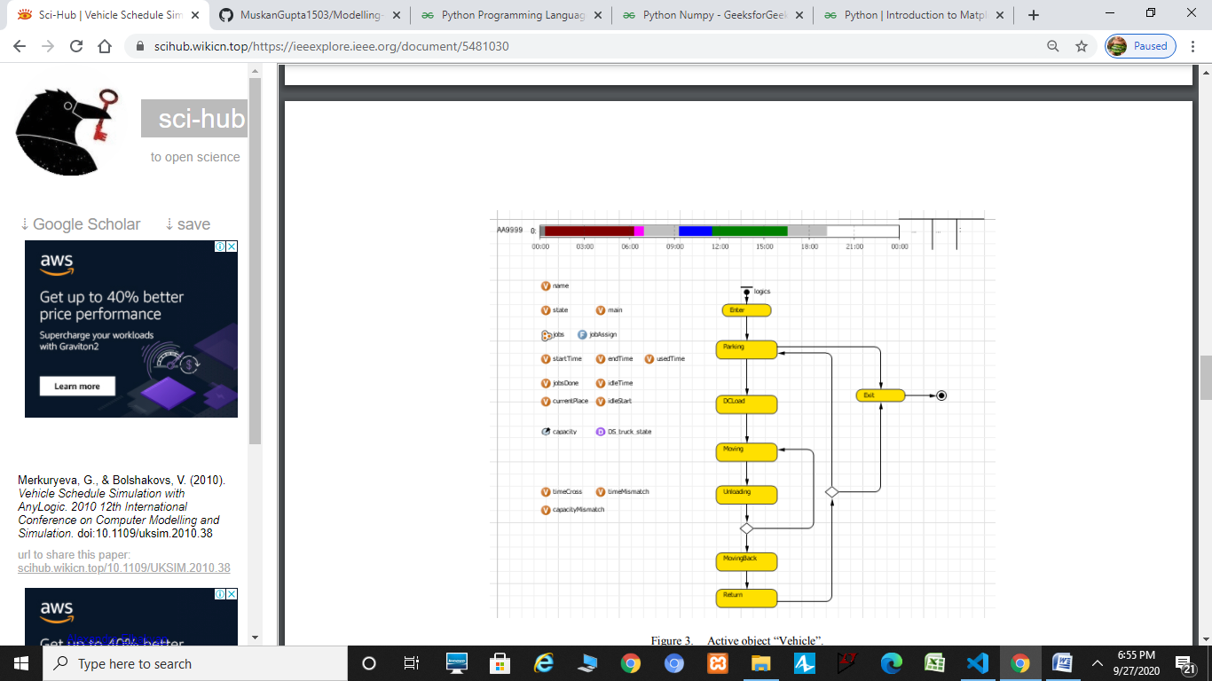
DIFFERENT STATES OF VEHICLES
Enter
Parking
Loading
Moving
Unloading
Moving Back
Return
Exit
COLOR CODES ARE:
GREY- IDLE, BLUE- MOVING, GREEN- LOADING, UNLOADING- MAROON/RED

Slide 6
MODEL BUILDING
To build the model, I leant basics of python and its various Libraries like NumPy, Matplotlib etc. to be able to program the model and implement it. The model has been coded in python in Vs code IDE
Github link for code: - https://github.com/MuskanGupta1503/Modelling-and-Simulation/blob/master/Code/index.py
we generate data using random functionality in python for various trips and states.
We consider a trip where each of the 6 vehicles start from parking state (idle state) and would then load their goods during loading time.
Then they would start their trips. Here we have considered at most 3 trips. We stated at most because random function can generate 0 number as well indicating no trip or idle state.

Slide 7
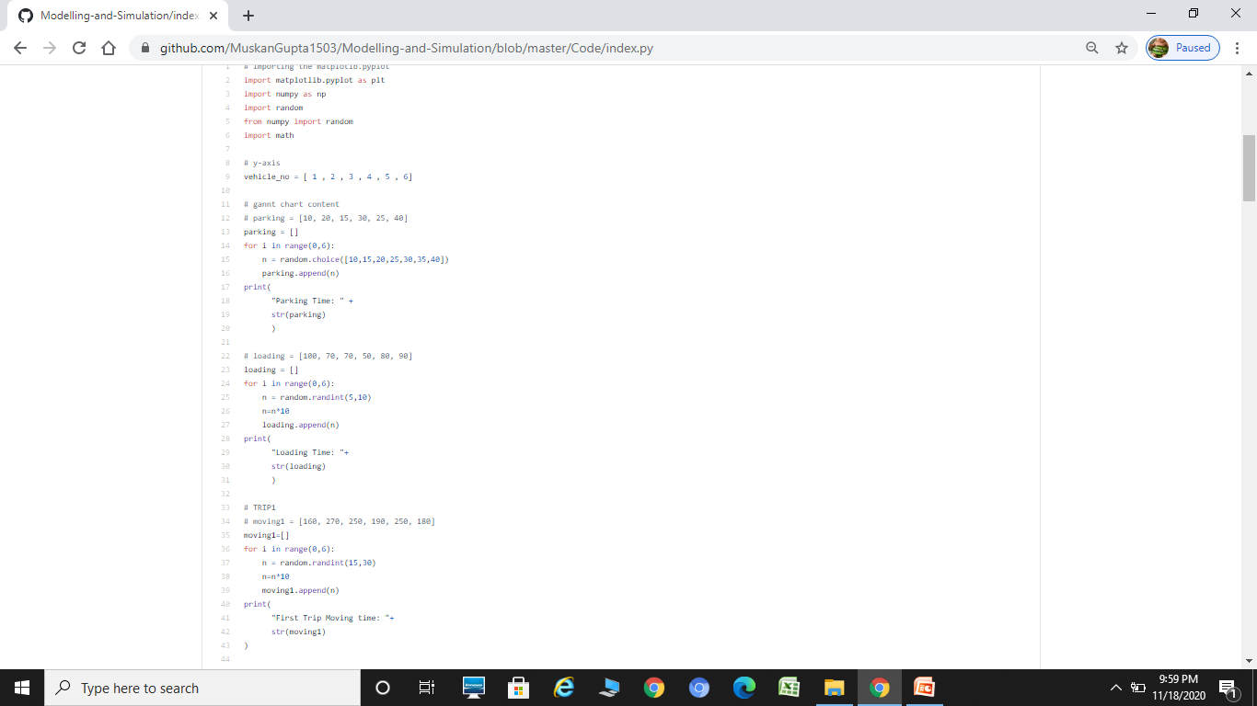
MODEL CODE
Link for whole code :- https://github.com/MuskanGupta1503/Modelling-and-Simulation/blob/master/Code/index.py

Slide 8
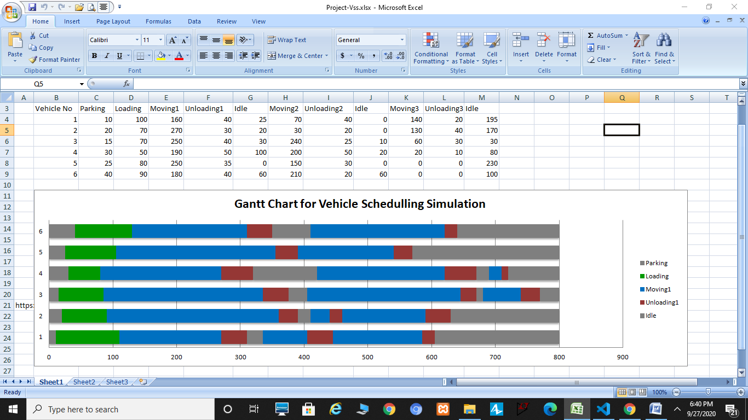
SCREENSHOTS OF OUTPUT

Slide 9
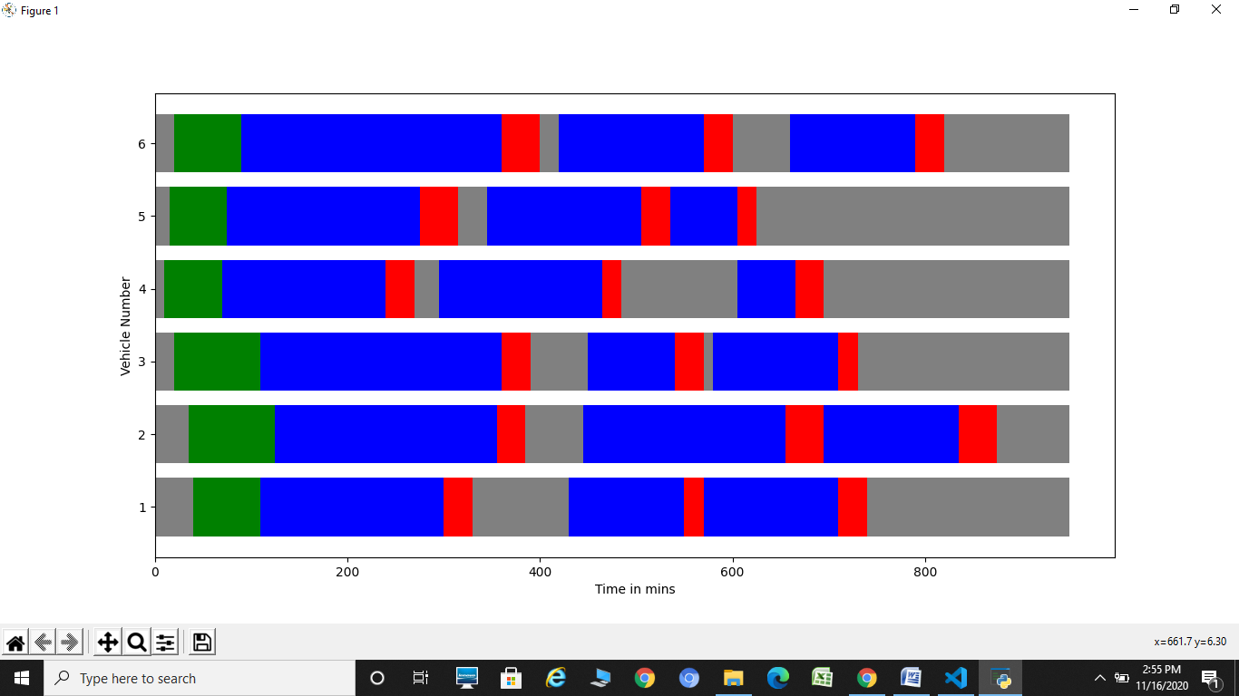
SCREENSHOTS (PYTHON CODE)

Slide 10
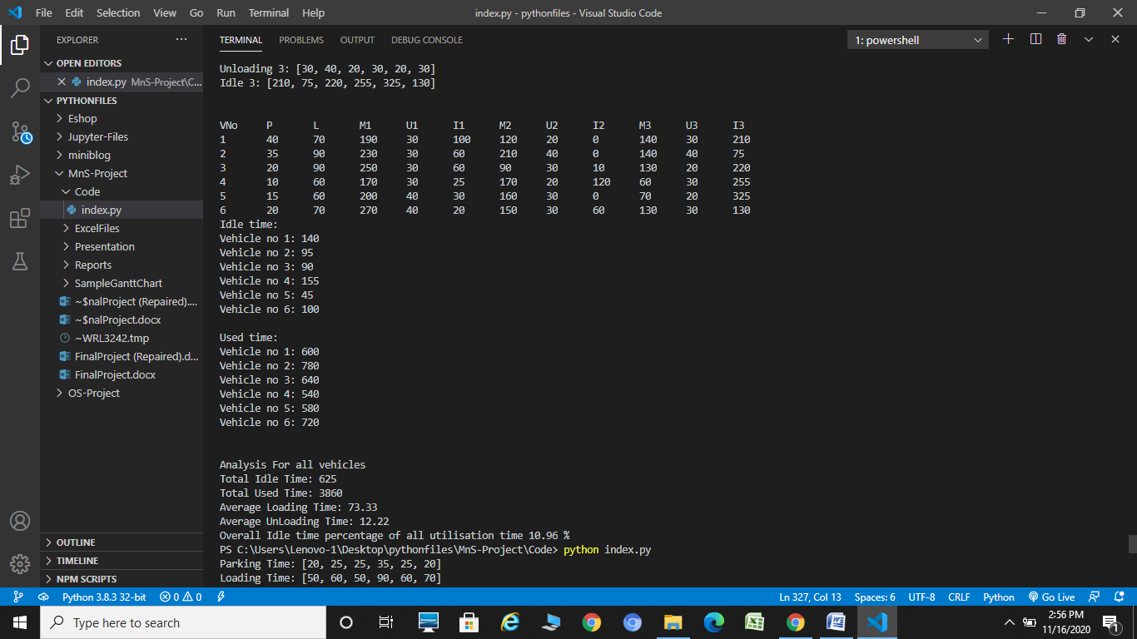
STATISTICAL REPORT

Slide 11
ANALYSIS
First it provides idle time and used time data for all individual trips and then analyses all trips combined.
Here we find out that overall idle time percentage of all utilization time is 10.96% in this sample data.
Similarly such analysis can be performed for all schedules and with the help of Gantt charts and analysis report.
Possible transformations of the schedule are also visible, for example, the second trip of the first vehicle could be assigned for the fifth vehicle to prevent long idle period of the fifth vehicle.

Slide 12
CONCLUSION
The visualization of vehicle and distribution centre utilization combined with statistical data can be used by expert to redefine vehicle schedule.
This model provides “what if” analysis for further improvement of a vehicle schedule generated with heuristic algorithms.
It is also useful for vehicle schedule adjustment for unexpected changes of input data and parameters of vehicle schedule, when heuristics are excessive for regeneration of a new schedule.
As all vehicles are simulated separately, simulation model is very flexible in terms of unique parameter definition for each vehicle.

