Slide 1


Financial Wings Loan System
Case study : This Loan Management system database was made based on loan management requirements. The system can encode the debtors’ information.

Slide 2
Objective
Facility to store the information of new customer, different types of loans provided by the banking, interest rates of different types on loan etc..
Facility to calculate EMI based on loan amount and period of repayment.
Facility to keep record of all loans given by bank and there current status, also keep record of loan repayment and late fine.
Aim is to provide financial support from the banking system.
The company makes a decent profit in the long run if the finance manager makes the proper decisions.

Slide 3
RDBMS
It stands for Relational Database Management System.
Simple and Sound theoretical basis.
Developed By E F Codd in early 1970s.
The model is base on tables, rows and columns and the manipulation of the data stored within.
Relational database is a collection of these tables.
First commercial system :MULTICS in 1978
Has overtaken hierarchical and Network models.
Main features: Single database can be spread across several tables.
Example include : Oracle,IBM’s DB2,Sysbase ,MySQL & Microsoft Access.

Slide 4
MySQL
MySQL is a Relational Database Management System .
MySQL allows multiple tables to be related to each other.
Similar to a Grandparent to a parent, a parent to a child and so forth.

Slide 5
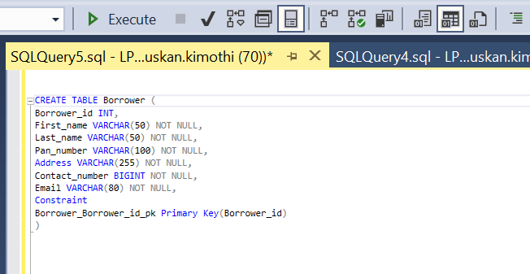
>borrower table consist of customer information, having 6 columns:- userid, firstname, lastname,pan, address, contact,email.
Creating table

Slide 6
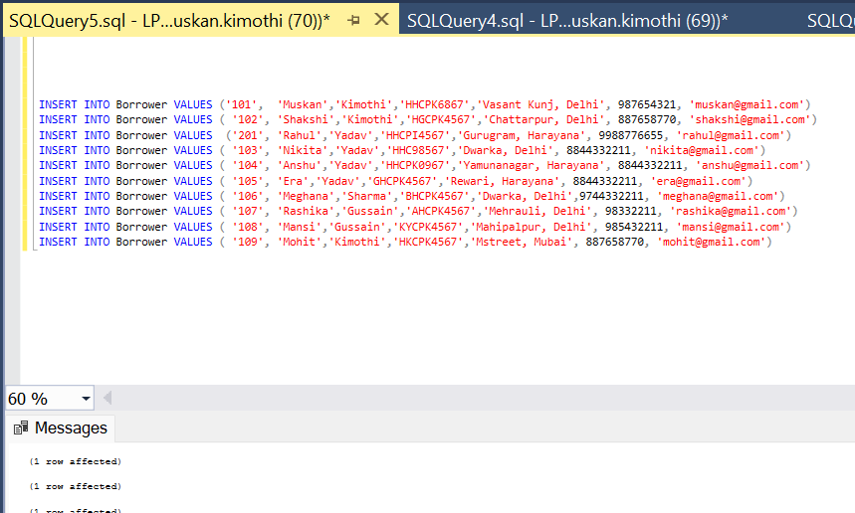
Inserting Values into borrower table

Slide 7
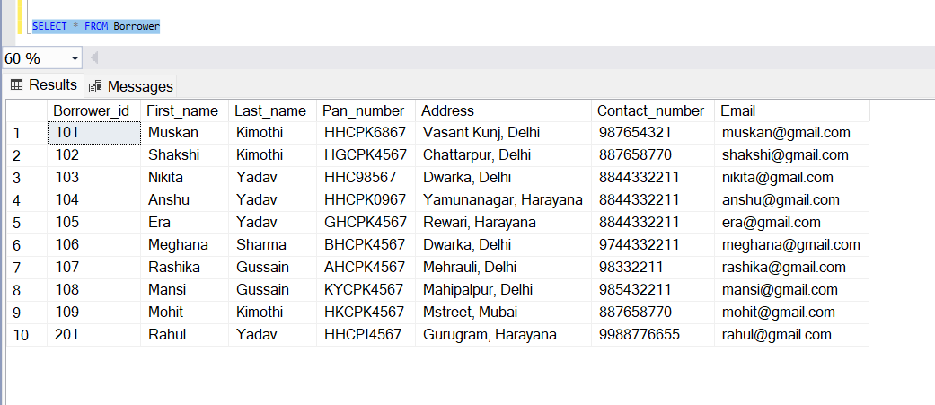
Borrower Table:

Slide 8
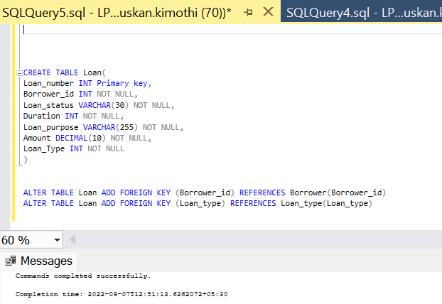
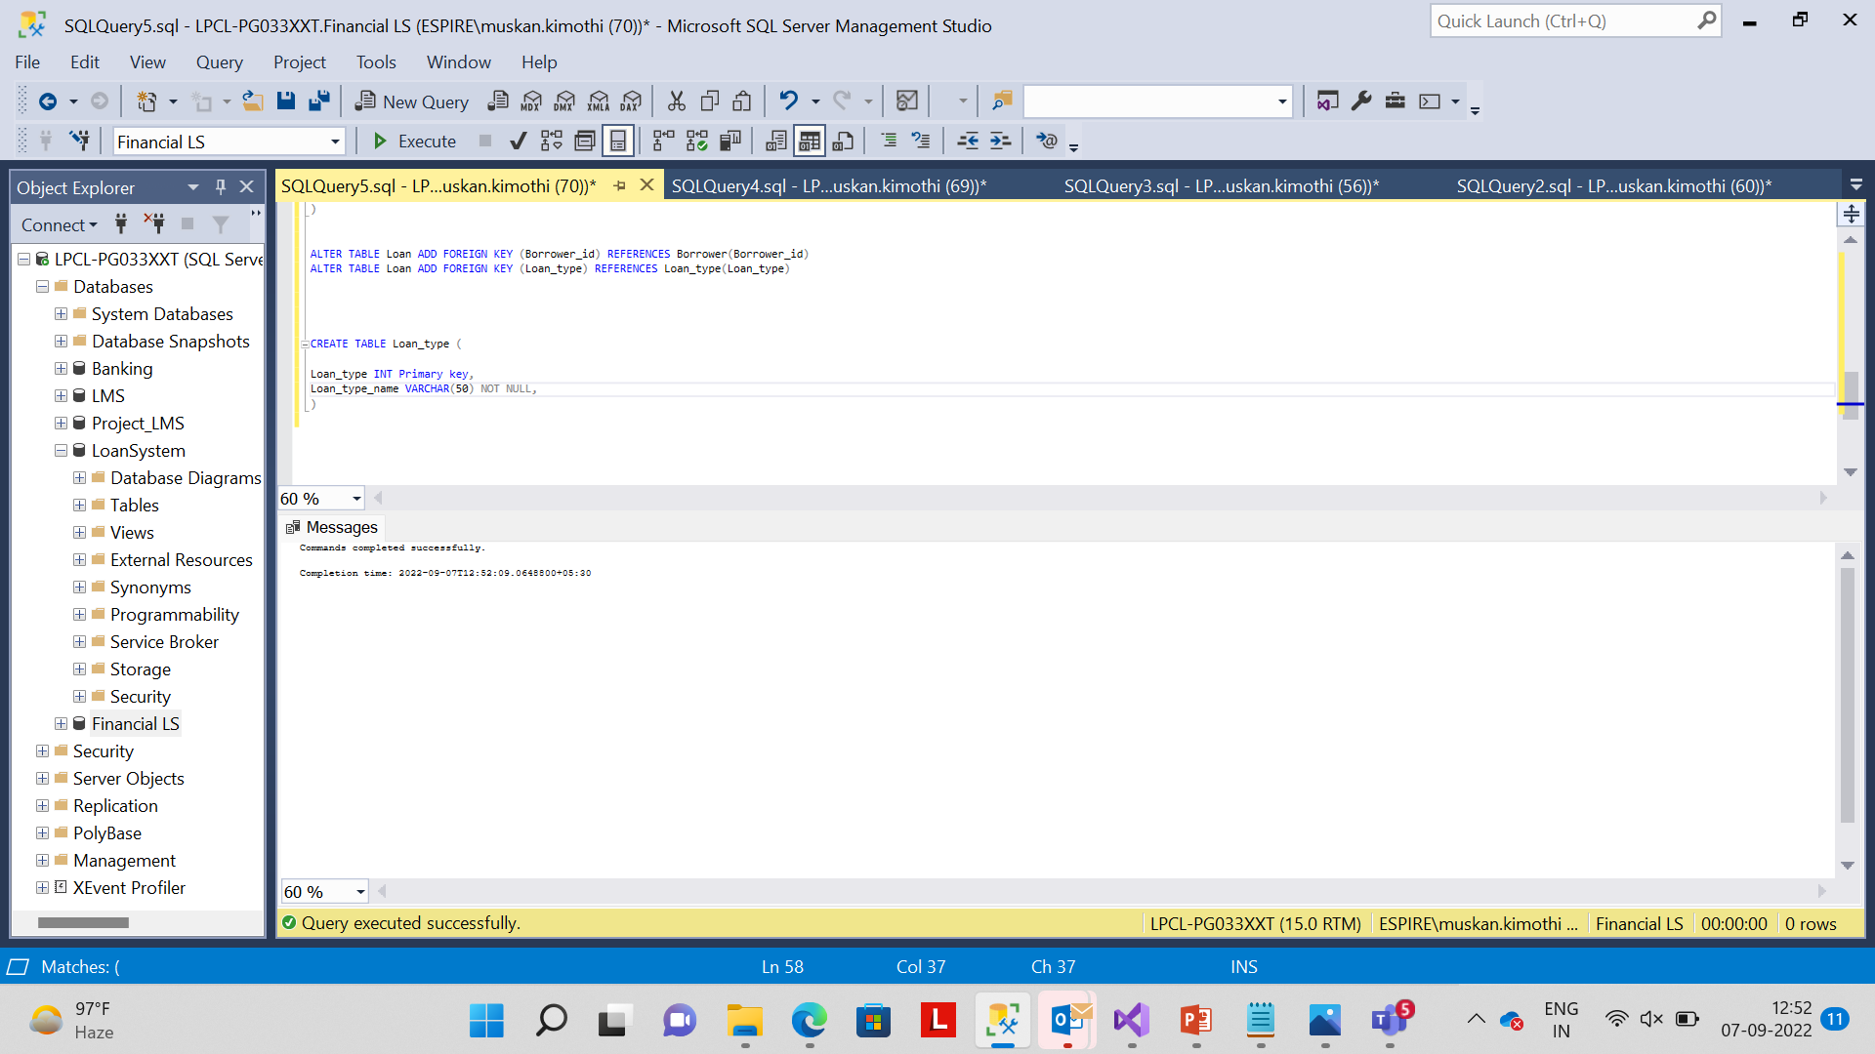
>Loan_type table ,loan table consist of 7 columns:-loan_number, userid, loan_status, duration, purpose, amount, type.

Slide 9
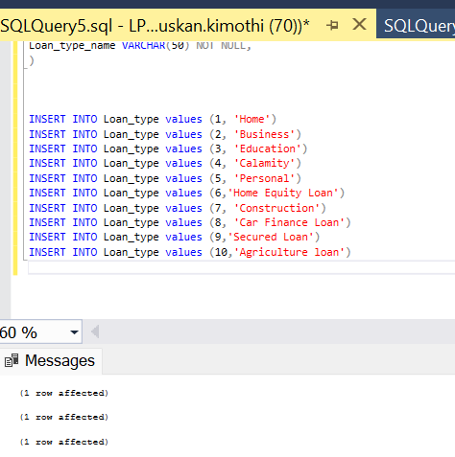
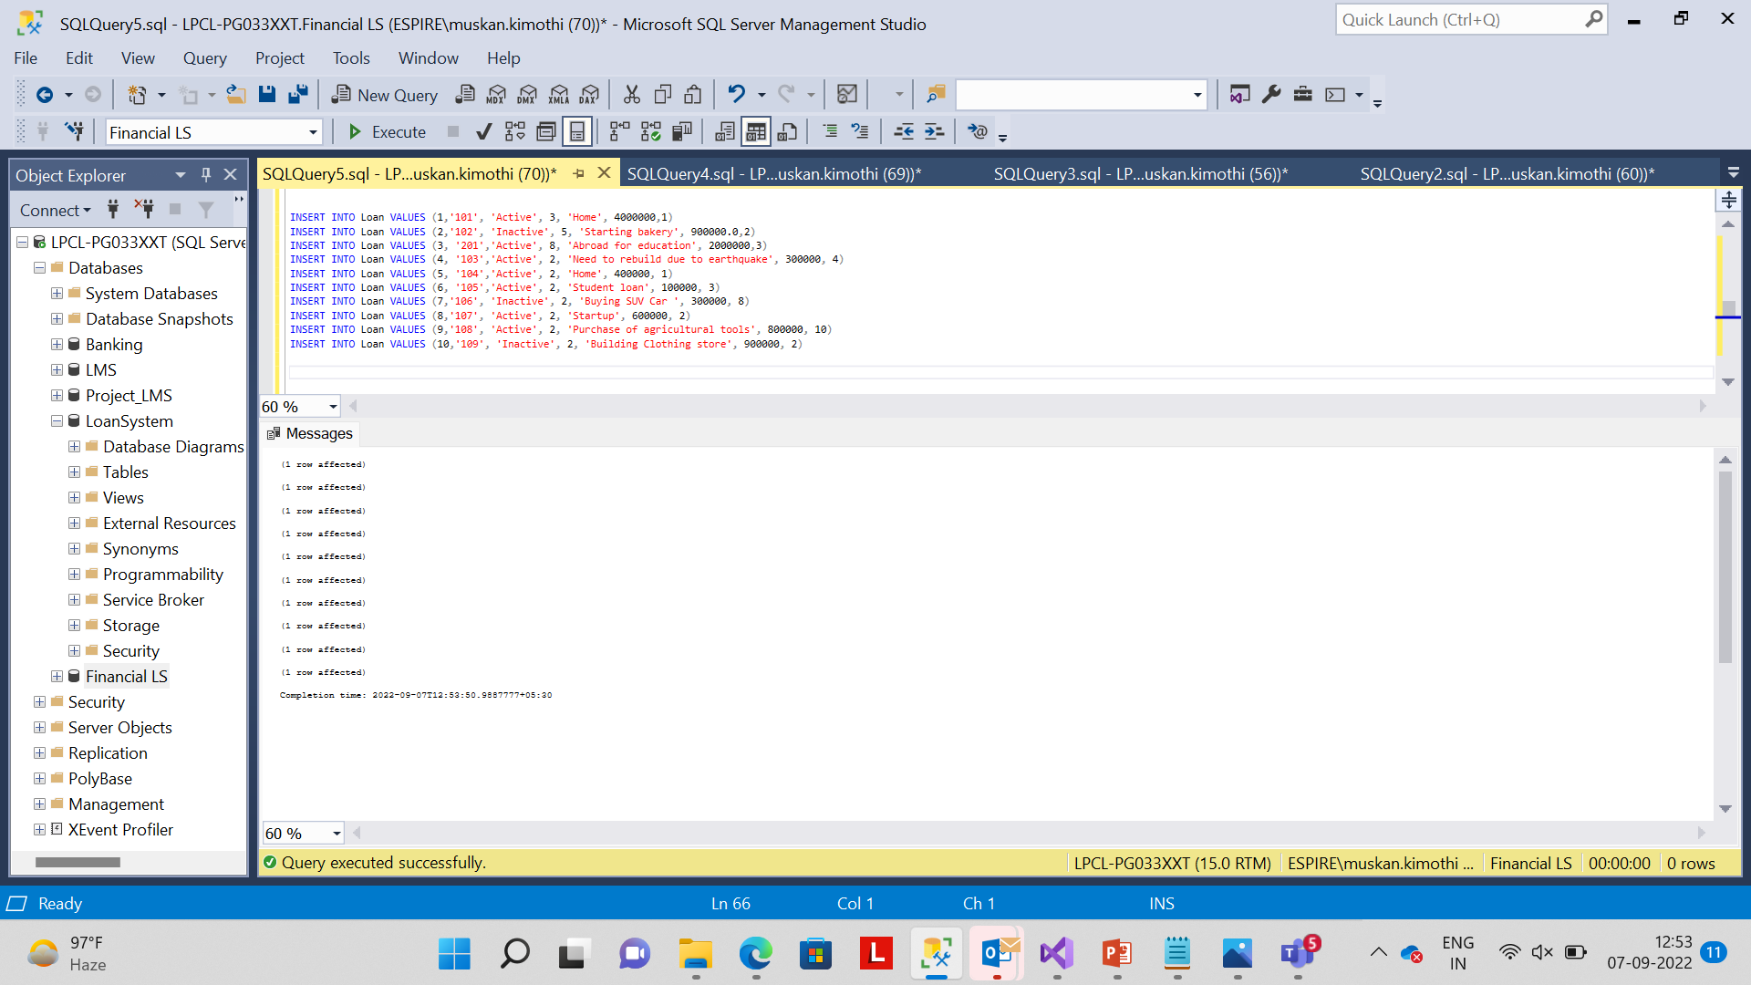
Inserting values into loan and Loan_type table

Slide 10
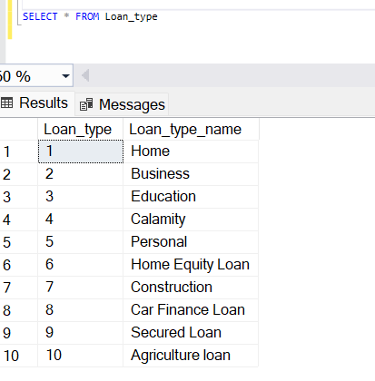
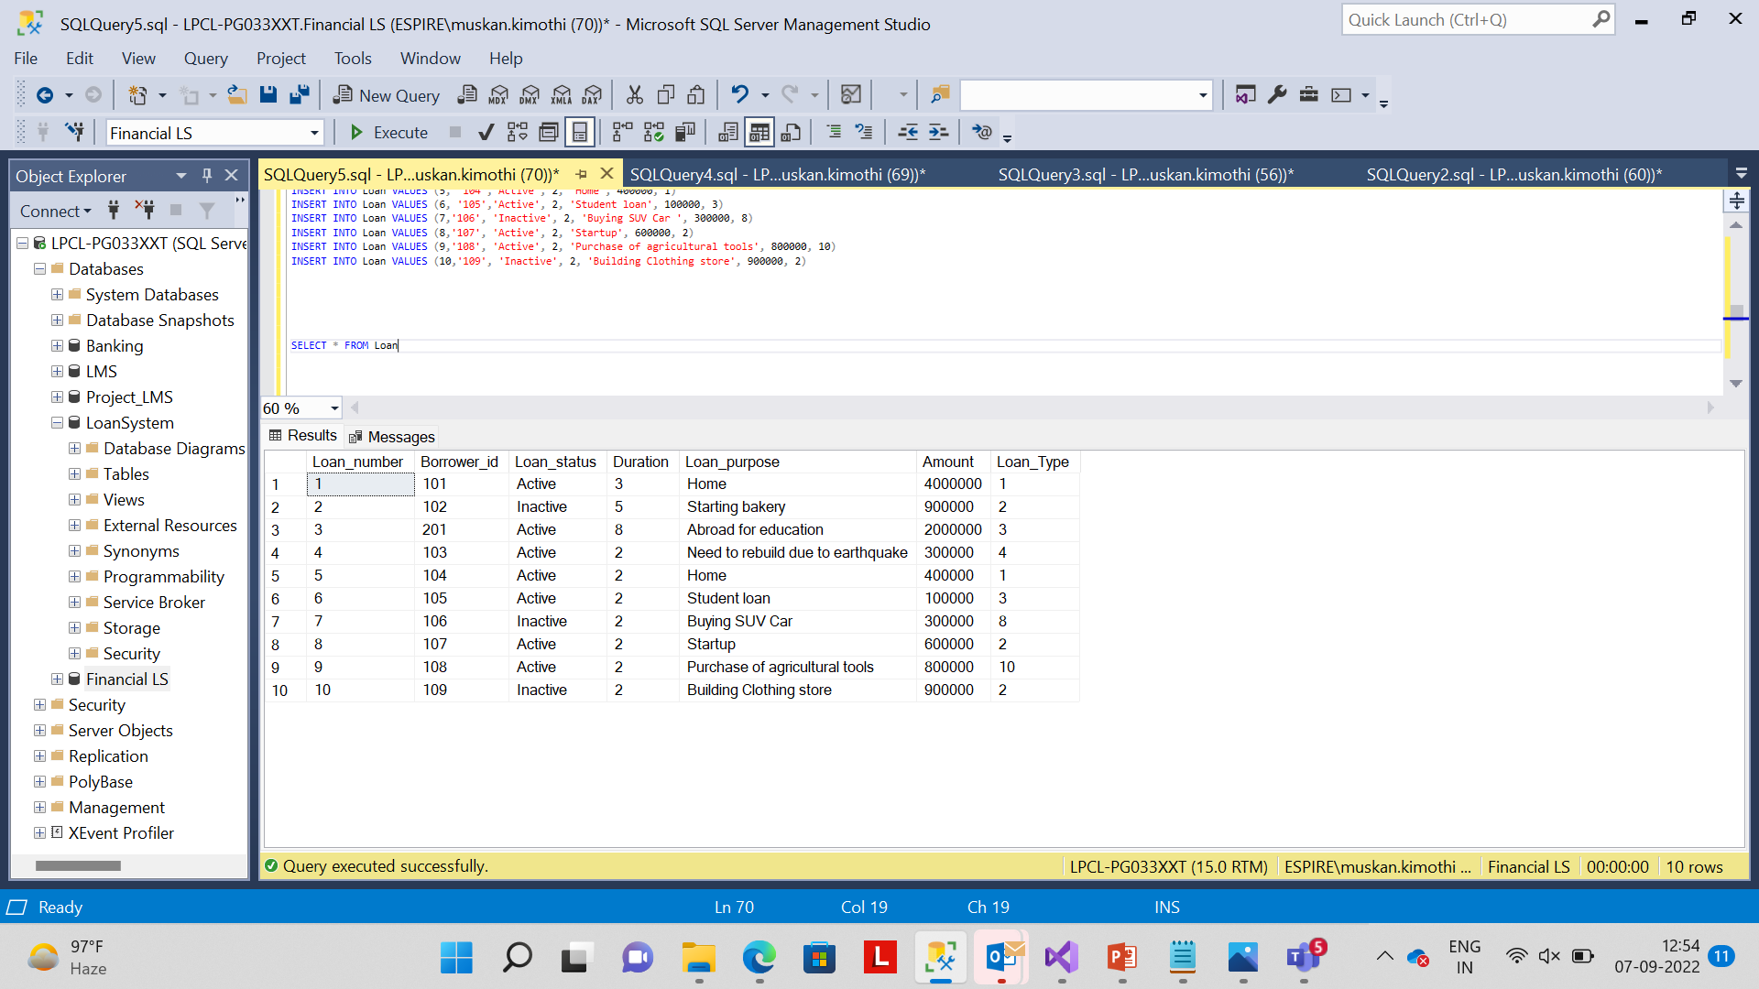
Loan table AND LOAN_TYPE TABLE

Slide 11
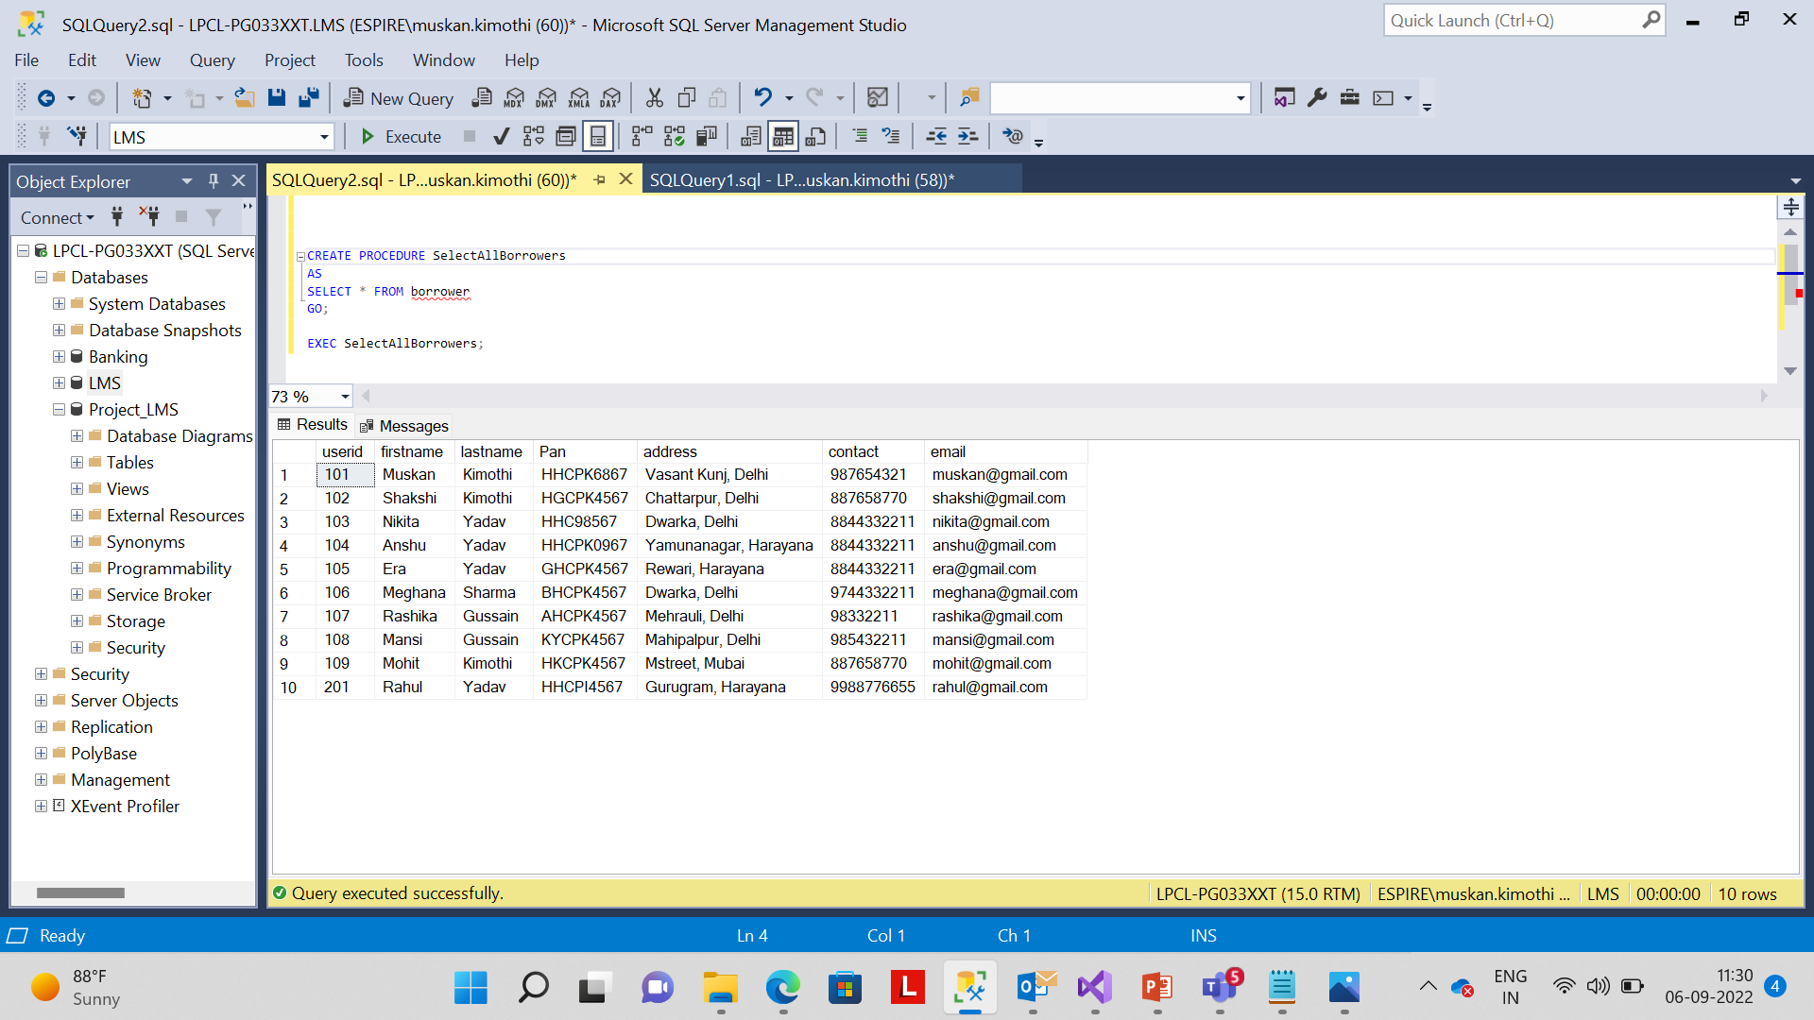
A stored procedure in SQL is a group of SQL statements that are stored together in a database. Based on the statements in the procedure and the parameters you pass, it can perform one or multiple DML operations on the database, and return value, if any. Thus, it allows you to pass the same statements multiple times, thereby, enabling reusability.
Stored procedure

Slide 12
Conclusion
It is software that helps the user to work with the different banks and their branches easily. This software reduces the amount of manual data entry and gives greater efficiency. In the end, we can say that the software is performing all the tasks accurately and is doing the work for which it is made.

Slide 13
Thank You

