Slide 1
Dot Net Bootcamp
-MUSKAN KIMOTHI

Slide 2
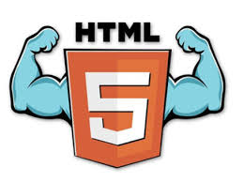
HTML
HTML is a language for describing web pages.
It stands for Hyper Text Markup Language.
It is a markup language. “markup” => No logical evaluations, just structuring. It’s a set of markup tags.
Browser reads it and displays the content.
HTMl5-
HTML5 is the newest version of HTML.
It adds a diverse set of new tools for the web developer to use.
Support all existing web pages. Reduce the need for external plugins and scripts to show website content.

Slide 3
HTML Tags
HTML tags are keywords(tag names) surrounded by angle brackets like <html>.
.Start and end tags are also called opening and closing tags.
It is a markup language. “markup” => No logical evaluations, just structuring. It’s a set of markup tags.
Browser reads it and displays the content.
<!DOCTYPE HTML>
<html>
<head>
<title>Page</title>
</head>
<body>
<p> Some text……</p>
</body>
</html>
HTML Program-<html></html>
Bold- <B></b>
Italic-<I></i>
Head-<head></head>
Body-<body></body>
Html body

Slide 4
CSS is used to apply the style in the web page which is made up of HTML elements. It describes the look of the webage.

Slide 5
Thank You

