Slide 1
Linear Discriminant Analysis GROUP NO : 3
MEMBERS:
Muskan Matwani – AU1741027
Kevin Kukadiya – AU1741066
Yesha Shastri – AU1741035
Mihir Kanjaria – AU1741065
Krushna Shah – AU1741086

Slide 2
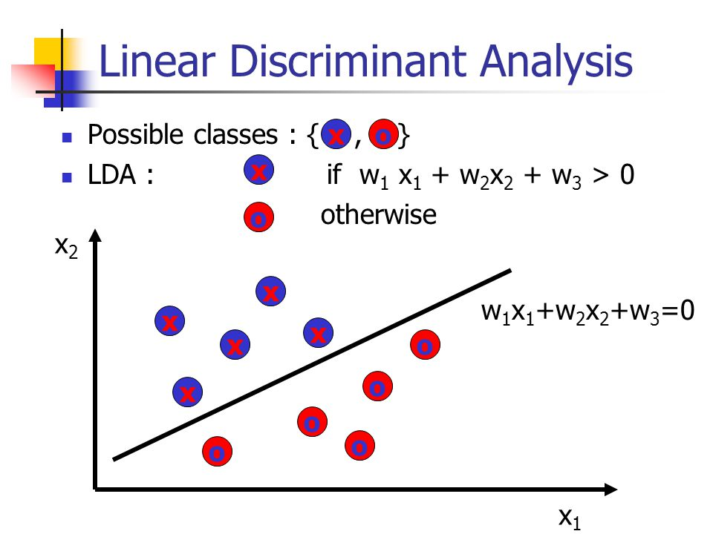
Introduction
Objective of LDA : Dimensionality reduction by preserving much of the class discriminatory information.
Used to find linear combination of features that characterise or separate two or more classes.
USES
Statistics
Pattern recognition
Machine learning

Slide 3
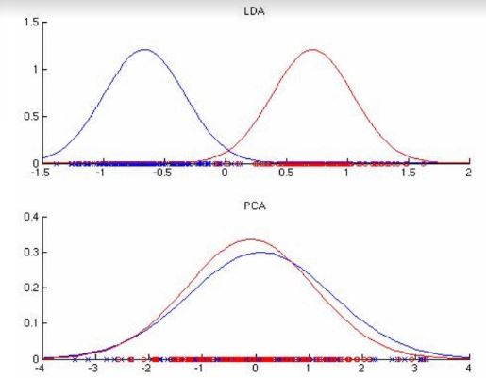
Introduction
Why LDA?

Slide 4
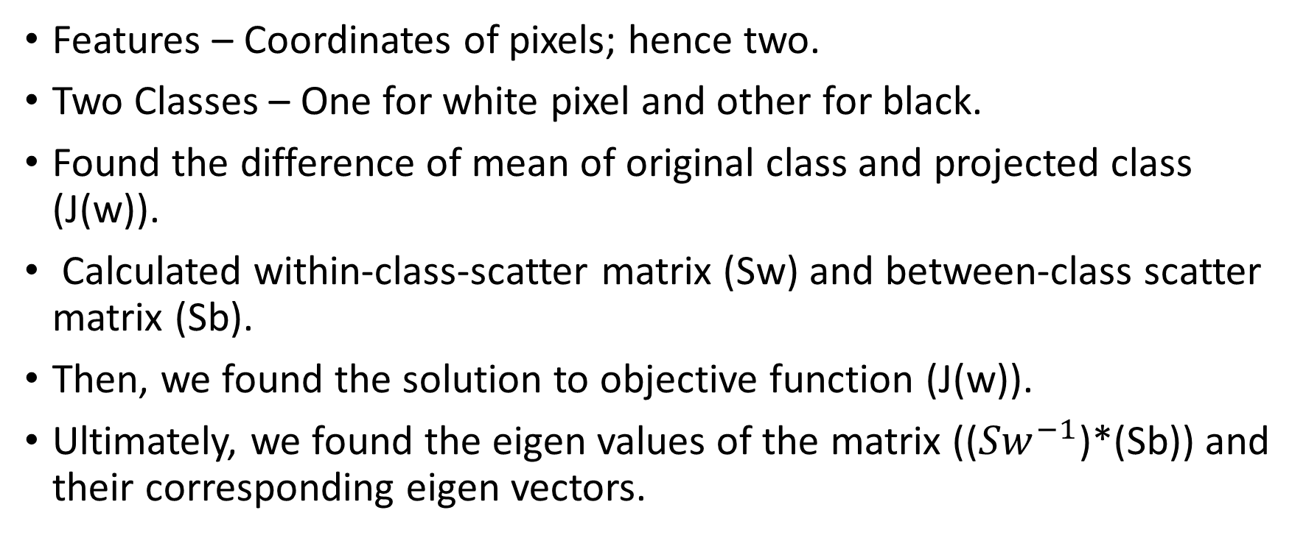
Earlier Approach (Matlab Scripting)
Features – Coordinates of pixels; hence two.
Two Classes – One for white pixel and other for black.
Found the difference of mean of original class and projected class (J(w)).
Calculated within-class-scatter matrix (Sw) and between-class scatter matrix (Sb).
Then, we found the solution to objective function (J(w)).
Ultimately, we found the eigen values of the matrix ((${Sw}^{−1}$)*(Sb)) and their corresponding eigen vectors.

Slide 5
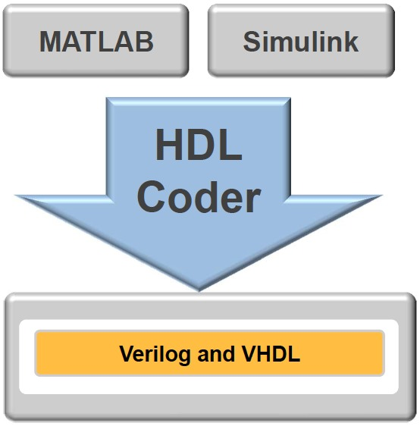
HDL Coder
Matlab has inbuilt HDL Coder which coverts the Matlab script to Verilog code.
It uses fixed-point conversion to handle floating point operations and values.
DRAWBACK
It can compute only for a given particular matrix.
A matrix cannot be given as an input nor can be obtained as an output.
SOLUTION
To overcome the drawbacks of HDL Coder, we proceeded towards writing the Verilog code manually that will generalise the code for any given matrix.

Slide 6
MANAGING FLOATING POINT VALUES
METHODS
FPU
IP-Core

Slide 7

FPU – Floating Point Unit
It is a module to handle floating point operations in single clock cycle.
INPUTS – Two floating point operands in IEEE-754 format. - an opcode for operation to be performed - - clock
OUTPUT – A floating point number in IEEE-754 format.
Representation -

Slide 8
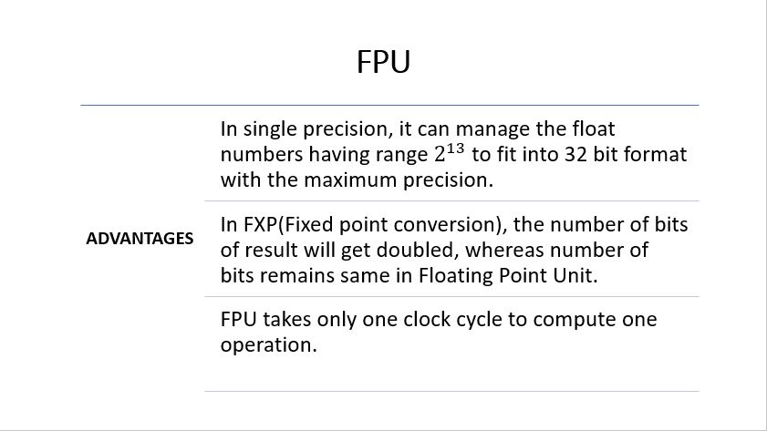

Slide 9
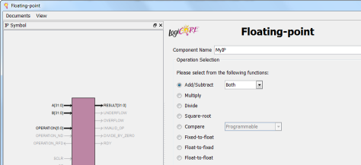
IP-Core
Xilinx provides a wide selection of IP that is optimized for Xilinx fpga.
IP refers to the preconfigured logic functions that can be used in our design.
Input and Output – 32 bit floating point (IEEE 754 format)

Slide 10
Implementation of operations
FPU module requires one clock cycle to compute above operations whereas IP core requires approximately 40 clock cycles.
Since operation of square-root is not defined in FPU we have implemented it through IP core.
Floating Point Unit (FPU) | Intellectual Property Core (IP core)
Addition | Division
Subtraction | Square-root
Multiplication

Slide 11
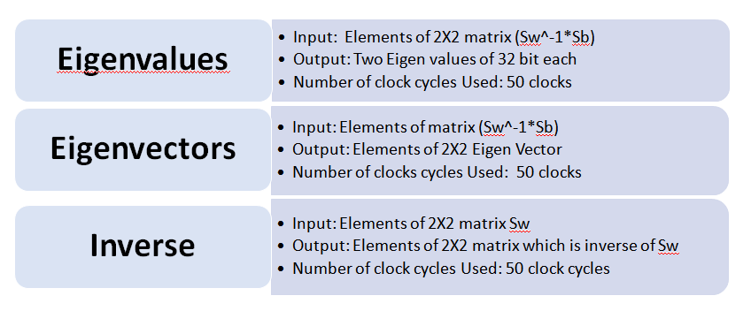
MODULES

Slide 12
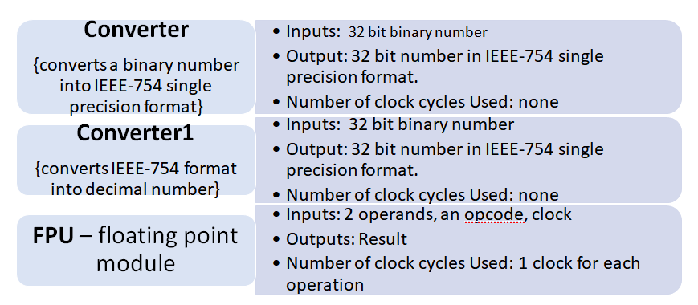
MODULES

Slide 13
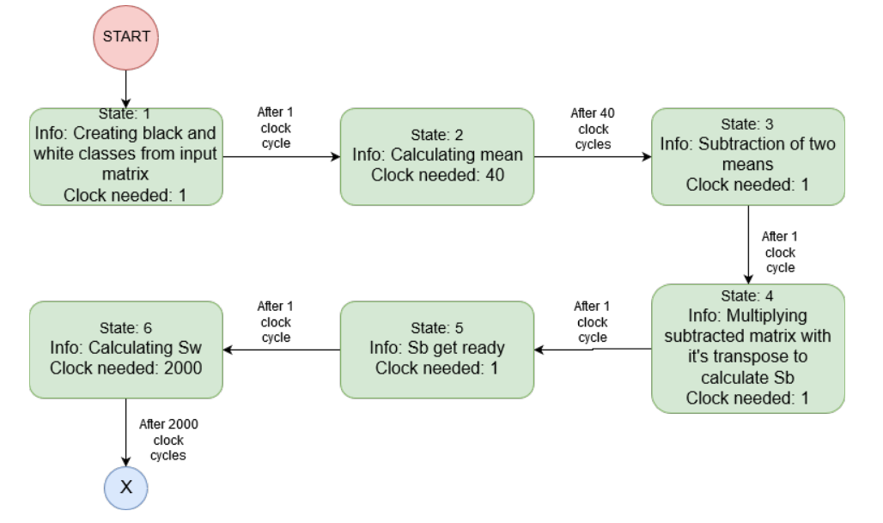
Working

Slide 14
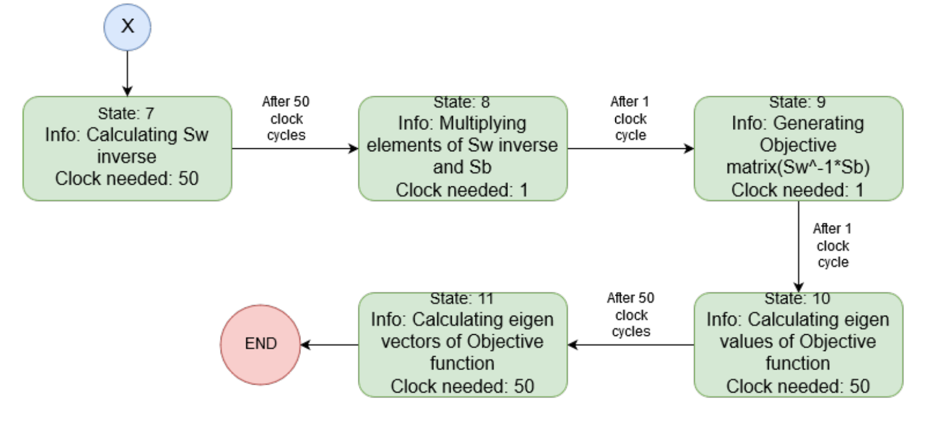
Working (Cont’d)

Slide 15
MAIN MODULE
Input is a clock and 32*32 image matrix is defined inside LDA main .v file.
Eigen value 1
Clock E Eigen value 2
Eig Eigen vector 1
Eig Eigen vector 2
This main module calls all other modules which are described above for computing the LDA.
LDA

Slide 16
SPECIFICATIONS
Clock width : 10 ns
Total time taken : approximately 30 microseconds in behavioural simulation

Slide 17
Earlier Results
Above values are for a 32*32 matrix. We have obtained same values in both cases so by mean-square error method the final error is zero.
Properties | In-built functions | User-defined functions
Eigen values | 1) 0.1798 2) 0.0000 | 1) 0.1798 2) 0.0000
Eigen vectors | 1) [0.9931 ; 0.1170] 2) [-0.8230 ; 0.5681] | 1) [0.9931 ; 0.1170] 2) [-0.8230 ; 0.5681]

Slide 18
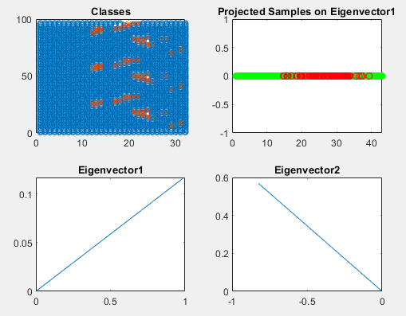
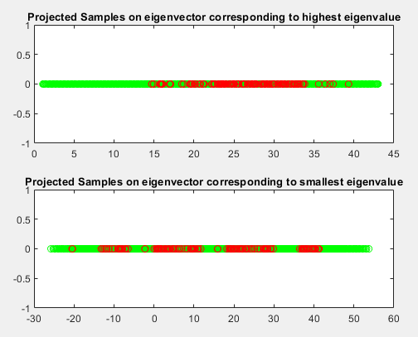
Earlier Results
32*32 matrix

Slide 19
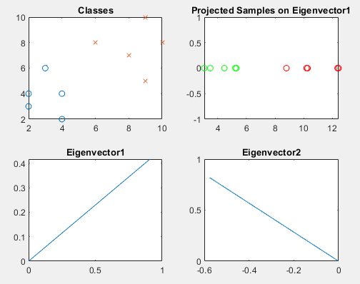
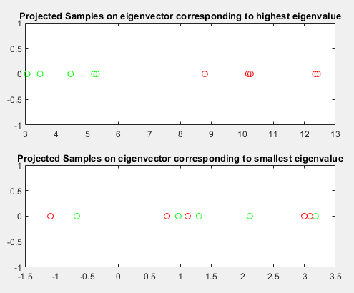
Earlier Results
For test case data samples :
c1[4 2; 2 4; 2 3; 3 6; 4 4] and c2[9 10; 6 8; 9 5; 8 7 ; 10 8]

Slide 20
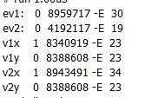
Verilog Results
+0.0083
+7.9958
-0.9943
+1
-0.0005
+1
NOTE: ‘-E’ denotes the negative power of 2
Input Matrix (Binary Image) :
ev1 and ev2 are our two eigen values
v1x and v1y makes the first vector corresponding to eigenvalue ev1
V2x and v2y makes the second vector corresponding to eigenvalue ev2.

Slide 21
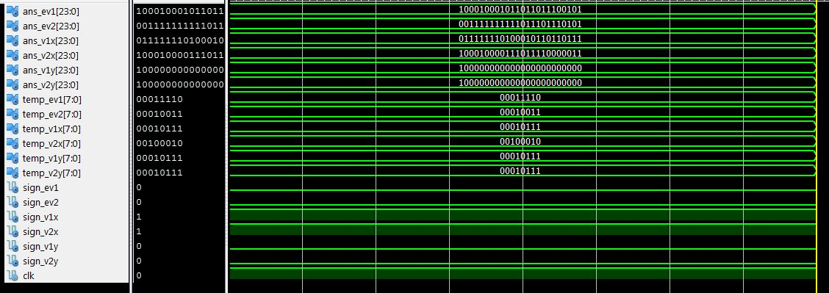
Waveforms of the above results
sign component of all values is the sign bit (denoting positive or negative).
ans component of all values is the Integer value denoted in the previous slide.
Temp component of all values is the power part denoted after ‘E’ in the previous slide.

Slide 22
Comparison with the Matlab Results
Matlab answers: Error:
Ev1 = 0.0083 No error
Ev2 = 7.995 No error
V1x = -1 0.001
V1y = 1 No Error
This is our LDA computation

Slide 23
DIFFICULTIES☹☹
Division operation defined in FPU module was not producing
correct output so we had chosen IP core to make our task easier.
Reason to go manually in Verilog is because HDL only converts LDA
code of defined matrices (not generalised) into Verilog code.
Since computing scatter matrix (Sw) needs calculation of
covariance, i.e. (x-mu1)*(x-mu1)’ where ‘x’ is my data sample and
mu1 is my mean of first class, It takes many clock cycles to
complete as there are 1024 data samples in total. Hence, whole
process takes a longer period of time.

Slide 24
References
Devadasi, Ruby. Developing an efficient IEEE754 compliant FPU in verilog. Diss. 2012.
Malik, Sunita. "Design and Analysis of Multimode Single Precision Floating Point Arithmetic Unit Using Verilog." International Journal of Scientific Research and Management 5.5 (2017): 5331-5335.
Ushasree, G., and R. Dhanabal. "VLSI implementation of a high speed single precision floating point unit using verilog." Information & Communication Technologies (ICT), 2013 IEEE Conference on. IEEE, 2013.

Slide 25
THANK YOU☺

