Slide 1
GROUP NO : 3
MEMBERS:
Muskan Matwani – AU1741027
Kevin Kukadiya – AU1741066
Yesha Shastri – AU1741035
Mihir Kanjaria – AU1741065
Krushna Shah – AU1741086

Slide 2
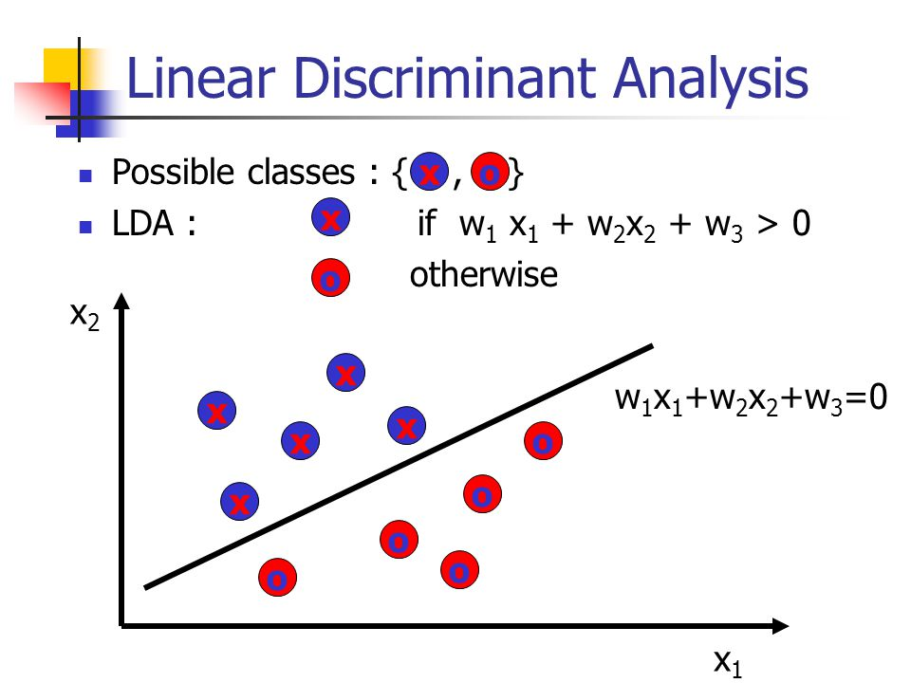
Introduction
Objective of LDA : Dimensionality reduction by preserving much of the class discriminatory information.
Used to find linear combination of features that characterise or separate two or more classes.
USES
Statistics
Pattern recognition
Machine learning

Slide 3
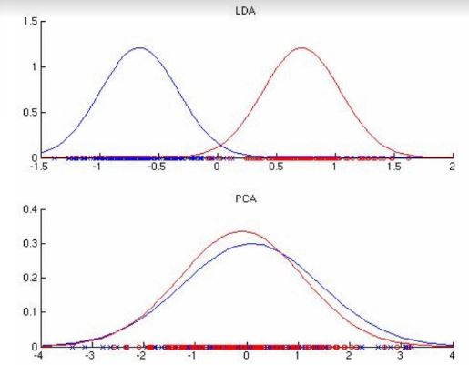
Introduction
Why LDA?

Slide 4


Existing Approaches
LDA
Class dependent transformation Class independent transformation
Involves maximizing the ratio of - Involves maximising the ratio of overall
between class variance to within variance to within class variance.
class variance.
It uses two optimizing criteria - Uses only one optimizing criterion to
for transforming the data sets transform the data sets.
Independently.

Slide 5
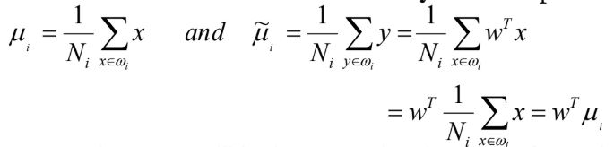
Existing Approaches
Here, features of class are the coordinates of pixels present in our image matrix. Hence, we obtain two features.
We have created two classes ; one corresponding to pixel value of black colour and other corresponding to that of white colour.
In order to define a measure of separation between the projections we have found the mean of original class and that of projected class.

Slide 6
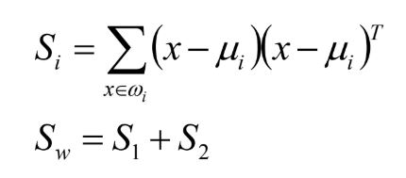

Existing Approaches
We now have computed difference between the projected means.
Now we found within-class-scatter matrix which measure the variability within the two classes.
For between-class-scatter matrix

Slide 7
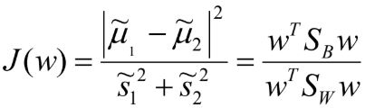

Existing Approaches
Objective function now becomes
To find the maximum of this function, we differentiate it and then equate it to zero.
Solution turns out to be :

Slide 8

Existing Approaches
We now find eigen values of the obtained matrix.
We have then obtained eigen vectors corresponding to the eigen values.

Slide 9
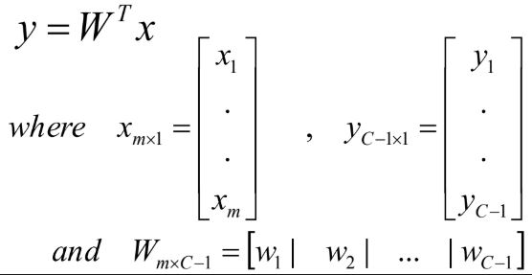
Existing Approaches
Ultimately, we have found projections corresponding to the projection vectors and classes.
Here y is the projection, w is a matrix of projection vectors and x is the class.

Slide 10
Results
Above values are for a 32*32 matrix. We have obtained same values in both cases so by mean-square error method the final error is zero.
Properties | In-built functions | User-defined functions
Eigen values | 1) 0.1798 2) 0.0000 | 1) 0.1798 2) 0.0000
Eigen vectors | 1) [0.9931 ; 0.1170] 2) [-0.8230 ; 0.5681] | 1) [0.9931 ; 0.1170] 2) [-0.8230 ; 0.5681]

Slide 11
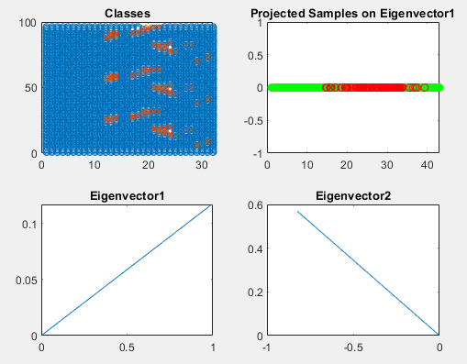
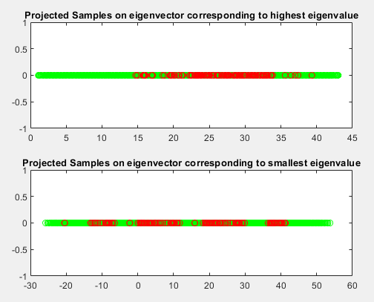
Results
32*32 matrix

Slide 12
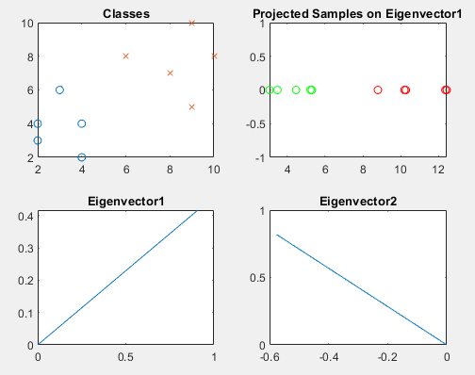
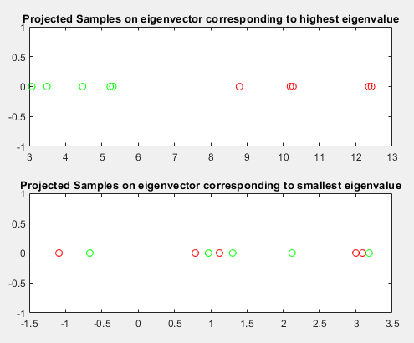
Results
For test case data samples :
c1[4 2; 2 4; 2 3; 3 6; 4 4] and c2[9 10; 6 8; 9 5; 8 7 ; 10 8]

Slide 13
References
Shireen Elhabian and Aly A. Farag University of Louisville, CVIP Lab September 2009
IEEE TRANSACTIONS ON SYSTEMS, MAN, AND CYBERNETICS—PART B: CYBERNETICS, VOL. 35, NO. 5, OCTOBER 2005

Slide 14
THANK YOU

