Slide 1
COMPUTER ORGANIZATION
Course Instructor :- Prof. Pratik Trivedi
GROUP - 9
MUSKAN MATWANI AU1741027
JAYDEEP MODI AU1741070
DHRUVIL SHAH AU1741024

Slide 2
Software and Language used in Designing
The Software used in designing is XILINX ISE design suite for programming.
Programming language for the designing of processor was VERILOG.
Processor Instructions to compute Addition and Multiplication was dumped on FPGAs (field programmable gate arrays).
The programming of 8085 was done on the 8085 kit.
Programming Language for 8085 instructions was ASSEMBLY language.

Slide 3
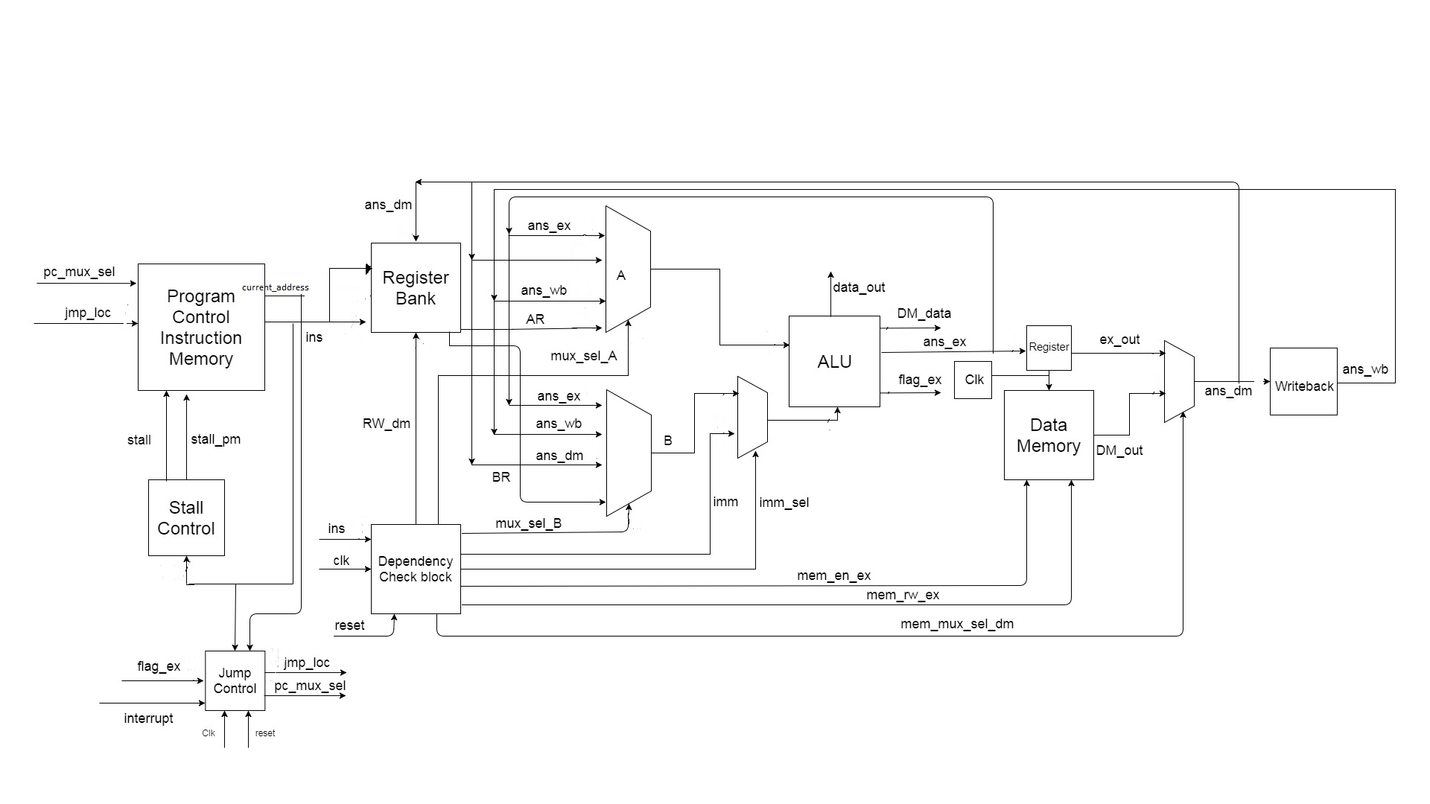
MIPS PROCESSOR
Program Memory
Register Bank
Execution
Data Memory
Data Dependency
Jump Control
Stall Control
Writeback

Slide 4
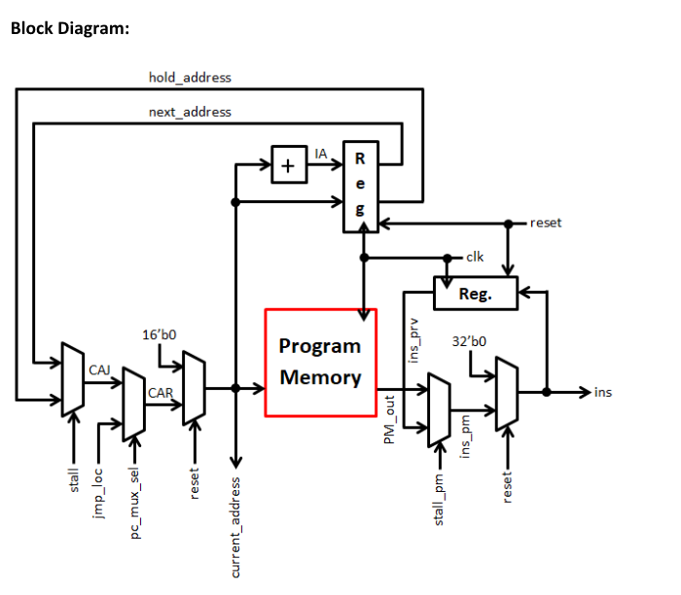
Program Memory Block
INPUTS BITS | OUTPUTS BITS
Jmp_loc 16 | Current_addr 16
Pc_mux_sel 1 | Ins 32
Stall 1
Stall_pm 1
Reset 1
Clk 1

Slide 5
Program Memory Block
Program Memory Block size - 65536 X 32
This is used in Instruction Fetch stage. The motive of this block is to generate instructions for the further blocks.
Stall and stall_pm signal comes from stall control block and used to hold the previous address and instruction respectively.
Pc_mux_sel decides to pass either the current address or jump location address provided by jump control block.
Program Counter is a combination of increment and register and points to next instruction.

Slide 6
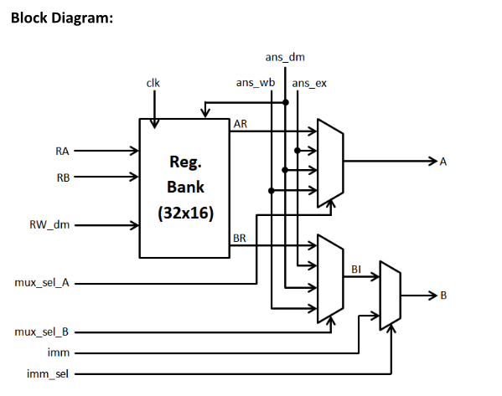
Register Block
INPUTS BITS | OUTPUTS BITS
Ans_ex 16 | A 16
Ans_dm 16 | B 16
Ans_wb 16
Imm 16
RA 5
RB 5
Imm_sel 1
RW_dm 5
mux_sel_A 1
mux_sel_B 1
Clk 1

Slide 7
Register Block
Register Block generates operands for the Execution Block based on the input addresses RA (5bit) and RB(5 bit) generated from the instruction in Program Memory Block.
Two 4X1 Muxes are used to forward the data from execution, data memory and write back block based on the value of the signal : Mux_sel_A and Mux_sel_B.
If the instruction is of I-type, then immediate value is passed as the second operand.

Slide 8
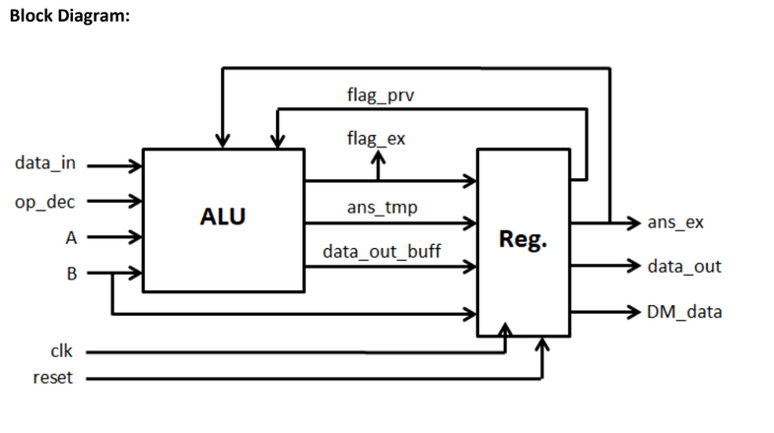
Execution Block
INPUTS BITS | OUTPUTS BITS
A 16 | Ans_ex 16
B 16 | DM_data 16
Data_in 16 | Data_out 16
Opcode 6 | Flag_ex 2
Clk 1
Reset 1

Slide 9
Execution Block
Execution Block takes in operands A and B each of 16 bits and an opcode of 6 bit .
Generates execution block output, data for data memory block and data to external output port.
ALU performs 28 operations (arithmetic, logical, branch , Input/output etc) and generates address for branch and memory related instructions.
Register is used to delay the process to 1 clock cycle for pipeline processing and to store the output of the ALU.

Slide 10
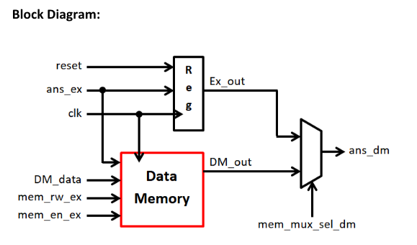
Data Memory Block
INPUTS BITS | OUTPUTS BITS
Ans_ex 16 | Ans_dm 16
DM_data 16
Mem_en_ex 1
Mem_rw_ex 1
Mem_mux_sel_dm 1
Reset 1
Clk 1

Slide 11
Data Memory Block
Data Memory is designed by IP-Core. It’s a 65536x16 RAM with R/W and enable signal.
Generates data stored at the address given by ans_ex, if mem_rw_ex is 0 (read operation), else data (DM_data) is stored at the location specified by ans_ex (data write).
Register is used to delay the ALU output to 1 clock cycle.
2X1 Mux is used to select between answer from execution block and memory block by the signal mem_mux_sel_dm.

Slide 12
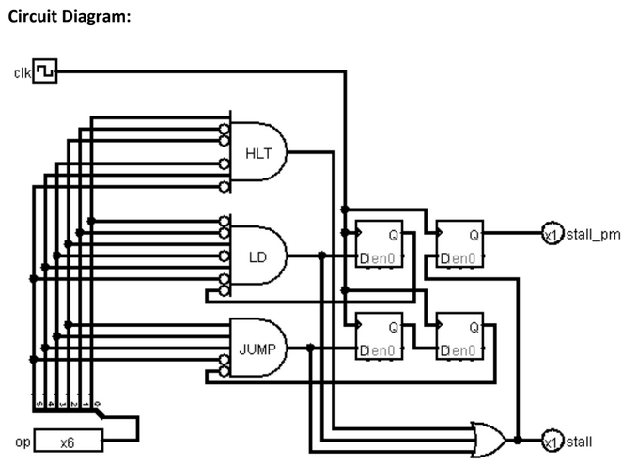
Stall Control Block
INPUTS BITS | OUTPUTS BITS
Opcode 6 | Stall 1
Clk 1 | Stall_pm 1
Reset 1

Slide 13
Stall Control Block
Stall Control Block is used to stall the pipeline for one or two clock cycles dependent on the opcode given.
This is used to overcome RAW data hazard created by Load and control hazards created by Conditional Jump.
Also, this block stall pipeline forever when ‘HLT’ instruction is executed.

Slide 14
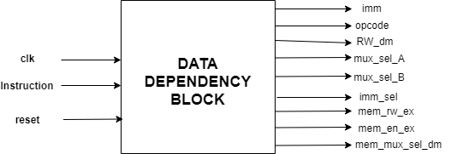
Data Dependency Block
INPUTS BITS | OUTPUTS BITS
Clk 1 | Imm 16
Instruction 32 | Opcode 6
Reset 1 | RW_dm 5
 | mux_sel_A 1
 | mux_sel_B 1
 | Imm_sel 1
 | Mem_rw_ex 1
 | Mem_en_ex 1
 | Mem_mux_sel_dm 1

Slide 15
Data Dependency Block
Data Dependency Block handles data hazard in pipeline processor. It checks data dependency between current and previous three instructions and enable the signals Mux_sel_A and Mux_sel_B accordingly.
It also generates 6-bit opcode, Memory control and Immediate control signals.

Slide 16
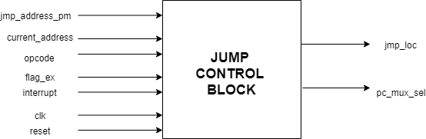
Jump Control Block
INPUTS BITS | OUTPUT BITS
Jmp_address_pm 16 | Jmp_loc 16
Current_address 16 | Pc_mux_sel 1
Opcode 6
Flag_ex 2
Interrupt 1
Clk 1
Interrupt 1

Slide 17
Jump Control Block
Jump Control Block is used to generate jump location (jmp_loc) and mux control signal (pc_mux_sel) for Program Memory Block.
Pc_mux_sel will be 1 when the instruction is of unconditional and conditional jumps, interrupt, or RET.
When interrupt is 1, we store the current address and flag_ex in the system and it jumps to another location. When RET instruction is executed, it reproduce current address and flag_ex stored in the system.

Slide 18
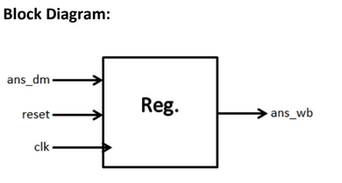
Write Back Block
INPUTS BITS | OUTPUTS BITS
Ans_dm 16 | Ans_wb 16
Reset 1
Clk 1

Slide 19
Write Back Block
Write Back Block is used to delay answer from data memory block for one clock cycle.
This block helps to resolve read after write hazard in instruction decode stage.

Slide 20
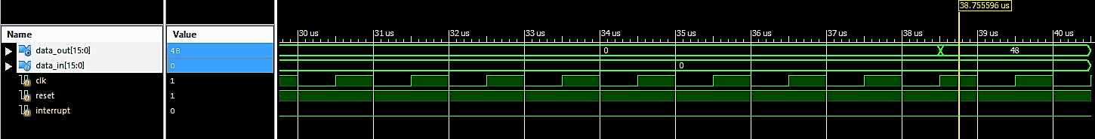
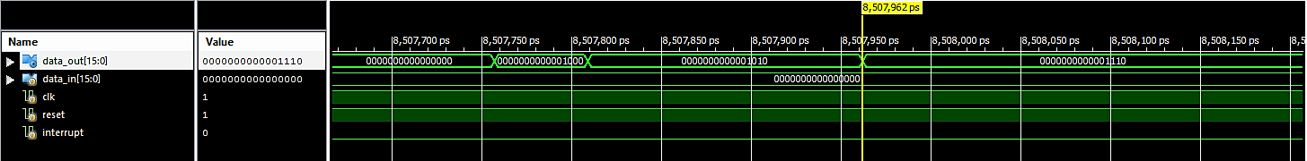
Post Route Simulation
Multiplication
Addition

Slide 21
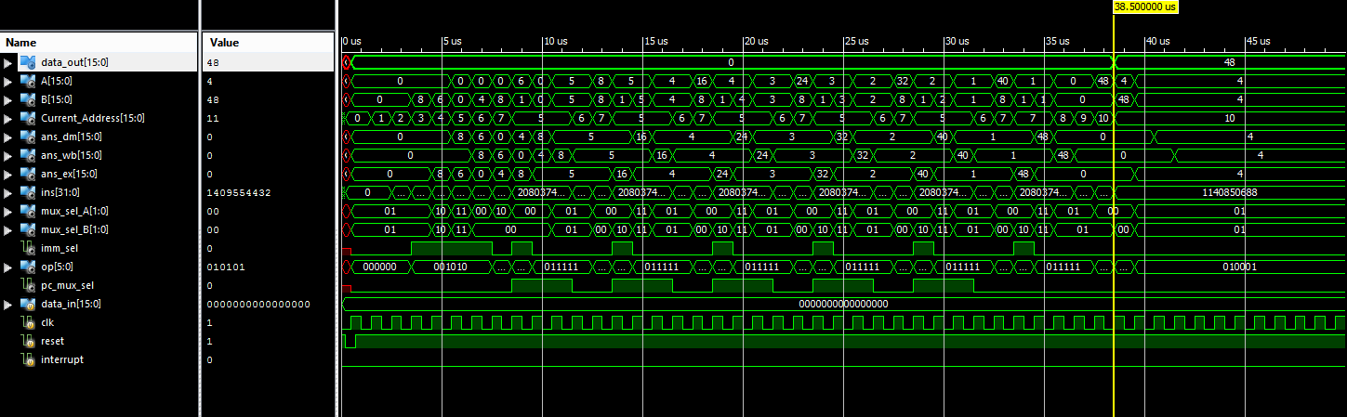
Behavioral results (multiplication)

Slide 22
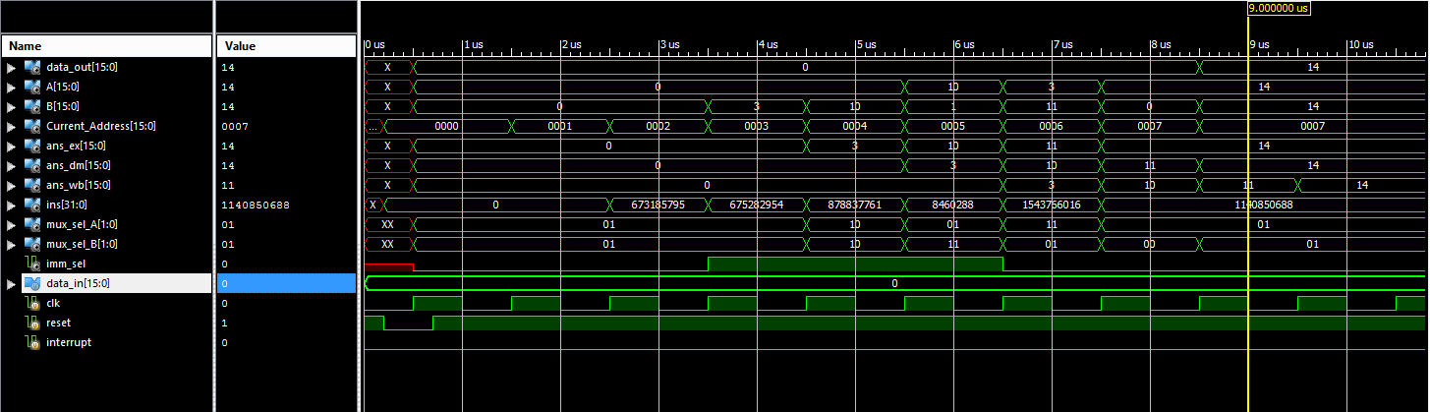
Behavioral results (addition)

Slide 23
Challenges faced
In multiplication simulation, desired output 48 by multiplying 6 and 8 was not coming due to an extra delay generated by inputting opcode in blocks instead of instruction. The problem was resolved by inputting MSB 6 bits of instruction.
Verilog doesn’t generate errors when the variables are not declared and hence, it was sometimes difficult to debug the code.
It was difficult to convert behavioral code into structural / data-flow whenever required.

Slide 24
8085 MICROPROCESSOR Our Processor(MIPS)
COMPARISONS
It is Semi-CISC architecture | It is RISC based architecture
Consists of a Single Memory for instructions and Data (Von Neuman) | Consists of Two seperate memories for Data and Instructions (Harvard)
1 accumulator,6 registers and 1 flag register are present | Other than accumulator, each and every register are used for operation.
5 interrupts RST 5.5,6.5,7.5 (maskable and vectored) , INTR (Non-vectored), TRAP(non-maskable) and 8 software interrupts (RST0-RST7) | Only one interrupt is used for going back to current address from jump location
Data bus and address bus are multiplexed | Both (Data and Address) buses are seperate

Slide 25
Comparisons (contd.)
Single cycle CPU | Pipelined processor is present. Consists of 5 stages.
Clock frequency : 3-6 MHz | Clock frequency : 1 MHz (artix 7)
It has total 246 opcodes | It has total 28 opcodes
4 machine control instruction - HLT,NOP,PUSH,POP | Only 1 machine control instruction -HLT (HALT)
Instruction is of 8 bits | Instruction is of 32 bits
Has a Stack Pointer Register | Doesn’t have a Stack Pointer Register
40 pin Dual Line structure | Number of pins used ~ 70

Slide 26
Future Work
WAYS TO IMPROVE PERFORMANCE OF THE MIPS PROCESSOR:
Applying Branch Prediction technique to reduce the delay from 2 cycles to zero cycles.
Adding faster and temporary memory, Cache before the Data Memory for the faster retrieval and storage of data.
Increasing the number of opcodes by inserting a multiplication opcode and applying Booth Algorithm.

Slide 27
Future Work
Adding small and a temporary memory called, Cache before the Data Memory to make the retrieval or storage of data faster.
SPECIFICATIONS : Block Size = 4 words, One word contains 2 Bytes.
CACHE MEMORY DATA MEMORY
128 Bytes of cache memory is used. | Size of Data Memory is: 131072 Bytes
Number of Cache Blocks: 16 | Number of Memory Blocks: 16384

Slide 28
Future Work (contd.)
Mapping Function : Direct Mapped Mapping can be used as there are fewer cache blocks.
Tag field Size: One cache block is connected to 1024 MBs. So, 10 bits.
Address Format :
16 Bits
Tag (10 bits) | CB field (4 bits) | Word (2 bits)

Slide 29
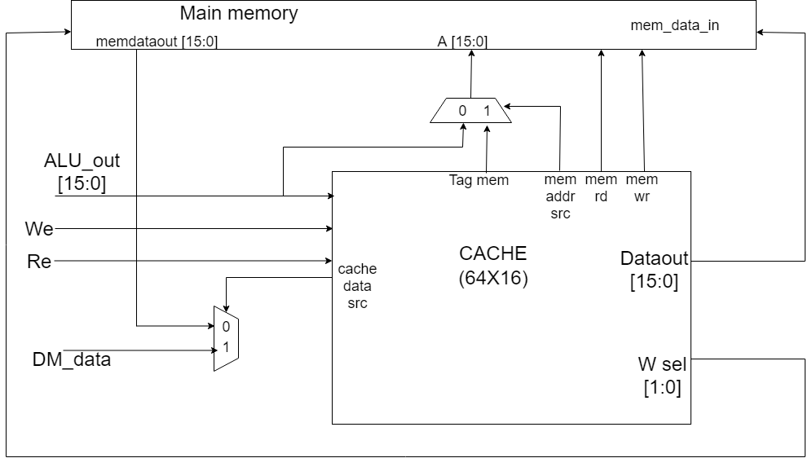

Slide 30
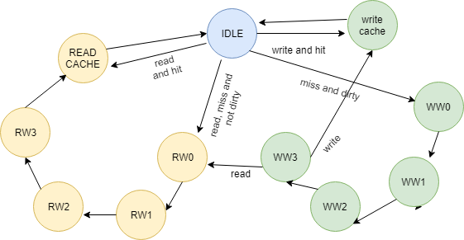
Future work (contd.)
FINITE STATE MACHINE:
HIT and READ: cache is read and no memory signal is used.
READ, MISS and NOT DIRTY: Corresponding memory block is copied into cache block and then read is performed.
WRITE andHIT: write is performed.
MISS and DIRTY: contents of cache block is written into memory block and then either of the function is performed.

Slide 31
State | Hit | read | Write | Dirty | Stall | Cache wr | Cache rd | Mem rd | Mem wr | C_data_src | M_addr_src | Rst_dly | wsel
Start(st0) | x | 0 | 0 | x | 1 | 0 | 0 | 0 | 0 | x | x | 1 | 00
Write Cache(st1) | x | 0 | 1 | 0 | 1 | 1 | 0 | 0 | 0 | 0 | x | 1 | 00
Read | 1 | 1 | 0 | x | 1 | 0 | 1 | 0 | 0 | x | x | 1 | 00
WW0 | 0 | 1 or 1 |  | 1 | 0 | 0 | 1 | 0 | 1 | x | 1 | 0 | 00
WW1 | 0 | 1 or 1 |  | 1 | 0 | 0 | 1 | 0 | 1 | x | 1 | 0 | 01
WW2 | 0 | 1 or 1 |  | 1 | 0 | 0 | 1 | 0 | 1 | x | 1 | 0 | 10
WW3 | 0 | 1 or 1 |  | 1 | 0 | 0 | 1 | 0 | 1 | x | 1 | 0 | 11
RW0 | 0 | 1 | 0 | 0 | 0 | 1 | 0 | 1 | 0 | 1 | 0 | 0 | 10
RW1 | 0 | 1 | 0 | 0 | 0 | 1 | 0 | 1 | 0 | 1 | 0 | 0 | 01
RW2 | 0 | 1 | 0 | 0 | 0 | 1 | 0 | 1 | 0 | 1 | 0 | 0 | 10
RW3 | 0 | 1 | 0 | 0 | 0 | 1 | 0 | 1 | 0 | 1 | 0 | 0 | 11

Slide 32
Branch Prediction Technique
BASIC IDEA: To use the past branch behavior to predict the future.
We use hardware to dynamically predict the outcome of a branch : the prediction will depend on the behavior of the branch at run time and will change if the branch changes its behavior during execution.
Branch Prediction Block is inserted in the Instruction Fetch Stage. It is based on two interacting schemes:
BRANCH OUTCOME PREDICTOR: to predict the direction of the branch (taken/not taken).
BRANCH TARGET PREDICTOR: to predict the branch target address in case of taken branch.

Slide 33
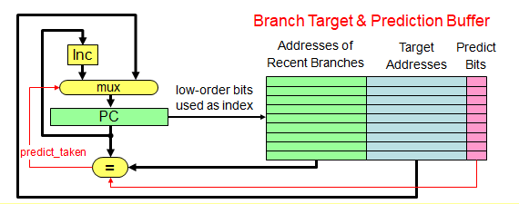
Branch Target and Prediction Buffer
The following block is in IF stage. PC goes in the buffer and uses lower order bits as index and corresponding Predict bits are taken.
PREDICTION: we assume it to be correct and fetching begins in the predicted direction.
(If hint turns out to be wrong, prediction bit is updated, pipeline is flushed and correct sequence is executed.)

Slide 34
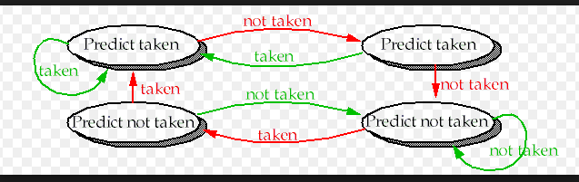
2-Bit Branch Prediction
The prediction must miss twice before it is changed.
For each index in the table, the 2 bits are used to encode the four states of a finite state machine.

Slide 35
Multiplication Operation
REASONS TO ADD MULTIPLICATION OPCODE IN THE OPERATIONS:
Multiplication can be directly computed without recursive additions.
Reduces the time required and improves performance.
WHAT TO BE USED TO COMPUTE MULTIPLICATION:
Booth Algorithm
WHERE TO BE INSERTED?
The Booth’s Architecture will be placed inside ALU to compute multiplication when the respective opcode comes.

Slide 36
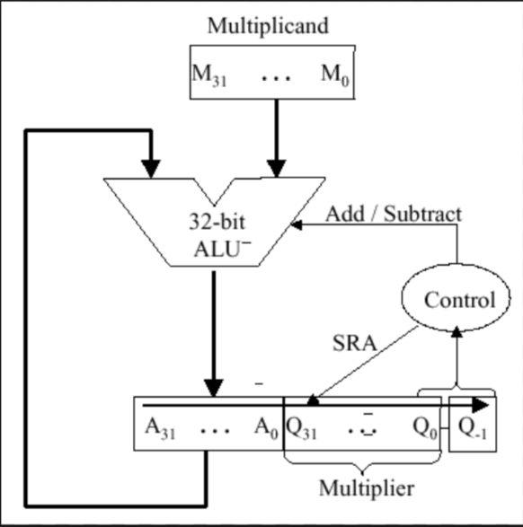
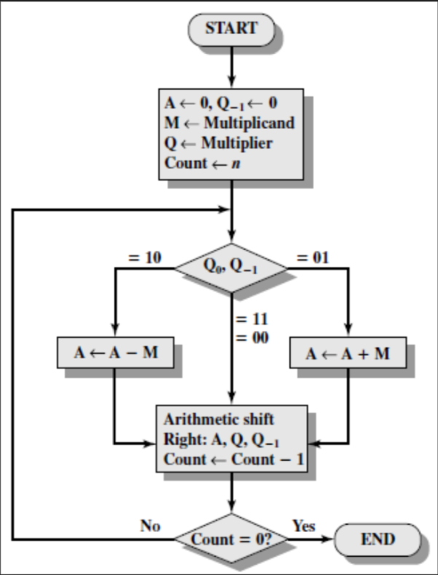
Booth Architecture

Slide 37
References
Lab material - Block diagrams and explanation provided in the lab material.
User Manual DYNA-8085 for 8085 Microprocessor.
Pipelined MIPS Processor with Cache Controller, by Hadeel Sh. Mahmood and Safaa S. Omran,https://www.researchgate.net/publication/283778569_Pipelined_MIPS_processor_with_cache_controller_using_VHDL_implementation_for_educational_purposes, December 2014.
Thank You !!!

