Slide 1
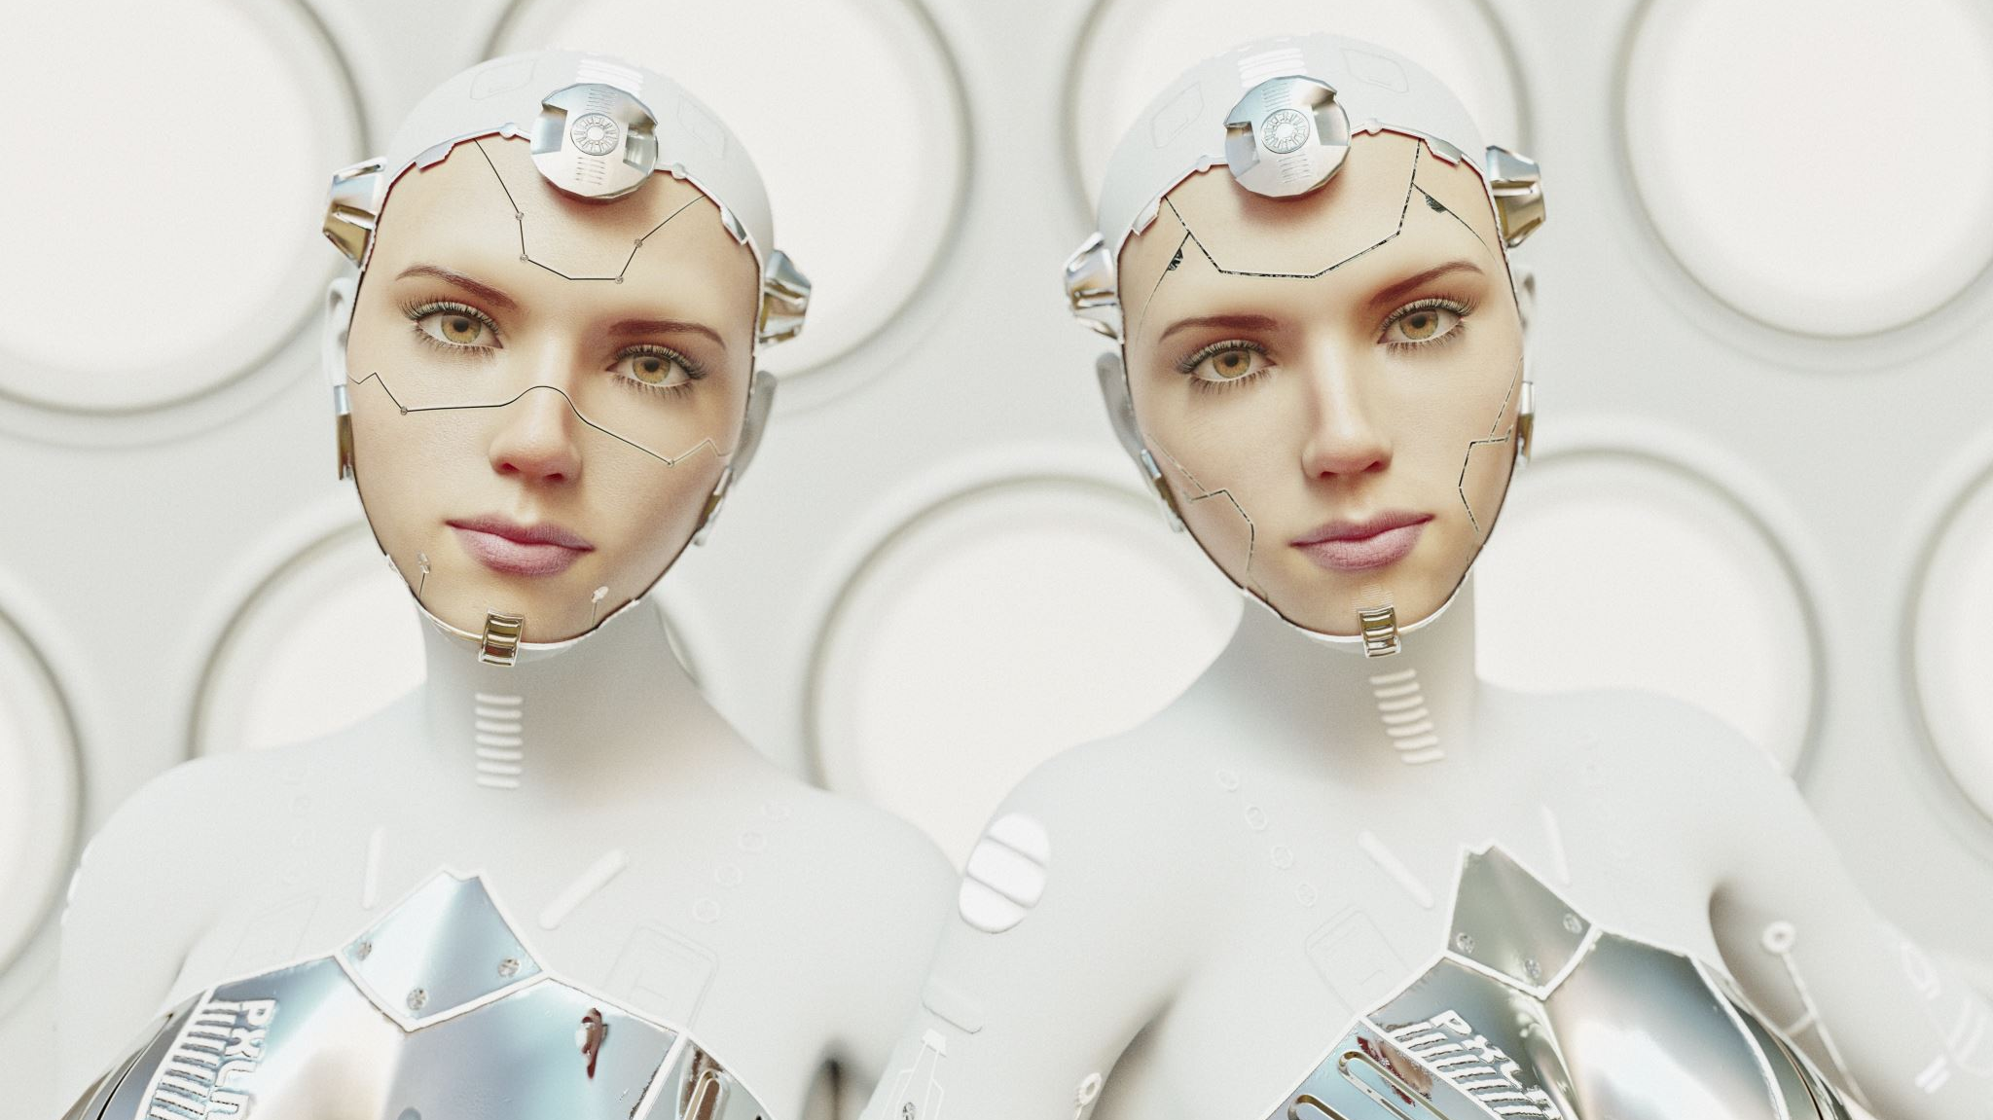
INTRO
SKIN AI
AI Powered dermitologist and bridging gap in remote health care

Slide 2




Objectives
Offer preliminary health insights and precautions.
Encourage users to seek professional medical advice when needed.
Provide AI-driven skin analysis. condition
Increase accessibility to dermatological insights in remote areas.

Slide 3
Tech Stack
Frontend
AI/ML
Tools
Backend
Tech Stack

Slide 4
Stack Home
Frontend
Backend
AI/ML
Deployment

Slide 5
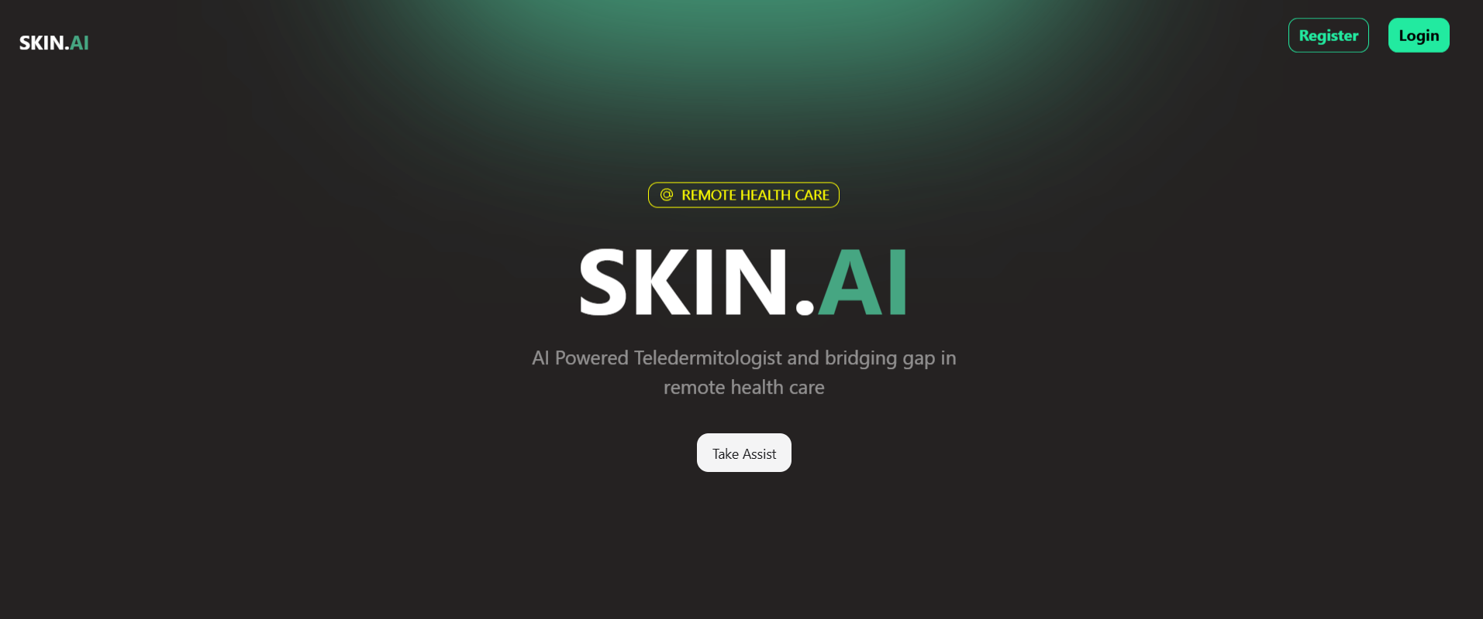
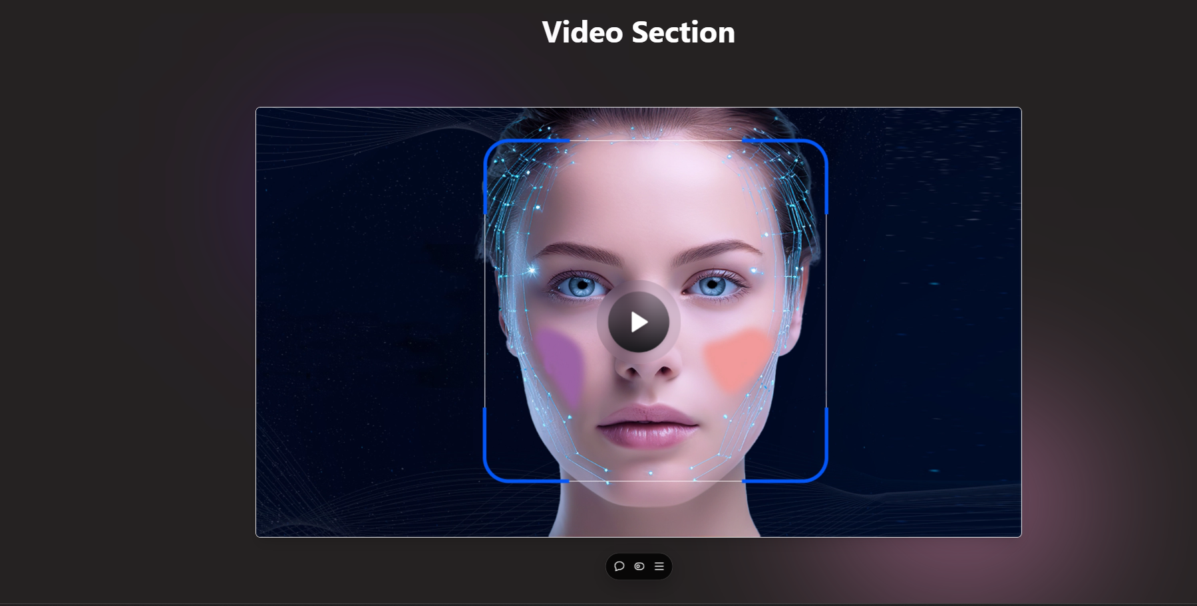
Stack Frontend
Frontend
Tech Used
React
TypeScript
Tailwind CSS
Axios
Working
User-friendly interface for uploading skin images.
Real-time feedback and recommendations powered by AI.
Responsive design for seamless use across devices.
Backend
Tools
AI/ML

Slide 6
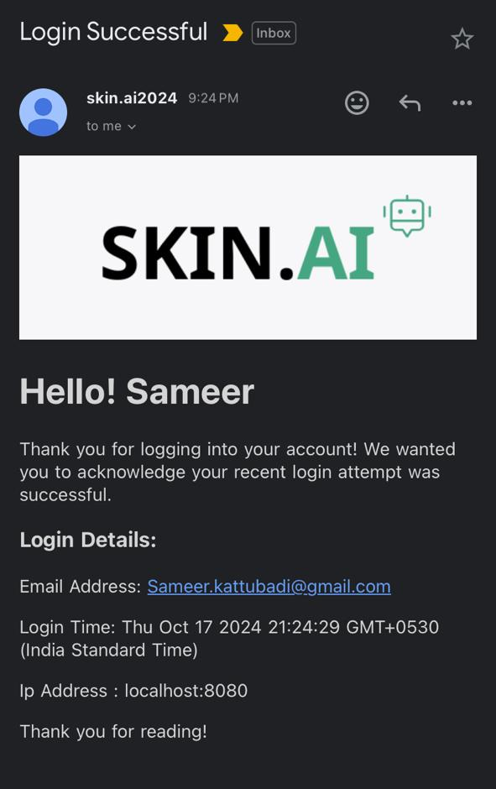
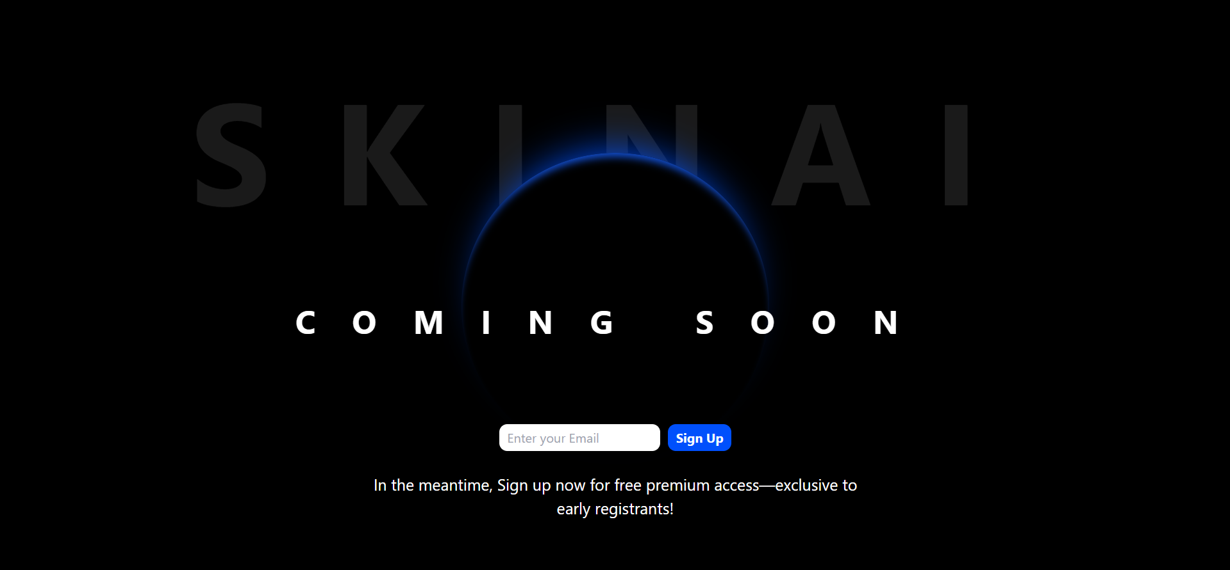
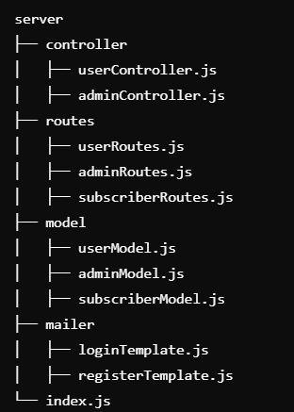
Stack Backend
Frontend
Backend
Tech Used
Node.JS
JavaScript
Express.JS
Nodemailer
Working
Secure API endpoints to handle image uploads.
Backend logic to preprocess and send data to the AI model.
Real-time feedback and recommendations powered by AI.
Email notifications for detailed insights via Nodemailer.
Tools
AI/ML

Slide 7
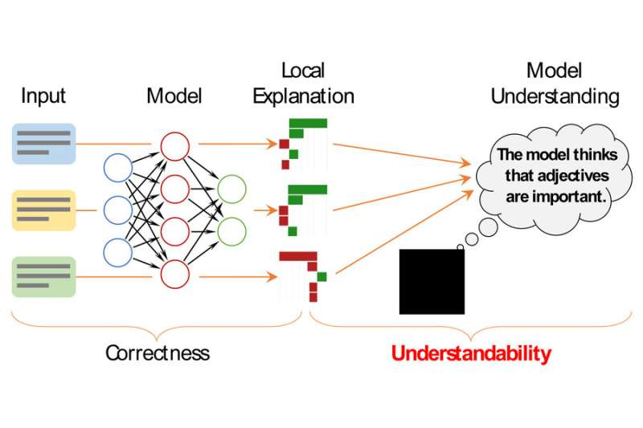
Stack AI-ML
Frontend
Backend
Tools
Tech Used
TensorFlow, OpenCV
Pre-trained Convolutional Neural Network (CNN) for classification.
Working
Uploaded skin images are preprocessed (resized, normalized).
The CNN model categorizes the image into predefined category.
Predicted condition and severity score are sent to the frontend.
AI/ML

Slide 8
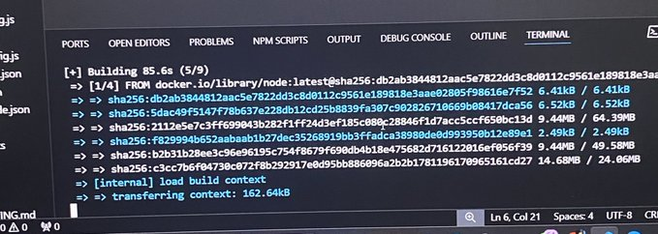
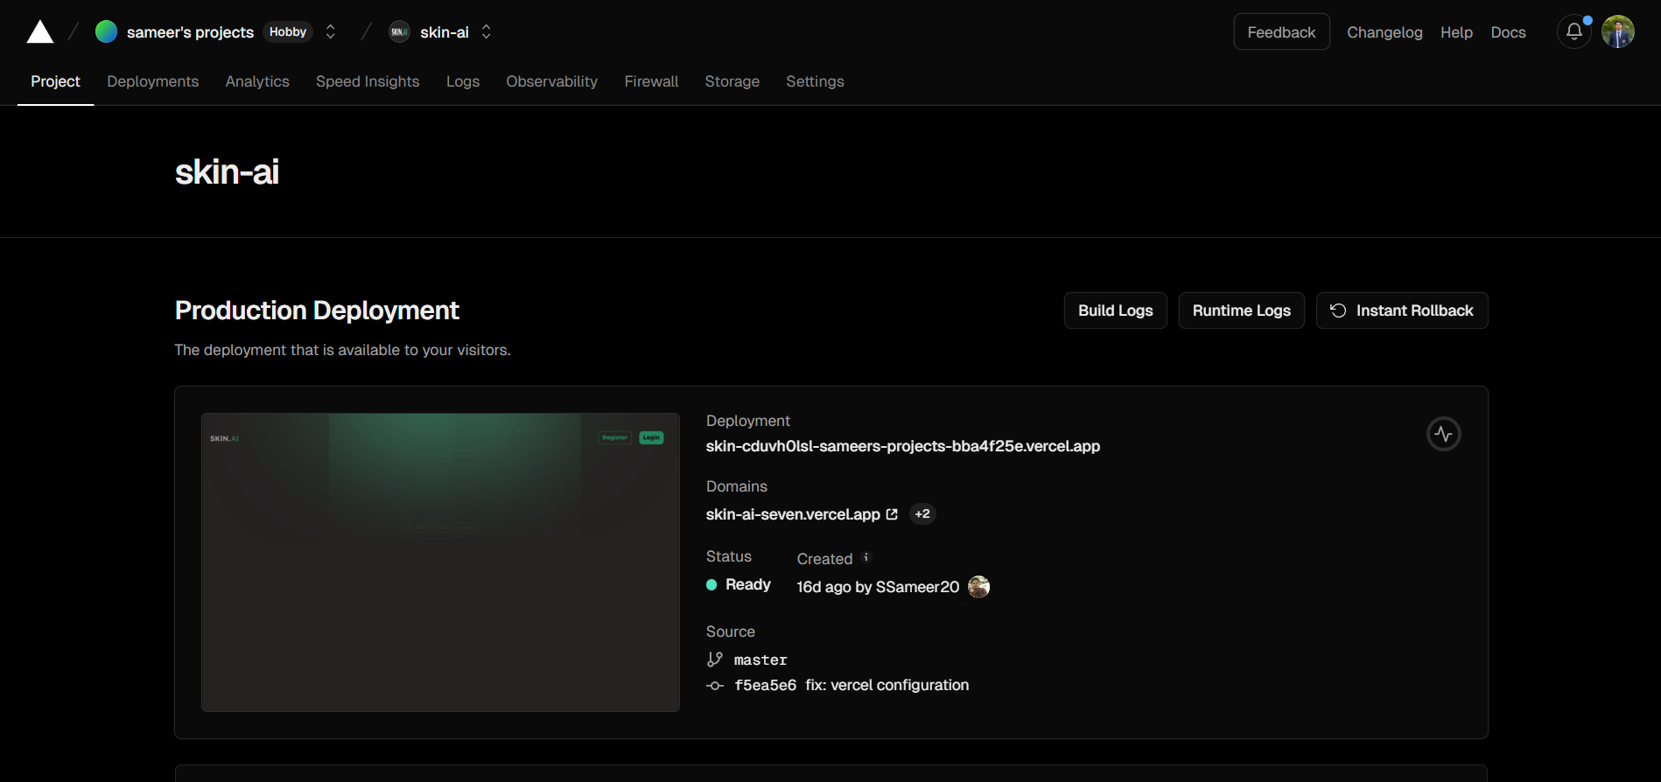
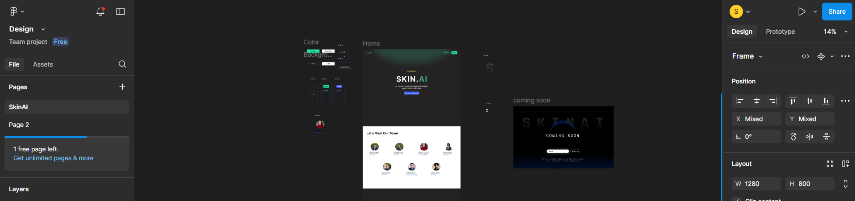
Stack Tools
Frontend
Tech Used
Docker
Vercel
Figma
Working
Uploaded skin images are preprocessed (resized, normalized).
The CNN model categorizes the image into predefined category.
Predicted condition and severity score are sent to the frontend.
Backend
Deployment
AI/ML
Containerization using Docker
Project Deployment using Vercel
Using Figma to design UI

Slide 9
Outcomes
Successful classification of skin conditions with accuracy.
01
Increased awareness of skin health in underserved areas.
02
Positive user feedback for its accessibility and ease of use.
03
Encouraged community contributions to enhance the model and features.
04

Slide 10

Thank You

