Slide 1
ATTENDIFY
Web Based Online Attendance Management System
Presented By
Nishika Sahu (230950120083)
Anjali Nikhate (230950120025)
Snehal Khandwe (230950120144)
Puja Pant (23095010096)
Muskan Dewangan (230950120080)

Slide 2
OLD ATTENDANCE MARKING SYSTEM
Paper-based attendance
Inaccurate
Ineffective
Time-consuming

Slide 3
INTRODUCTION
Attendify aims to provide organizations with a robust and efficient solution for tracking and managing employee attendance. This application is designed to streamline the attendance monitoring process, enhance accuracy, and facilitate real-time data entry.

Slide 4
MAIN FUNCTIONALITY
User Authentication
Attendance Tracking
Reporting And Analytics
Reliable Data Storage
Notifications And Alerts
User-friendly Interface

Slide 5
Technology Requirement
Frontend :- React Js , Bootstrap
Backend :- Node Js
DataBase :- MySQL

Slide 6
How it Works
User Logs In
System checks for existing user if new user then sign up else logins
Enters into dashboard.
Marks attendance and logout.
Admin can manually mark Employee attendance, create a new user and view employee details.

Slide 7
Benefits
Time Efficiency
Accuracy Improvement
Customization Options
Data Security
Cost-effectiveness

Slide 8
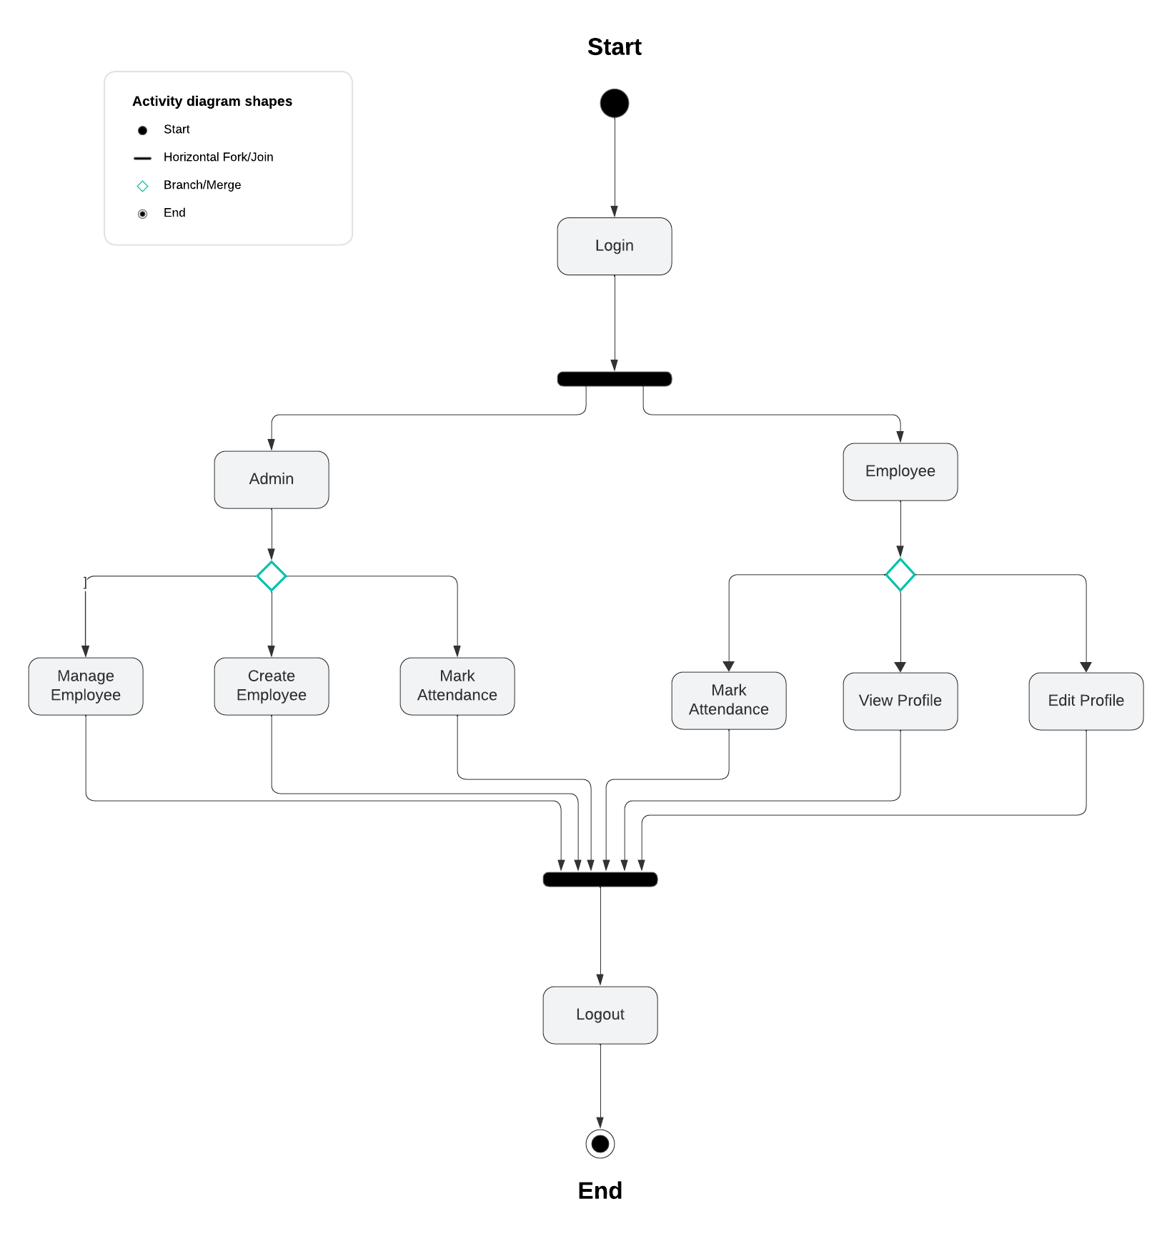
Activity Diagram

Slide 9
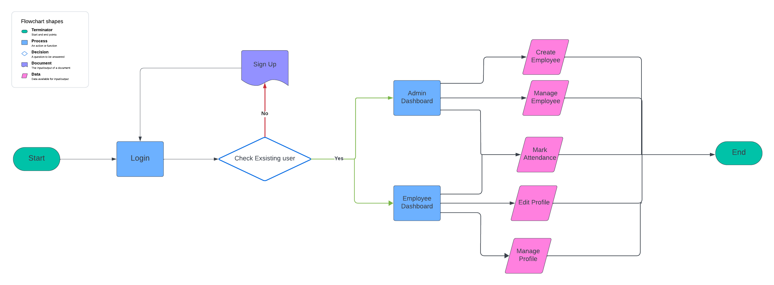
FLOWCHART

Slide 10
CONCLUSION
The implementation of an attendance management system presents a significant advancement in organizational efficiency and accountability. Through the utilization of modern technology, such a system streamlines attendance tracking, reduces administrative burdens, and fosters a culture of punctuality and responsibility among employees.
By automating attendance recording and analysis, the system minimizes errors and ensures accuracy in payroll processing.

