Slide 1
Linux Storage Monitoring System
Scripts to monitor disk utilization, inode usage and storage growth, with administrator alerts
Microproject | Unit III, IV | CO3, CO4

Slide 2
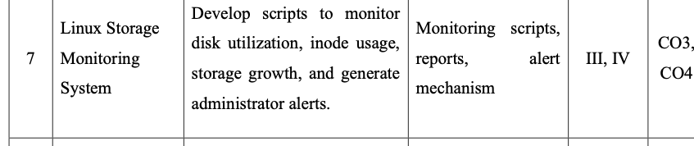
Aim and objectives
Project number 7 in the microproject list
Monitor disk utilization on every volume
Track inode usage to catch exhausted file tables
Record storage growth between runs
Alert the administrator when a threshold is crossed
Generate reports automatically with cron
Project description from the syllabus table

Slide 3
How the system works
Cron runs the monitors; every alert goes to four places
Cron schedule
Monitor scripts
disk, inode, growth
Compare with
thresholds
Alert
mechanism
>
>
>
Alerts go to: log file (alerts.log), system log (logger), desktop popup (osascript), and the terminal.
report.sh then collects usage, alerts and growth history into a dated report file.

Slide 4
Tools and project structure
df: disk and inode usage
du and find: largest folders and files
awk and sed: parse output and edit settings
cron: scheduled runs
logger and osascript: system log and popup
bash scripts, plus a Python dashboard
storage-monitor/
scripts/
config.sh thresholds
alert.sh alert function
disk_monitor.sh
inode_monitor.sh
growth_monitor.sh
report.sh
logs/
alerts.log
usage_history.csv
reports/
storage_dashboard.py

Slide 5
Core script: disk_monitor.sh
Checks every volume against DISK_THRESHOLD
#!/bin/bash
DIR="$(dirname "$0")"
source "$DIR/config.sh"; source "$DIR/alert.sh"
df -P | awk 'NR>1 && $1 ~ /^\/dev\// {print $5, $6}' | \
while read use mount; do
pct=${use%\%}
if [ "$pct" -ge "$DISK_THRESHOLD" ]; then
send_alert "Disk usage on $mount is ${pct}% (threshold ${DISK_THRESHOLD}%)"
fi
done
echo "Disk check completed."
# alert.sh
send_alert() {
local msg="$1"
echo "$(date '+%F %T') [ALERT] $msg" >> "$ALERT_LOG"
logger -t storage-monitor "$msg"
osascript -e "display notification \"$msg\" with title \"Storage Alert\" sound name \"Glass\""
echo "ALERT: $msg"
}

Slide 6
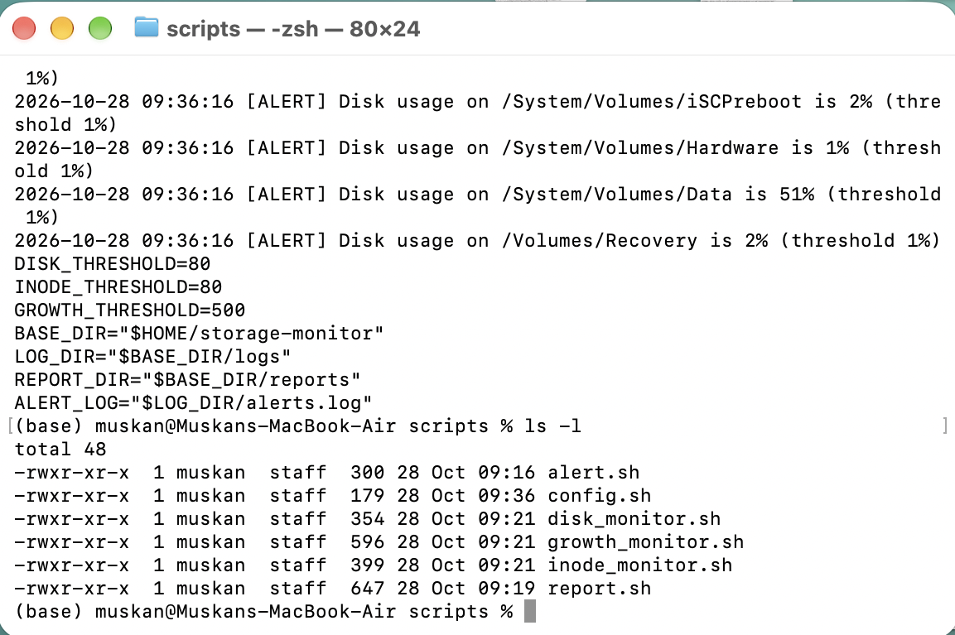
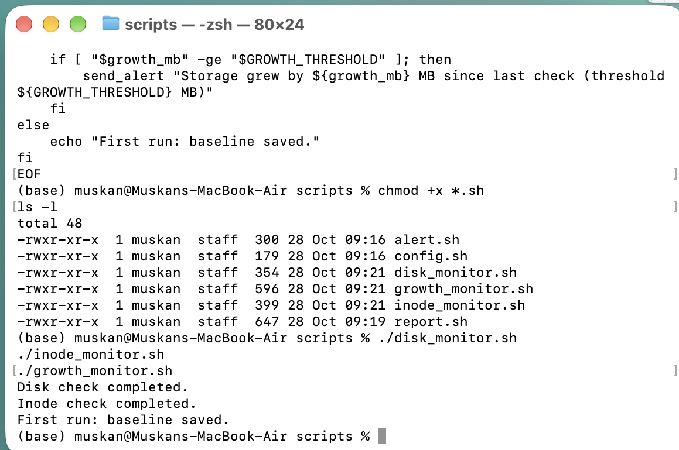
Output: scripts created and first run
All six scripts are executable; first run saves a baseline
ls -l shows six scripts with rwxr-xr-x
Monitors run and report completion

Slide 7
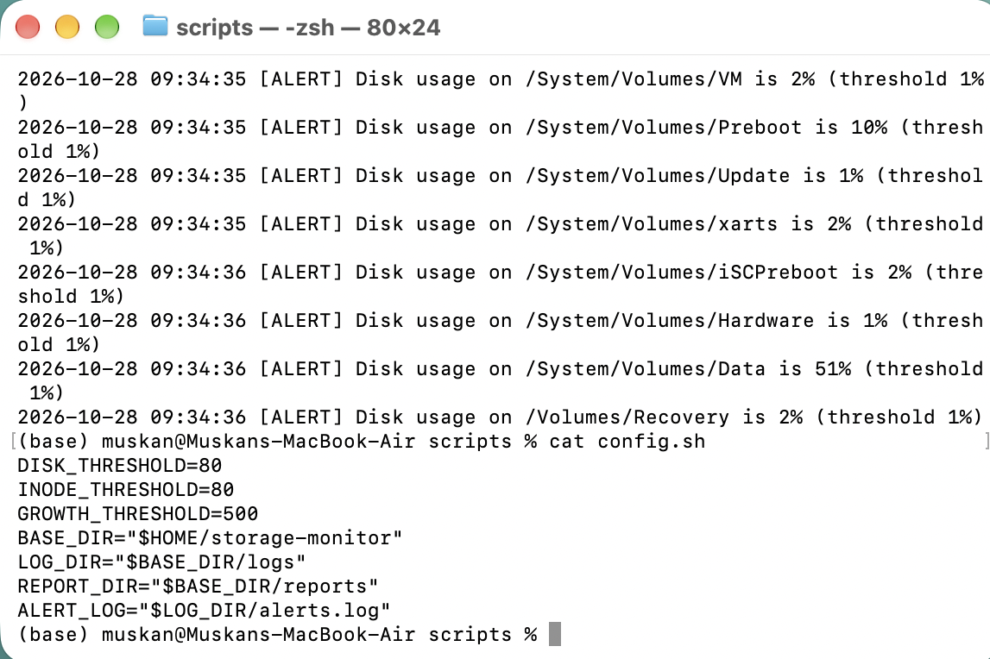
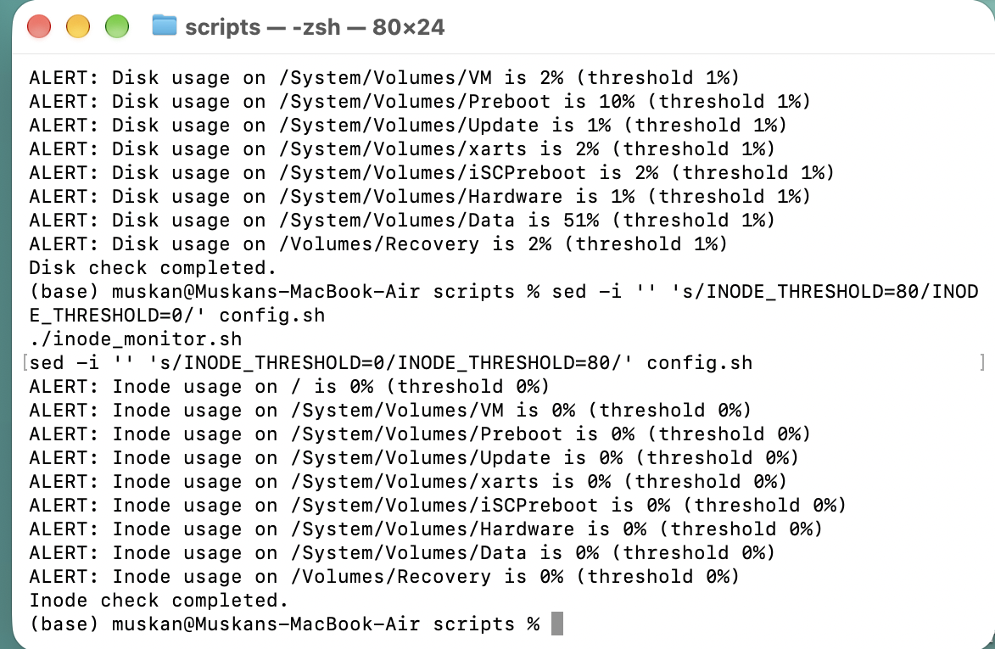
Output: disk alerts
Threshold lowered to 1% to trigger the demo, then restored to 80%
Disk alerts logged and config.sh restored
Inode alerts in the terminal

Slide 8
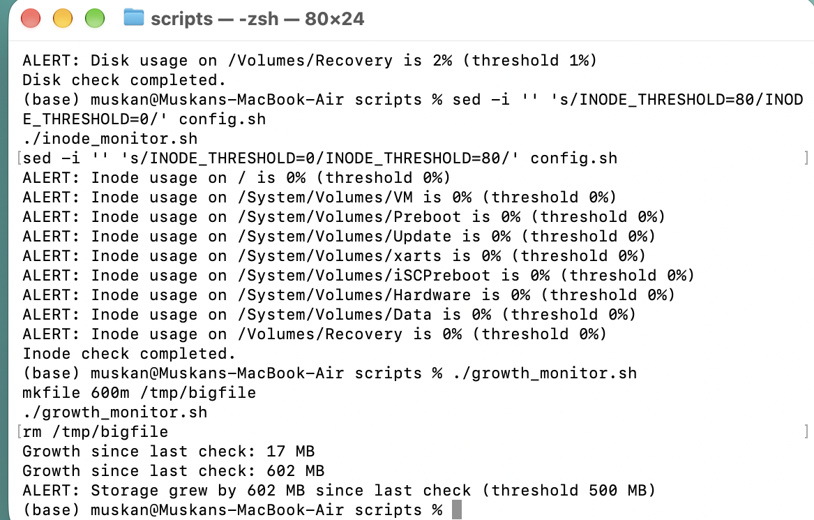
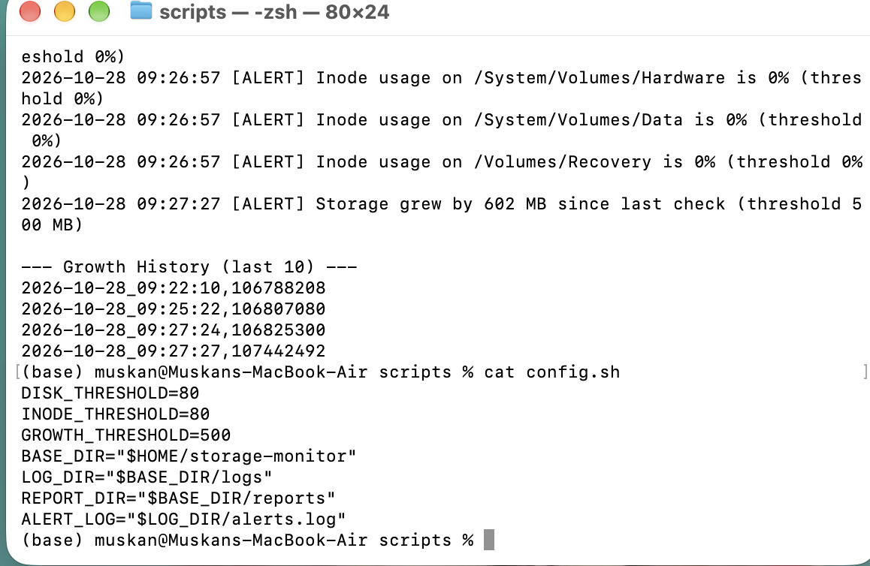
Output: inode and growth alerts
A 600 MB test file triggers the growth alert
Growth since last check: 17 MB, then 602 MB, alert fires
Growth history and restored thresholds

Slide 9
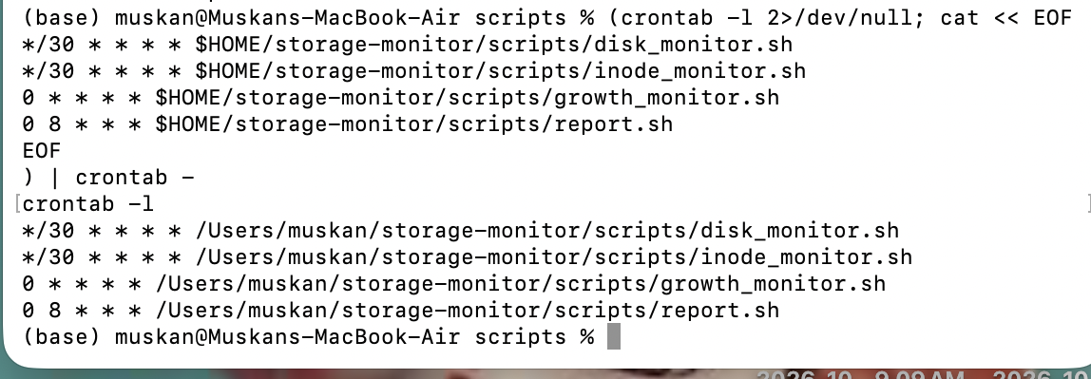
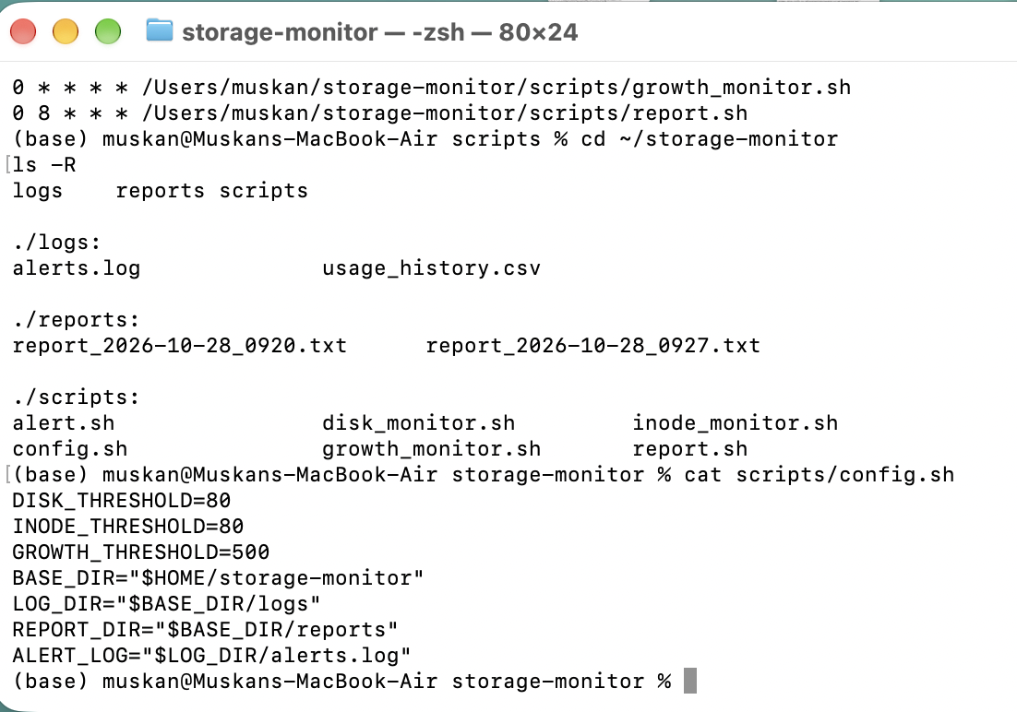
Output: automation with cron
Disk and inode every 30 minutes, growth hourly, report daily at 8:00
crontab -l lists all four jobs
Disk check: every 30 minutes
Inode check: every 30 minutes
Growth check: every hour
Report: daily at 8:00
ls -R shows scripts, logs and reports

Slide 10
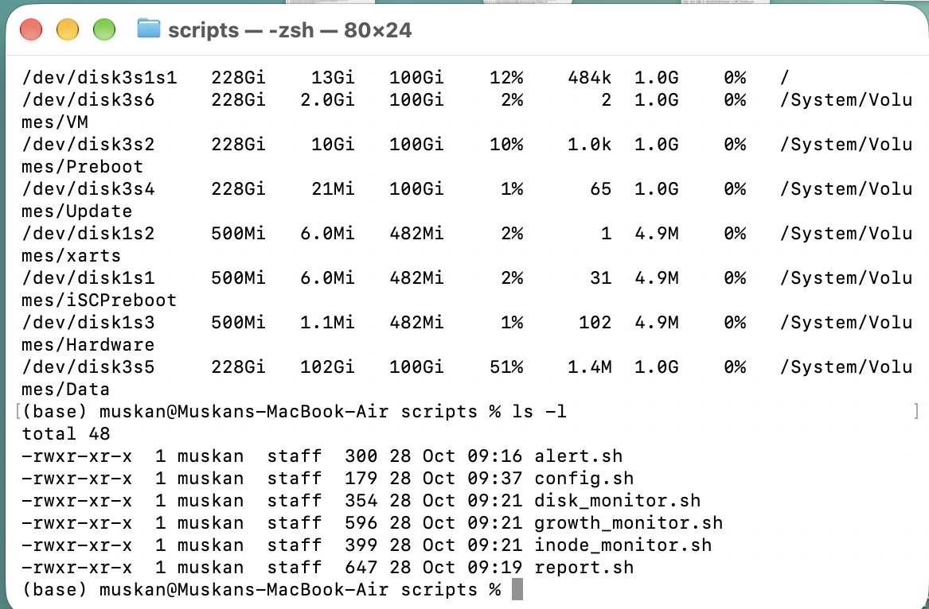
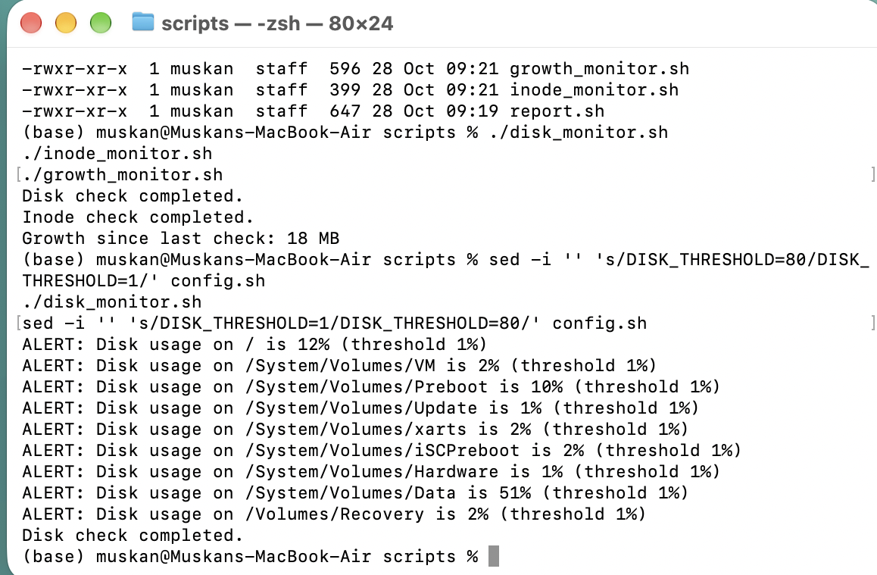
Output: generated report
Disk utilization, inode usage, largest folders, alerts and growth history
Growth check and alert run
Disk utilization section of the report

Slide 11
Dashboard GUI
A browser front end that calls the same scripts
Python http.server backend reads the real logs, reports and config
Volume bars with a threshold mark; red when over the limit
Buttons run disk, inode, growth and report scripts
Edit thresholds and save them back to config.sh
Growth chart and alert log refresh every 10 seconds
Run: python3 storage_dashboard.py, then open localhost:8765

Slide 12
Conclusion
Automated monitoring catches full disks, inode exhaustion and sudden growth before an outage
Alerts reach the administrator through log, system log, popup and terminal
Cron and dated reports make the system hands-free and auditable
macOS note: APFS allocates inodes dynamically, so usage stays near 0%; on Linux ext4 inodes can run out even when space is free
Tested on macOS; the same scripts work on Ubuntu with small command changes

