Slide 1
Competitive Ad Analysis – EdTech Sector
Digital Marketing Internship Assignment
Name- MUSKAN KUMARI
Date- 6 FEB 2026

Slide 2
Selected Competitors (Ad Library Analysis)
UpGrad
Great Learning
Simplilearn
Coursera
Jaro Education

Slide 3
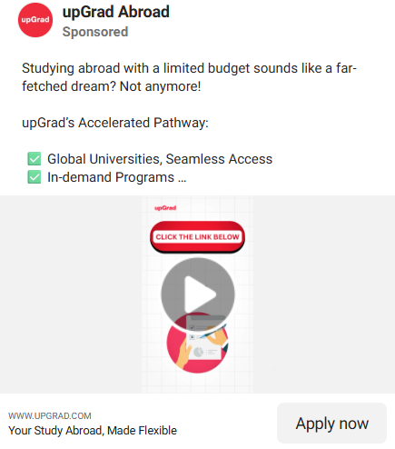


UpGrad
Key Themes
Affordable study-abroad programs
Global university partnerships
Short-term tech and AI courses with heavy discounts
Strengths
Strong price-driven messaging that grabs attention
Clear career and global outcome positioning
Gaps
Over-reliance on discount and price-based hooks
Limited emotional storytelling or success journeys

Slide 4



Great Learning
Key Themes
Programs with top universities and industry partners
Career-focused messaging (salary hike, placements)
Future-ready skills in AI, data science, and analytics
Strengths
Strong credibility through IIT and global university partnerships
Clear career outcome and salary growth messaging
Gaps
Repetitive, similar messaging across ads
Limited emotional storytelling or student success journeys

Slide 5
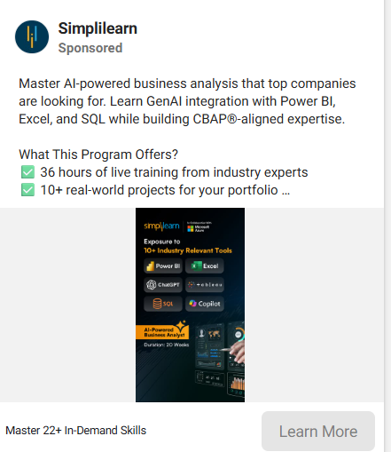
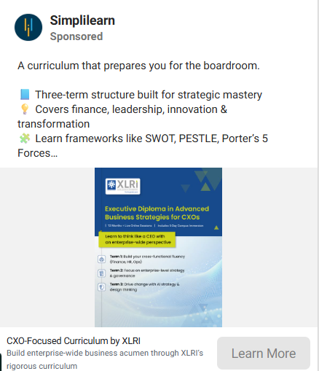

Simplilearn
Key Themes
Professional certifications in AI, PMP, and cybersecurity
Career transformation and future-proof skill messaging
Partnerships with industry leaders and top institutes
Strengths
Strong focus on industry-recognized certifications
Clear, career-oriented messaging
Gaps
Text-heavy creatives with limited visual storytelling
Repetitive messaging across different programs

Slide 6
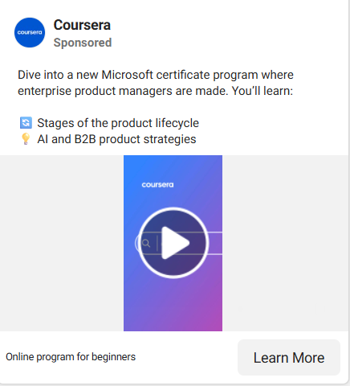
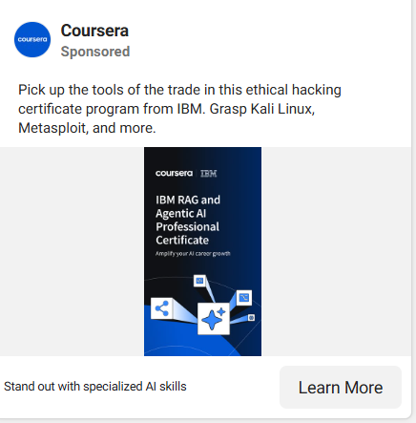
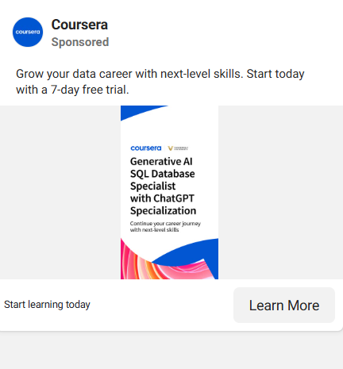
Coursera
Key Themes
Certifications from global tech companies (Google, Microsoft, IBM)
Self-paced, beginner-friendly learning
Skill-based professional certificates
Strengths
Strong credibility through partnerships with major tech brands
Simple, accessible messaging for beginners
Gaps
Limited urgency or strong promotional triggers
Less emphasis on salary or career outcome messaging

Slide 7


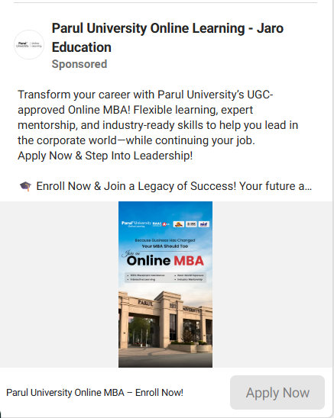
Jaro Education
Key Themes
Online and executive MBA programs from partner universities
Career advancement for working professionals
Strong focus on accreditation and university rankings
Strengths
Clear positioning around accredited university degrees
Strong appeal to working professionals seeking promotions
Gaps
Weak standalone brand identity for Jaro
Text-heavy, informational creatives with limited storytelling

Slide 8
Industry-Level Insights & Strategic Opportunities
Key Industry Patterns
Career growth and salary-focused messaging
Strong use of university and tech partnerships
Heavy focus on AI, data, and management programs
Common Gaps
Repetitive messaging across brands
Limited emotional storytelling
Opportunity for Our Brand
Use real learner success stories
Build stronger aspirational messaging
Create more distinctive positioning

