Slide 1
tableau_project_codebasics
File created on: 16-10-2023 22:00:08

Slide 2
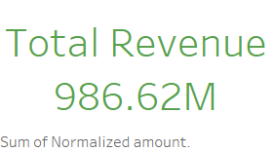

Slide 3
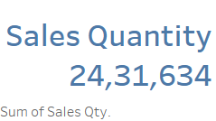

Slide 4
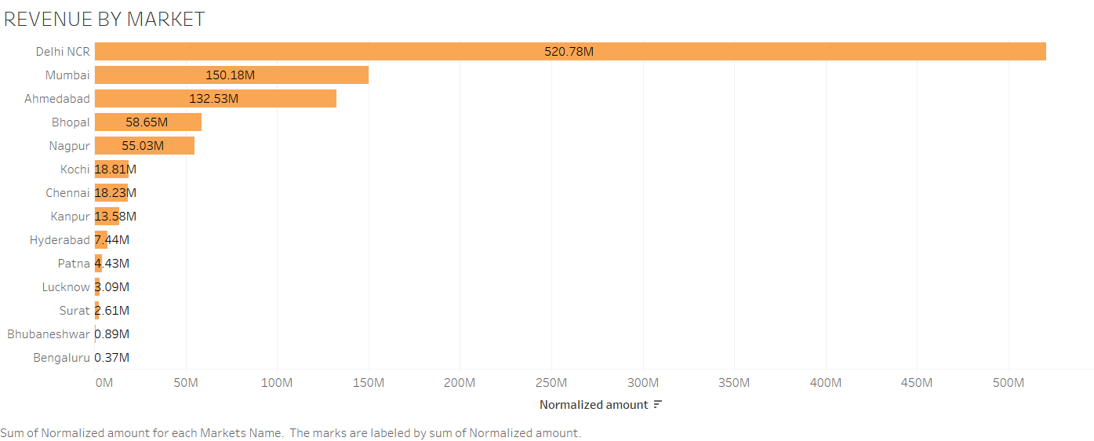

Slide 5
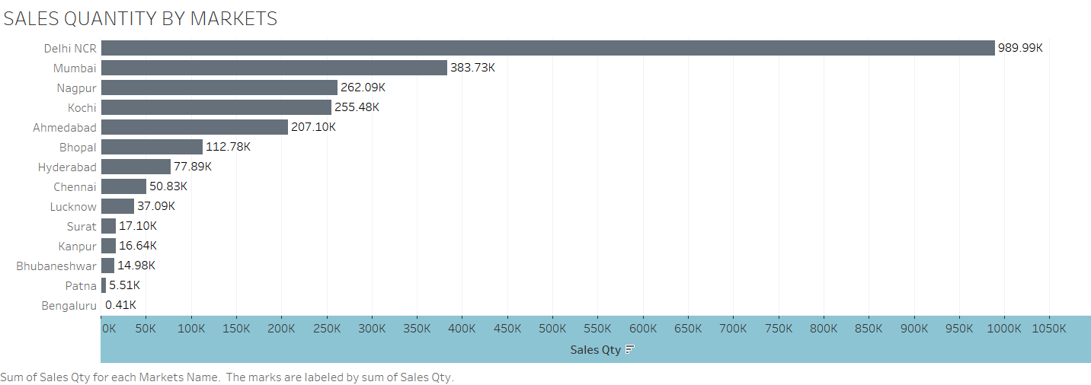

Slide 6


Slide 7


Slide 8
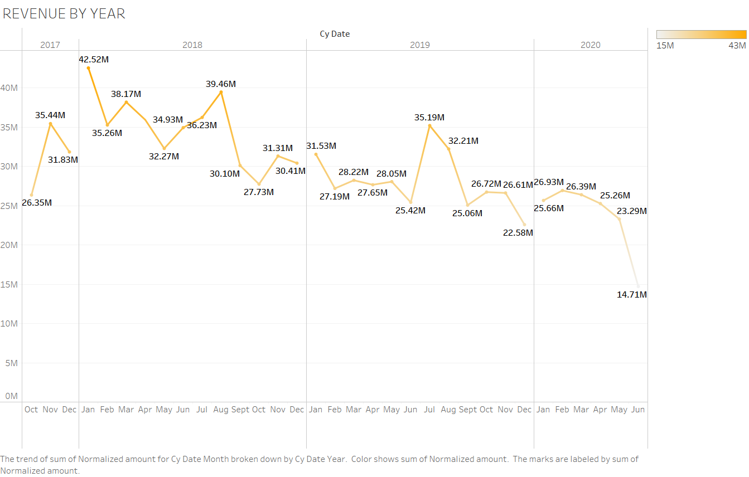

Slide 9


