Slide 1
Superstore Sales
Dashboard Analysis
Team project
Ahmed Mahmoud
Eid Magdy
Fares Walaa
Yomna Mahmoud

Slide 2
What's Inside
01
Sales Overview
02
Customer Analysis
KPIs, Sales by Year, State Map
Customer Distribution, Top 10, Avg Order Value
03
Products Analysis
04
Regional Performance
Top & Bottom Products, Sales by Category
Sales by Region and Ship Mode Distribution

Slide 3
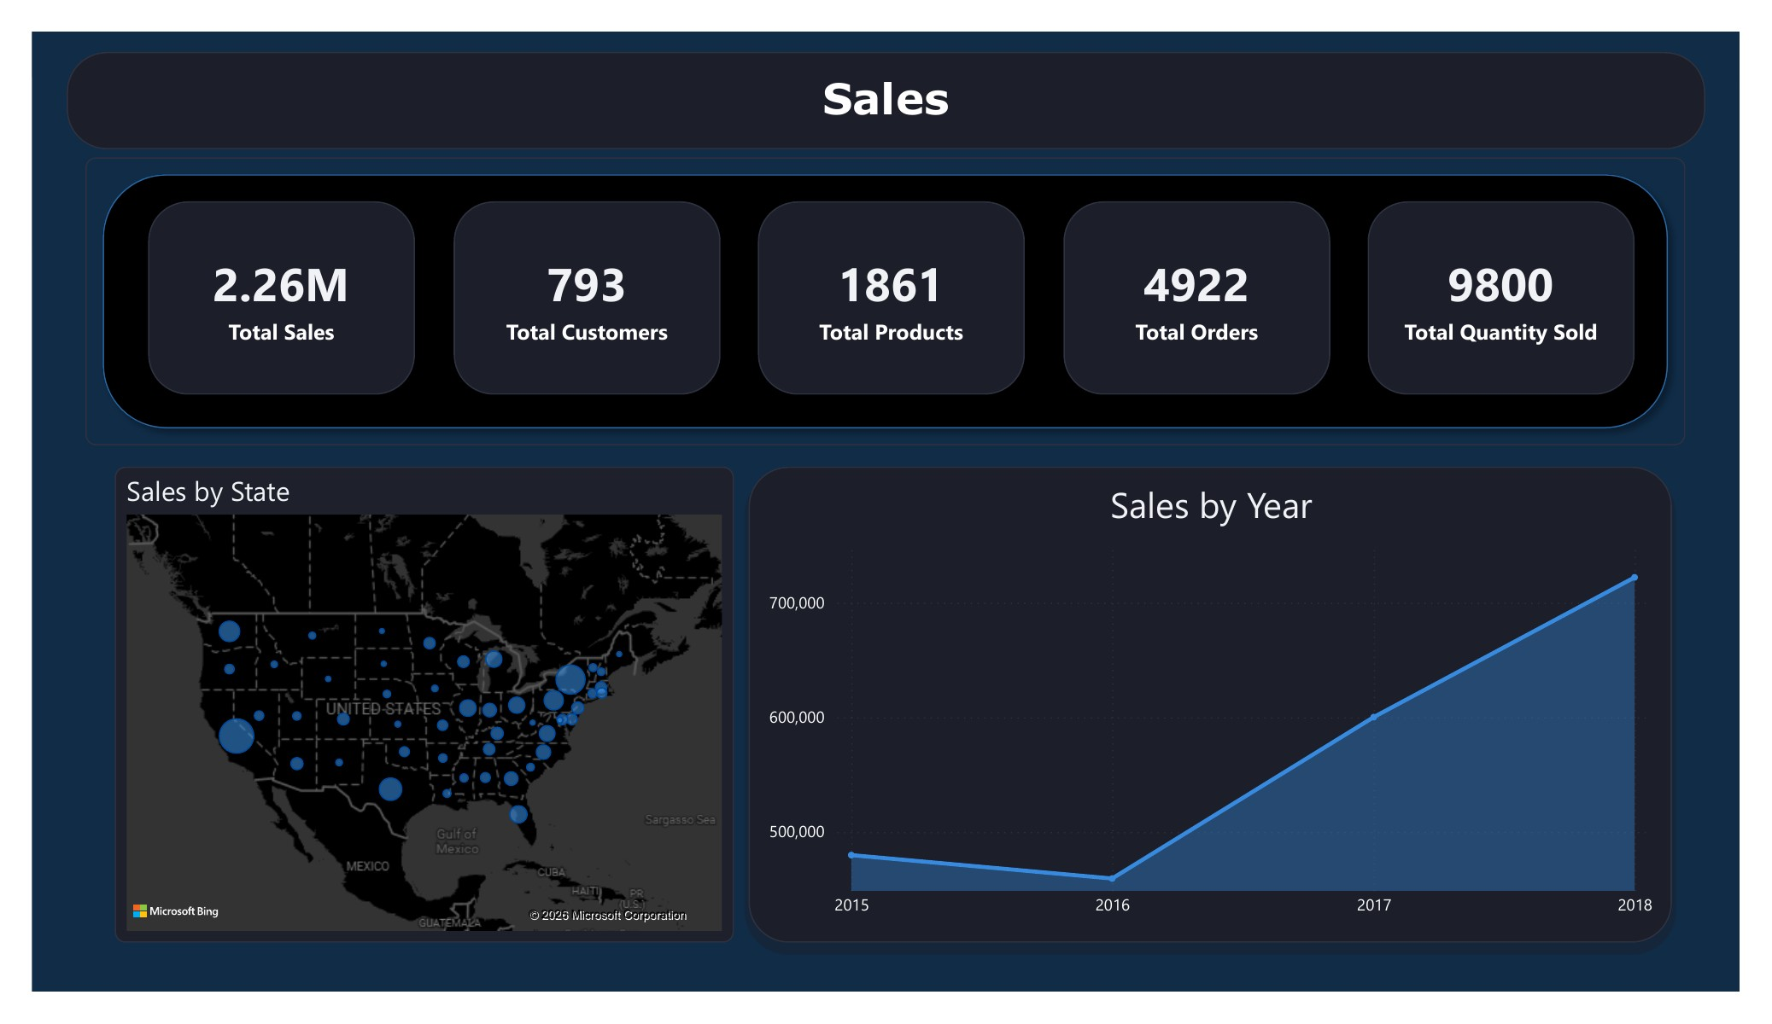
Sales Overview
Total Sales, Annual Trend, and Geographic Distribution
Key Insights
1
Total revenue of $2.26M across 4 years
2
Consistent growth from 2016 to 2018 after a slight dip
3
California and New York are the top-selling states
4
Technology is the most profitable despite mid-level sales

Slide 4
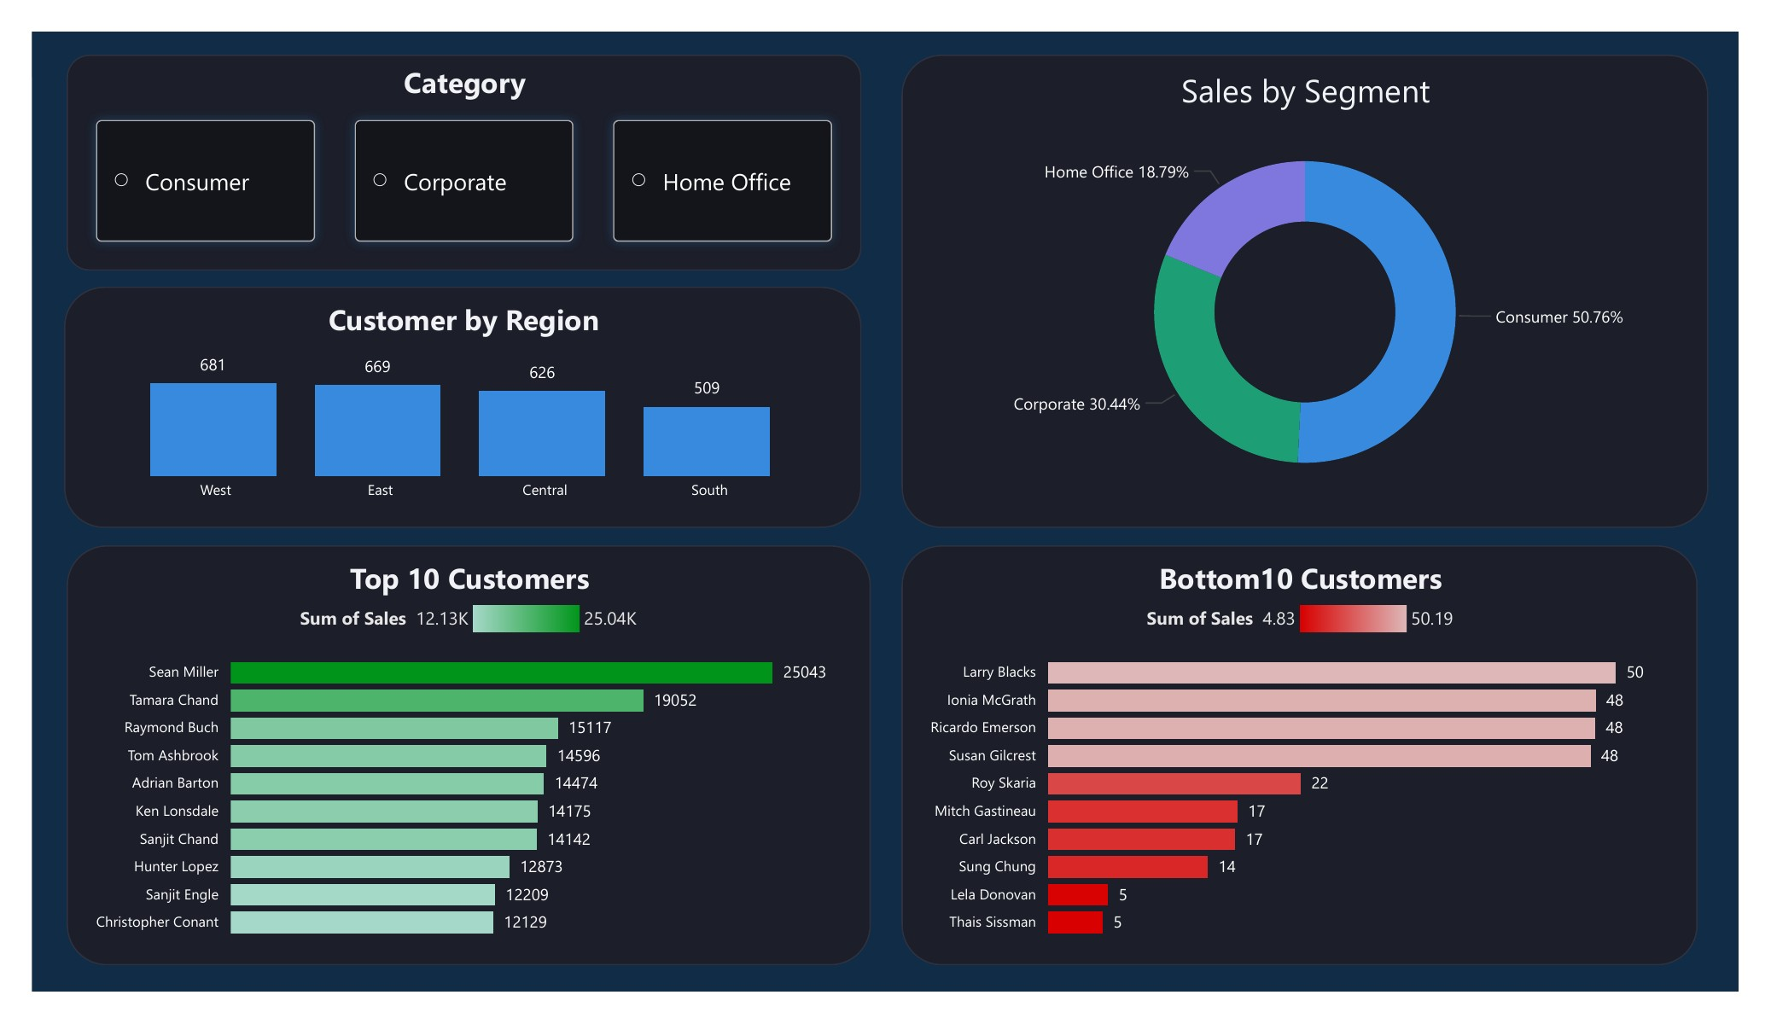
Customer Analysis
Customer Behavior, Segment Distribution, and Top Buyers
Key Insights
1
Consumer is the largest segment at 50.76% of sales
2
Home Office has the highest Avg Order Value at $475
3
Sean Miller is the top individual customer at $25,043
4
West Region has the largest number of customers

Slide 5
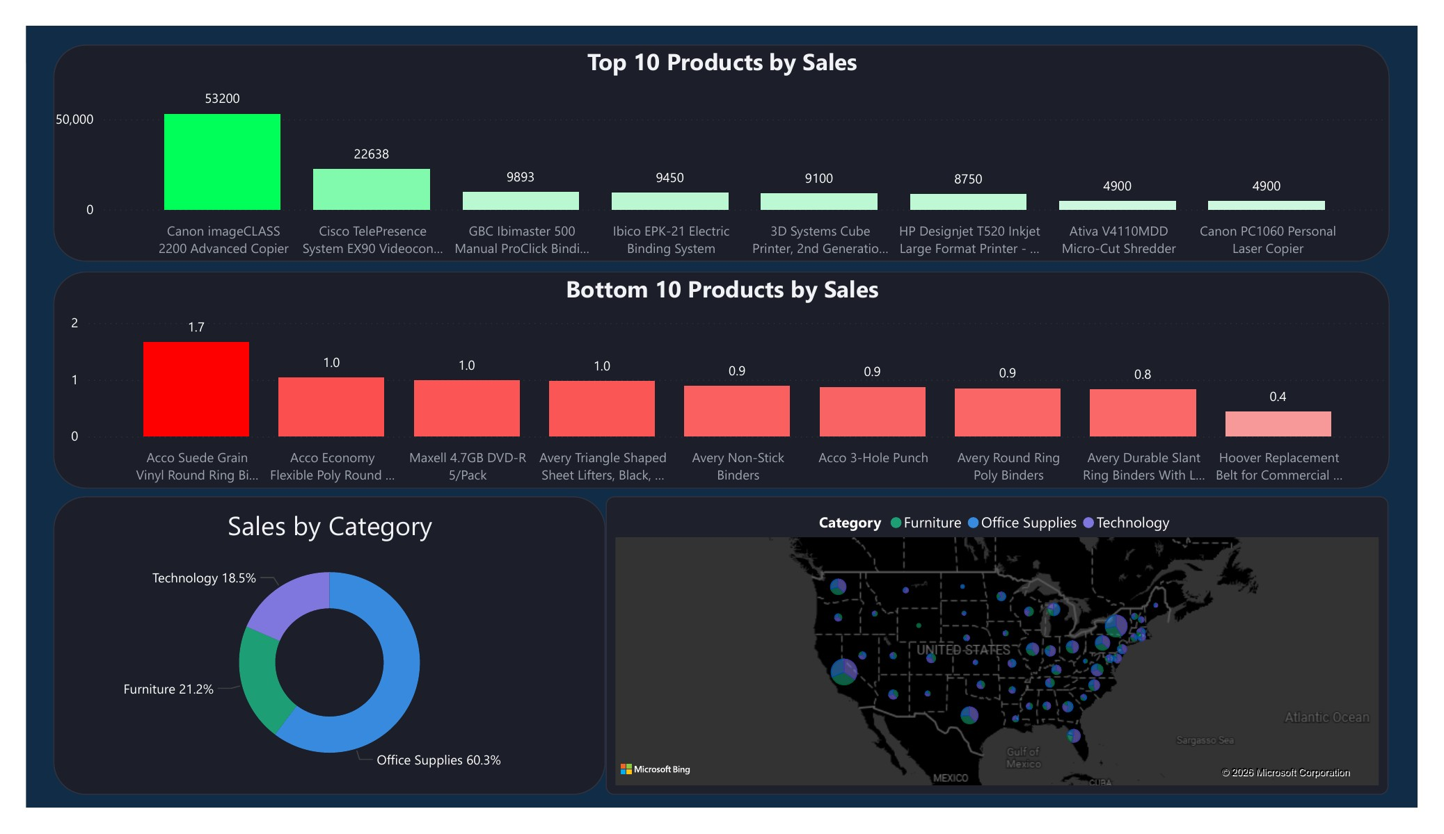
Products Analysis
Best and Worst Selling Products and Category Distribution
Key Insights
1
Canon imageCLASS 2200 is the top product at $53,200
2
Office Supplies leads in number of products and orders
3
Technology has the highest average product value
4
Bottom products sell for less than $2 each

Slide 6
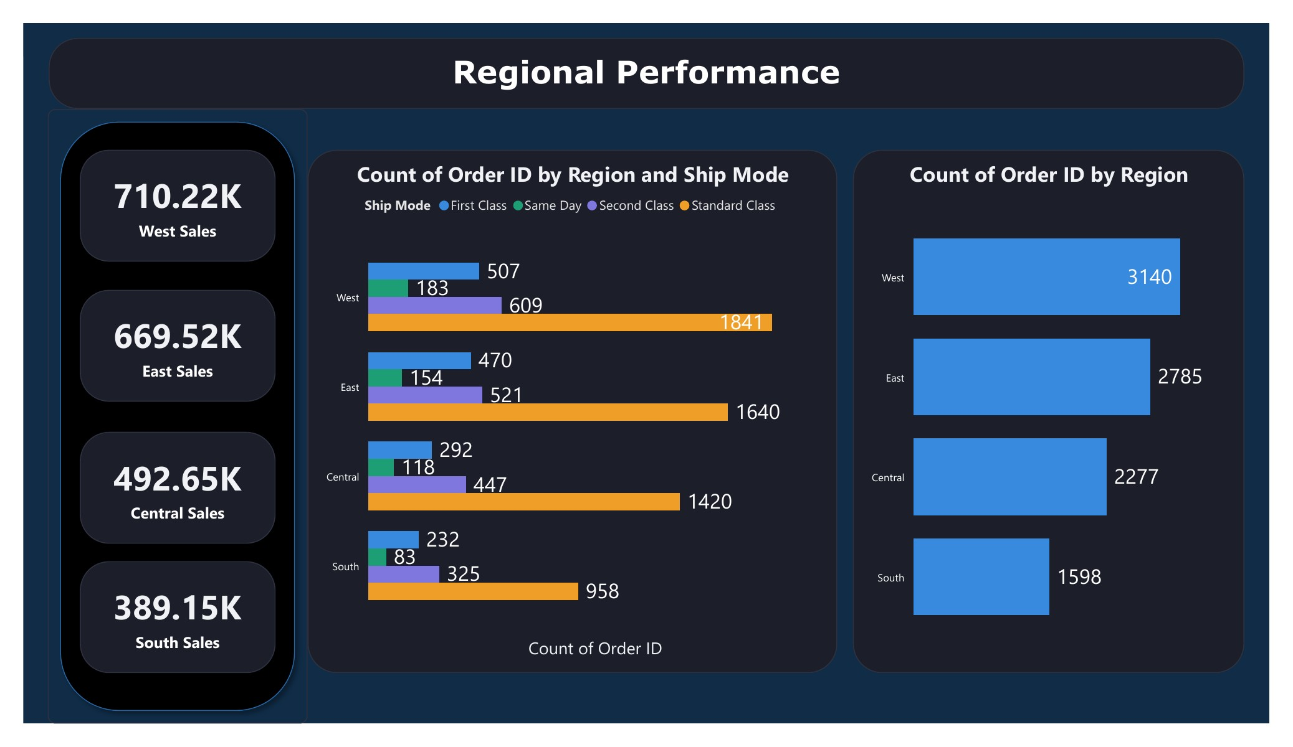
Regional Performance
Performance by Region and Ship Mode Comparison
Key Insights
1
West leads with $710K in sales (31% of total)
2
Standard Class is the most used shipping in all Regions
3
South has the lowest sales and orders
4
First Class accounts for ~16% of orders in each Region

Slide 7
Recommendations
Key action items based on dashboard analysis
Sales
Customer
Customer
Replicate 2017-2018 Growth
Invest in Home Office Segment
Build a VIP Loyalty Program
Revenue grew 56% in two years. Identify and scale the strategies behind this peak performance.
Highest Avg Order Value at $475. Targeted campaigns here deliver the best revenue per customer.
Top 10 customers drive a large share of revenue. Retain them with dedicated account management.
Products
Regional
Regional
Discontinue Bottom Products
Recover South Region
Promote Faster Shipping
Bottom 10 products sell for under $2 each. Replace with higher-margin alternatives.
South lags at $389K vs West 710K. Launch targeted regional promotions to close the gap.
Standard Class dominates but First Class and Same Day drive higher satisfaction for key customers.

Slide 8
Thank You
Superstore Sales Dashboard
Built with Power BI | Dataset: Superstore Sales

