Slide 1
Backend in Node.js (Express js)
Muslim Shah

Slide 2
Course Content
Understand how backend works (client–server–database model)
Work with Node.js core modules and asynchronous programming
Build and manage APIs using Express.js
Connect backend with databases MongoDB & MySQL
Implement authentication and authorization
Optimize backend with middleware, error handling, and caching
Learn RESTful API design principles
Deploy backend projects to cloud platforms (e.g., Azure / Render)
Complete a final project integrating all concepts

Slide 3
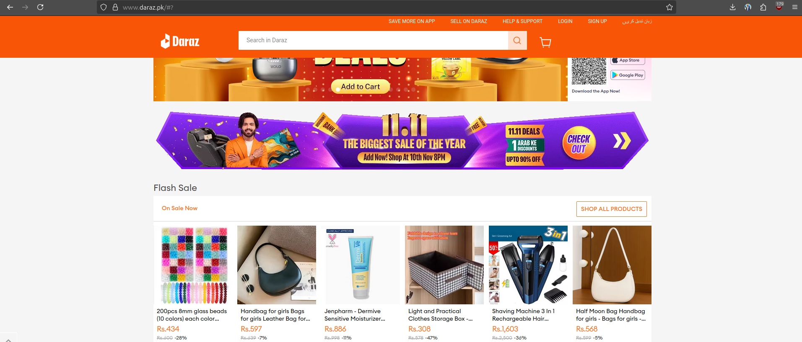
Each website or app consists of two parts
Frontend
Backend

Slide 4
Frontend
The frontend is the part of a website or app that the user directly interacts with the visual interface built using HTML, CSS, and JavaScript (like React)
Backend
The backend is the part of an application that runs on the server, handling data, logic, authentication, and communication with the database.

Slide 5


How Computers Communicate on the internet
Internet

Slide 6

How Computers Communicate on the internet
Internet

Slide 7
How Computers Communicate on the internet
Client
Client
Internet

Slide 8
How Computers Communicate on the internet
Client
Client
Internet
Server

Slide 9
How Computers Communicate on the internet
A computer cannot receive messages from the internet by default.
By default, it cannot act as a server.
We need to write a program that tells the computer how to listen for requests and send responses.
This is done using a programming language like Node.js (JavaScript) for backend development.

Slide 10
Frontend vs Backend
Feature | Frontend | Backend
Language | Html,css,js,flutter | Js(Node.js),python,java
Runs On | Browser,mobile app | Server
Purpose | User Interface | Logic and data
Example | Login Form | Verify user and respond with data

Slide 11


How client server communicate
GET daraz.pk/product/1
Client
Internet
API
Server

Slide 12
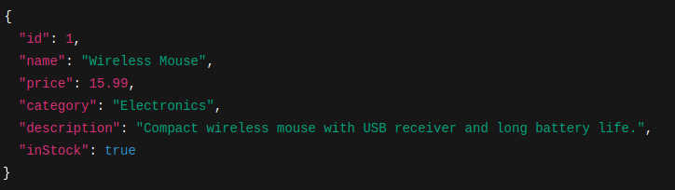
How client server communicate
GET daraz.pk/product/1
Client
Client
Internet
API
Server
Status 200
Data

Slide 13

How client server communicate
GET daraz.pk/product/1
Server
Database
Client
Internet
API
Status 200
Data

Slide 14
What is Client?
The client is the user-facing side of an application.
It sends requests to the server and displays the responses.
Examples: web browsers, mobile apps, desktop apps.
Example:
When you click “Add to Cart” in an online store, your browser (client) sends a request to the backend server.

Slide 15
What is Server?
The server is the brain that processes requests from clients.
It contains business logic and connects to the database.
Returns processed data or pages back to the client.
Example:
The server receives “Add to Cart” request → updates user’s cart data → sends confirmation back

Slide 16
What is API?
API = Application Programming Interface.
Acts as a bridge between client and server.
Defines how clients can request data (using URLs, JSON, etc.).
Example:
GET /api/products → returns a list of products in JSON.
Clients use this to display products in the app.

Slide 17
What is Database?
Stores and organizes the data for the application.
The server reads/writes data from the database.
Common databases: MongoDB, MySQL, PostgreSQL.
Example:
Product info, user accounts, and order history are all stored in the database

Slide 18
What is JSON?
JSON stands for JavaScript Object Notation.
It is a lightweight data format used to exchange information between client and server.
Data is stored in key-value pairs easy for humans to read and for machines to parse.
Commonly used in APIs to send and receive data.

Slide 19
What is Node.js?
Node.js = runtime that lets you run JavaScript outside the browser
Built on Google Chrome’s V8 engine
Enables JavaScript to run on the server side
Single-threaded, asynchronous, event-driven

Slide 20


Slide 21
What does single threaded mean?
A thread is like a “lane” on a highway
it’s the sequence of instructions your CPU executes.
Node.js runs all your JavaScript code in one main thread ,one lane ,where only one line of code executes at a time.
That’s why you can’t have two JS functions running at exactly the same moment on different threads in Node’s main execution context.
Node.js is built on top of Google Chrome’s V8 JavaScript Engine,
and JavaScript itself (in browsers too) was designed to be single-threaded to avoid complexity like race conditions and deadlocks in front-end environments.

Slide 22
But Wait How Does Node Handle Multiple Tasks Then?
Node.js runs JavaScript on a single thread, yet it handles many requests simultaneously using an event-driven, non-blocking model powered by libuv (a C++ library).
libuv provides:
Thread Pool: runs background tasks (file I/O, DB queries, etc.) without blocking JS.
Event Loop: manages callbacks and decides when completed tasks return to JS.

Slide 23
Node.js Event Loop
The Event Loop is the core mechanism that allows Node.js to handle multiple tasks using a single thread.
Key Idea:
It continuously checks if there’s work to do like callbacks, timers, or I/O results and processes them in order.
How it works:
Runs JS code on the main thread.
Sends async tasks (like I/O) to background threads via libuv.
When those tasks finish, their callbacks are queued.
The Event Loop picks and executes them one by one fast and non-blocking.
Result: Node.js stays responsive and efficient, even under heavy load.

Slide 24
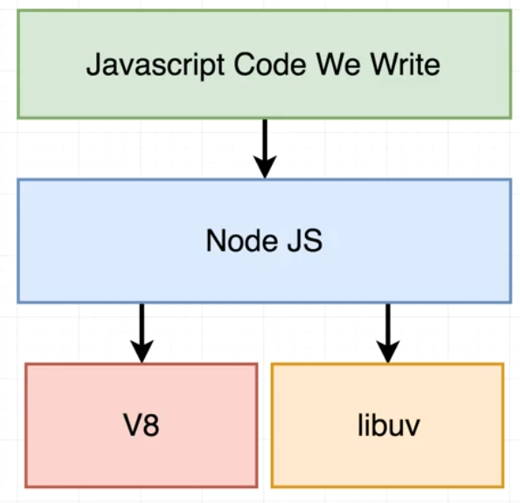

Slide 25
Node.js Setup and installation
Download node.js
Install node.js
Verify installation by running node -v in terminal
Open vs code
Create folder <folder-name>
Create project <project-name>.js
Run with command node <project-name>.js

Slide 26
Node.js JavaScript Requirements
Variables
Functions
Objects
Arrays
Asynchronous programming (callbacks, promises, async/await)

Slide 27
Variables
JavaScript variables are containers for data.
JavaScript variables can be declared in 4 ways
Using let
Using const
Using var
Automatically

Slide 28
Example
let price =1000;
const name =”ali”
var x=1;
A=25;

Slide 29
What is an Object?
An object is a special data type in JavaScript used to store many values together.
Think of it like a box or a real-world thing (like a car, student, or mobile)
that has properties (data) and actions (functions).

Slide 30
How to declare an object​?
The most common approach is object literal method
The second most common method is constructor function

Slide 31
Object Example
const car = {
color: "red",
brand: "Toyota",
model: 2022
};
Object can also have functions (called methods)
Object = Box of related things

Slide 32
const person = {
name: "Ali",
age: 25,
greet: function() {
console.log("Hello, my name is " + this.name);
}
};
person.greet(); // Hello, my name is Ali

Slide 33
Task 1
getUser(id, callback) → returns user after 2 sec
getOrders(userId, callback) → returns list of orders after 2 sec
getOrderDetails(orderId, callback) → returns details after 2 sec

Slide 34
Node Modules
Modules are reusable blocks of code in Node.js.
They help keep code organized, maintainable, and reusable.
Every file in Node.js is treated as a separate module.

Slide 35
Example
// greet.js
function greet(name) {
return `Hello, ${name}!`;
}
module.exports = greet;

Slide 36
Types of Node.js Modules
Built-in Modules → come with Node.js
Examples: fs, http, path, os, url
User-defined Modules → created by developers
Example: const utils = require('./utils');
Third-party Modules → installed via npm
Example: const express = require('express');

Slide 37
Node.js Path Module
A core Node.js module for working with file and folder paths.
Provides utilities to parse, format, join, and resolve paths.
Works perfectly with the fs module to handle files safely.
Makes file handling code safer, cleaner, and easier to read.

Slide 38
Node.js Path Module Key Methods
File & Folder Information
basename() → Get file name
dirname() → Get folder/directory name
extname() → Get file extension
Path Manipulation
join() → Combine paths safely
resolve() → Get absolute path
relative() → Get relative path between two paths
Path Parsing & Building
parse() → Break path into components
format() → Build path from components

Slide 39
Node.js fs Module File System Module
What is fs?
Core Node.js module for working with files and folders
Allows reading, writing, updating, deleting, and managing files
Supports both synchronous and asynchronous operations
Works well with streams for large files

Slide 40
File Operations
Create / Write
writeFile() – async write to file
writeFileSync() – sync write
Append
appendFile() – async append data
appendFileSync() – sync append

Slide 41
File Operations
Read
readFile() – async read
readFileSync() – sync read
Rename / Delete
rename() – async rename/move
renameSync() – sync rename/move
unlink() – async delete
unlinkSync() – sync delete

Slide 42
File Operations
Folder Operations
mkdir() – create folder
mkdirSync() – sync create
readdir() – read folder contents
readdirSync() – sync read
existsSync() – check if file/folder exists

Slide 43
Node.js Streams
What are Streams?
Streams are objects in Node.js that let you read or write data piece by piece, instead of loading the entire file into memory.
Think of it like water flowing through a pipe: data comes in chunks, not all at once.
Very useful for large files (like videos, logs, CSVs).

Slide 44
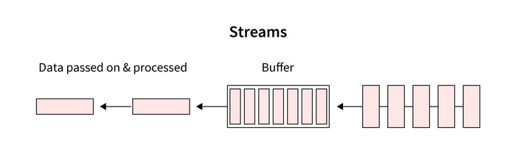

Slide 45
File Read Stream
Reads a file chunk by chunk.
Useful when file is too large to load into memory at once.
Key Readable Stream Functions / Events
createReadStream(filename,encoding) → Create a readable file stream
Events:
data → Triggered when a new chunk of data is available
end → Triggered when all data has been read
error → Triggered on error

Slide 46
File Write Stream
Writes data to a file in chunks, instead of all at once.
Useful for large files or continuous data writing.
Key Writable Stream Functions / Events
createWriteStream() → Create a writable file stream
Functions:
write() → Write data chunk
end() → Signal that writing is finished
Events:
finish → All data written
error → Triggered on error

Slide 47
Pipe –Connecting Streams
pipe() → Connect a readable stream to a writable stream
Useful for copying files, streaming data, or chaining transformations

