Slide 1
P
PMS
Property Management System by BJP Technologies
Run your rentals from one place
A short tour of PMS for landlords, property managers and their teams.
pms.bjptechnologies.co.tz
Notes:
Introduce PMS as one place for buildings, renters, leases, billing, receipts, maintenance and reports.

Slide 2
OVERVIEW
How PMS works
1
2
3
4
Set up
Lease
Bill and collect
Track
Your locations, properties and units, with rent, amenities and photos. Done once.
Add renters and create leases. Print the contract as a PDF.
Issue invoices, record payments, and receipts go out automatically.
Dashboard, seven reports, maintenance and your own website.
One workspace, on a computer or a phone, for you and your whole team.
PMS · BJP Technologies
2
Notes:
The order a landlord uses PMS in: set up once, then lease, bill and collect every month, and track.

Slide 3
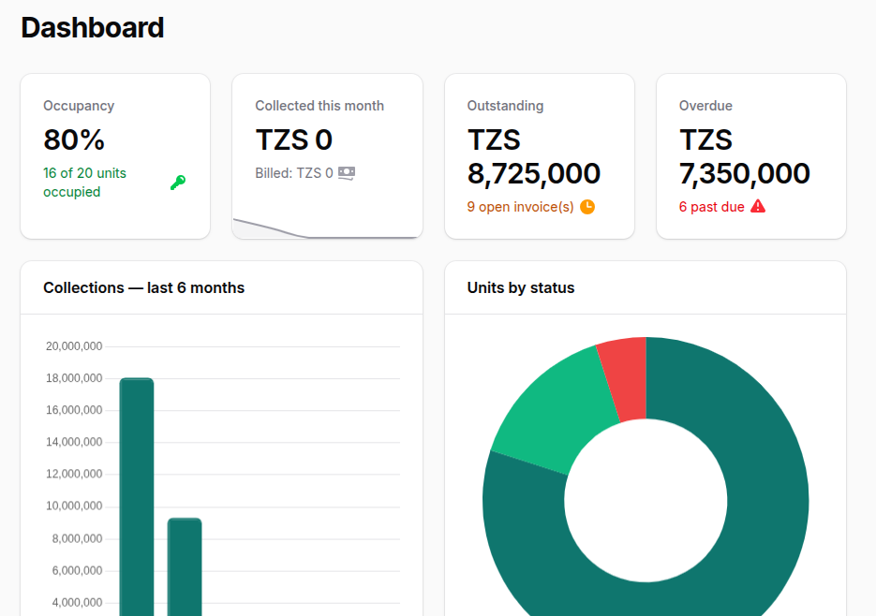
EVERY DAY
Your dashboard at a glance
Occupancy
How many of your units are rented.
Collected this month
Payments recorded against what was billed.
Outstanding
Everything still owed on open invoices.
Overdue
The part that is past its due date.
PMS · BJP Technologies
3
Notes:
Below the four figures: collections over six months, units by status, the five largest unpaid invoices and recent payments.

Slide 4
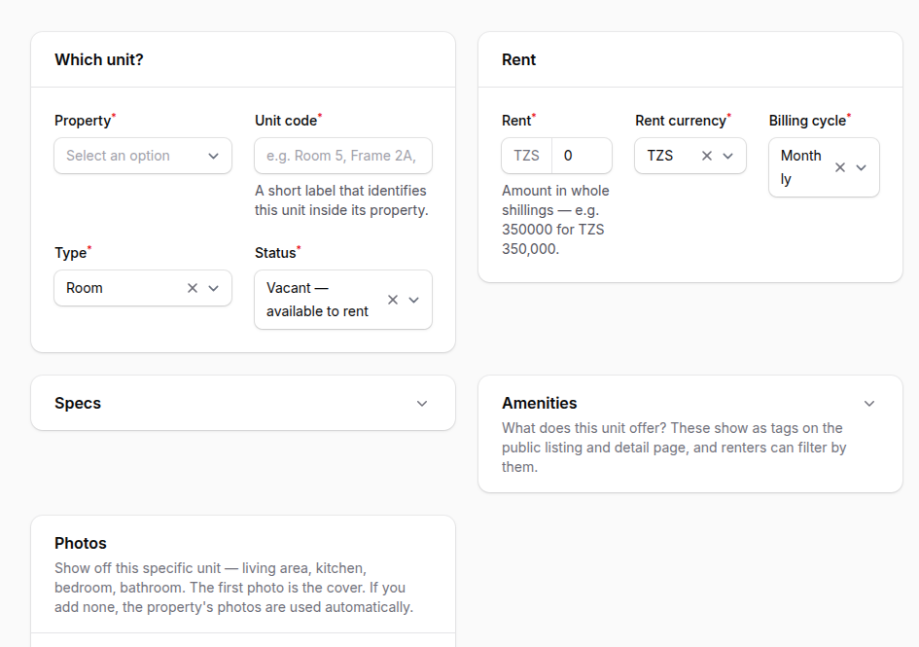
SET UP ONCE
Your buildings and units
1
Locations
Region, district and ward.
2
Properties
A building or compound, with photos.
3
Units
Room, apartment, business frame, office, shop or warehouse, each with its rent and billing cycle.
Vacant units appear on your website automatically, with photos, rent and amenities.
PMS · BJP Technologies
4
Notes:
Our team can enter all of this for you during setup.

Slide 5
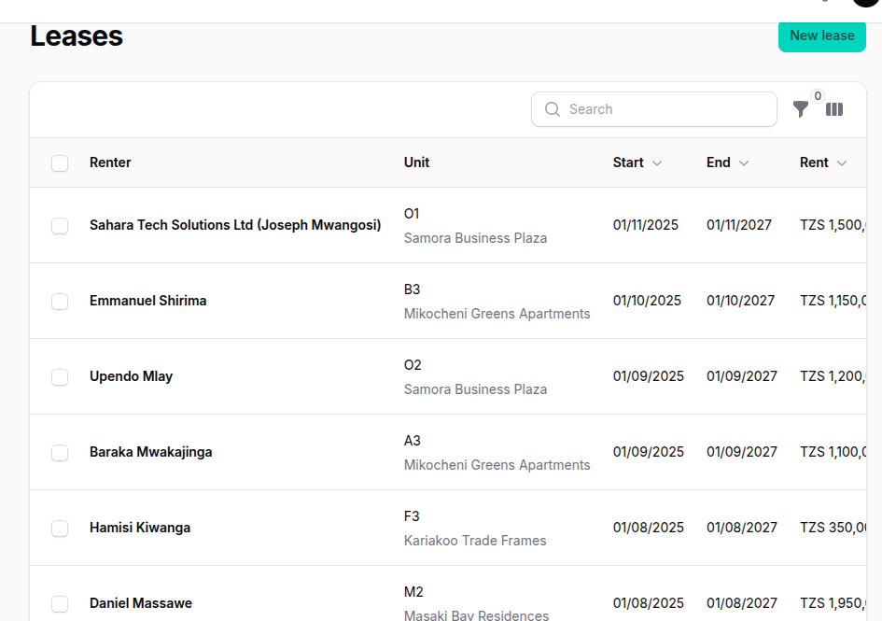
LEASING
Renters and leases
1
Add the renter
Name, phone and email. The phone is their portal sign-in.
2
Create the lease
Four steps: renter, unit, terms, confirm.
3
Activate it
The unit is marked occupied and the renter is invited to the portal.
4
Print the contract
Download the lease as a PDF to sign.
PMS · BJP Technologies
5
Notes:
End or terminate a lease when it finishes; every change is kept in the lease history.

Slide 6
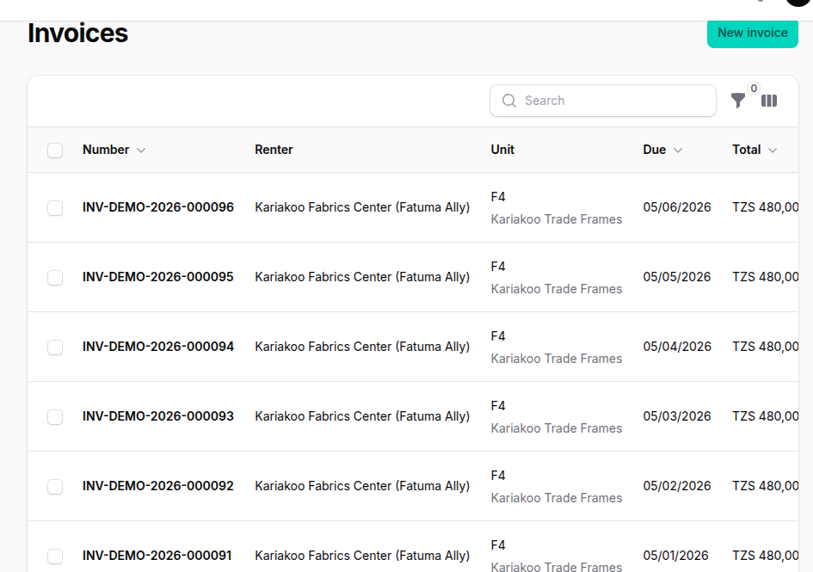
BILLING
Invoices
1
Create
Pick the lease and period, add rent and any other charges.
2
Check the draft
Only you can see it until it's issued.
3
Issue
It gets its number and the renter is emailed and sees it in the portal.
Every morning at 06:00 PMS marks late invoices as overdue and emails the renter a reminder.
PMS · BJP Technologies
6
Notes:
Invoices are created per period in a few clicks. Statuses: draft, unpaid, partial, paid, overdue, cancelled. Each downloads as a PDF.

Slide 7
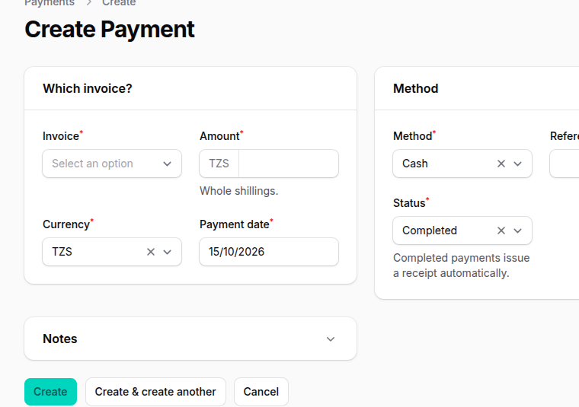
BILLING
Payments and receipts
1
Record the payment
Cash, bank transfer, mobile money, cheque or card. Part payments are fine.
2
Balance updates
The invoice becomes partial or paid.
3
Receipt goes out
A numbered PDF receipt is emailed to the renter automatically.
PMS · BJP Technologies
7
Notes:
Renters keep paying the way they do today; PMS records it and produces the receipt.

Slide 8
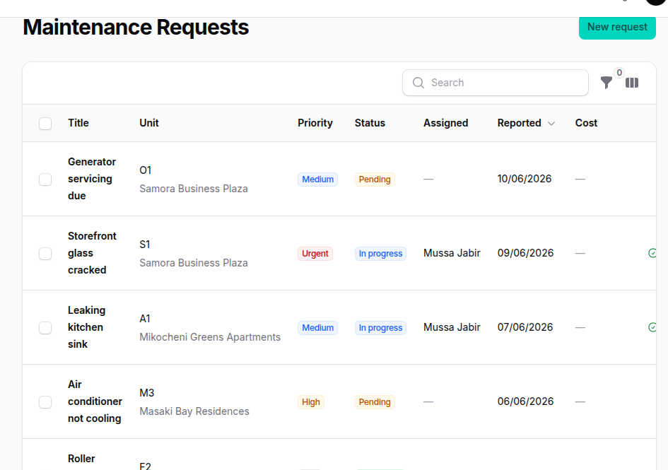
OPERATIONS
Maintenance requests
Renters report problems from their phone, with photos.
The owner, managers and maintenance staff are notified straight away.
Press Start when work begins and Complete when it's done; the renter sees each step.
Notes on each request keep a record of what was done.
PMS · BJP Technologies
8

Slide 9
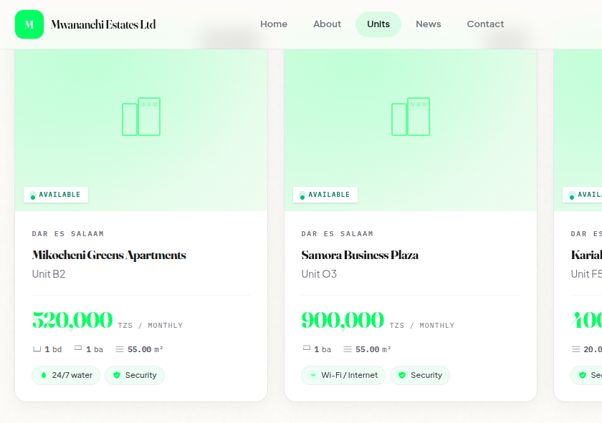
MARKETING
Your own website
Home, About, Units, News and Contact pages under your name.
Vacant units are listed automatically, with search and filters.
Messages from the contact form land in your inbox.
Post announcements, such as new units or a water cut.
PMS · BJP Technologies
9

Slide 10
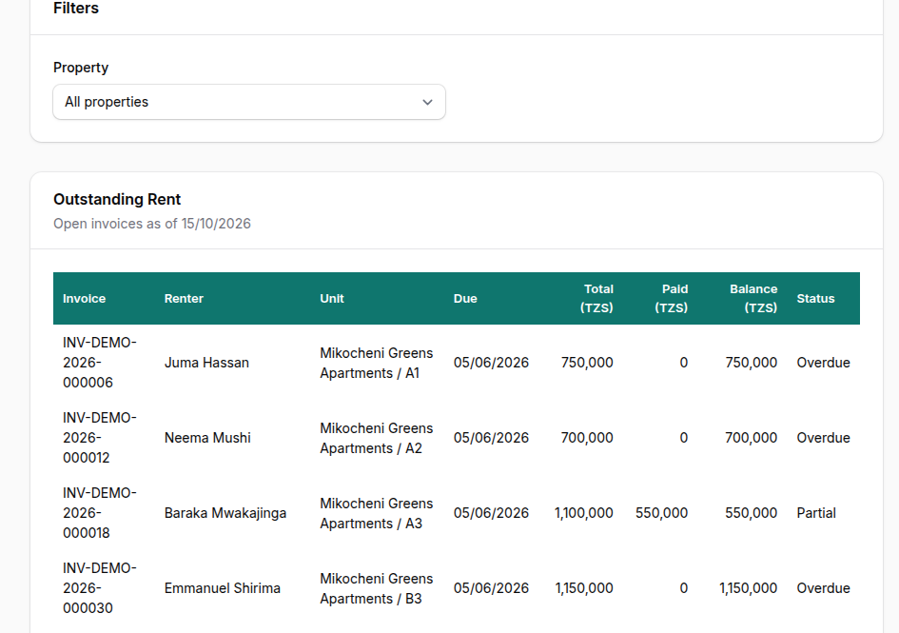
INSIGHT
Seven reports, ready to download
Monthly rent collection
Outstanding rent
Occupancy
Property income
Expenses
Profit summary
Renter payment history
Each one downloads as Excel or PDF.
PMS · BJP Technologies
10

Slide 11
ADMINISTRATION
Your team, with the right access
Owner
Everything, including the team, settings and plan.
Manager
Day-to-day running: renters, leases, billing and maintenance.
Accountant
Invoices, payments, expenses and reports.
Maintenance staff
Maintenance requests, from report to done.
Invite staff by email; each one sets their own password. On the Pro plan, the owner can fine-tune what each role may do.
PMS · BJP Technologies
11

Slide 12
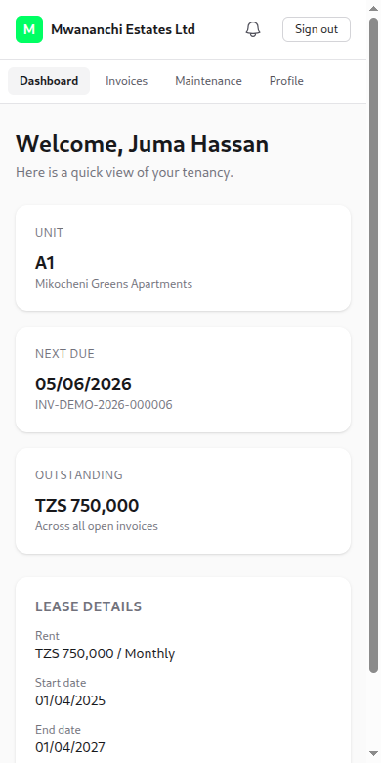
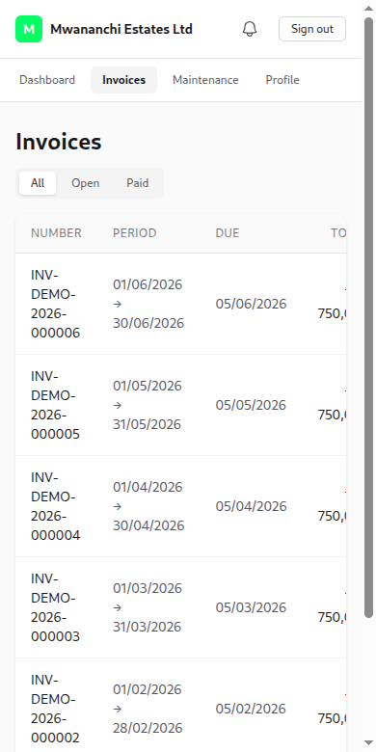
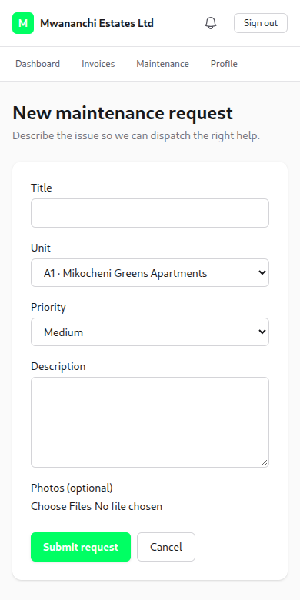
FOR YOUR RENTERS
A portal on their phone
Sign in with their phone number; nothing to install.
See rent due, what they owe and their lease.
Download every receipt.
Report problems with photos and follow progress.
PMS · BJP Technologies
12
Notes:
Renters who forget their password ask the landlord to resend the activation link.

Slide 13
NEXT STEPS
Getting started
1
2
3
4
Choose a plan
We set you up
Train your team
Go live
Every plan starts with a free trial of 30 days.
Send us your properties, units and renters; our team enters them.
Setup and training are free.
Issue invoices, record payments and send receipts from day one.
Plans and prices: pms.bjptechnologies.co.tz/#pricing
PMS · BJP Technologies
13

Slide 14
P
PMS
Property Management System by BJP Technologies
Questions?
Free trial of 30 days
Free setup and training
Your data entered for you
New features built on request
Talk to us to start your free trial.
+255 764 764 011
info@bjptechnologies.co.tz
pms.bjptechnologies.co.tz

