Slide 1
Some graphs for our observations

Slide 2
The Sample Probability of Click by the Ad’s Rank
Prob(click|rank)

Slide 3
The Sample Probability of Click by Customer’s Characteristics
Prob(Click|rank, characteristics)
Whether a customer clicks an ad depends only on rank of the ad, not on the customer’s characteristics
: having insurance, # vehicles, #drivers, marriage

Slide 4
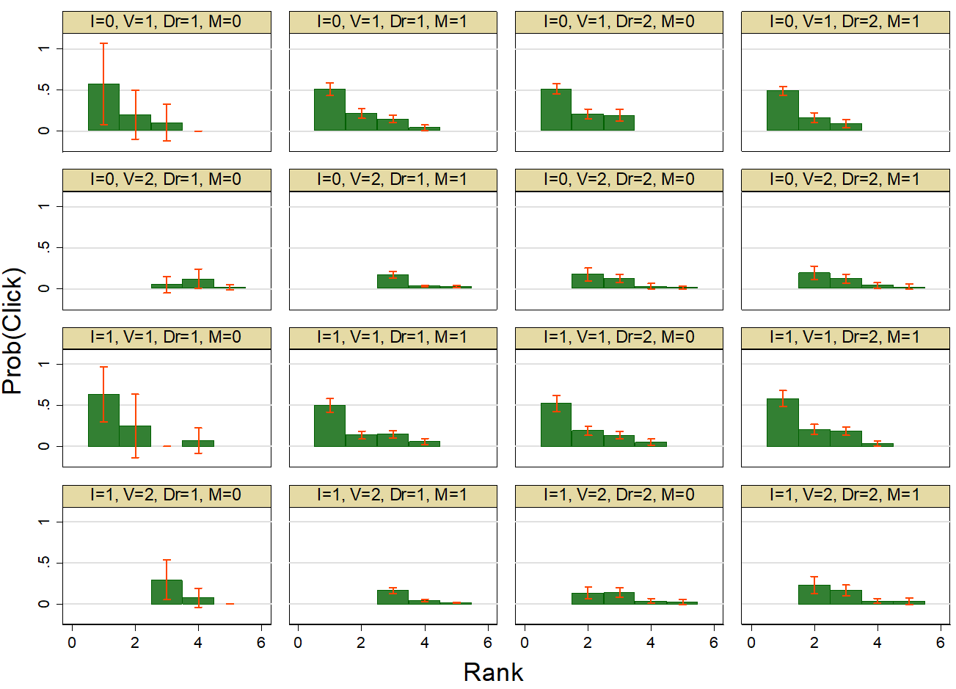
The Sample Probability of Click by Customer’s Characteristics
If you prefer 4X4..
Prob(Click|rank, characteristics)

Slide 5
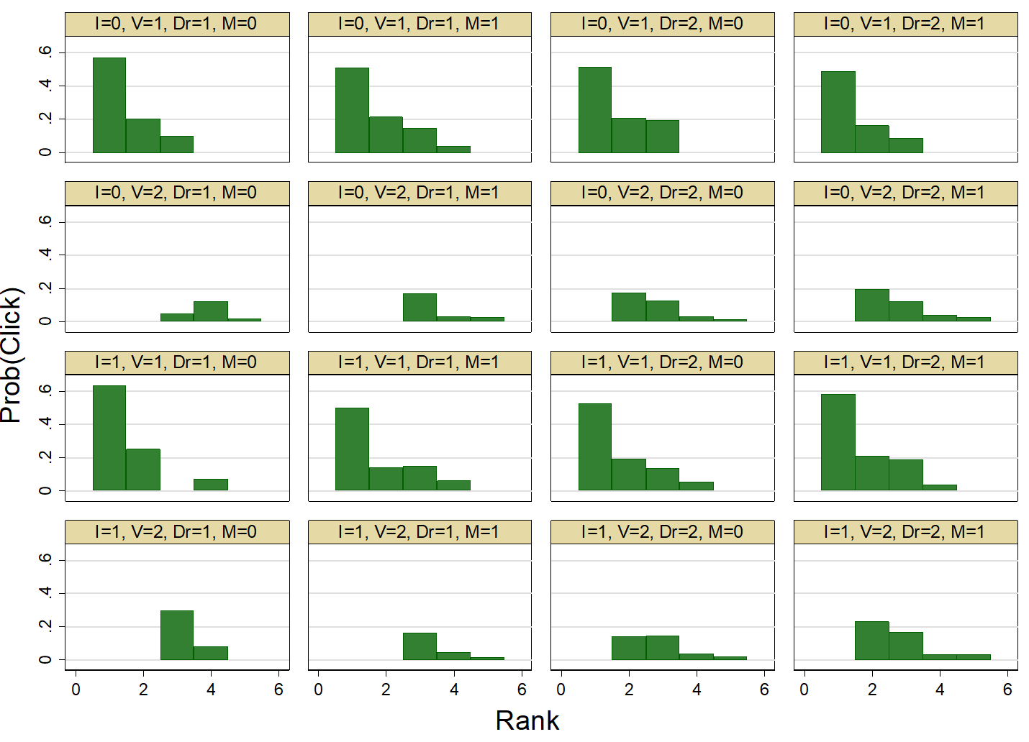
The Sample Probability of Click by Customer’s Characteristics
If you don’t like confidence intervals
Prob(Click|rank, characteristics)

Slide 6
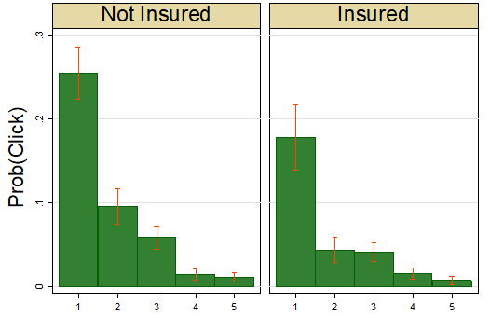
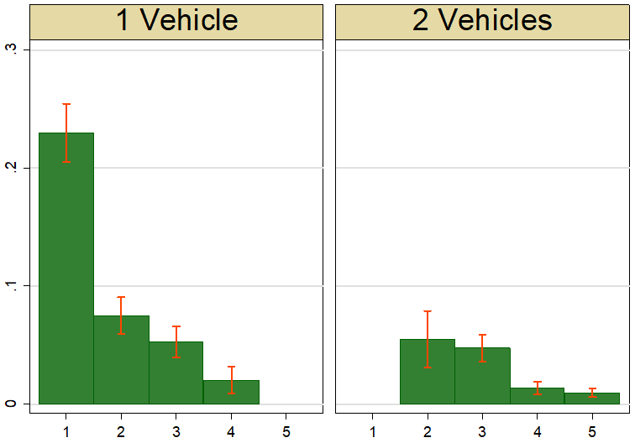
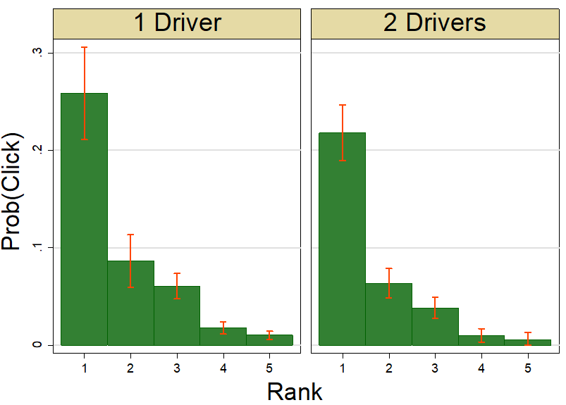
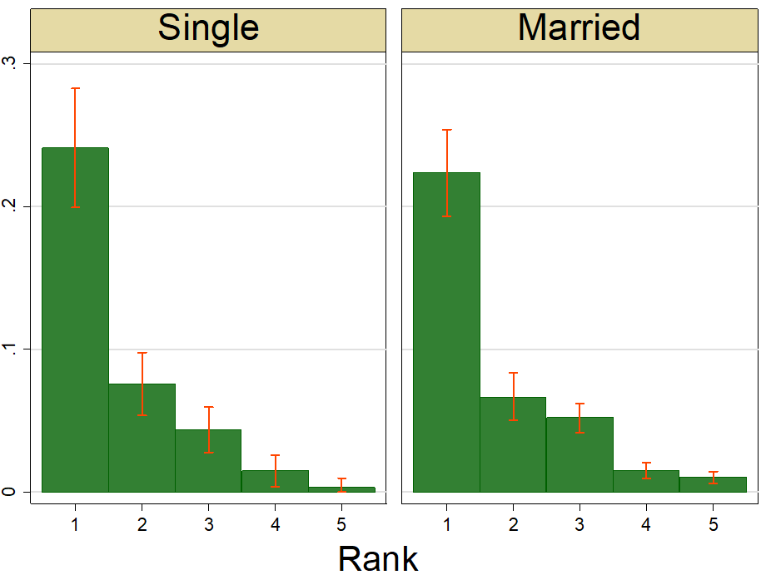
The Sample Probability of Sale by Customer’s Characteristics
Prob(Sale|rank,characteristics)

