Slide 1


Title
subtitle

Slide 2
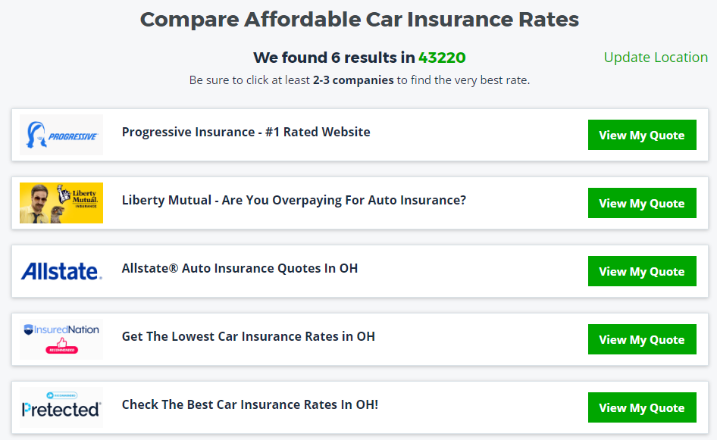
Vertical Search Websites for Car Insurance
The website shows ads based on the consumer’s information s/he entered.
The order of ads is determined by an online auction: higher bid, higher rank
The companies can set different bid prices for different type of customers.
The companies only pay if their ad is clicked on.
Goal: Find the best bidding strategy which optimizes the cost per customer,
Ensuring that at least 400 customers are expected for every 10,000 ads.

Slide 3
Our Approach
Set Model
Set an optimization strategy
Descriptive Analysis
Analyze customer types
Confirm our assumptions
Optimization
Implement optimization
Present results
Make reasonable assumptions
Predict probabilities

