Slide 1
LP104: Object-Oriented Programming
Operator overloading

Slide 2
Introduction
Operator overloading
  Enabling C++’s operators to work with class objects
  Using traditional operators with user-defined objects
  Requires great care; when overloading is misused, program difficult to understand
  Examples of already overloaded operators
    Operator << is both the stream-insertion operator and the bitwise left-shift operator
    + and -, perform arithmetic on multiple types
  Compiler generates the appropriate code based on the manner in which the operator is used

Slide 3
Introduction
Overloading an operator
  Write function definition as normal
  Function name is keyword operator followed by the symbol for the operator being overloaded
  operator+ used to overload the addition operator (+)
Using operators
  To use an operator on a class object it must be overloaded unless the assignment operator(=)or the address operator(&)
    Assignment operator by default performs memberwise assignment
    Address operator (&) by default returns the address of an object

Slide 4
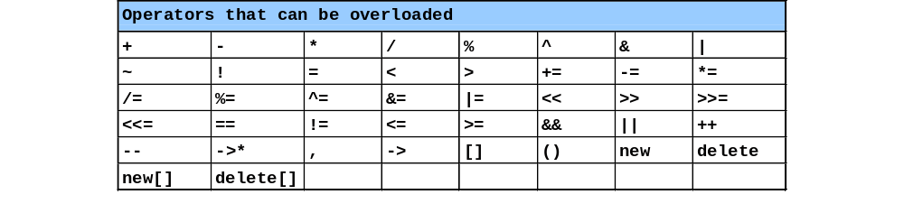
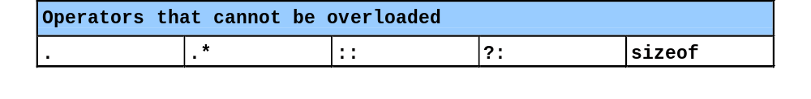
Restrictions on Operator Overloading
C++ operators that can be overloaded
C++ Operators that cannot be overloaded

Slide 5
Restrictions on Operator Overloading
Overloading restrictions
  Precedence of an operator cannot be changed
  Associativity of an operator cannot be changed
  Arity (number of operands) cannot be changed
    Unary operators remain unary, and binary operators remain binary
    Operators &, *, + and - each have unary and binary versions
    Unary and binary versions can be overloaded separately
No new operators can be created
  Use only existing operators
No overloading operators for built-in types
  Cannot change how two integers are added
  Produces a syntax error

Slide 6
Operator Functions as Class Members vs. as friend Functions
Member vs non-member
  Operator functions can be member or non-member functions
  When overloading ( ), [ ], -> or any of the assignment operators, must use a member function
Operator functions as member functions
  Leftmost operand must be an object (or reference to an object) of the class
    If left operand of a different type, operator function must be a non-member function
Operator functions as non-member functions
  Must be friends if needs to access private or protected members
  Enable the operator to be commutative

Slide 7
Overloading Unary Operators
Overloading unary operators
  Can be overloaded with no arguments or one argument
  Should usually be implemented as member functions
    Avoid friend functions and classes because they violate the encapsulation of a class
  Example declaration as a member function:
      class String {
      public:
      bool operator!() const;
      ...
      };

Slide 8
Overloading Unary Operators
  Example declaration as a non-member function
    class String {
    friend bool operator!( const String & )
    ...
    }

Slide 9
Overloading Binary Operators
Overloaded Binary operators
  Non-static member function, one argument
  Example:
    class String {
    public:
    const String &operator+=(
    const String & );
    ...
    };
  y += z is equivalent to y.operator+=( z )

Slide 10
Overloading Binary Operators
  Non-member function, two arguments
  Example:
    class String {
    friend const String &operator+=(
    String &, const String & );
    ...
    };
  y += z is equivalent to operator+=( y, z )

Slide 11
Overloading ++ and --
Pre/post incrementing/decrementing operators
  Allowed to be overloaded
  Distinguishing between pre and post operators
    prefix versions are overloaded the same as other prefix unary operators
        d1.operator++(); // for ++d1
    convention adopted that when compiler sees postincrementing expression, it will generate the member-function call
        d1.operator++( 0 ); // for d1++
    0 is a dummy value to make the argument list of operator++ distinguishable from the argument list for ++operator

