Slide 1
LP104: Object-Oriented Programming
General Information

Slide 2
People
Instructor:
Alex Po Leung
Room: A210
Email: alexpleung@gmail.com
Phone: 8897-2372

Slide 3
Lectures and labs
Course Moodle
http://moodle.must.edu.mo/
Students Login: Student's should login with their MUST E-mail Account.
Student ID:1234567A-BC89-0123 =
  Username: 1234567abc89012
  Password: <Student's e-Mail Password>

Slide 4
Language medium
Lectures and labs:
  English
Exercises:
  English
Exams:
  Paper: English
  Answer: English

Slide 5
Course Objectives
After taking this course, you should be able to:
Understand basic C++ programming model and abstract data types for collections;
Identify basic object-oriented programming (OOP) principles;
Apply their knowledge on OOP to design C++ programs;
Grasp advanced OOP skills including inheritance, generic and operator overloading;
Solve the practical programming problem;
Work as a team to give the solution to a practical problem.

Slide 6
Textbook and References
Textbooks
  Walter Savitch, “Absolute C++ (5th ed),” Addison-Wesley. 2012
Reference Books
  Bruce Eckel, “Thinking in C++, Volume 1: Introduction to Standard C++”, Prentice Hall, 2000
  Bruce Eckel, “Thinking in C++, Volume 2: Practical Programming”, Prentice Hall, 2000
  Stephen Prata, “C++ Primer Plus (5th Edition),” Sams, 2004
  Bjarne Stroustrup, “The C++ Programming Language: Special Edition”, Addison-Wesley.
  Derek Capper, “Introducing C++ for Scientists, Engineers, and Mathematicians (2nd Edition),” Springer 2001

Slide 7
Course Assessment
Participation (classes) ~ 5%
In-class exercises / labs ~ 15%
Midterm Exam (Tentative) ~ 15%
Project (Tentative) ~ 15%
Final Exam ~ 50%

Slide 8
Projects
There is a project, which will be released around week 7.
You can form a group with at most two members. You cannot change your members during the whole project.
This project consists of two phases. There is a deadline for each phase.

Slide 9
Programming Tools
Visual Studio 2010
  Available with PCs in labs.
Microsoft VS.NET Express [Free]
  http://www.visualstudio.com/en-US/products/visual-studio-express-vs
Dev C++ [Free]
  http://www.bloodshed.net/devcpp.html
Qt [Free]
  http://qt-project.org/

Slide 10
Notes
Check your email and visit the course ftp regularly
Plagiarism and Cheating
The best way to learn programming is through writing programs

Slide 11
Plagiarism and Cheating
The definition of plagiarism includes
  copying of the whole or parts of written assignments, programming exercises, reports, quiz papers, mid-term examinations.
The penalty will apply to both the one who copies the work and the one whose work is being copied, unless the latter can prove his/her work has been copied unwittingly.
Furthermore, inclusion of others' works or results without citation in assignments and reports is also regarded as plagiarism with similar penalty to the offender.
A student caught plagiarizing during final examinations will be reported to the Academic Affair Office of our university and appropriate disciplinary authorities for further action, in addition to failing the course.

Slide 12

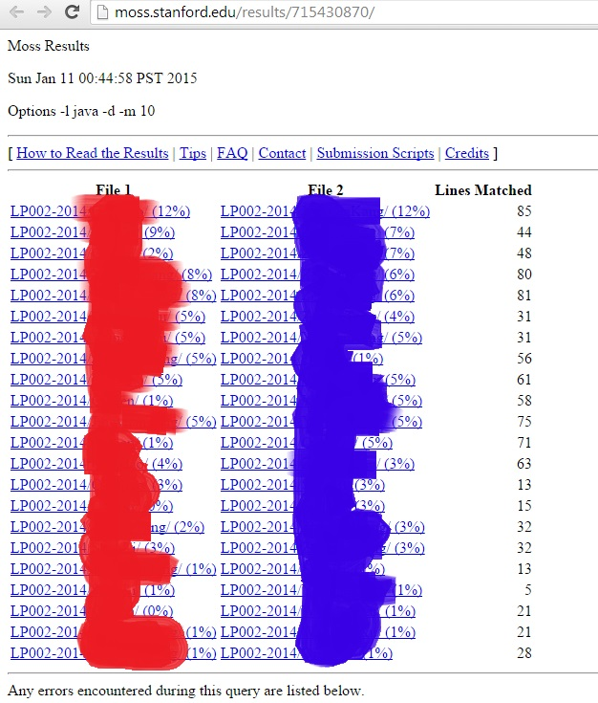
Tools to check Plagiarism and Cheating
I have the following powerful facilities:
  JPlag promises to find ‘similarities among multiple sets of source code files’.
  MOSS (Measure Of Software Similarity)

