Slide 1
LP104: Object-Oriented Programming
Basics of Flow Controls
Part2

Slide 2
Outlines
for loops
Nested loops
break statement
continue statement
Empty statements in for loops and
switch … case
the comma operator

Slide 3
1. Counting using for loops
for (i = 0; i < 10; i++) {
statement;
}
i = 0
false
i < 10
i = 0;
while (i < 10) {
statement;
i++;
}
true
statement
i++
These loops are equivalent.

Slide 4
for loop (syntax)
for (expr1; expr2; expr3)
statement;
next_statement;
expr1
false
expr2
Typical use of each "expr"
  expr1 – initialization
  expr2 – condition (loop while expr2 is true)
  expr3 – increment / decrement
  Must separate expr1, expr2, and expr3 using ";"
true
statement
expr3
next_statement

Slide 5
1
2
3
4
5
6
7
8
9
10
11
12
13
14
15
16
17
18
#include <iostream>
using namespace std;
int main() {
int count, i;
cout << "Count? ";
cin >> count;
cout << endl;
for (i = 0; i < count; i++)
cout << (count – i) << endl;
cout << "Go!\n";
return 0;
}
Count? 5↵
5
4
3
2
1
Go!
Alternative ➔
for (i = count; i >= 1; i--)
cout << i << endl;

Slide 6
int i; // Declaring the loop variable outside the loop
for (i = 0; i < 5; i++)
cout << i << endl;
// i is accessible outside the for loop
// Declaring the loop variable inside the for loop
for (int i = 0; i < 5; i++)
cout << i << endl;
// i is NOT accessible outside the loop
The latter declaration is more convenient and helps localize the use of loop variable. However, you should be careful not to access the loop variable outside the loop.
Note: Some compilers may allow the variable "i" declared this way to be used outside the loop, but you should never do so.

Slide 7
1
2
3
4
5
6
7
8
9
10
11
12
13
14
15
16
17
18
#include <iostream>
using namespace std;
// Calculate n factorial = n! = 1 * 2 * … * (n-1) * n
int main() {
int n, factorial = 1;
cout << "n ? ";
cin >> n;
for (int i = 1; i <= n; i++)
factorial *= i;
cout << "The factorial of " << n << " is "
<< factorial << ".\n";
return 0;
}
n ? 4↵
The factorial of 4 is 24.

Slide 8
1.1. Using for loop
for (int i = A; i <= B; i += C)
task(i);
Determine the value of A, B, and C
Determine how the task is related to i
(Exercise) Using a for loop to …
Print all odd numbers from 1 to N
for (int i = ; i <= ; i += )
Notes:
i=1; i<=N; i+=2;

Slide 9
2. Nested Loops
1 1
1 2
1 3
1 4
2 1
2 2
2 3
2 4
3 1
3 2
3 3
3 4
i = 1
A loop inside another loop
e.g.:
i = 2
int i, j;
for (i = 1; i <= 3; i++)
for (j = 1; j <= 4; j++)
cout << i << " " << j << endl;
i = 3
A for loop is consider as only ONE statement.
For each outer loop iteration, the inner loop iterates 4 times.

Slide 10
Tips: Replacing inner loop by a function
int i, j;
for (i = 1; i <= 3; i++)
for (j = 1; j <= 4; j++)
cout << i << " " << j << endl;
int i;
for (i = 1; i <= 3; i++)
sub_task(i);
void sub_task(int i) {
int j;
for (j = 1; j <= 4; j++)
cout << i << " " << j << endl;
}
Easier to focus

Slide 11
1
2
3
4
5
6
7
8
9
10
11
12
int row, column;
cout << "Row = ? ";
cin >> row;
cout << "Column = ? ";
cin >> column;
for (int i = 1; i <= row; i++) {
for (int j = 1; j <= column; j++)
cout << "*";
cout << endl;
}
Row = ? 3↵
Column = ? 5↵
*****
*****
*****

Slide 12
1
2
3
4
5
6
7
8
9
10
11
12
1314
15
int size;
cout << "Size = ? ";
cin >> size;
for (int i = 1; i <= size; i++) {
for (int j = 1; j <= (size – i); j++)
cout << " ";
for (int j = 1; j <= i; j++)
cout << "*";
cout << endl;
}
Size? 5↵
*
**
***
****
*****

Slide 13
2.1. Exhaustive (brute-force) Approach
An approach for finding the solution by trying out all possibilities
  Easy to implement but usually not the best solution.
For examples,
  Print all prime numbers that are less than 10000
  Show all integers solutions to a² + b² = 2c² + 3d² for all a, b, c, d in the interval [1, 1000000]

Slide 14
3 break and continue
break quits the loop without execution of the rest of the statements in the loop
continue stops the execution of the current iteration and goes back to the beginning of the loop to begin a new iteration

Slide 15
1
2
3
4
5
6
7
8
9
10
11
12
13
14
15
16
17
18
19
20
21
22
23
24
#include <iostream>
using namespace std;
int main() {
char c; // To hold response while(true) {
cout << "MAIN MENU:" << endl;
cout << "l: left, r: right, q: quit -> ";
cin >> c;
if(c == 'q')
break; // Out of "while(1)"
if(c == 'l') {
cout << "LEFT MENU:" << endl;
cout << "select a or b: ";
cin >> c;
if(c == 'a') {
cout << "you chose 'a'" << endl;
continue; // Back to main menu
}
}
…
…
}//end while
statement;
Example as shown in pp. 122 (Thinking in C++)

Slide 16
3. Controlling Loop with break
while (...) {
for (. . .) {
for (. . .) {
break;
}
statement1;
break;
}
statement2;
break;
}
statement3;
Forces an immediate exit from the innermost for loop. Execution continues from statement1.
Forces an immediate exit from the middle for loop.
Execution continues from statement2.
Forces an immediate exit from the while loop. Execution continues from statement3.
break
Causes an immediate exit from the innermost enclosing loop

Slide 17
1
2
3
4
5
6
7
8
9
10
int x;
while (true) {
cin >> x;
if (x <= 0)
break;
cout << "square = " << (x * x) << endl;
}
cout << "Bye!\n";
10↵
square = 100
16↵
square = 256
0↵
Bye!
Example 1:
A while loop that iterates until the input value is less than or equal to zero.

Slide 18
1
2
3
4
5
6
7
8
9
10
11
int i, x;
for (i = 0; i < 10; i++) {
cout << "i = " << i << " ";
cout << "x = ? ";
cin >> x;
if (x == 0)
break;
}
cout << "After the loop, i = " << i << endl;
Example 2:
A for loop that iterates ten times or stop when the input value is zero.
i = 0 x = ? 10↵
i = 1 x = ? 20↵
i = 2 x = ? 0↵
After the loop, i = 2

Slide 19
1
2
3
4
5
6
7
for (int i = 0; i < 5; i++) {
for (int j = 0; j < 5; j++) {
if (i == j)
break;
cout << i << " " << j << endl;
}
}
Example 3: Using break in an inner loop
Outer loop iterates 5 times.
For each outer loop iteration
Inner loop iterates 5 times or until (i == j).
1 0
2 0
2 1
3 0
3 1
3 2
4 0
4 1
4 2
4 3

Slide 20
4. Controlling Loop with continue
while (condition) {
for (expr1; expr2; expr3) {
statement1;
continue;
statement2;
}
statement3;
continue;
statement4;
statement5;
}
Skip the remaining statements (statement2) in the for loop. Continue executing from expr3
Skip the remaining statements (statement4 and statement5) in the while loop. Directly go to checking the while loop condition
continue
Causes the current iteration of the innermost enclosing loop to stop, and continues with the next iteration

Slide 21
1
2
3
4
5
6
7
8
9
10
11
int data, sum = 0;
for (int k = 0; k < 5; k++) {
cin >> data;
if (data <= 0)
continue;
sum += data;
}
cout << "Sum of +ve values is " << sum
<< endl;
Example 1:
Read 5 inputs
Only accumulate the input values if they are positive
10↵
20↵
-1↵
90↵
-5↵
Sum of +ve values is 120

Slide 22
5. The Empty Statement and for
for (expr1; expr2; expr3)
statement;
next_statement;
expr1 and/or expr2 and/or expr3 can be omitted.
; is still needed at the proper position.
  ; is called the empty statement.
  Useful when a statement is needed syntactically but no action is required semantically.

Slide 23
Examples
int i = 1;
int sum = 0;
for ( ; i <= 10; i++)
sum += i;
Infinite loop using for
Used as while loop
for (;;)
statement;
for (;condition;)
statement;

Slide 24
6. switch-case statements
int choice;
…
switch (choice) {
case 1:
/* Execute statements
here if choice == 1 */
break;
case 2:
case 3:
/* Execute statements
here if choice == 2 or
choice == 3*/
break;
default:
/* Execute statements here
if choice is not 1, 2 or 3.
*/
}
statement;
Another kind of selection control structure
e.g.: To carry out one of several tasks based on the value of choice

Slide 25
if (choice == 1) {
/* Create account */
}
else
if (choice == 2) {
/* Login */
}
else
if (choice == 3) {
/* Exit */
}
else {
/* Invalid choice */
}
switch (choice) {
case 1:
/* Create account */
break;
case 2:
/* Login */
break;
case 3:
/* Exit */
break;
default:
/* Invalid choice */
}
Everything that can be expressed using switch-case can also be expressed using if-else.

Slide 26
if (month == 2)
{
cout << "28/29 days";
}
else
if (month == 4 ||
month == 6 ||
month == 9 ||
month == 11)
{
cout << "30 days";
}
else {
cout << "31 days";
}
switch (month) {
case 2:
cout << "28/29 days";
break;
case 4:
case 6:
case 9:
case 11:
cout << "30 days";
break;
default:
cout << "31 days";
}
Another example showing the equivalence between if-else and switch-case statements.

Slide 27
// This is only a segment of code (incomplete program)
1 int number;
2
3 cout << "Enter a number between 1 and 3: ";
4 cin >> number;
5
6 switch( number ) {
7 case 1:
8 cout << "One\n";
9 break;
10 case 2:
11 cout << "Two\n";
12 break;
13 case 3:
14 cout << "Three\n";
15 break;
16 default:
17 cout << "Invalid number!\n";
18 }
19 …
This does not need to be a variable.
In general, this can be an expression such as
a + b - c
The value after case must be a constant of some fundamental type such as int, char, and double.
However, float and double are rarely used in a switch…case statement.
Enter a number between 1 and 3: 2
Two

Slide 28
1
2
3
4
5
6
7
8
9
10
11
12
13
14
15
16
17
int number = 2;
switch( number ) {
case 1:
cout << "One\n";
case 2:
cout << "Two\n";
case 3:
cout << "Three\n";
break;
default:
cout << "Invalid number!\n";
}
…
When a "case" is matched, flow control jumps to that location and start executing the remaining statements in the switch block until a break statement is encountered.
In this example, the flow control jumps to
line 7, then execute the statement at line 8, follow by the statement at line 11, then jump to line 17 (because of the "break" at line 12).
Two
Three
Example 1: Falling through without "break" in switch selection structure.

Slide 29
1
2
3
4
5
6
7
8
9
10
11
12
13
14
15
16
int number;
cout << "Enter a number (1-3): ";
cin >> number;
switch( number ) {
case 3:
cout << "Three\n";
case 2:
cout << "Two\n";
case 1:
cout << "One\n";
default:
cout << "Invalid number!\n";
}
Enter a number (1-3): 1
One
Invalid number!
Enter a number (1-3): 2
Two
One
Invalid number!
Enter a number (1-3): -1
Invalid number!
Example 2: Falling through without "break" in switch selection structure.

Slide 30
1
2
3
4
5
6
7
8
9
10
11
12
13
14
15
16
int number;
cout << "Enter a number (1-3): ";
cin >> number;
switch( number ) {
default:
cout << "Invalid number!\n";
case 1:
cout << "One\n";
case 2:
cout << "Two\n";
case 3:
cout << "Three\n";
}
Enter a number (1-3): 1
One
Two
Three
Enter a number (1-3): 0
Invalid number!
One
Two
Three
Example 3: Falling through without "break" in switch selection structure.

Slide 31
Comma operator
expr1, expr2
Lowest precedence of all operators.
Left-to-right associativity.
Value of expr2 is taken as value of the whole expression.
  e.g. z = (x = 2, y = 3); // z gets 3
Useful for initializing more than one variables in a for loop.
e.g:
for (i=1, factorial=1; i <= n; i++)
factorial *= i;

Slide 32
Summary
Understand how for loop works
Knowing how to read and write nested loops
Understand how break and continue work

Slide 33
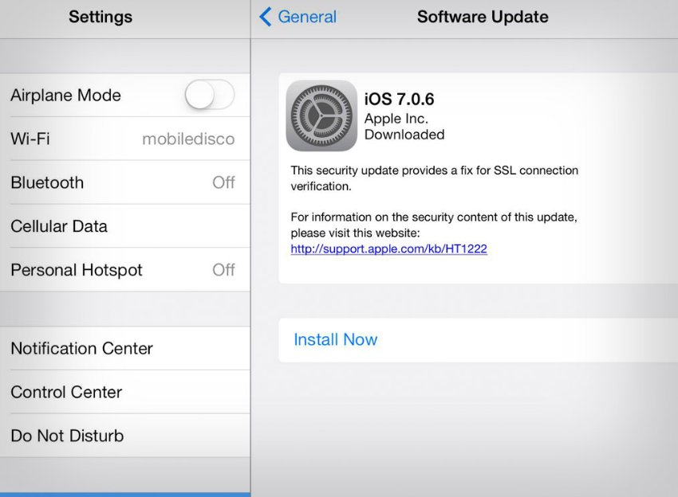
Apple’s bug
Apple recently releases a bug fix package.
  security update for iOS that suggested that something was horribly wrong with SSL/TLS in iOS but gave no details.
Do you know the reason why the bug happens?

Slide 34
1
2
3
4
5
6
7
8
9
10
11
12
13
14
15
16
17
18
19
20
21
22
static OSStatus
SSLVerifySignedServerKeyExchange(SSLContext *ctx, bool isRsa, SSLBuffer signedParams, uint8_t *signature, UInt16 signatureLen)
{
OSStatus err;
...
if ((err = SSLHashSHA1.update(&hashCtx, &serverRandom)) != 0)
goto fail;
if ((err = SSLHashSHA1.update(&hashCtx, &signedParams)) != 0)
goto fail;
goto fail;
if ((err = SSLHashSHA1.final(&hashCtx, &hashOut)) != 0)
goto fail;
...
fail:
SSLFreeBuffer(&signedHashes);
SSLFreeBuffer(&hashCtx);
return err;
}
Here's the Apple’s bug

Slide 35
Some bad practice in the above program
Use of goto (obviously)
No brackets around the statements inside the if condition, these should be used even with one statement to avoid such stupid mistakes
No proper code formatting applied, otherwise the second goto would have jumped 4 spaces backwards and became
Using only if instead of else if for the following if statements, which would have resulted in compilation failure after the second goto statements, and ultimately it could have been detected.
https://www.imperialviolet.org/2014/02/22/applebug.html
http://opensource.apple.com/source/Security/Security-55471/libsecurity_ssl/lib/sslKeyExchange.c

