Slide 1
LP104: Object-Oriented Programming
Introduction to objects

Slide 2
Outline
Basics of object-oriented programming
Software analysis and design

Slide 3
1. Characteristics of object-oriented programming (OOP)
Everything is an object
A program is a bunch of objects telling each other what to do by sending messages
Each object has its own memory made up of other objects (an object can contain other objects)
Every object has a type (class)
All objects of a particular type can receive the same messages

Slide 4
2. An object has an interface
Creating abstract data types (classes) is a fundamental concept in OOP
Abstract data types work almost exactly like built-in types
  You can create variables of a type (called objects or instances)
  You can manipulate those variables (called sending messages or requests)

Slide 5
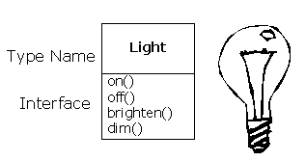
2.1. An object has an interface
Request an object to do something
  The requests you can make of an object are defined by its interface, and the type determines the interface.
  Example:
Light lt;
lt.on();

Slide 6
3. The hidden implementation
Access control
  Client programmers only care about some important members of a class
  The changes made by library designer on a class won’t affect the client programmers

Slide 7
3.1. Three types of access control in C++:
public: the following definitions are available to everyone
private: no one can access those definitions except the creator of the type, inside member functions of that type
protected: acts just like private, with the exception that an inheriting class has access to protected members, but not private members

Slide 8

4. Reusing the implementation
Create a member object
The new class can be made up of any number and type of other objects
“has-a” relationship
a car has an engine

Slide 9
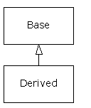
5. Inheritance: reusing the interface
To create a new class with similar functionality of the original class
inheritance – child class (derived class) inherit from the parent class (the base class)

Slide 10
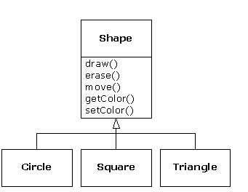
5.1. Inheritance: example
Shape class
Circle, square, triangle inherit from shape

Slide 11
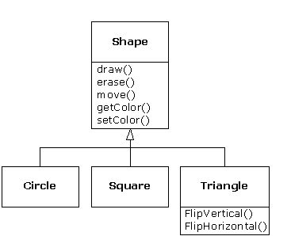
5.2. New class different from the original class
By defining new member functions in the new derived class

Slide 12
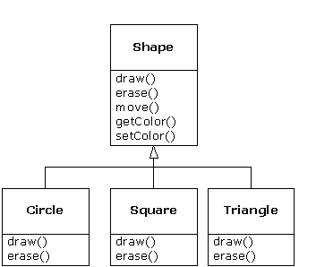
5.2. New class different from the original class
By overriding the member functions in the new derived class

Slide 13
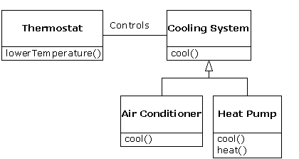
5.3. Is-a vs. is-like-a relationships
is-a: The derived class is exactly the same type as the base class (they have the same interface)
is-like-a: extend the base class to a derived class with new interface.

Slide 14
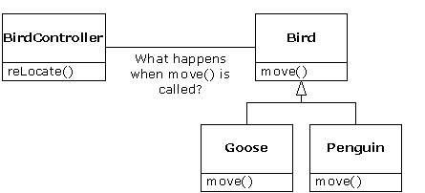
6. Interchangeable objects with polymorphism
An example

Slide 15
6.1. Early binding vs. late binding
Early binding (non-OOP): the compiler generates a call to a specific function name, and the linker resolves this call to the absolute address of the code to be executed
Late binding (OOP): when you send a message to an object, the code being called isn’t determined until runtime.
To use late binding in C++, you should use the keyword “virtual”
By default, the member function is not dynamically bound.

Slide 16
Example
void doStuff(Shape& s) { s.erase();
// ...
s.draw(); }
In other part of the program
Circle c;
Triangle t;
Line l;
doStuff(c);
doStuff(t);
doStuff(l);

Slide 17
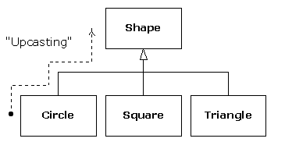
6.2. Upcasting
Treating a derived type as though it were its base type upcasting

Slide 18
7. Creating and destroying objects
Variables on the stack are sometimes called automatic or scoped variables
to create objects dynamically in a pool of memory called the heap
  If you need a new object, you create it on the heap by “new”
  If you finished your task, you must release the object by “delete”

Slide 19
8. Exception handling: dealing with errors
Exception handling wires error handling directly into the programming language and sometimes even the operating system.
An exception is an object that is “thrown” from the site of the error and can be “caught” by an appropriate exception handler designed to handle that particular type of error.
Exception handling is not the feature of OOP

Slide 20
9. Brief on analysis and design
Phase 0: make a plan
Phase 1: What are we making?
  "Who will use this system?"
  "What can those actors do with the system?"
  "How does this actor do that with this system?"
  "How else might this work if someone else were doing this, or if the same actor had a different objective?" (to reveal variations)
  "What problems might happen while doing this with the system?" (to reveal exceptions)

Slide 21
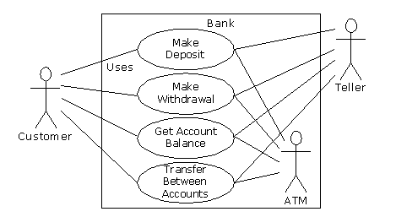
Analysis and design
Use case diagram in UML
Actor
Actor
Actor
Use case

Slide 22
Phase 2: How will we build it?
The name of the class
The “responsibilities” of the class
The “collaborations” of the class

Slide 23
Five stages of object design
Object discovery
Object assembly
System construction
System extension
Object reuse

Slide 24
Other phases:
Phase 3: Build the core
  Compile, execute and test
Phase 4: Iterate the use cases
Phase 5: Evolution

Slide 25
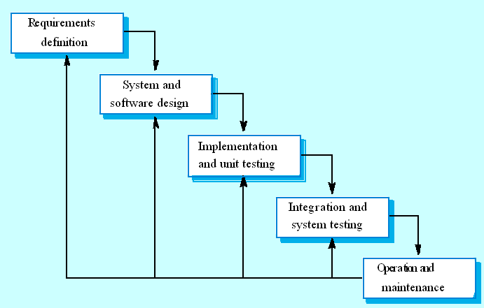
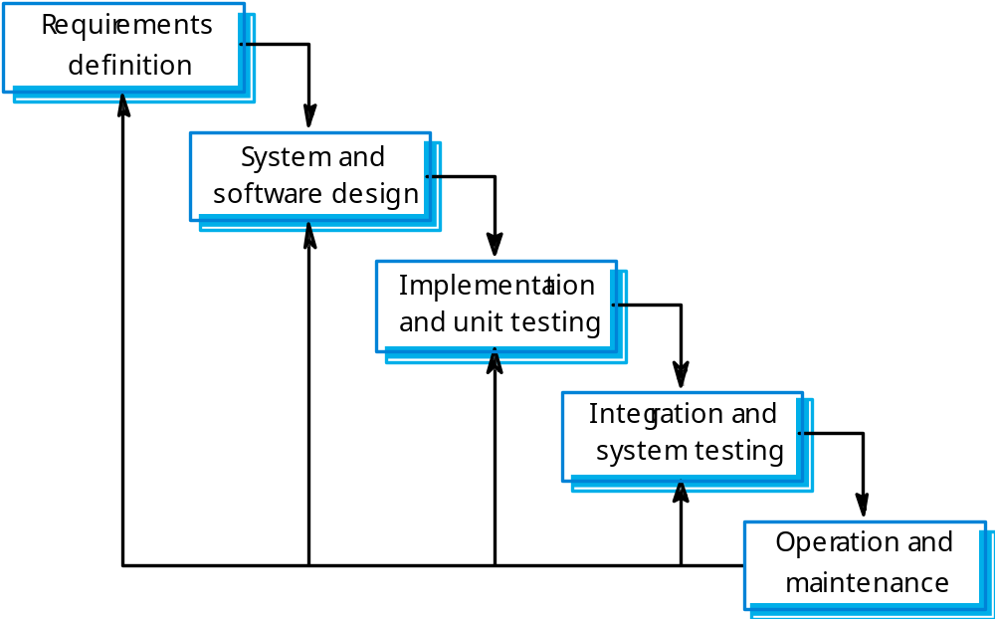
Waterfall model

Slide 26
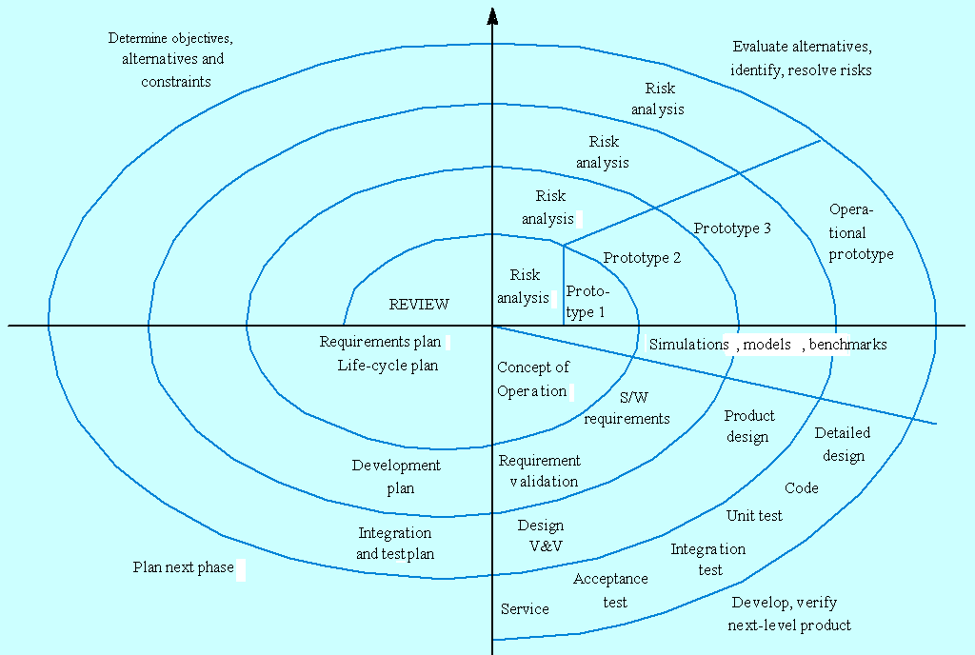
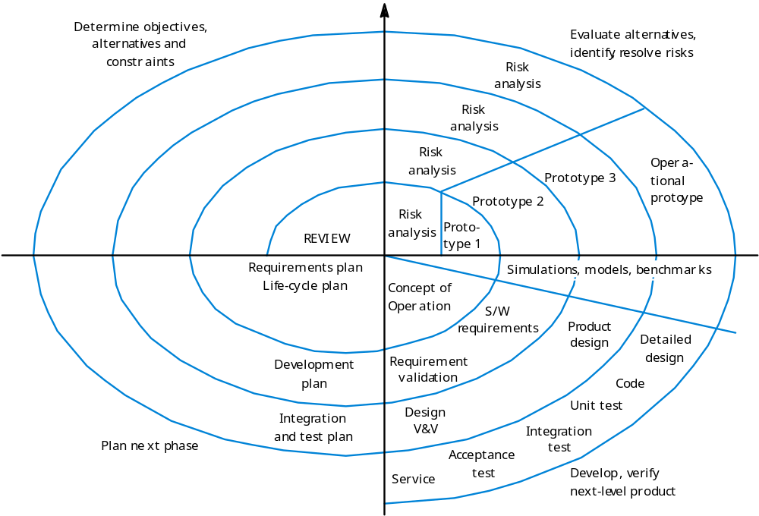
Spiral model of the software process

Slide 27
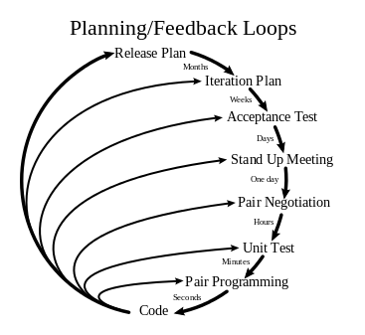
Extreme programming (XP)

Slide 28
Summary
What is an object
Hidden implementation
Inheritance
Polymorphism
Creating and destroying objects
Software analysis and design process

