Slide 1

Makes babies smile
Your smile is contagious
Everyone loves you

Slide 2
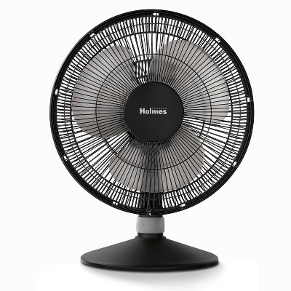
Pretty charming
People think you’re weird
In reality you’re awkward but sweet

Slide 3
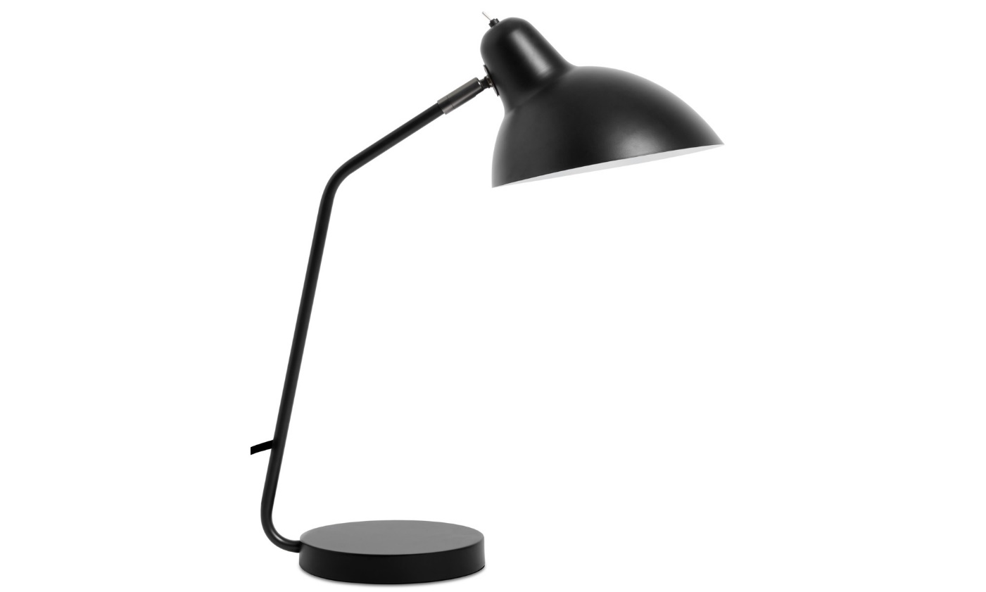
Smart
Lightens up the mood
Warm

Slide 4
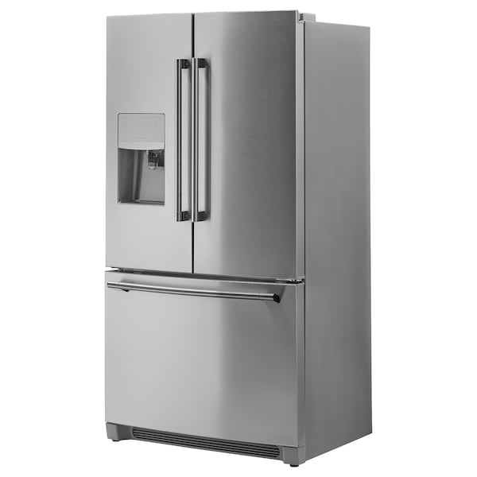
Impeccable manners
I like your style
Cool n’ chill

Slide 5
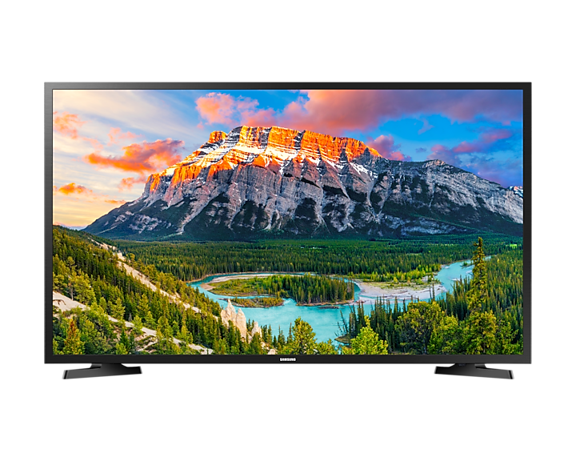
Good looking
Your perspective is refreshing
Entertains the group

Slide 6

Awesome friend
More helpful than he realizes
Carries people in group assignments

