Slide 1
Table of Contents
3D Modeling
Adaptive Families
Dynamo Scripts

Slide 2

3D Modeling
2-VENT BOX GRDER BRIDGE
UNDERPASS
CULVERT

Slide 3
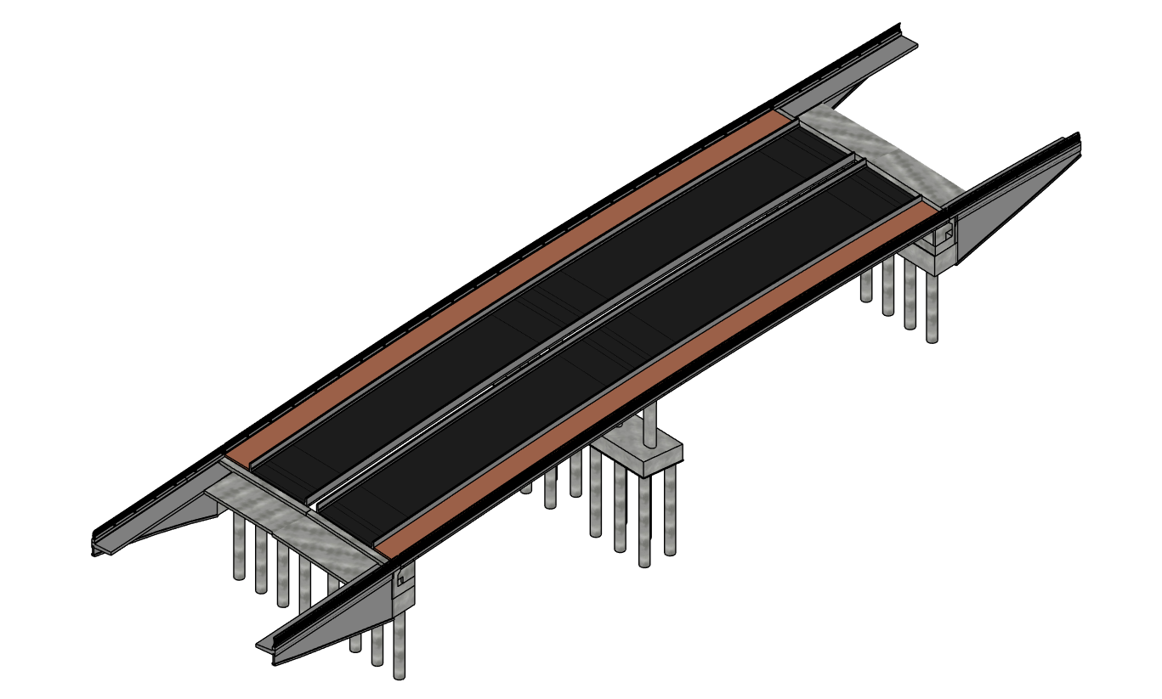
2-VENT BOX GRDER BRIDGE

Slide 4
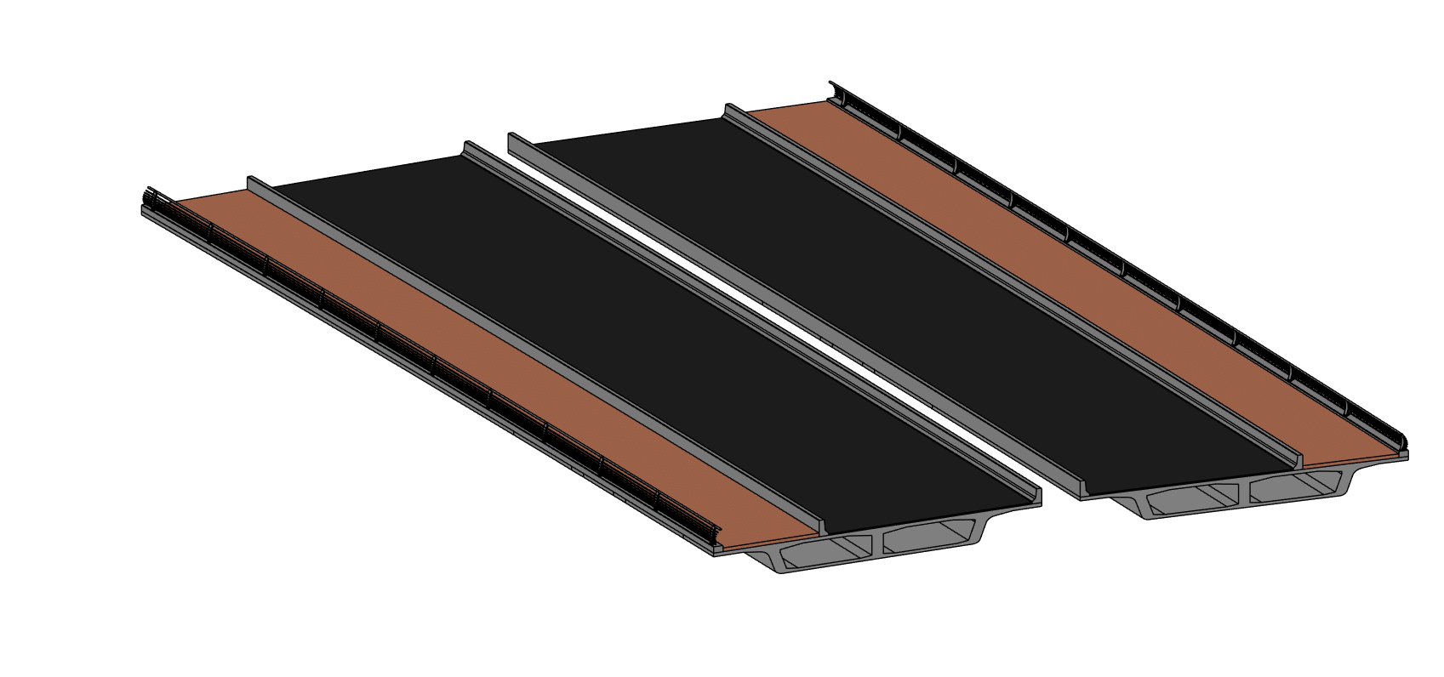
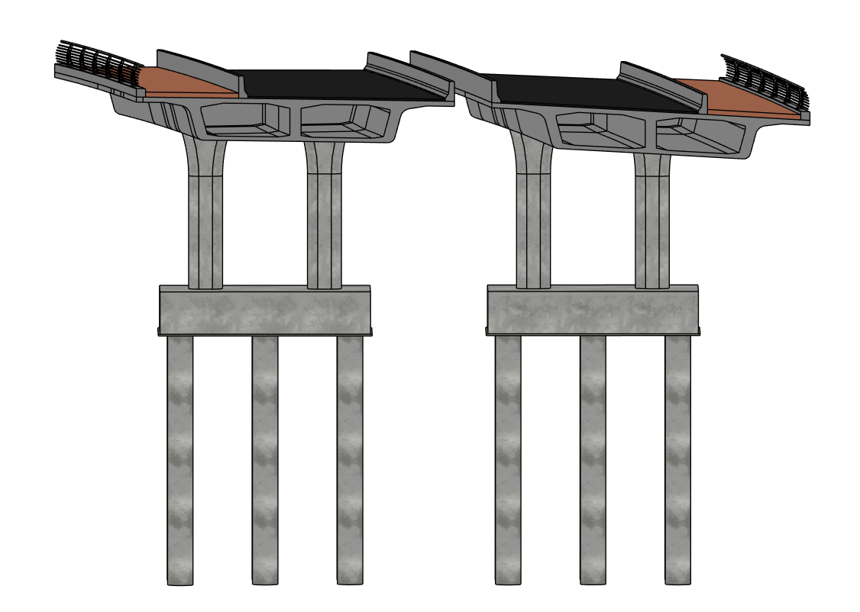
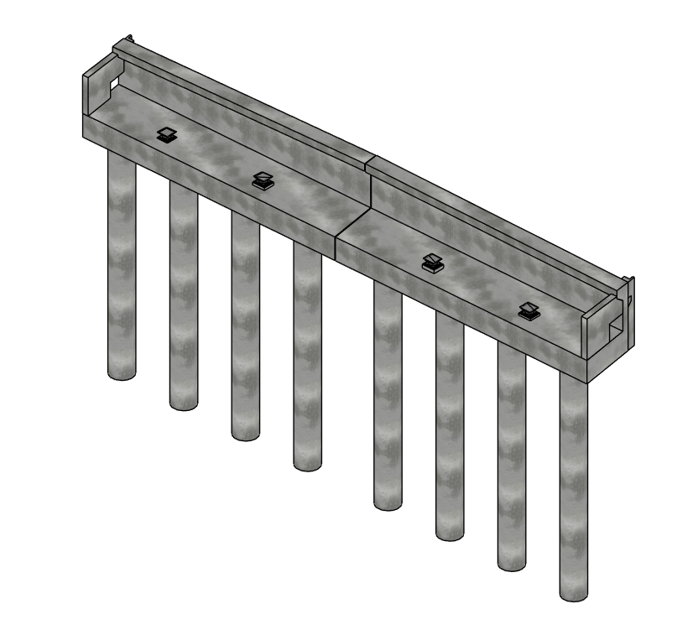
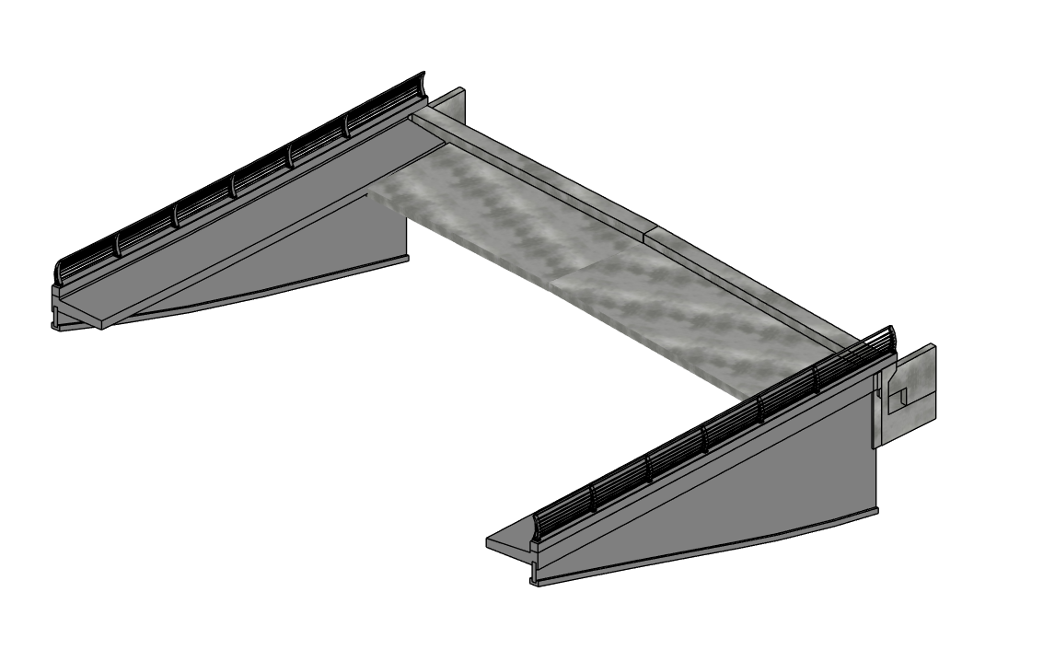
2-VENT BOX GIRDER BRIDGE

Slide 5
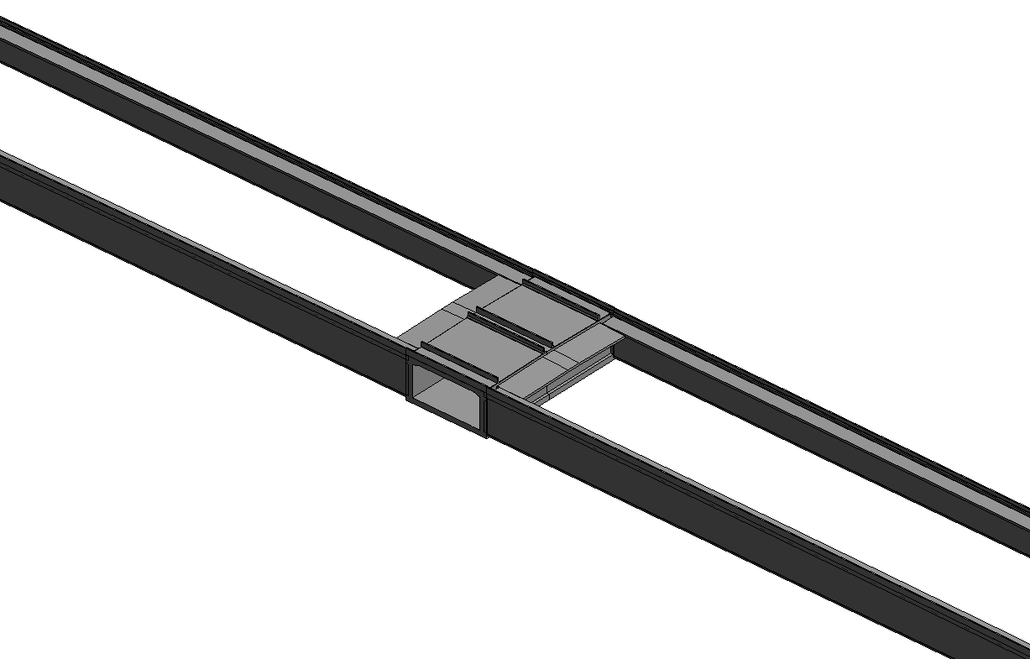
UNDERPASS

Slide 6
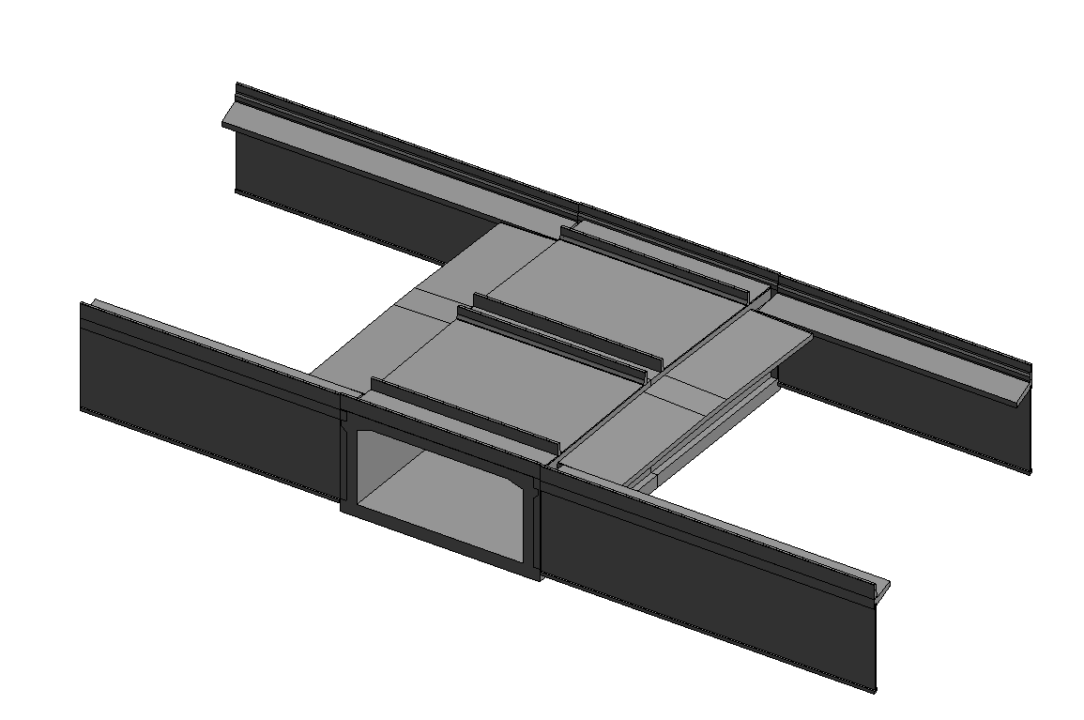
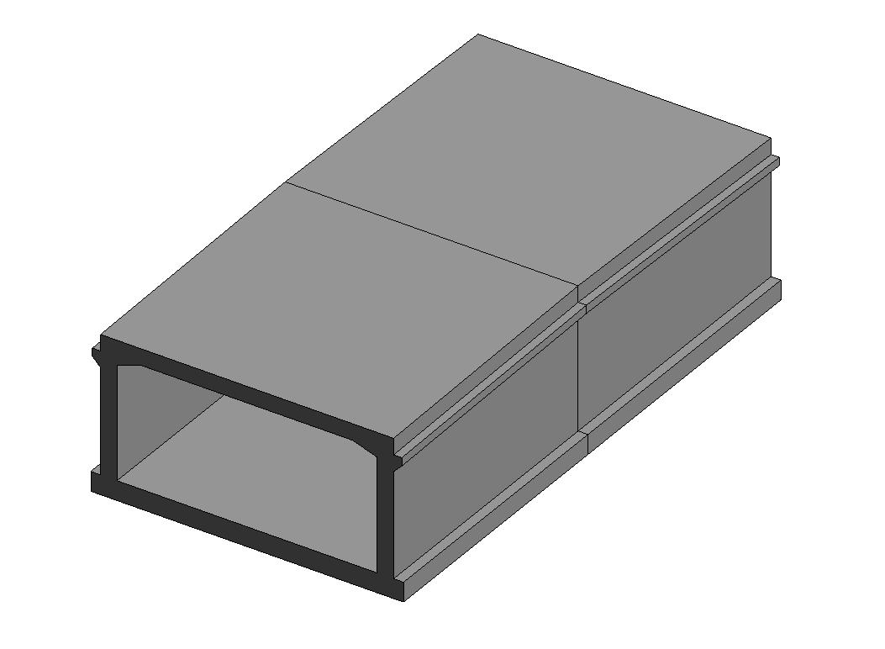
UNDERPASS

Slide 7
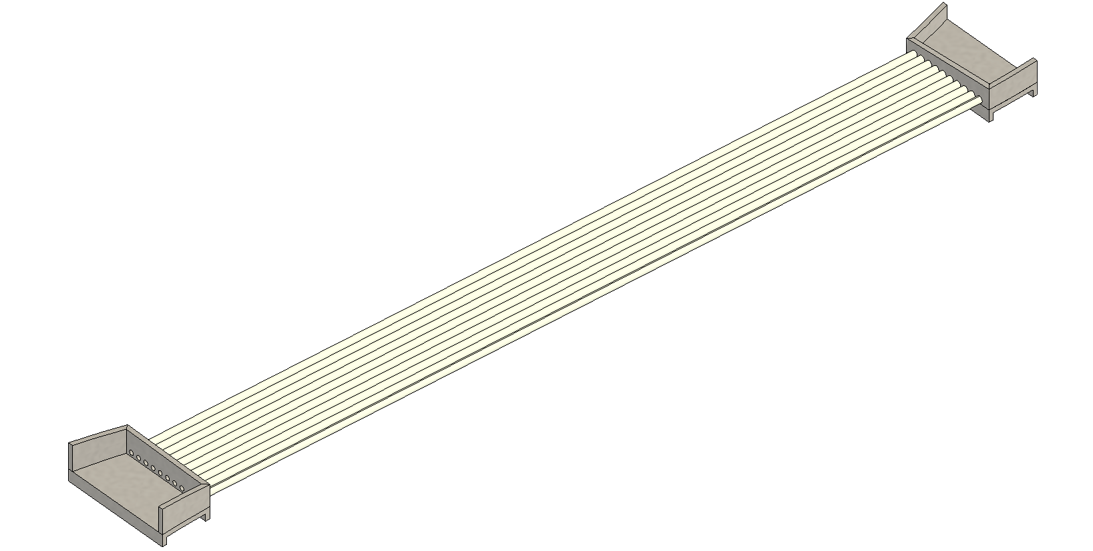
CULVERT

Slide 8
ADAPTIVE FAMILIES
PIER
UNDERPASS
RAILING
RETAINING WALL

Slide 9
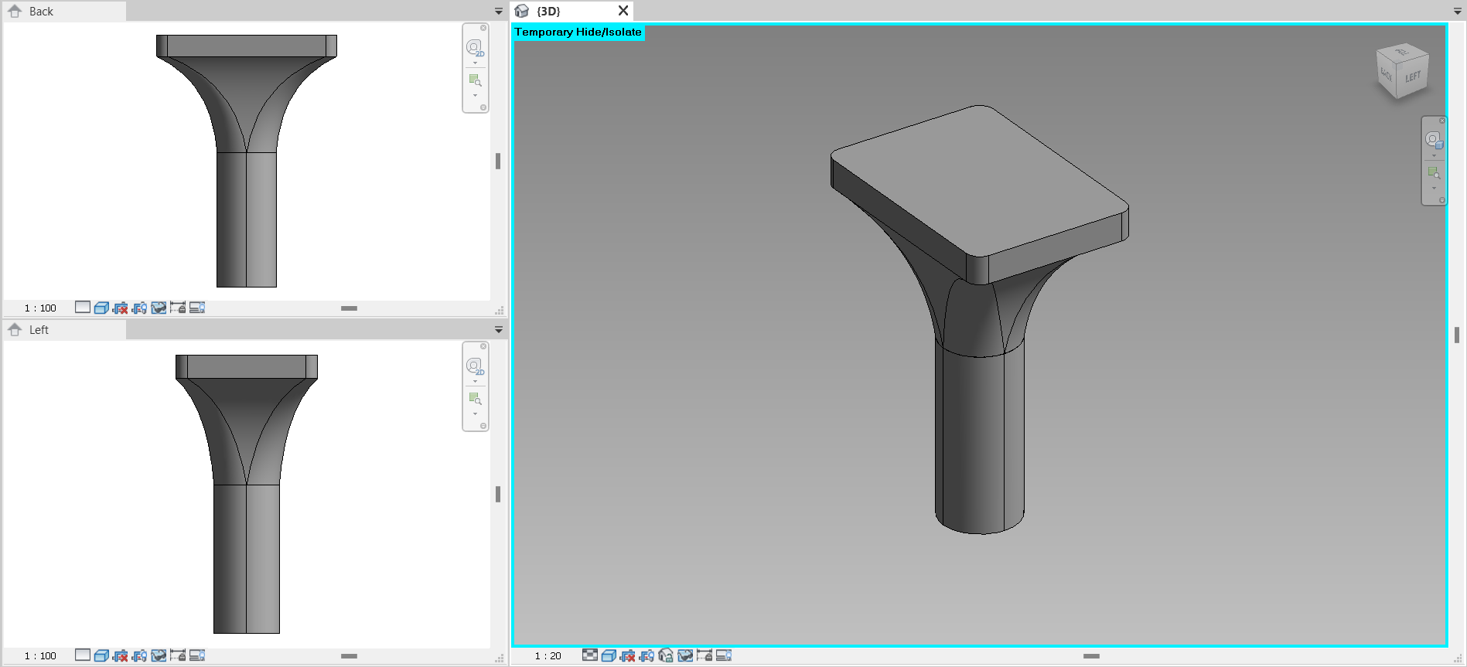
PIER

Slide 10
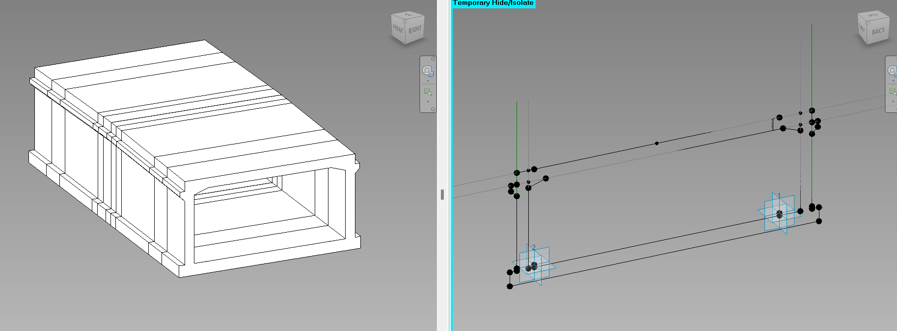
UNDERPASS

Slide 11
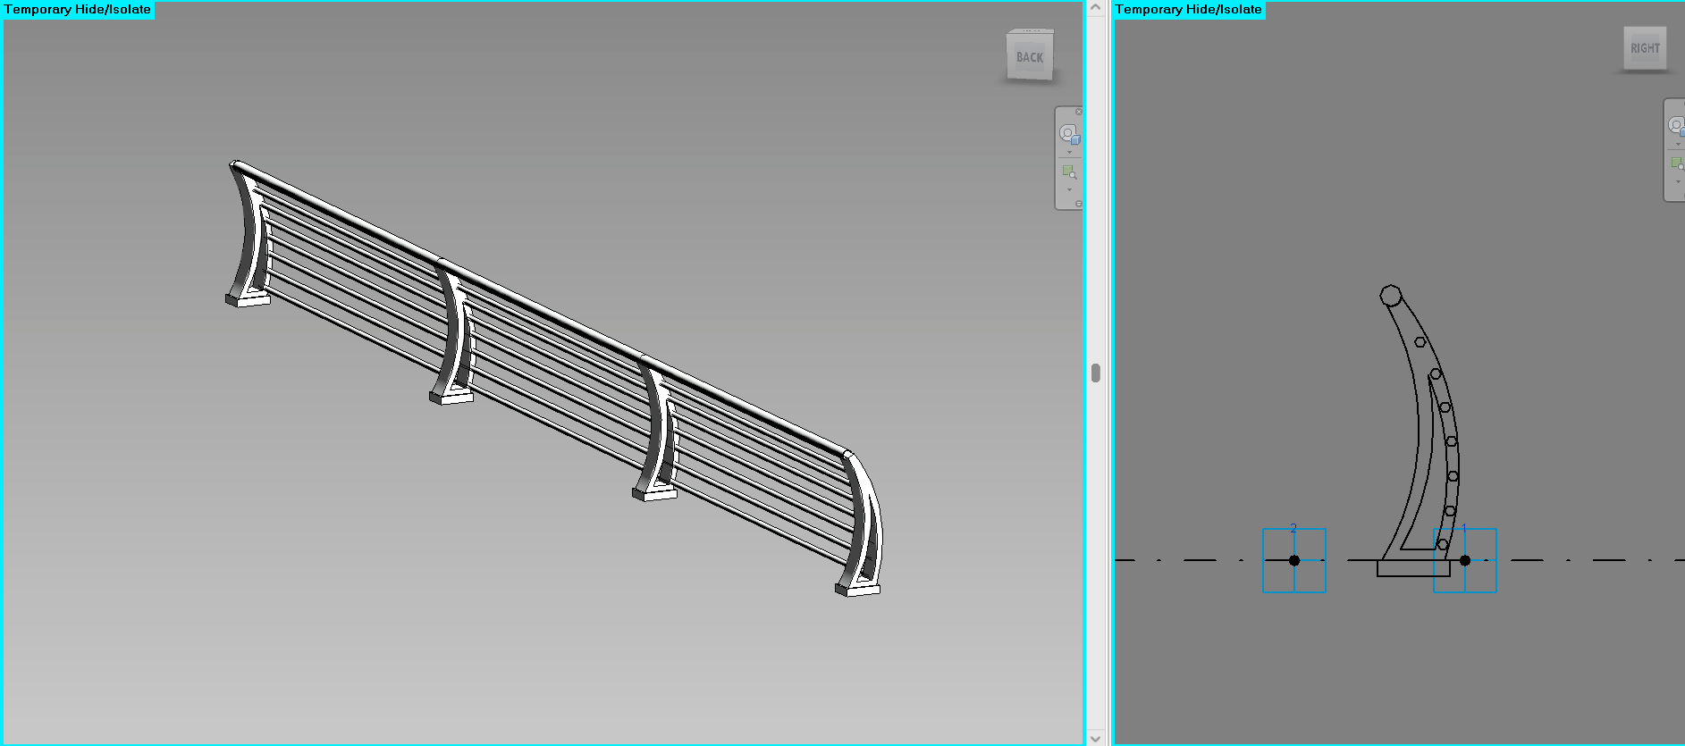
RAILING

Slide 12
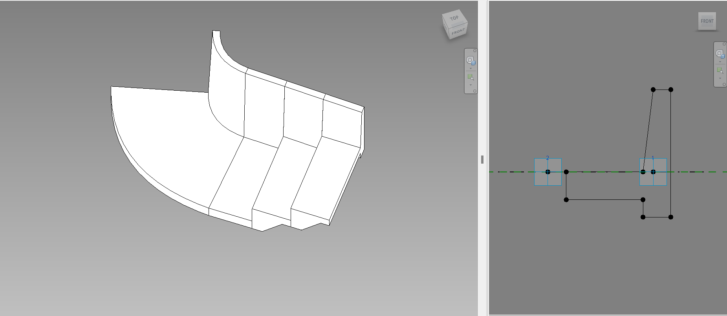
RETAINING WALL

Slide 13

DYNAMO SCRIPTS
1-VENT BOX GIRDER
UNDERPASS
RETAINING WALLS

Slide 14
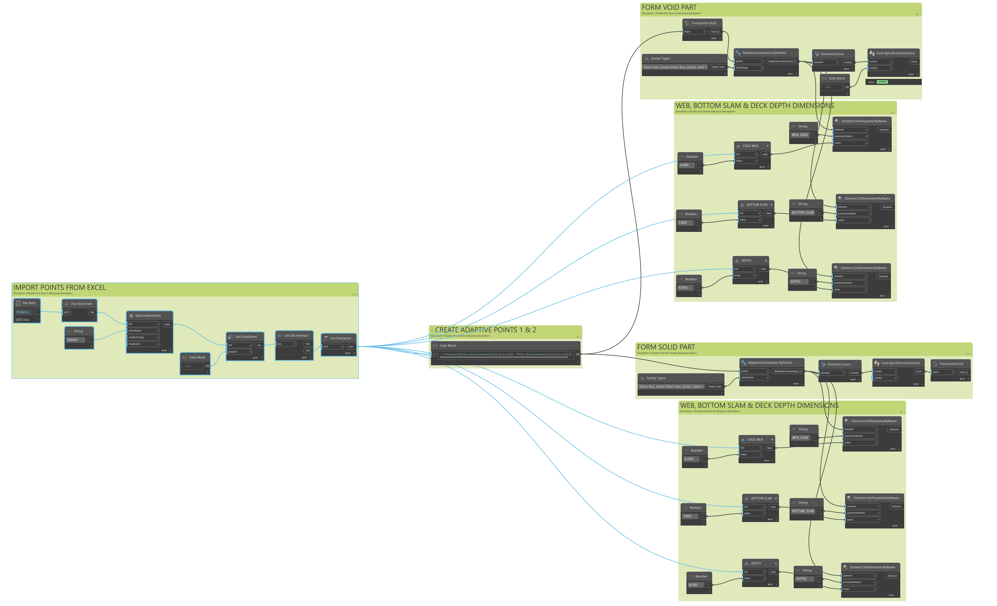
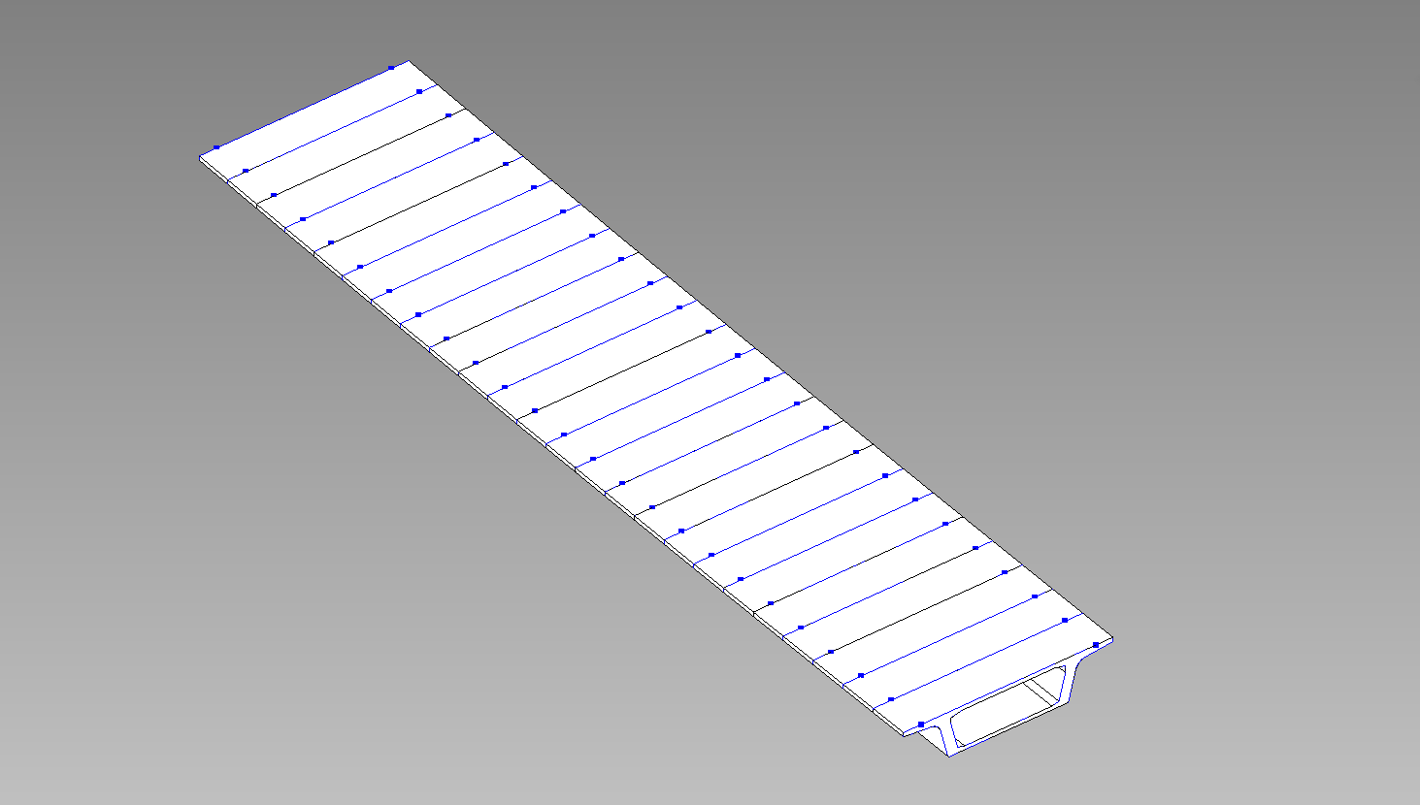
1-VENT BOX GIRDER

Slide 15
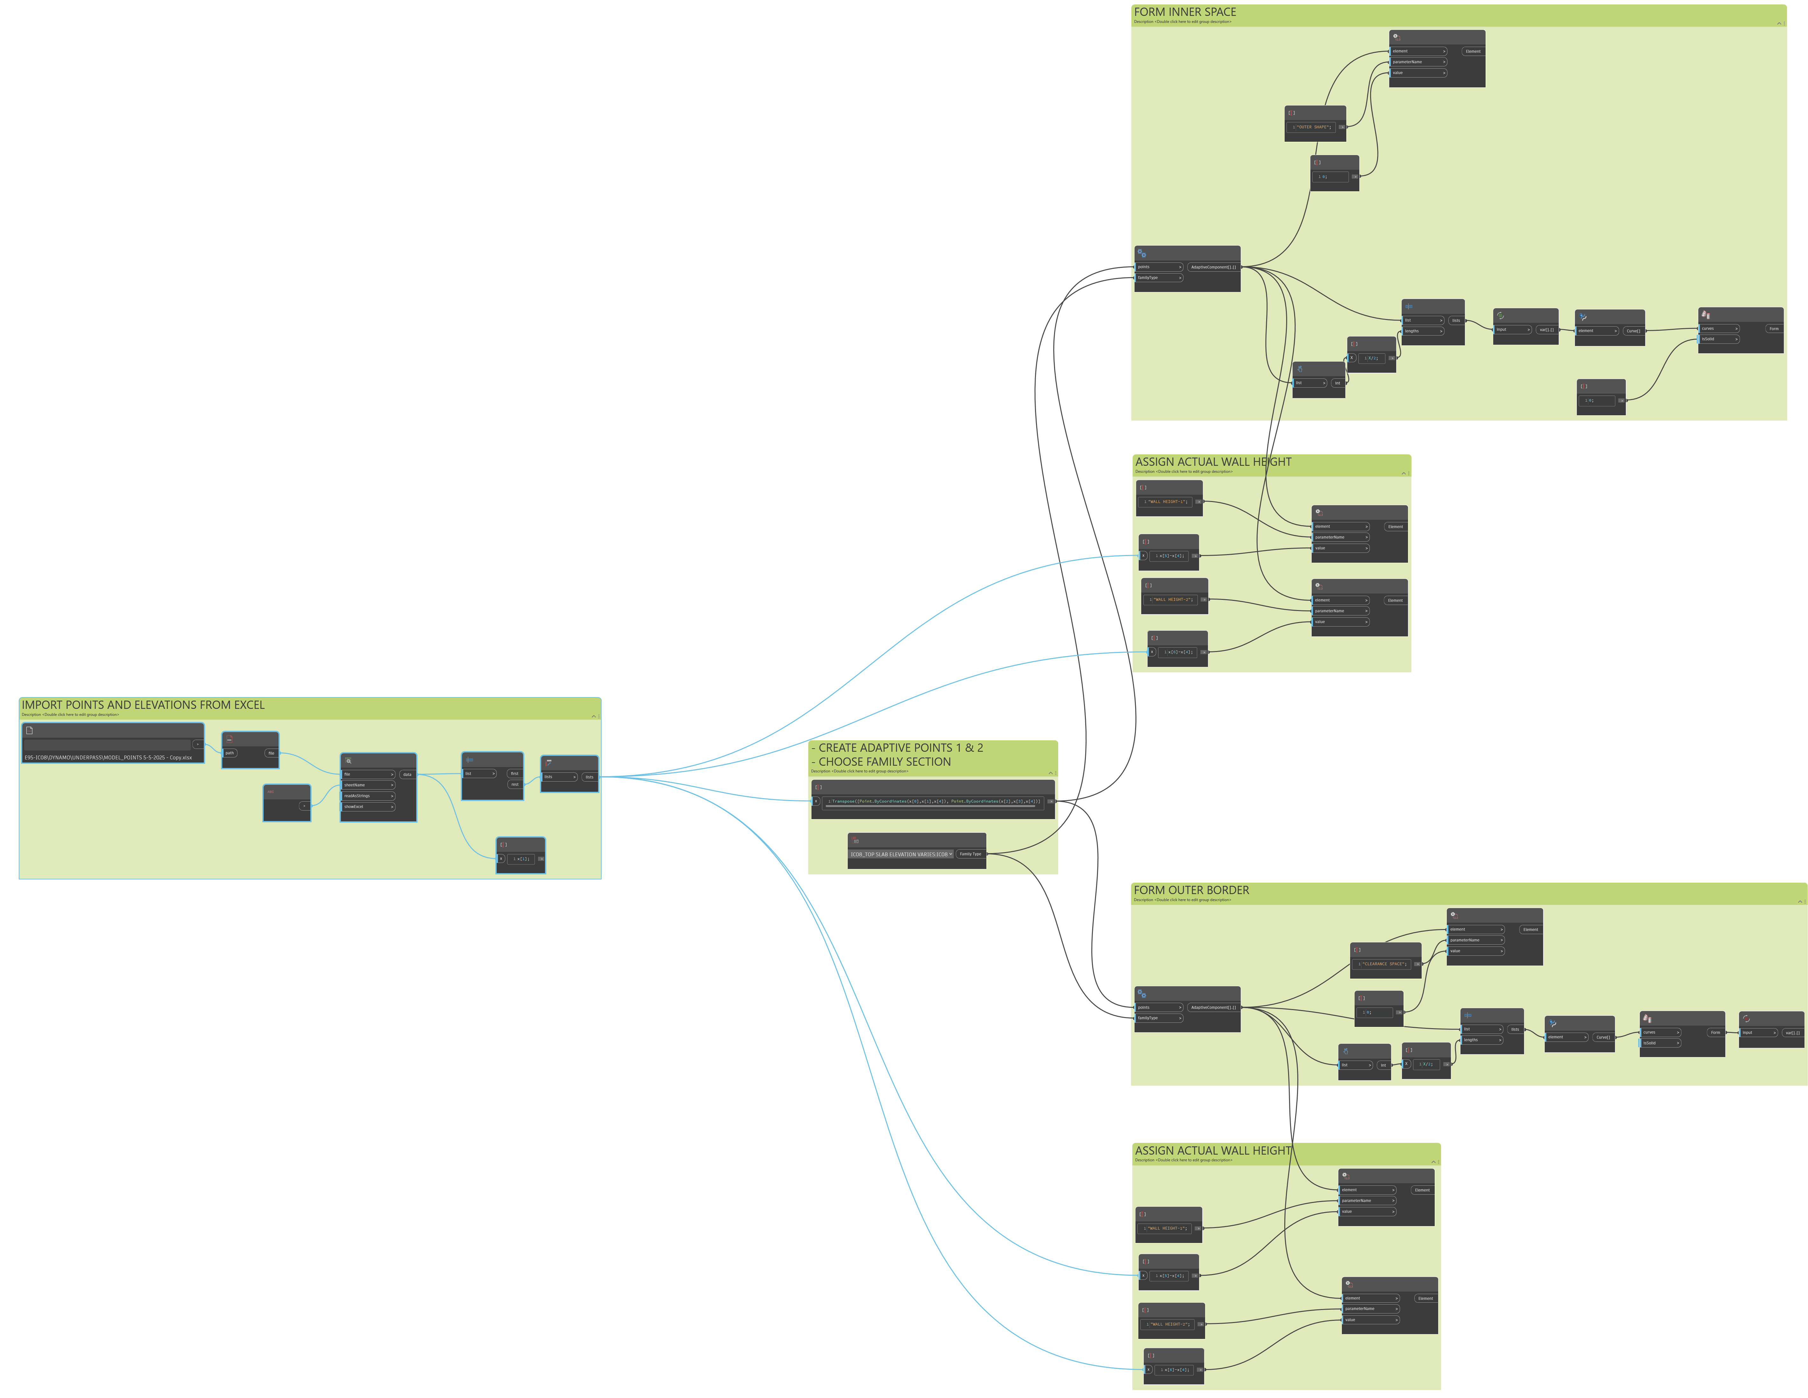
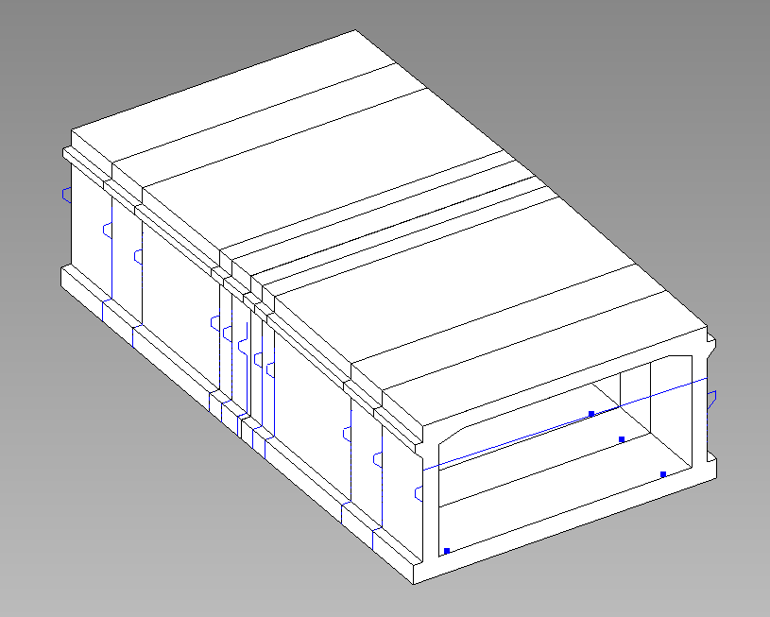
UNDERPASS

Slide 16
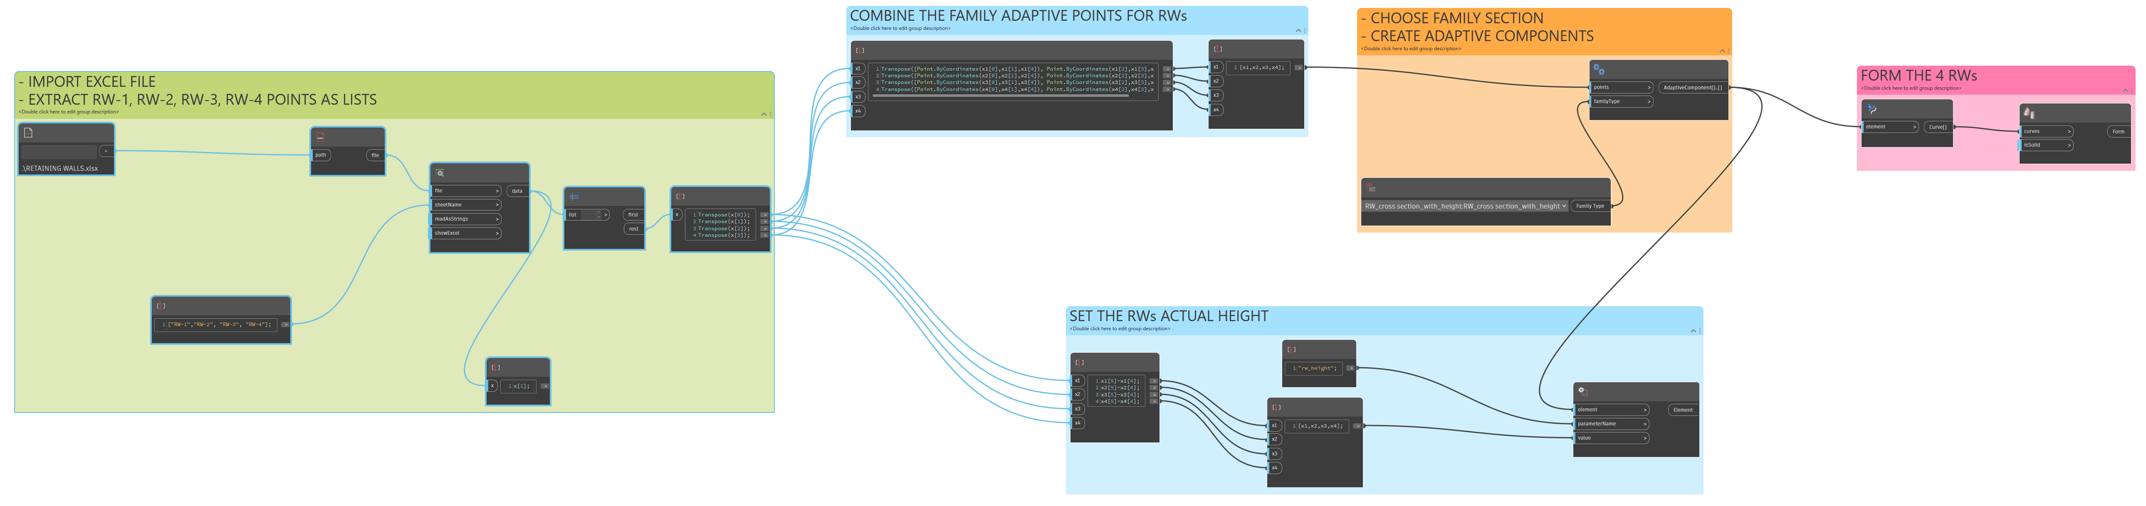
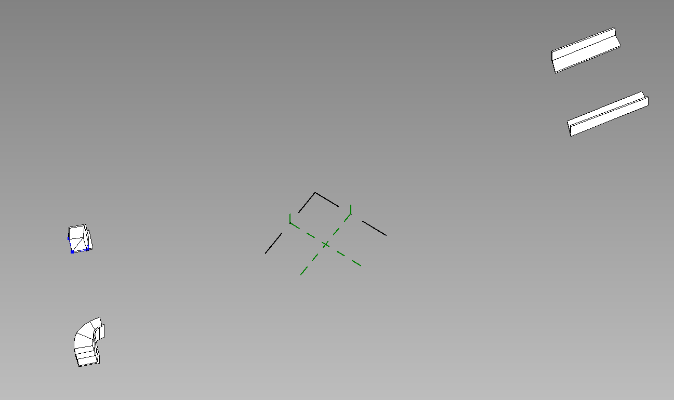
RETAINING WALLS

