Slide 1
Group P06
Anomalous Login Detection
Aaffan Niazi, Mustafa Hussain, Muhammad Mustafa, Shehroz Faryad

Slide 2
Overview
Objective: Detect suspicious or unusual login activities in real-time using the ELK Stack (Elasticsearch, Logstash, Kibana) integrated with Wazuh.
Function: Collects authentication logs, detects patterns like multiple failed attempts or logins from abnormal locations.
Users: System administrators and security engineers.
Key Benefit:
Real-time alerts for abnormal logins.
Faster detection and response to security threats.
Centralized dashboard for visualization and monitoring.

Slide 3
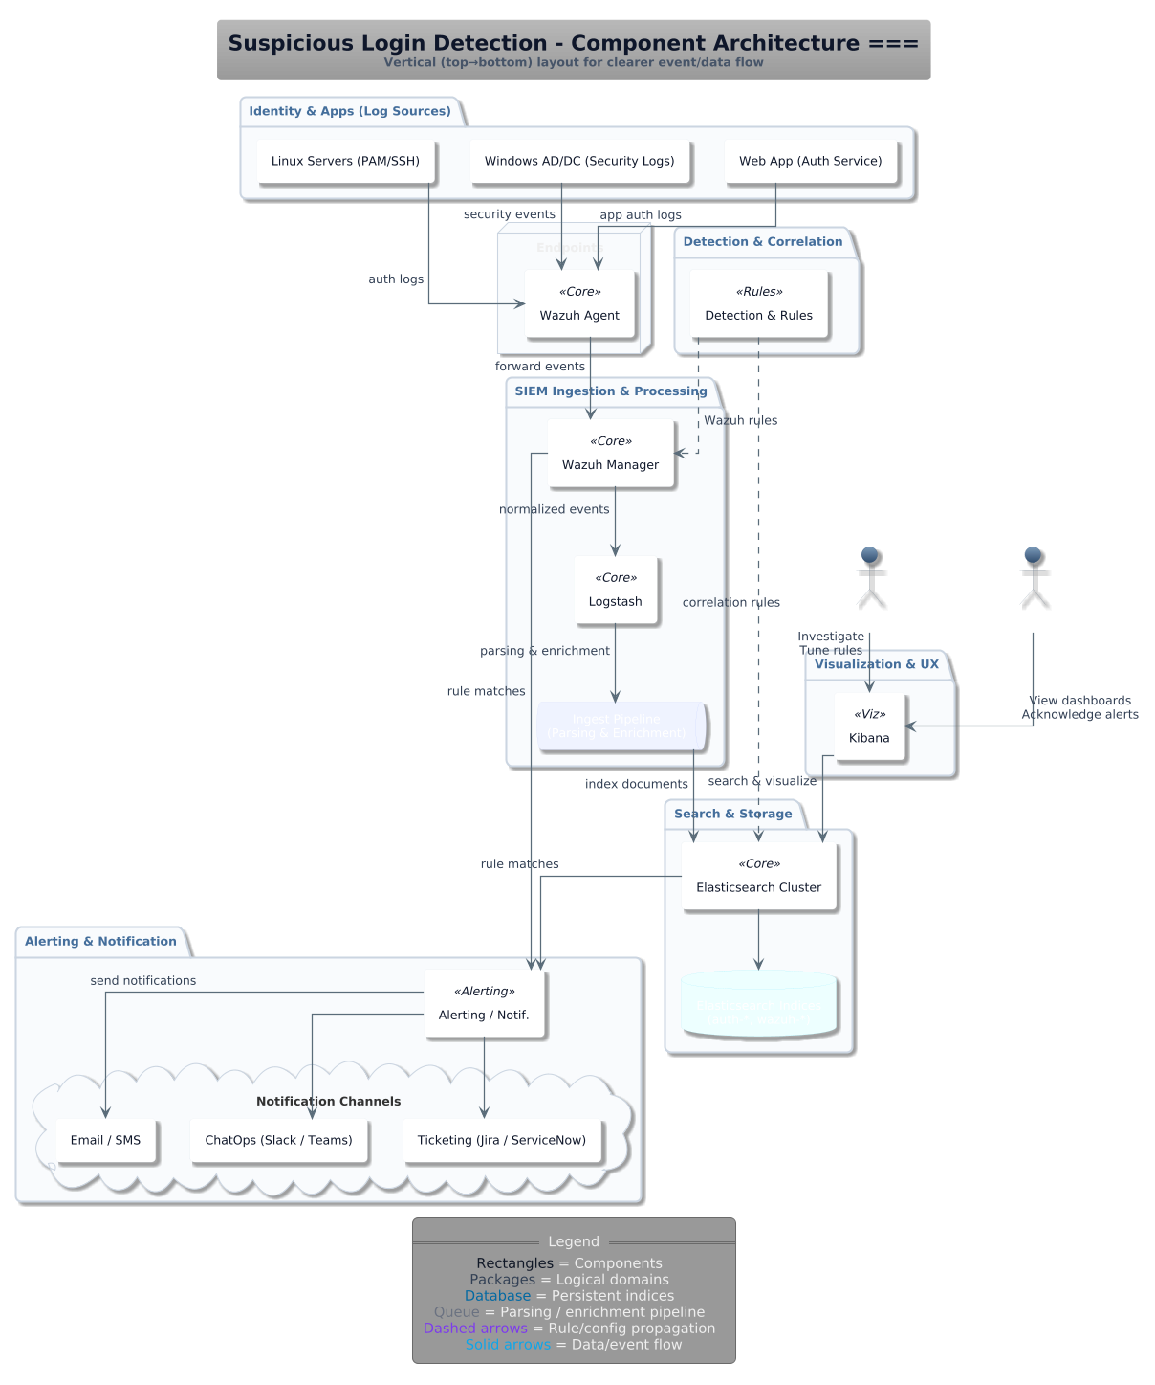
System Architecture

Slide 4
System Architecture
Core Components:
Log Sources (Identity & Apps): Generate authentication/security logs from servers and web apps.
Wazuh Agent: Collects and forwards logs securely.
Wazuh Manager + Logstash: Normalize and enrich logs; apply detection rules.
Elasticsearch Cluster: Stores and indexes events for fast search.
Kibana: Provides dashboards for analysis and visualization.
Alerting & Notification System: Sends alerts via Email, SMS, or ChatOps tools.
Architecture Features:
Modular and scalable design (collection, processing, storage, and visualization layers).
Real-time data processing pipeline.
Fault-tolerant and easily extendable structure.

Slide 5
How Architecture Supports Non-Functional Requirements
1. Performance – Process 10,000 log entries per second
Parallel ingestion from multiple Wazuh Agents.
Optimized Logstash enrichment and time-based Elasticsearch indices.
Horizontal scalability across ingestion tiers.
2. Reliability – Recovery within 5 minutes after failure
Fault isolation between collection, processing, and storage tiers.
Stateless components enable quick restart and auto-recovery.
Health monitoring dashboards in Kibana.
3. Efficiency – Memory usage under 1 GB
Lightweight event forwarding at the edge.
Compact data indices in Elasticsearch.
Minimal enrichment to reduce processing load.

Slide 6
How Architecture Supports Security Requirements
1. Broken Access Control
Kibana is the only user-facing entry point.
Role-based access: read-only for analysts, edit rights for engineers.
Private network isolation for backend components (Wazuh, Logstash, Elasticsearch).
2. Input Manipulation Attack
Early validation and normalization by Wazuh Agent and Manager.
Strict schema enforcement—reject malformed logs.
Alert triggers for suspicious log patterns or volume spikes.
3. Data Poisoning Attack
Pre-processing and filtering of logs before storage.
Separation of recent and archival data to limit contamination.
Continuous performance reviews in Kibana to refine detection rules.

Slide 7
Thank You

