Slide 1

VSkill Online Marketplace for skills
Developed By
Mustafa Supariwala

Slide 2


Introduction To VSkill
The VSkill Application is a platform that provides an ecosystem for the users to teach their skills to others and earn coins that they can spend on learning other skills.
It creates a community of people helping each other grow and motivates them to learn new skills.

Slide 3


Easy Registration
# Skill Cards
Request Tracking
Certifications
Transactions Storage
Efficient Search
Coin Ecosystem
Quick Chat
Profile Dashboard
Account Privacy

Slide 4











Technology Used
Frontend
Backend
Tools

Slide 5
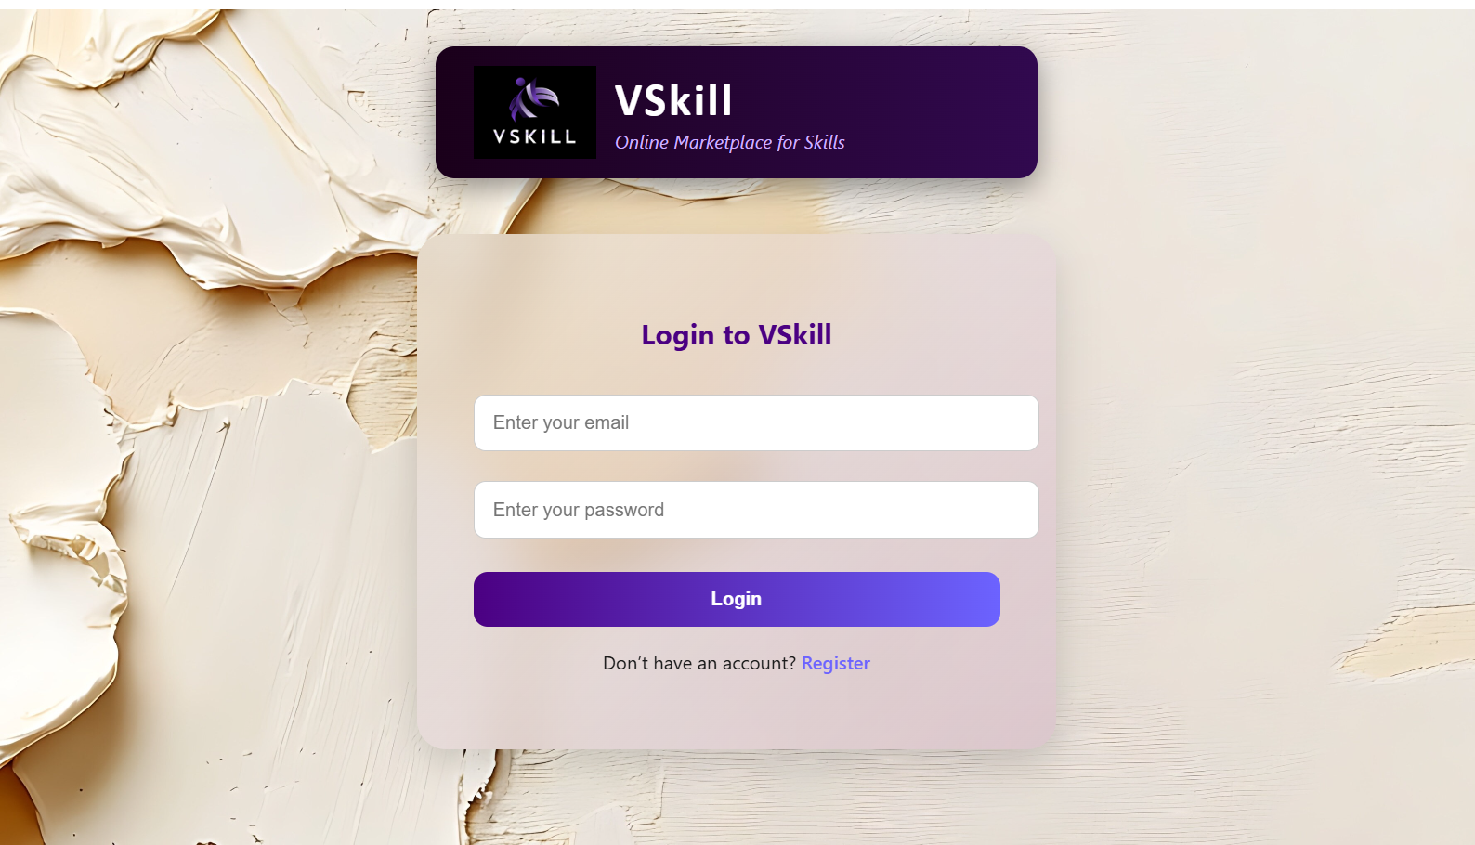
Login Page

Slide 6
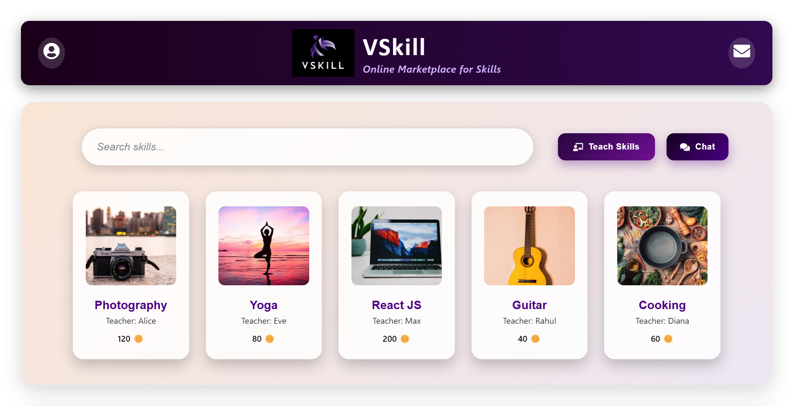
Homepage Overview

Slide 7
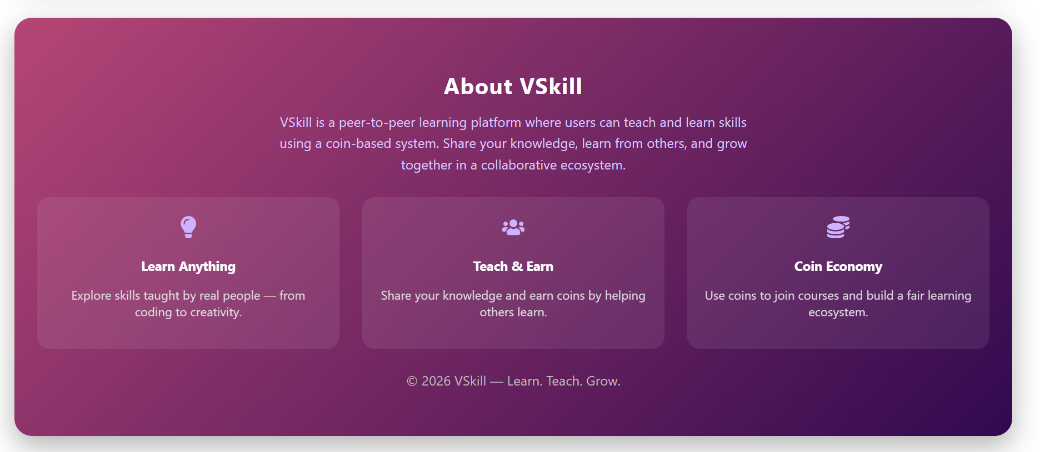
About Section

Slide 8
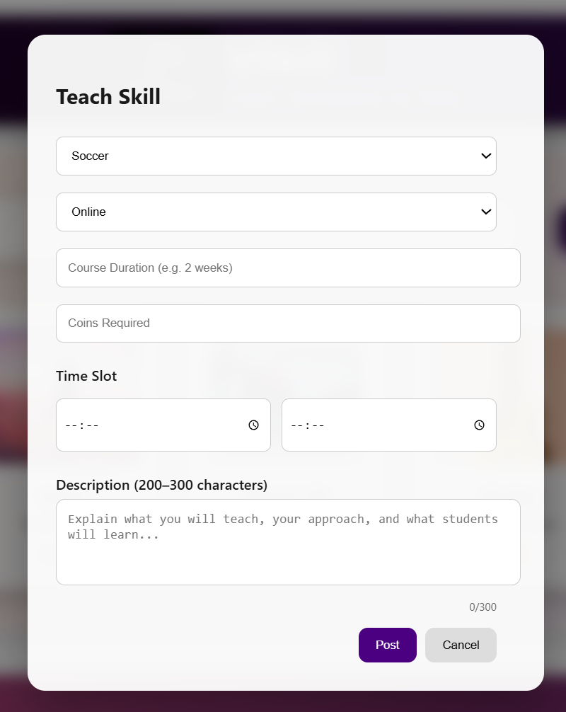
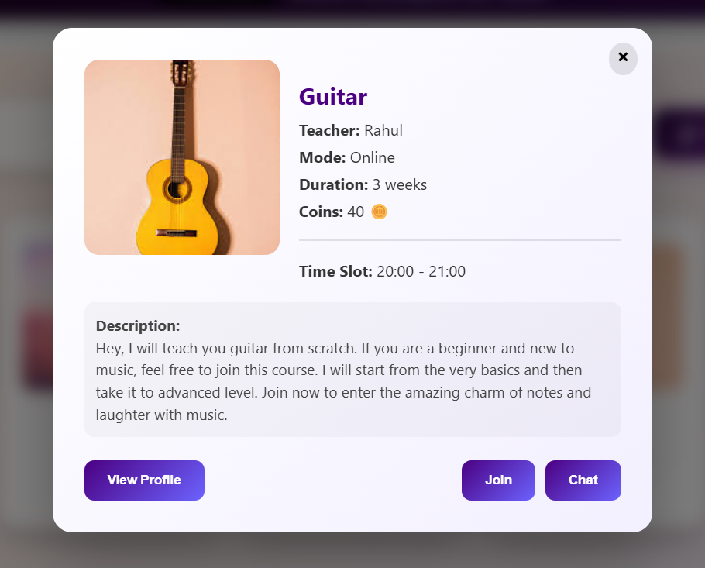
Skill Posting

Slide 9
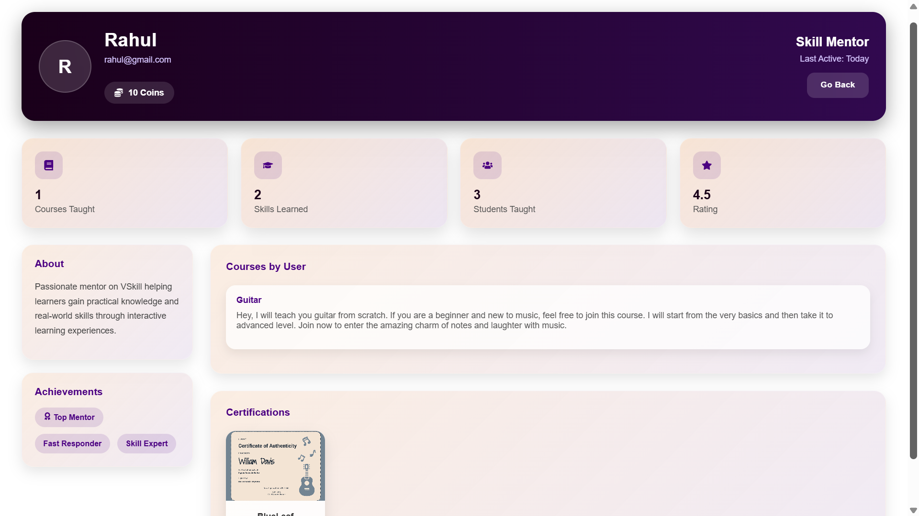

Slide 10
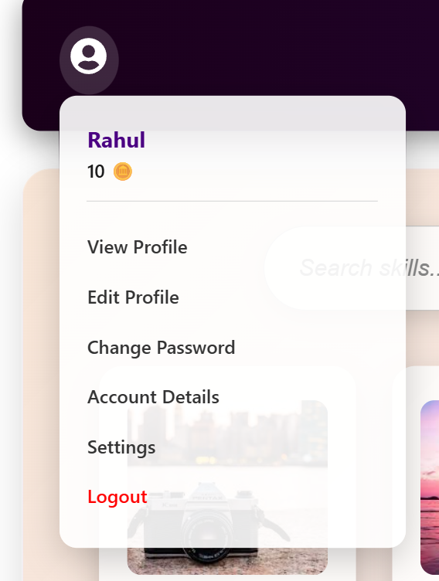
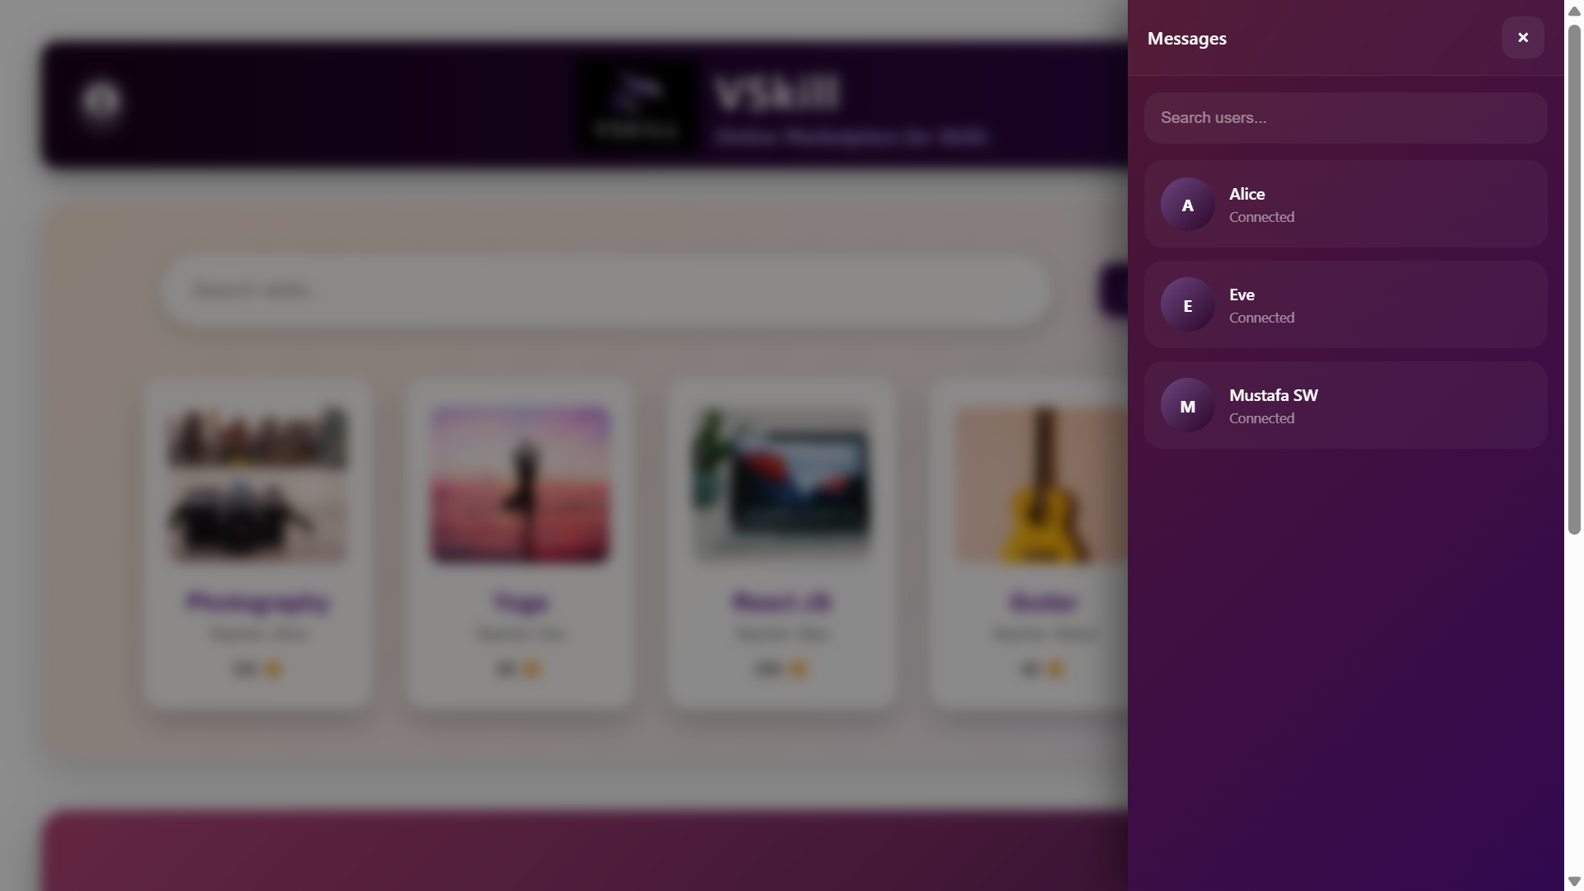
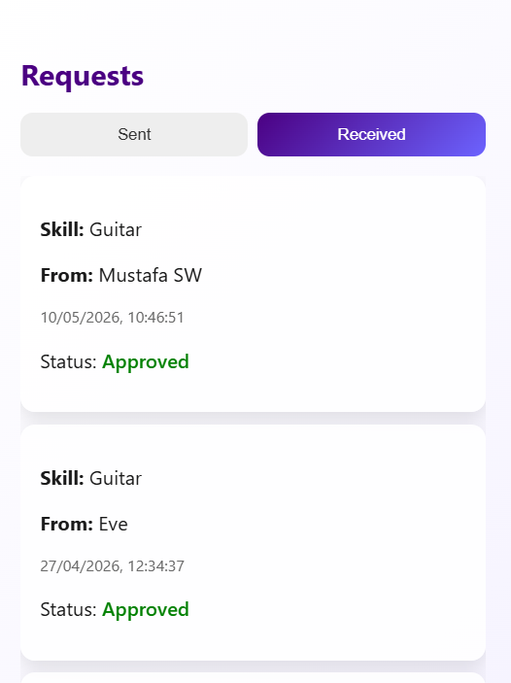
User Menu
Chat Section
Request Section

Slide 11
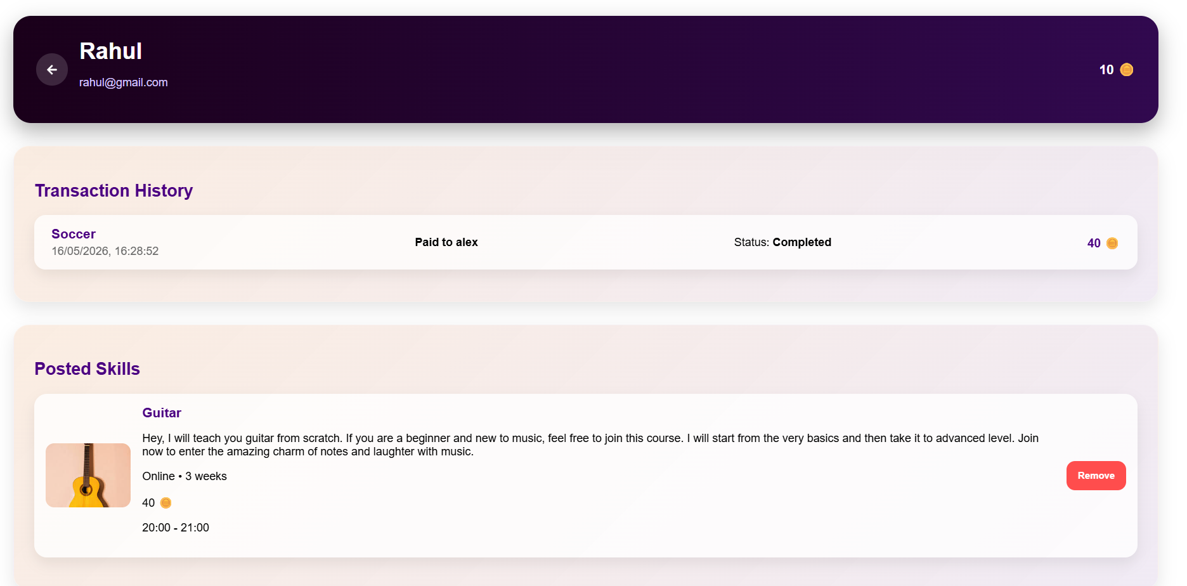
Account Details

Slide 12

Future Enhancements
Data Analytics & Insights
Feedback & Rating System
Cloud Integration
Notifications & Alerts
Gamification & Rewards
Security Enhancements

Slide 13


Thanks!
DO YOU HAVE ANY QUESTIONS?
You can view the project on :
www.github.com/Mustafa-SW

