Slide 1
The routing problem
Student 1
Support agent
flag 0
Search tools + LLM
Policies / FAQs
OUR BLOCK
Intent router
flag 0 or 1
KIO chat
message
Sales agent
flag 1
Search tools + LLM
Products / plans / pricing
KIO is the chat entry point to two specialist agents:
support (problems, complaints, existing requests)
and sales (new purchases, packages, quotes).
Routing picks the workflow; retrieval (RAG) then finds
information inside it. A wrong route means the
wrong tools and the wrong knowledge base.
Our block is the intent router: message in, flag out. 0
= support, 1 = sales.
We built the router twice and compared the two on
the same flag.
Notes:
STUDENT 1 - 0:45 of a 2:15 chapter.
KIO is the chat entry point to two specialist agents: support handles problems, complaints and existing requests; sales handles new purchases, packages and quotes. Our block is the highlighted one in the middle: a message goes in, a routing flag comes out, 0 for support and 1 for sales, and KIO uses that flag to call the agent. Routing picks the workflow; retrieval then finds information inside it, so a wrong route means the wrong tools and the wrong knowledge base and the answer cannot recover. We built this router twice and compared the two on the same flag.

Slide 2
The dataset
Student 1
60
24
20
16
synthetic English messages
30 support / 30 sales
plain
negation
mixed intent
60 synthetic English messages = 30 intent groups, each group a base message plus a paraphrase. 30 support / 30
sales.
Three categories on purpose, written so keywords mislead - support messages that say upgrade and premium
package, sales messages that say nothing is wrong.
Labeling guideline, agreed before any model ran: support = a problem or an existing service; sales = a new purchase
with no unresolved problem; mixed intent with an unresolved problem -> support.
Split 40 train / 20 test, balanced by class, split at group level so a paraphrase never lands on the other side of the
split. Seed 42.
Notes:
STUDENT 1 - 0:50.
Sixty synthetic English messages, written as thirty intent groups: each group is a base message plus a paraphrase of it. Thirty support, thirty sales. Three categories on purpose - twenty-four plain, twenty negation, sixteen mixed intent - and they are written so that keywords mislead: support messages that say upgrade and premium package, sales messages that say nothing is wrong. The labeling guideline was agreed before any model ran, and the important line is the last one: mixed intent with an unresolved problem is support. We split forty train, twenty test, balanced by class, at group level, so a paraphrase never lands on the other side of the split.

Slide 3
Sample rows, and how the two approaches differ
Student 1
id | message | label | split | category
1 | My internet connection keeps dropping every evening. | 0 | test | plain
13 | I did not order this upgrade, so why am I being billed for it? | 0 | test | negation
25 | Before I buy a second license, can you fix the error the first one keeps showing? | 0 | test | mixed
33 | I'd like to buy three more licenses for my team. | 1 | test | plain
43 | Nothing is wrong with my service, I just want a faster plan. | 1 | test | negation
53 | My last issue was fixed quickly, thanks! Now I'd like to order the security add-on. | 1 | train | mixed
How a decision model differs from a trained classifier
Trained classifier
Decision model
Learns from our labels: it turns the message into numbers and fits a boundary. It knows only what the 40 training messages taught it.
Already understands English: it is given the message plus routing instructions in words and returns a typed decision. Zero training examples - we tune wording, not weights.
Notes:
STUDENT 1 - 0:40.
Six real rows from the dataset. Notice id 13 and id 43: both are negations, and the surface words point the wrong way. Id 25 is mixed intent - the customer wants to buy a second license but has an unresolved error, so by our guideline it is support.
The conceptual difference, one line each. The classifier learns from our labels: it turns the message into numbers and fits a boundary, and it knows only what the forty training messages taught it. The decision model already understands English: we give it the message plus routing instructions in words and it returns a typed decision, with zero training examples. We tune wording, not weights.
HAND-OFF: 'Student 2 will show the decision model first.'

Slide 4
The decision model: what we used and why
Student 2
A Decision API like Jev (TypeSafe AI) takes message + instructions
and returns a typed decision. We had no paid API, so we used the
open-source equivalent with our own structured-output wrapper.
Message + routing instructions
Method: zero-shot via natural-language inference - the message is
the premise, each label becomes a hypothesis, entailment scores
are compared.
Zero-shot NLI model
facebook/bart-large-mnli
Architecture
BART-large, 407M parameters, fine-tuned on MultiNLI
Structured-output wrapper
License
MIT (weights); MultiNLI under its own permissive terms
Setup
local HuggingFace cache, HF_HUB_OFFLINE=1
Typed decision + flag
Runs
CPU, no API key, no network call, no training on our data
customer_service -> 0 | sales -> 1
Notes:
STUDENT 2 - 0:50 of a 2:30 chapter.
A Decision API like Jev from TypeSafe AI takes a message plus instructions and returns a typed decision. We had no paid API, so we used the open-source equivalent with our own structured-output wrapper. The model is facebook/bart-large-mnli: BART-large, four hundred and seven million parameters, fine-tuned on MultiNLI. The weights are MIT licensed. Setup is a local HuggingFace cache with HF_HUB_OFFLINE set to one - CPU only, no API key, no network call, and no training on our data. The method is zero-shot via natural-language inference: the message is the premise, each label becomes a hypothesis, and the entailment scores are compared.

Slide 5
Instructions, and output validation
Student 2
The instructions are the template + the two label descriptions
Structured output + validation: every answer
is parsed into {"decision", "confidence",
"scores"} and checked - decision in the
enum, confidence a float in [0,1], scores
over exactly the two labels summing to 1.
"This customer message is about {}."
customer_service -> "a problem with a service
the customer already has"
sales -> "buying a new product, a price
or an upgrade"
threshold = 0.41
Abstention band +/-0.05 around the
threshold returns "uncertain" and falls back
to support, the safe default. 3 of 60
abstained, 0 in test.
4 instruction variants, scored on the training split only
0 of 60
0.750
0.875
0.750
0.675
variant A
variant B (chosen)
variant C
variant D
outputs failed schema validation
Wording is worth 20 points - the key insight of this chapter
Notes:
STUDENT 2 - 0:50.
The instructions are the hypothesis template plus the two label descriptions, with a decision threshold of nought point four one. We wrote four instruction variants and picked one on the training split only: nought point eight seven five, nought point seven five, nought point seven five, nought point six seven five. Say this out loud: wording is worth twenty points - that is the key insight of this chapter.
On the output side, every answer is parsed into a decision, a confidence and the two scores, and schema-checked: the decision must be in the enum, confidence a float between zero and one, and the scores must cover exactly the two labels and sum to one. Zero of sixty outputs failed validation. There is also an abstention band of plus or minus nought point nought five around the threshold: inside it the wrapper returns uncertain and falls back to support, the safe default. Three of sixty abstained, none of them in the test split.

Slide 6
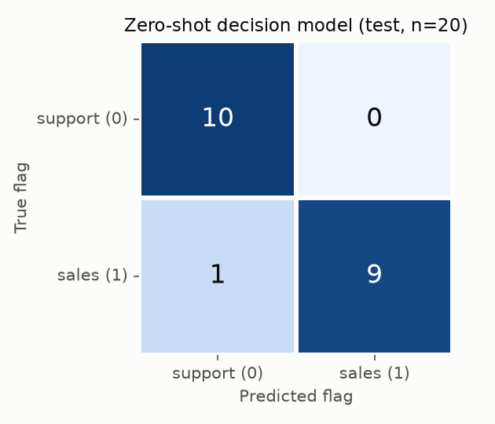
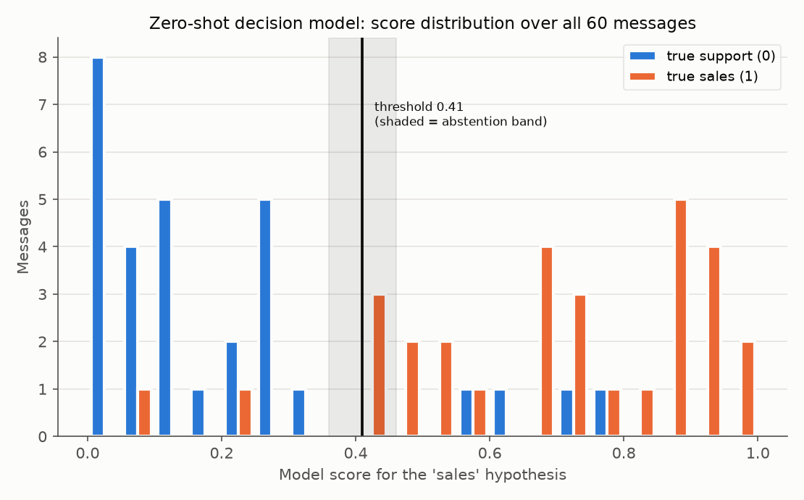
Decision model: results
Student 2
0.95
0.85
test accuracy (n=20)
macro F1 0.95
across all 60 messages
the test half is easier
By category: plain 8/8 negation 7/8 mixed 4/4
Never sent a real problem to sales
Two real outputs, copied from results/zeroshot_predictions.csv
id 25 is the win: mixed intent, the words buy and
second license are right there, and it still routes
to support.
id 33 "I'd like to buy three more licenses for my team." -> flag 1
{"decision": "sales", "confidence": 0.906,
"scores": {"customer_service": 0.094, "sales": 0.906}}
id 25 "Before I buy a second license, can you fix the -> flag 0
error the first one keeps showing?"
{"decision": "customer_service", "confidence": 0.704,
"scores": {"customer_service": 0.704, "sales": 0.296}}
One error - id 43 scored 0.07 for sales: confidently
wrong, outside the abstention band. Validation
guarantees the shape of the answer, never its
truth.
Cost: 546 ms per message on CPU, ~1.6 GB in memory
Notes:
STUDENT 2 - 0:50.
Test accuracy nought point nine five, macro F1 the same, on twenty test messages. Across all sixty messages it is nought point eight five - say both, because the test half is the easier one. The confusion matrix is ten, zero, one, nine: it never sent a customer with a real problem to sales. By category: plain eight of eight, negation seven of eight, mixed four of four.
These are two real outputs, copied from results slash zeroshot_predictions.csv - this is what the router actually returns, not a sketch. Id 33 is the easy case. Id 25 is the win: mixed intent, the words buy and second license are right there, and it still routes to support because the customer has an unresolved error. That is exactly the rule we wrote in the labeling guideline, obeyed by a model we never trained.
One error: id 43, 'Nothing is wrong with my service, I just want a faster plan.' It scored nought point nought seven for sales - confidently wrong, outside the abstention band. The lesson is that validation guarantees the shape of the answer, never its truth. Cost: five hundred and forty-six milliseconds per message on CPU.
HAND-OFF: 'Now the classical approach, and the head-to-head.'

Slide 7
The traditional ML classifier
Student 3
Numeric features. Two options were tried: TF-IDF word n-grams,
and 11 hand-crafted features. Lexicons fixed a priori from the
routing definition.
The 11 hand-crafted features
length in words
length in characters
'?' present
support-lexicon hits
sales-lexicon hits
their margin
negation hits
existing-service hits
new-purchase hits
money words
first-person request
Model search: linear SVM, degree-2 polynomial-kernel SVM, and
logistic regression on degree-2 polynomial features - 45
configurations, selected by 5-fold grouped cross-validation on the
40 training messages only (paraphrase pairs kept in the same
fold).
Selected: 11 hand-crafted features + SVM, degree-2 polynomial
kernel, C = 1. CV accuracy 0.825. TF-IDF came last (0.725) - with
40 messages there is almost no vocabulary overlap with unseen
text.
45
configurations cross-validated
best CV accuracy 0.825
Notes:
STUDENT 3 - 0:45 of a 2:45 chapter.
The features have to be numeric. We tried two representations: TF-IDF word n-grams, and eleven hand-crafted features - length in words and characters, whether there is a question mark, support-lexicon hits per ten words, sales-lexicon hits, their margin, negation hits, existing-service hits, new-purchase hits, money words, and a first-person request flag. The lexicons were fixed a priori from the routing definition.
For the model we searched exactly what the brief allows: linear SVM, degree-2 polynomial-kernel SVM, and logistic regression on degree-2 polynomial features. Fifty configurations in total, selected by five-fold grouped cross-validation on the forty training messages only, with paraphrase pairs kept in the same fold. The winner was the eleven hand-crafted features with a degree-2 polynomial-kernel SVM at C equals one, cross-validation accuracy nought point eight two five. TF-IDF came last at nought point seven two five - with forty messages there is almost no vocabulary overlap with unseen text.

Slide 8
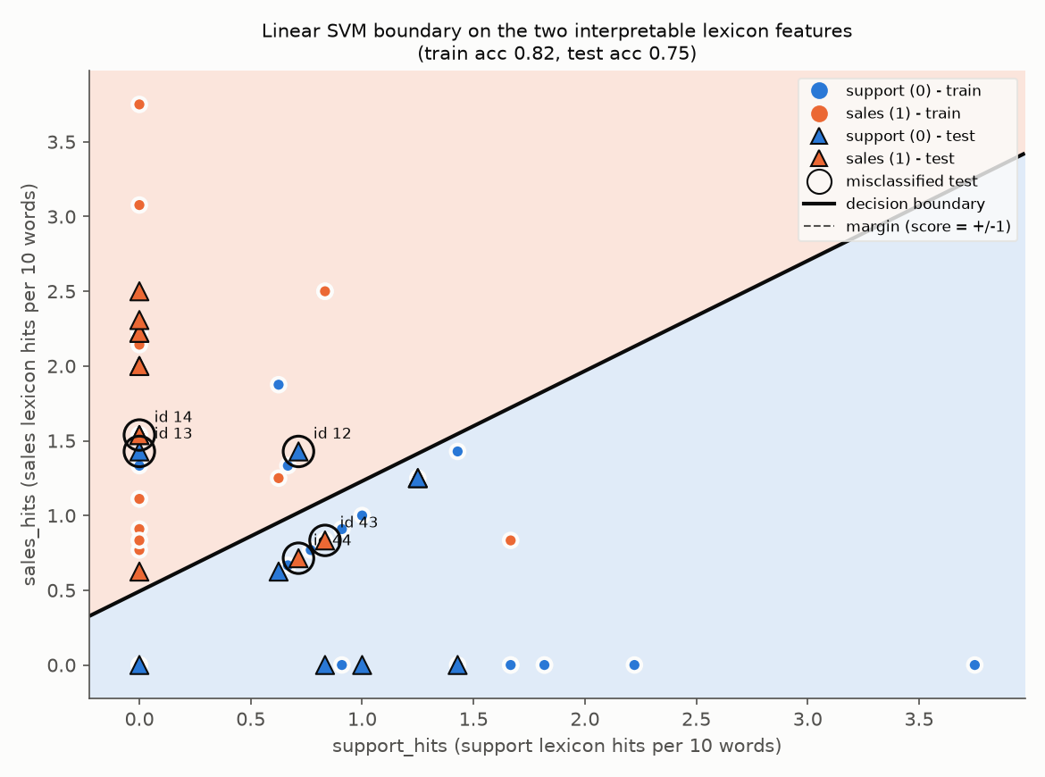
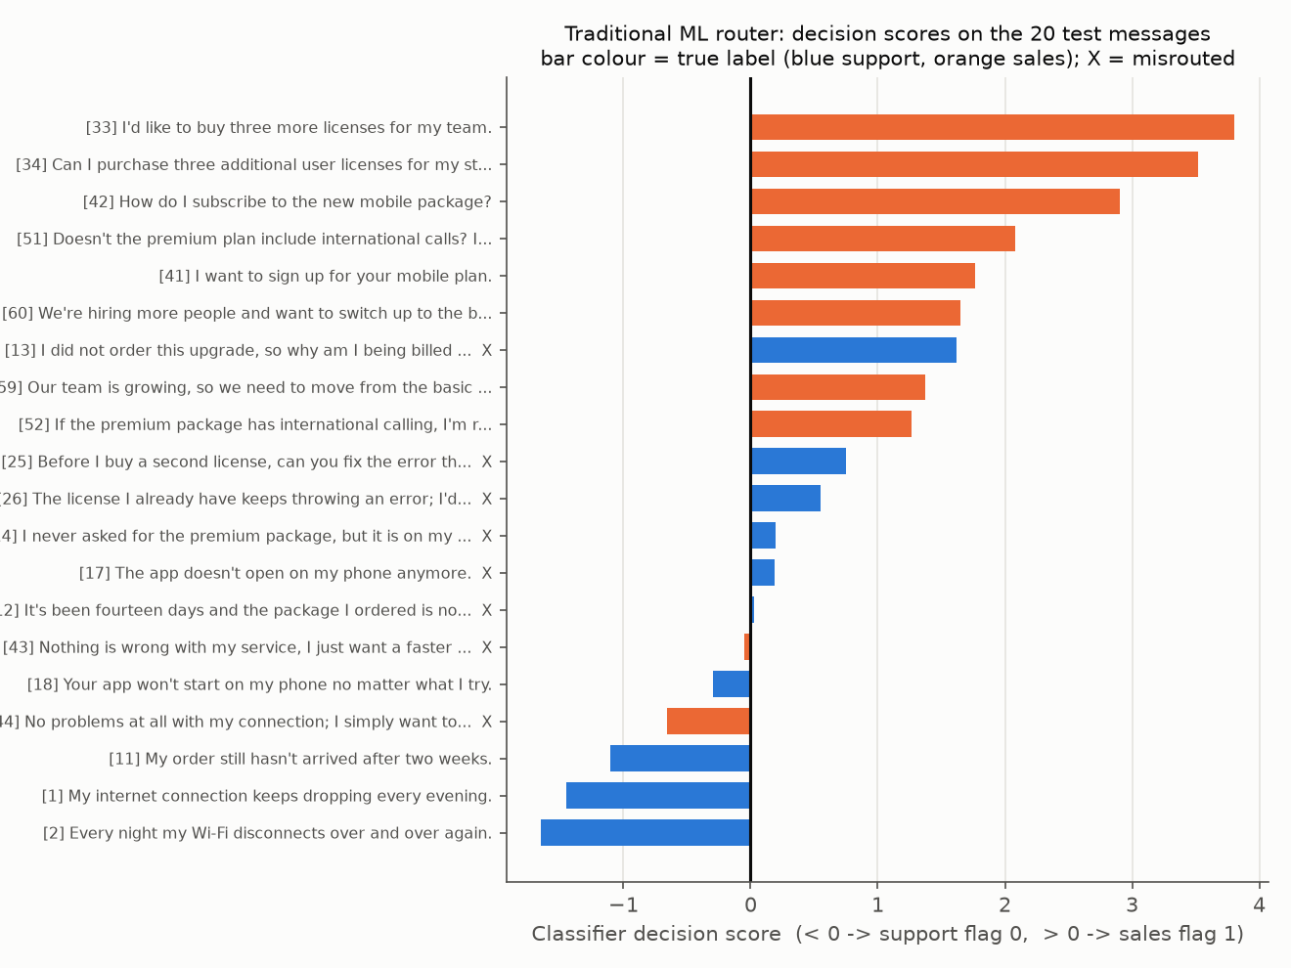
Its boundary, its outputs, its errors
Student 3
Boundary on two readable axes: support vs sales lexicon hits
Signed decision score of all 20 test messages
Train accuracy 0.975 -> test accuracy 0.600. That gap is overfitting: a
degree-2 kernel separates 40 points easily, and CV on 40 points is
too noisy to catch it.
Permutation importance: the strongest single feature is the question
mark (0.080 accuracy drop); negation is almost unused (0.007).
Latency 0.06 ms/message - about 9 000x faster than the decision
model.
ids 12 (score 0.02) and 17 (0.19) are support messages pushed over
the line by a hair.
Notes:
STUDENT 3 - 0:45.
On the left is the boundary, drawn on two readable axes: support-lexicon hits against sales-lexicon hits. The same boundary for a PCA projection of the full feature space is in ml_decision_boundary.png.
Train accuracy nought point nine seven five, test accuracy nought point six zero zero. That gap is overfitting: a degree-2 kernel separates forty points easily, and cross-validation on forty points is too noisy to catch it.
On the right are its actual outputs: the signed decision score of all twenty test messages, one bar each, coloured by true label, with the misrouted ones marked. Point at the bars sitting just past zero - ids 12 and 17 are support messages pushed over the line by a hair.
Permutation importance tells us why: the strongest single feature is the question mark, and negation is almost unused. That one fact explains the errors on the next slide. On speed it wins easily - nought point two three milliseconds a message.

Slide 9
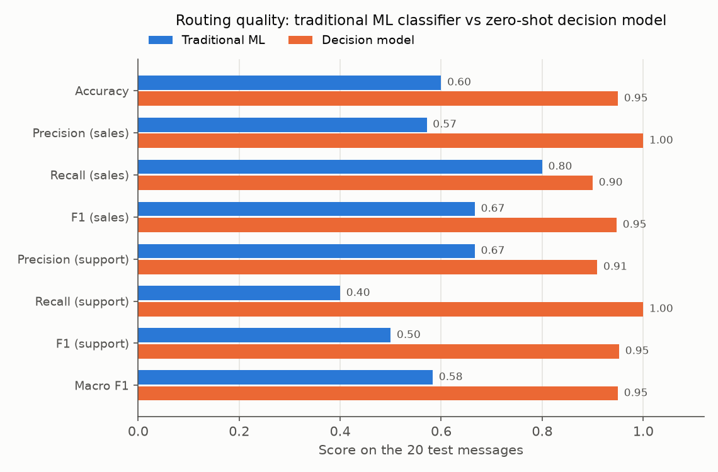
Head to head
Student 3
Metric (test, n=20) | Traditional ML | Decision model
Accuracy | 0.600 | 0.950
Macro F1 | 0.583 | 0.950
Recall (support) | 0.400 | 1.000
Recall (sales) | 0.800 | 0.900
plain / negation / mixed | 7/8, 3/8, 2/4 | 8/8, 7/8, 4/4
Latency per message | 0.06 ms | 546 ms
Labelled data needed | 40 and still rising | 0
The routers agree on 65% of test messages. Where they disagree, the decision model is right 7 times, the classifier 0. Exact McNemar p = 0.0156 -
significant, even at n = 20.
The error pattern: the classifier breaks on negation and mixed intent. "I did not order this upgrade, so why am I being billed for it?" - it sees upgrade,
order, '?' and routes to sales. The decision model reads the sentence and routes to support.
Fair to the classifier: the top six CV configurations score 0.60-0.75 on test, and the learning curve is still rising at 40 messages. It is not broken - it is
starved of data.
Notes:
STUDENT 3 - 0:45.
Side by side on the same twenty test messages. Accuracy nought point six against nought point nine five. The row that matters for the business is recall on support: nought point four against one point zero - the classifier sends six of ten customers with a real problem to the sales team.
The two routers agree on sixty-five per cent of test messages. Where they disagree, the decision model is right seven times and the classifier zero. An exact McNemar test gives p equals nought point nought one five six - significant, even at twenty messages.
The error pattern is consistent: the classifier breaks on negation and mixed intent. Take 'I did not order this upgrade, so why am I being billed for it?' - it sees upgrade, order and a question mark, and routes to sales. The decision model reads the sentence and routes to support.
To be fair to the classifier: the top six cross-validation configurations score between nought point six and nought point seven five on test, and the learning curve is still rising at forty messages. It is not broken - it is starved of data.

Slide 10
Recommendation for KIO
Student 3
Deploy the decision model now
0.95 vs 0.60
p = 0.0156
0
test accuracy against the classifier
exact McNemar - the gap is real
labelled examples it needed
Better where it matters, never misroutes a real problem in our test, needs no labelled data, and the wrapper makes the flag safe to use: typed
output, confidence exposed, abstain -> support.
What we accept: 546 ms per message and 1.6 GB of memory; MIT-licensed and fully offline, so no per-call fee and no customer data leaves the
machine. Instruction wording must be version-controlled - it is worth 20 points.
The path forward: log every decision with its confidence, let agents flag misroutes, and after a few thousand real labelled messages retrain the
classifier on that log and re-run this exact comparison.
Caveat we state ourselves: 20 test messages is small - the same decision model scores 0.85 over all 60. The ranking is solid; the exact numbers would
move on a larger set.
Notes:
STUDENT 3 - 0:30, the close.
Our recommendation is to deploy the decision model now. It is better where it matters - nought point nine five against nought point six, and the gap is statistically significant. It never misroutes a real problem in our test. It needs no labelled data. And the wrapper makes the flag safe to use in a pipeline: typed output, confidence exposed, and when it is unsure it abstains to support.
What we accept: five hundred and forty-six milliseconds a message and about one and a half gigabytes of memory. It is MIT licensed and fully offline, so there is no per-call fee and no customer data leaves the machine. The instruction wording has to be version-controlled, because it is worth twenty points.
The path forward is to log every decision with its confidence, let agents flag misroutes, and after a few thousand real labelled messages retrain the classifier on that log and re-run this exact comparison.
And the caveat we state ourselves: twenty test messages is a small sample - the same model scores nought point eight five over all sixty. The ranking is solid; the exact numbers would move on a larger set.

Slide 11
Sources
Student 3
Project 1 brief, Routing for Agent KIO
Dietterich (1998), Approximate statistical tests for comparing supervised classification learning algorithms
the task, the flag convention and the dataset specification
McNemar's test for paired comparison
facebook/bart-large-mnli model card, HuggingFace
MIT license (weights); MultiNLI corpus under its own permissive terms
Software
scikit-learn 1.9.1, transformers 5.20.1, torch 2.14.1+cpu, pandas 3.0.6, matplotlib 3.11.2, seaborn 0.13.2, scipy 1.18.1, Python 3.12.10
Yin, Hay & Roth (2019), Benchmarking Zero-shot Text Classification: Datasets, Evaluation and Entailment Approach
the NLI-as-zero-shot-classifier method we use
All code, data and saved results
the project repository (src/, data/, results/, REPORT.md)
Williams, Nangia & Bowman (2018), A Broad-Coverage Challenge Corpus for Sentence Understanding through Inference
Dataset
MultiNLI, the corpus the model was fine-tuned on
60 messages written by our team for this project, synthetic, no customer data
Notes:
STUDENT 3 - no extra speaking time; this slide is on screen while the recommendation lands and stays up through questions.
The brief asks us to present all work, results AND sources, so these are on screen: the project brief, the model card and its MIT license, the two papers behind the zero-shot method and its training corpus, Dietterich for the paired significance test, the exact software versions, the repository holding the code and all saved results, and a note that the dataset is synthetic and contains no customer data.

