Slide 1
WORKROSTER
A Smart Calendar for Shift Workers
Project Report · Version 1.0.1 · 2026
Mobile · iOS · Android · Web

Slide 2
WorkRoster
SECTION 01
The Problem Before WorkRoster
Shift workers had no proper tool to organize their schedules.
• Employees struggled to organize rotating shifts and track holidays.
• Schedules were managed manually using paper rosters or spreadsheets.
• Information was unclear, scattered, and easily out of date.
• Confusion in shift distribution led to missed days and overlap.
• No simple way to share holiday calendars between team members.
WorkRoster · Smart Scheduling for Shift Workers

Slide 3
WorkRoster
SECTION 02
Our Solution
WorkRoster turns shift management into a smart, automated system.
Set up once, run forever
Everything in one place
Configure your shift pattern and start date a single time. WorkRoster keeps the calendar up to date automatically — every day, every month, every year.
Shifts, holidays, notes, reminders, and team holiday sharing — all unified inside a clean, bilingual mobile app that works online or fully offline.
WorkRoster · Smart Scheduling for Shift Workers

Slide 4
WorkRoster
SECTION 03
How the App Works
1
2
3
Enter your shift schedule
The app fills the calendar
Receive smart reminders
Add your rotation pattern (morning / evening / night / rest) and choose your start date.
Daily and monthly views are generated automatically and updated as time passes.
Get alerts for upcoming holidays and shift changes — never miss an important day.
WorkRoster · Smart Scheduling for Shift Workers

Slide 5
WorkRoster
SECTION 04
Key Features
Shift Organization
Daily & Monthly View
Official Holidays
Morning, evening, night and rest shifts — color coded.
See your schedule at a glance, any month.
Add and manage public holidays.
Custom Annual Leave
Daily Notes
Smart Reminders
Personalize your own vacation days.
Attach notes to any day.
Get notified before key dates.
Simple Interface
Custom Themes
Powerful Search
Clean design, fast to learn.
Light, dark, and AI-generated themes.
Find any day, any range, any holiday.
WorkRoster · Smart Scheduling for Shift Workers

Slide 6
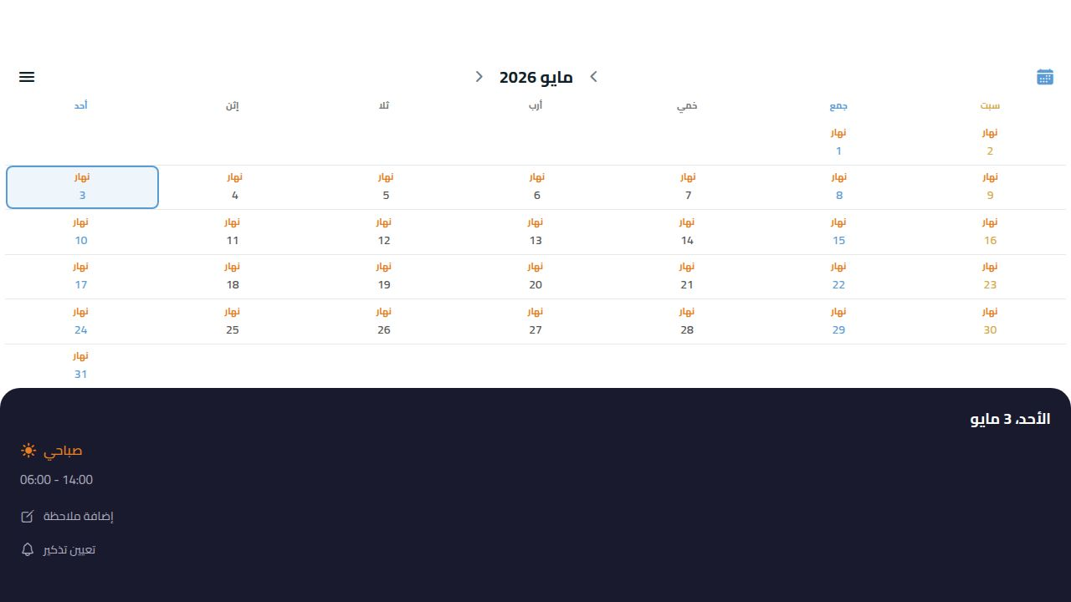
WorkRoster
FEATURE 01
Feature in Focus — The Calendar
Color-coded daily view
• Each day is auto-filled with the correct shift.
• Tap any day to see details, add notes or set a reminder.
• Indicators show where notes or holidays exist.
• Adjustable day-number font size for accessibility.
WorkRoster · Smart Scheduling for Shift Workers

Slide 7
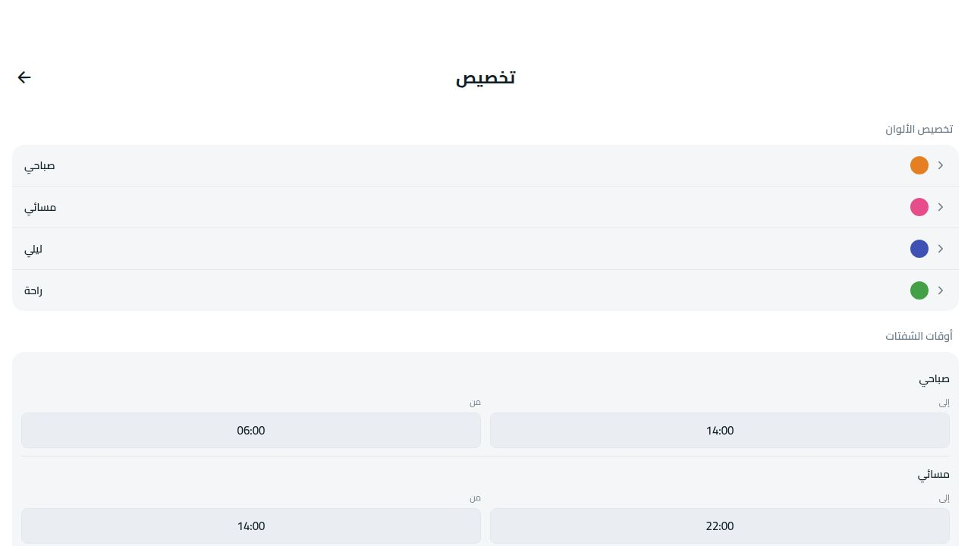
WorkRoster
FEATURE 02
Feature in Focus — Customize
Make the schedule yours
• Set your shift start date.
• Choose a Quick Setup preset or build a custom rotation.
• Adjust working hours per shift type.
• Personalize the color of every shift category.
WorkRoster · Smart Scheduling for Shift Workers

Slide 8
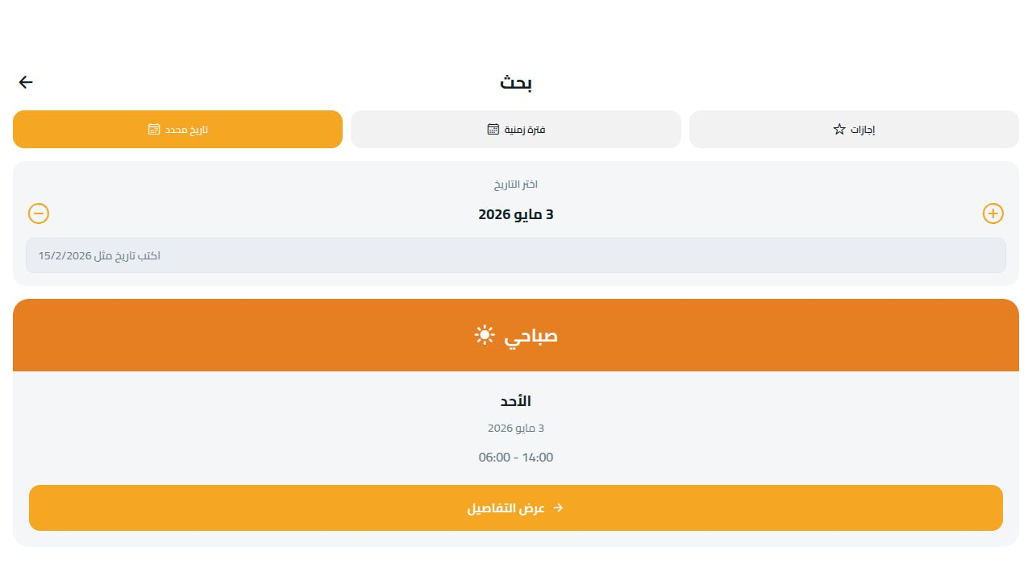
WorkRoster
FEATURE 03
Feature in Focus — Search
Find any day instantly
• Search by a single date — see if it is work or off.
• Search a date range and view every shift inside it.
• Browse all upcoming holidays in one list.
• Tap any result to jump straight to that day.
WorkRoster · Smart Scheduling for Shift Workers

Slide 9
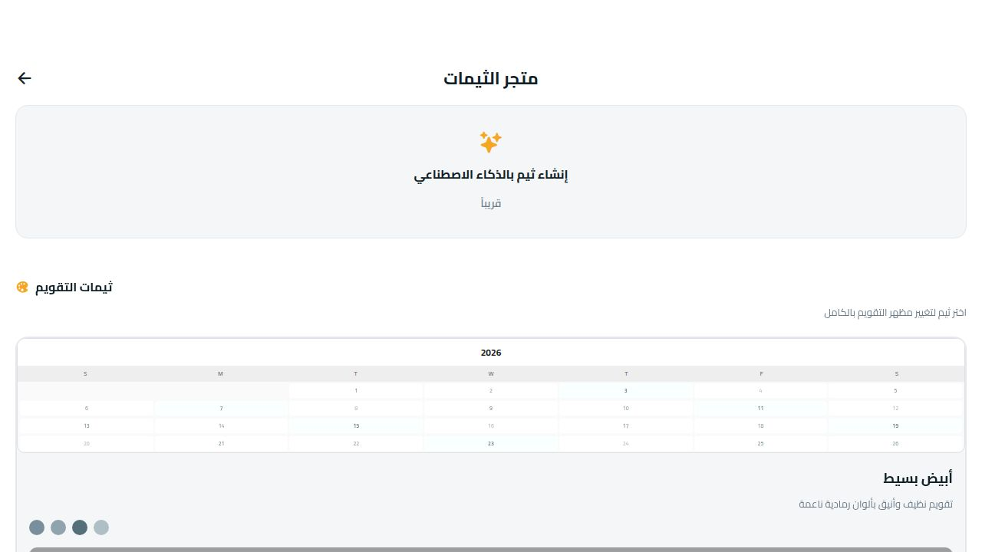
WorkRoster
FEATURE 04
Feature in Focus — Themes
Make it look the way you like
• Three premium built-in themes.
• Generate unlimited AI themes — describe a vibe, get a palette.
• Light and dark mode supported throughout.
• Themes apply instantly to the whole calendar.
WorkRoster · Smart Scheduling for Shift Workers

Slide 10
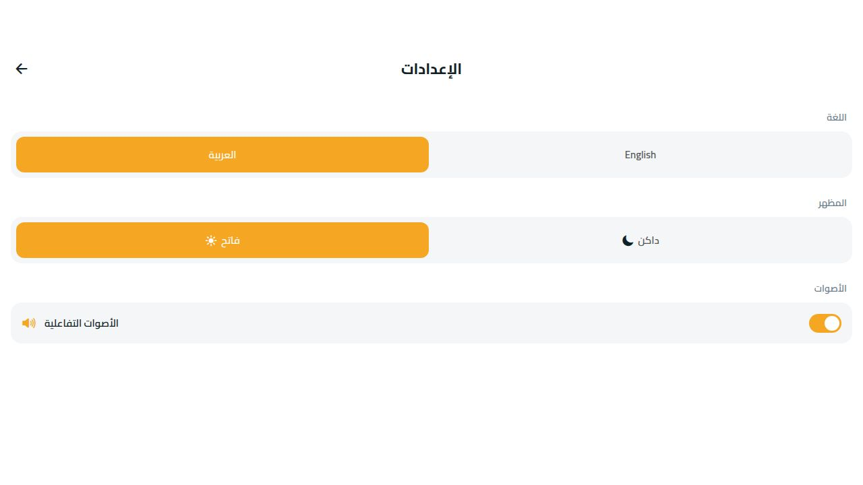
WorkRoster
FEATURE 05
Feature in Focus — Settings
Personal & accessibility controls
• Switch between Arabic and English.
• Light or dark appearance.
• Calendar number font size — Small to X-Large.
• Enable or mute interactive sounds.
WorkRoster · Smart Scheduling for Shift Workers

Slide 11
WorkRoster
SECTION 05
How to Use the App
01
Open the app
No signup required. The app is fully usable offline.
02
Configure your shift
Open Customize, pick a Quick Setup preset or build your own pattern, and set your start date.
03
View your calendar
Return to the home screen — your shifts are filled in for every month, past and future.
04
Add notes & reminders
Tap any day to view its shift, add personal notes, or set reminders.
05
Sync across devices (optional)
Create a free account in Account to back up data and sync between phones.
WorkRoster · Smart Scheduling for Shift Workers

Slide 12
WorkRoster
SECTION 06
What's Next — Future Roadmap
Coming soon: Team Lead module.
Built for managers and team leaders, with the same simple experience.
View team schedules
See the full roster of every team member at a glance.
Plan in advance
Adjust shifts and balance coverage weeks ahead.
Coverage alerts
Receive automatic warnings when a shift is understaffed.
Monthly reports
Generate clear monthly attendance and shift reports.
WorkRoster · Smart Scheduling for Shift Workers

Slide 13
WorkRoster
SECTION 07
Summary
WorkRoster turns shift management from a complicated task
into a smart, automated system.
Boosts efficiency
Supports planning
Stays simple
Removes manual scheduling and reduces day-to-day errors.
Lets workers and teams plan ahead with full visibility.
A clean, bilingual interface anyone can use in minutes.
WorkRoster · Smart Scheduling for Shift Workers

Slide 14
WorkRoster
SECTION 08
Availability & Reach
Ready to download on every major platform.
Apple App Store
Google Play Store
Web App
iPhone & iPad. Submission in progress for v1.0.1.
Android phones and tablets.
Run instantly in any modern browser — no install needed.
Already field-tested across multiple shift systems and companies — proving its flexibility and reliability.
WorkRoster · Smart Scheduling for Shift Workers

Slide 15
Thank You
WorkRoster — Your shifts, simplified.
Questions? We're happy to walk you through any part of the app.

