Slide 1
Comparison of the archetictures
Machine Learning:
Product Review Sentiment Analysis
A Comparative Study of Classification
By: Mustafa Abou Khatwa, Noha Ismail, Amira ElShehaby, Mohamed Mourad, Ahmed Gomaa
SERVICES
IDEA
TEAM
Statement
GOAL

Slide 2


Contents:
Problem
Description
Methodology
Proposed
Solutions
Validation
Results

Slide 3
Introduction
Problem Statement

Slide 4
Milestones To Solutions:
04
Solution
03
IMPLEMENTATION
& RESULTS
02
Problem
Analysis
01

Slide 5
Fisher
02
Mustafa Abou Khatwa

Slide 6
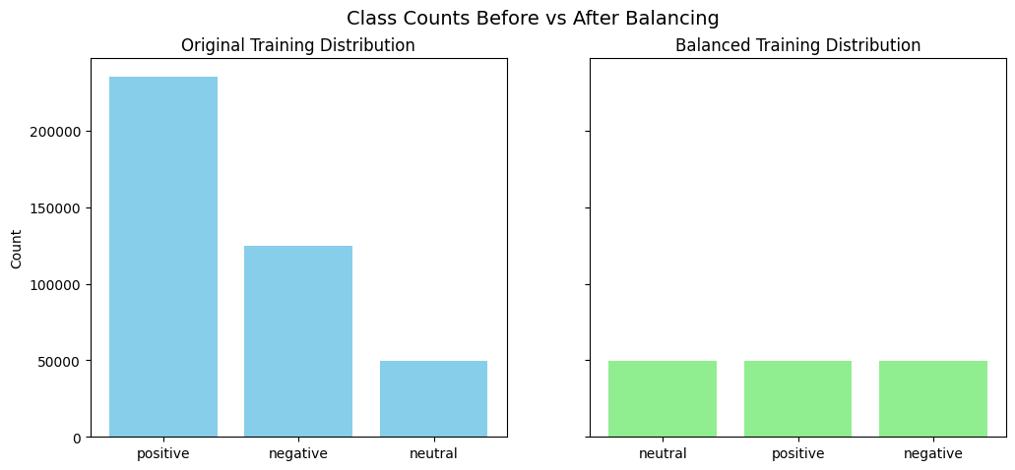
Motivation
Severe class imbalance (Neutral underrepresented, Positive dominant).
Need for interpretable linear baseline alongside Logistic Regression.
Goal: Evaluate Fisher’s discriminant with hybrid features and balancing strategies.

Slide 7
Methodology Overview
1
Data Preparation
Balanced training set: 49,373 samples per class.
Lexicon-only (VADER scores) vs Hybrid (TF-IDF + lexicon).
Model Design
Custom FisherEstimator with SVD dimensionality reduction.
Priors adjusted via prior_alpha (inverse-frequency weighting).
Optional Neutral upsampling capped at 50,000.
Tuning
GridSearchCV for solver, shrinkage, priors, and dimensionality.
Calibration with isotonic regression + threshold sweeping.
2
3

Slide 8
01
02
03
Lexicon-only
Hybrid
Key Insight:
Results
Lexicon vs Hybrid
Accuracy: 0.787
Macro-F1: 0.439
Neutral F1: 0.085
Accuracy: 0.734
Macro-F1: 0.458
Neutral F1: 0.169
Hybrid features consistently outperform lexicon-only, especially for Neutral sentiment.

Slide 9
Results
Lexicon vs Hybrid
 | Accuracy | Macro Precision | Macro Recall | Macro F1 | Micro F1 | ROC-AUC | F1-negative | F1-neutral | F1-positive | CV Mean ± Std
Lexicon-only | 0.787 ⬆ | 0.462 | 0.427 | 0.439 | 0.787⬆ | 0.719 ⬆ | 0.346 | 0.085 | 0.886 ⬆ | nan
Hybrid | 0.734 | 0.465 ⬆ | 0.461 ⬆ | 0.458 ⬆ | 0.734 | 0.718 | 0.352 ⬆ | 0.169 ⬆ | 0.852 | nan

Slide 10
Results
Hyperparameter Tuning
Best config: svd_n_components=100, lda_solver=lsqr, lda_shrinkage=None, prior_alpha=0.5.
Validation Macro-F1: 0.453
Neutral F1: 0.125
CV Macro-F1: 0.490 (stable generalization).
Takeaway: Dimensionality reduction + tempered priors yield balanced performance.

Slide 11
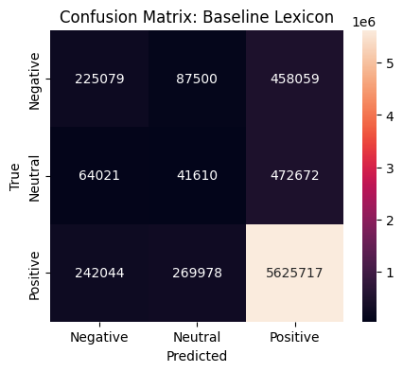
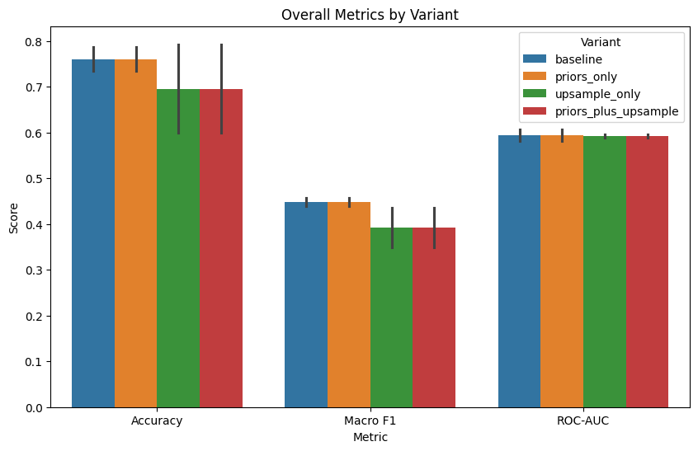
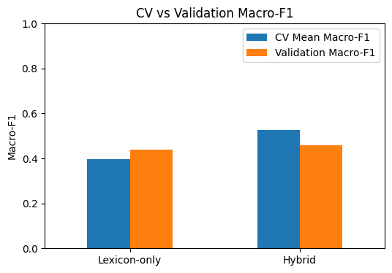
Validation & Diagnostics

Slide 12
Challenges and Responses / Future Directions
Problem: Neutral class performance remains weak.
Problem: Linear models underperform compared to Neural Networks.
Problem: Priors and upsampling effects are limited.
Response/Future Direction: Acknowledge linguistic overlap; calibration and upsampling partially mitigate. Explore contextual models (e.g., BERT, RoBERTa) to better capture semantics
Response/Future Direction: Emphasize interpretability, reproducibility, and auditability — critical in regulated contexts. Future work: adopt deep learning for complex boundaries while retaining linear baselines for audit‑ready pipelines.
Response/Future Direction: Show that hybrid features + dimensionality reduction are the real drivers of improvement. Future work: hierarchical classification to separate Neutral from Positive/Negative more effectively.

Slide 13
Variant | Feature Set | Accuracy | Macro F1 | ROC-AUC | F1-Negative | F1-Neutral | F1-Positive
baseline | Lexicon | 0.787 | 0.439 | 0.582 | 0.346 | 0.085 | 0.886
baseline | Hybrid | 0.734 | 0.458 | 0.607 | 0.352 | 0.169 | 0.852
priors_only | Lexicon | 0.787 | 0.439 | 0.582 | 0.346 | 0.085 | 0.886
priors_only | Hybrid | 0.734 | 0.458 | 0.607 | 0.352 | 0.169 | 0.852
upsample_only | Lexicon | 0.599 | 0.35 | 0.596 | 0.094 | 0.183 | 0.772
upsample_only | Hybrid | 0.793 | 0.435 | 0.589 | 0.356 | 0.065 | 0.885
priors_plus_upsample | Lexicon | 0.599 | 0.35 | 0.596 | 0.094 | 0.183 | 0.772
priors_plus_upsample | Hybrid | 0.793 | 0.435 | 0.589 | 0.356 | 0.065 | 0.885

Slide 14
Conclusion
Fisher’s Linear Discriminant is a defensible, interpretable
Baseline.
Hybrid features consistently outperform lexicon-only.
Calibration and upsampling highlight trade-offs in imbalance
Handling.
Provides audit-ready reproducibility, even if not the
top-performing model.

Slide 15
Logistic Regression
02
Mohamed Mourad

Slide 16
Model Design
Algorithm: Logistic Regression for multiclass sentiment classification
Regularization: L2 (ridge): stability & generalization L1 (lasso): sparsity & feature selection
Class handling: class_weight = balanced
Solver: lbfgs (L2) saga (L1)

Slide 17

Features and Training
Lexicon-only: VADER sentiment scores
Hybrid: TF-IDF + sentiment lexicons
Training strategy: Balanced labels GridSearchCV for C and penalty Macro-F1 as primary metric
Evaluation Focus: Fairness across all sentiment classes.

Slide 18
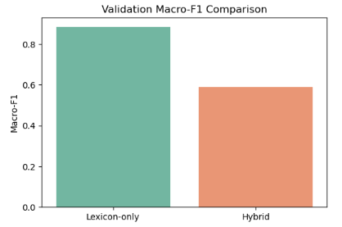
Results and Takaways
lexicon-only features outperform Hybrid
Strong performance on Positive & Negative
Neutral class remains challenging
Key strengths: Interpretability Reproducibility Audit-ready baseline
Conclusion: Logistic Regression is a reliable, transparent baseline, not the strongest model, but essential for understanding gains from more advanced methods.

Slide 19
Perceptron
03
Ahmed Gomaa

Slide 20
Perceptron Methodology
1
Feature Augmentation: Manual calculation of interaction features.
2
Strategic Undersampling: Balancing the training data distribution.
3
Model Architecture: Calibrated Perceptron within a robust pipeline.
4
Ensemble Learning: Bagging stabilization.
5
Threshold Optimization: Post-hoc tuning for minority class sensitivity

Slide 21

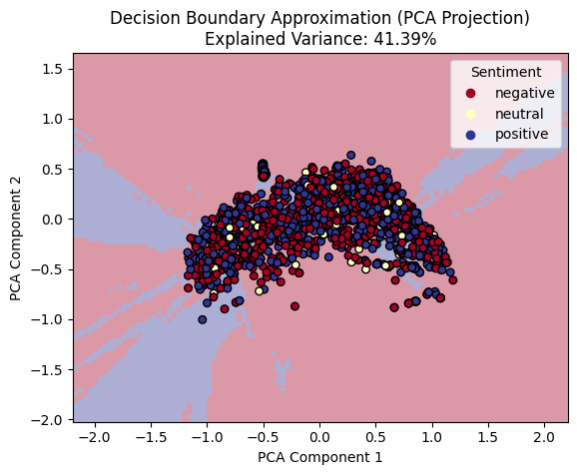
8
PCA OF THE DATA

Slide 22
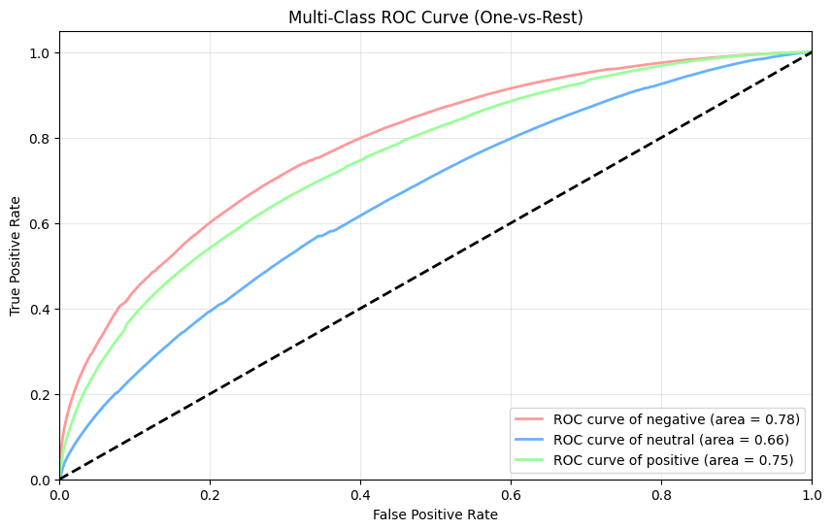
Beyond Accuracy: Measuring Predictive Potential with ROC

Slide 23
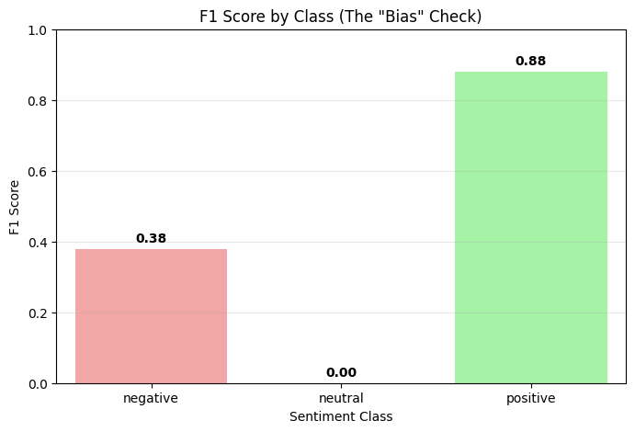
The Bais Check

Slide 24
Feature Space Augmentation
Goal: Help linear models detect non-linear relationships (mixed/neutral sentiment).
1
Feature Augmentation: Manual calculation of interaction features.
2
Strategic Undersampling: Balancing the training data distribution.
3
Model Architecture: Calibrated Perceptron within a robust pipeline.
4
Threshold Optimization: Post-hoc tuning for minority class sensitivit

Slide 25
Strategic Undersampling & Architecture
Class Balancing
Minority: Retained 100% of "Neutral" samples.
Majority: Randomly downsampled "Positive" and "Negative" to 2 times the size of Neutral.
Result: Loss function weights minority classes sufficiently.
Pipeline Components
Selection: SelectKBest (ANOVA F-value) to remove noise.
Scaling: StandardScaler for stable linear convergence. Classification: Perceptron (SGD-based) wrapped in
CalibratedClassifierCV for probabilistic outputs.
1
2
3

Slide 26
Ensemble & Optimization
Ensemble Stabilization (Bagging)
Technique: Bootstrap Aggregating with 10 independent estimators.
Training: Each estimator sees a random 70% subset of balanced data.
Output: Averaged probabilities to reduce variance.
Decision Threshold Optimization
Problem: Standard "Argmax" favors the majority class.
Solution: Grid search for optimal probability thresholds on the validation set.
Goal: Maximize Macro F1-Score, not Accuracy.

Slide 27
Results - Baseline vs. Hybrid
1. Baseline (Lexicon-Only)
The Accuracy Paradox: 81.9% Accuracy, but 0.00 Recall for Neutral/Negative.
Function: Acted as a trivial "Positive Detector."
2. Hybrid Model (Feature Engineering)
Interaction Features: Successfully "unlocked" Negative sentiment.
Improvement: Negative Recall rose to 0.18.
Limitation: Neutral class remained undetected (Recall 0.00).

Slide 28
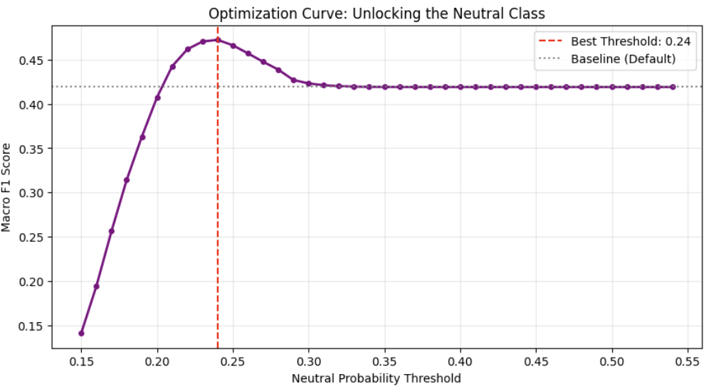
Results - Final Optimized Ensemble
The Breakthrough
Macro F1-Score: Peaked at 0.47 (56% improvement over baseline).
Unlocking Neutral: Threshold tuning raised Neutral Recall to 0.17 (previously 0).
Negative Detection: Massive improvement to 0.43 Recall.
The Trade-off
Accuracy: Dropped from 82% to 76%.
Positive Recall: Dropped from 98% to 86%.
Conclusion: We traded superficial accuracy for algorithmic fairness.

Slide 29
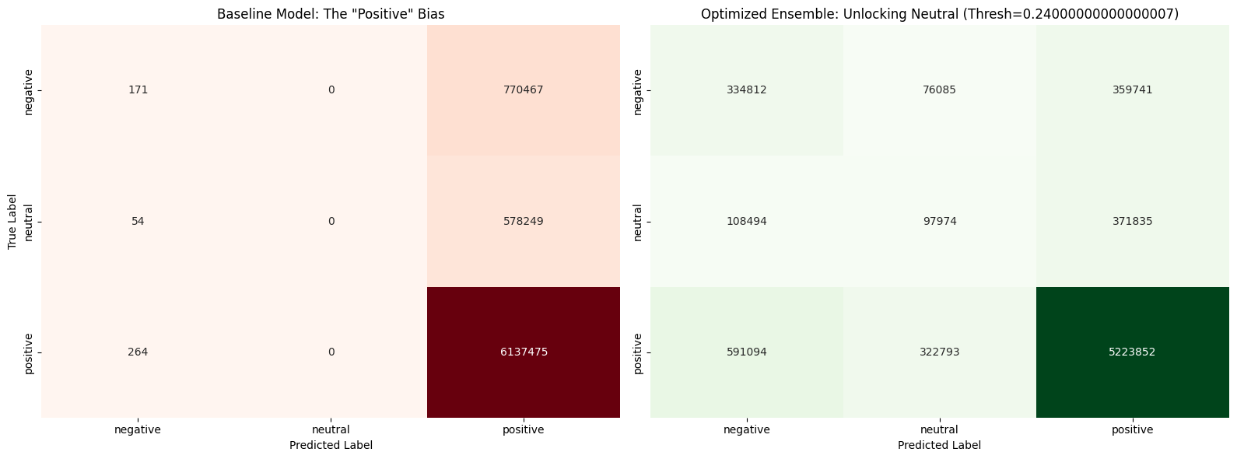
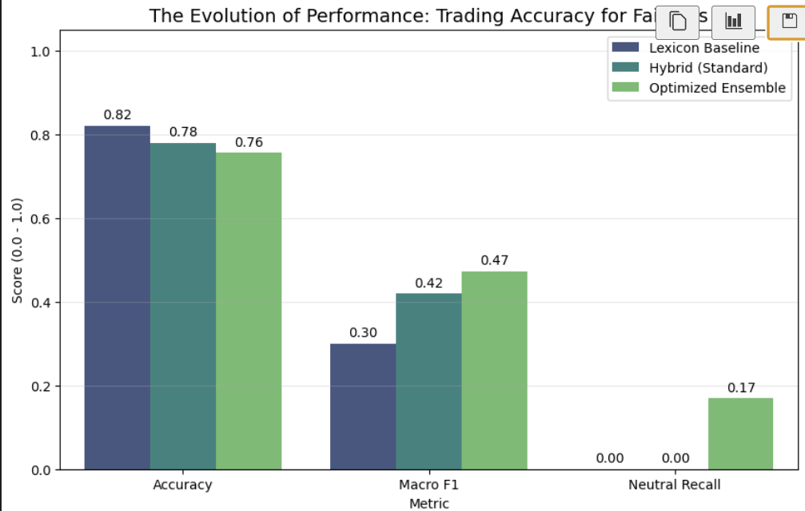
Performance Comparison

Slide 30
Support Vector Machine
(SVM)
04
Amira Ibrahim Elshehaby

Slide 31
Enhancing SVM Sentiment Classification through Hybrid Resampling and Stochastic Optimization
Key Challenge 1:
Large-scale, imbalanced sentiment data

Slide 32
Aim
Improve minority class detection (Neutral & Negative)
Maintain scalability for very large datasets
Compare linear, hybrid, ensemble, and deep models

Slide 34
Severe Class Imbalance
Severe class imbalance
Positive: 81.9%
Neutral & Negative: minority classes
Baseline SVM suffered from Neutral Collapse
Neutral Recall = 0.00

Slide 35
Pipeline of Improvement

Slide 36
Methodology Overview
Iterative Improvement Pipeline :
Baseline Linear SVM
Cost-Sensitive Learning
Data Balancing (SMOTE)
Scalable Optimization (SGD)
Hybrid Model (SMOTE + SGD)
Model Performance Comparison: Baseline SVM vs. Optimized Hybrid
Deep Learning

Slide 37
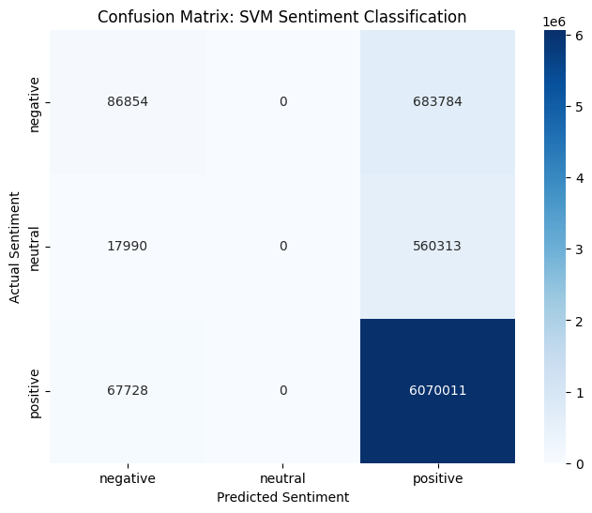
Baseline Model (CSV Linear)
Method:
Linear Support Vector Classifier
Result:
High overall accuracy
Neutral Recall = 0.00
Issue:
Strong majority class bias

Slide 38
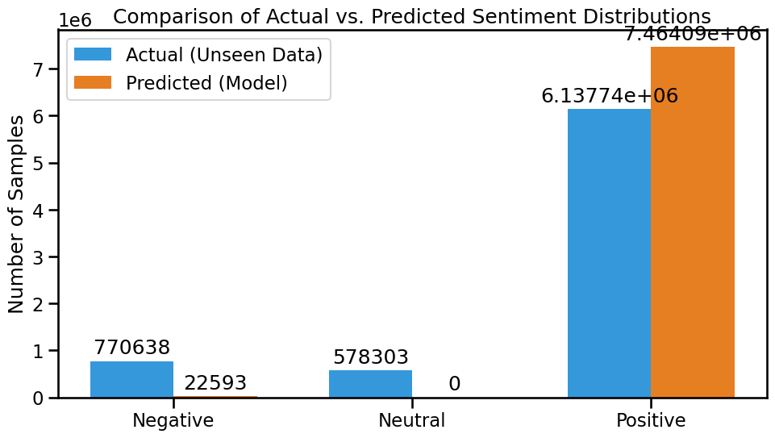
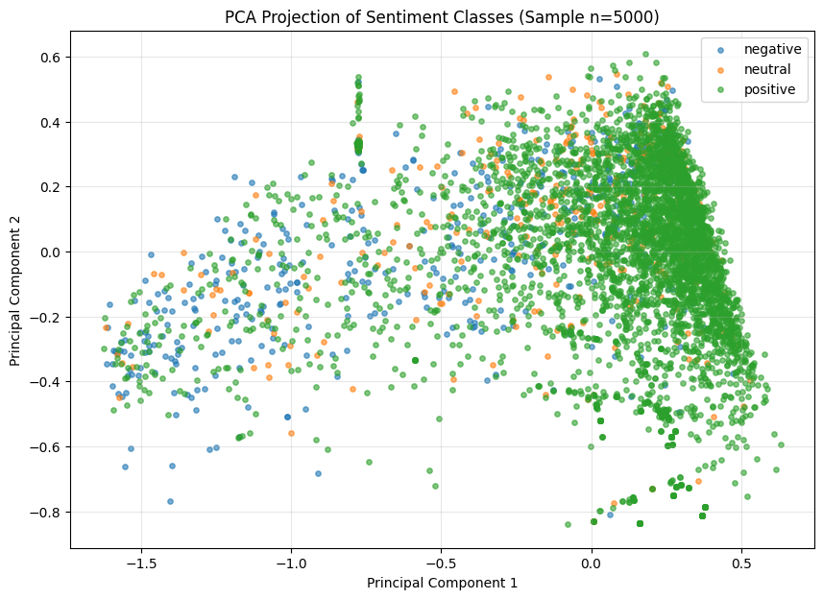
Key Challenge 2
Why standard SVM fails?!
Optimizes global accuracy
Biased toward majority class
Ignores neutral sentiment features

Slide 39
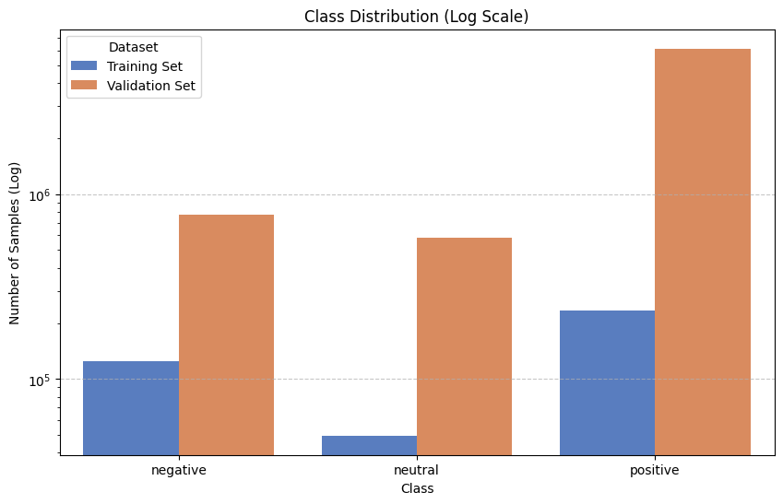
Cost-Sensitive SVM (CSV_COST)
Added class weights (class_weight = balanced)
Penalized minority class errors
Improvement:
Negative class performance increased
Limitation:
Neutral class still not recovered

Slide 40
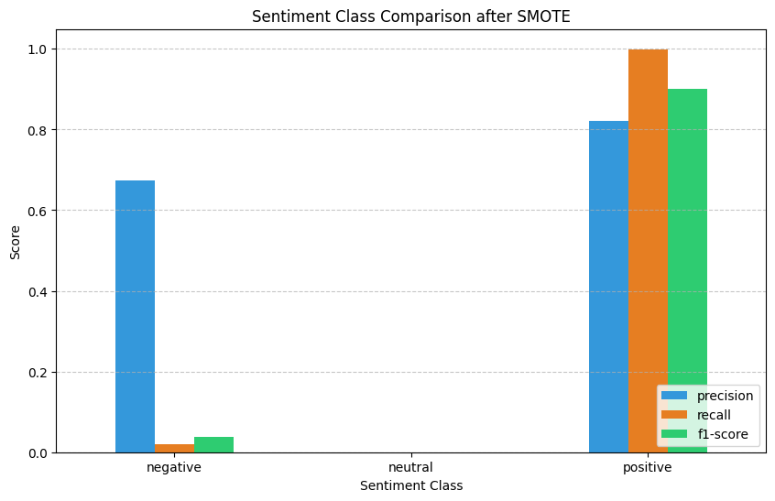
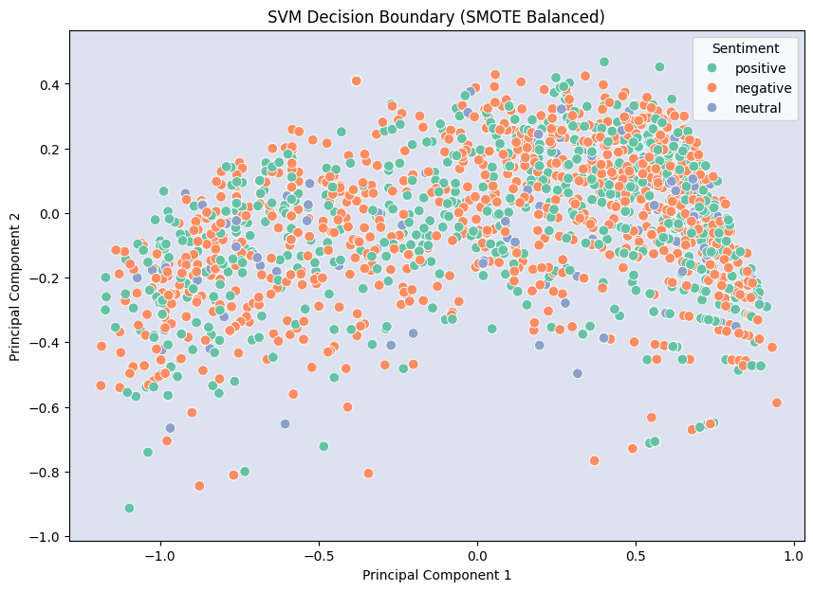
SMOTE (Data Balancing)
Synthetic Minority Over-sampling Technique
Generates artificial Neutral samples
Impact:
First recovery of Neutral Recall (0.04)
Insight:
Data imbalance was a core issue

Slide 41
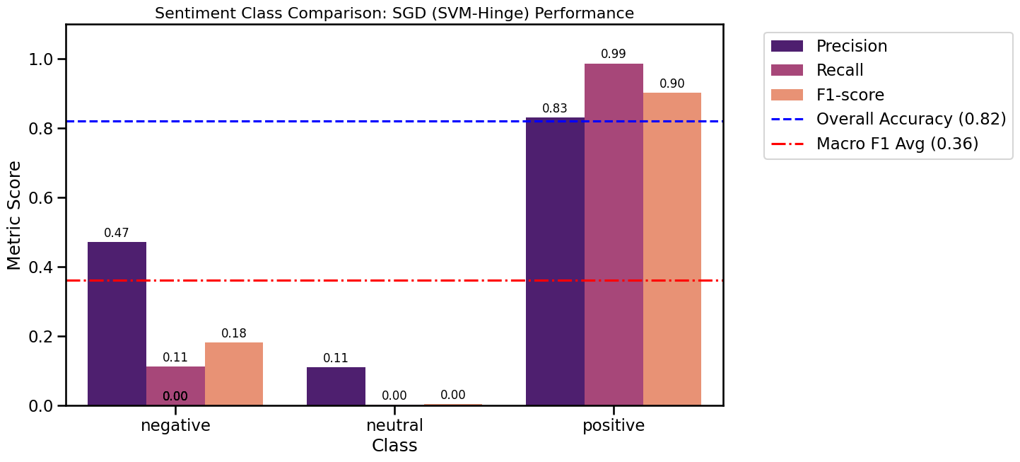
SGD for Scalability
Stochastic Gradient Descent with hinge loss
Handles millions of samples efficiently
Training time reduced:
Hours → Minutes
Maintains SVM-like decision boundaries

Slide 42
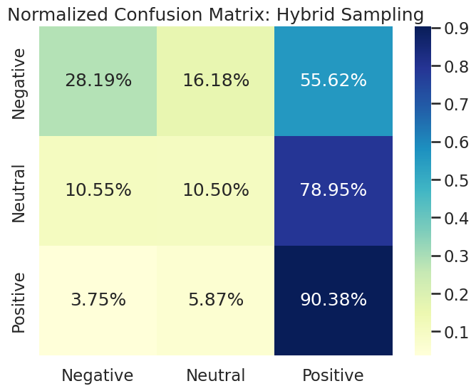
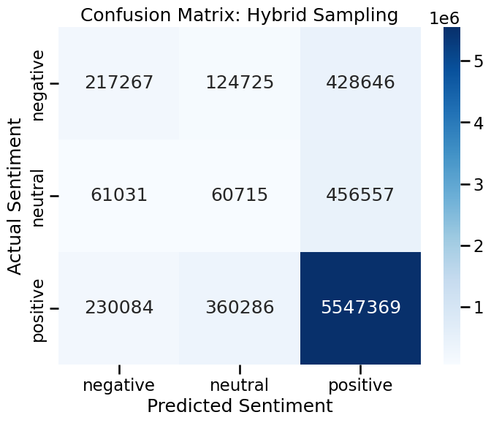
Final Hybrid Model
The "Neutral Recall" Breakthrough Indicates Successful Feature Engineering
SMOTE + SGD + Hybrid Features
TF-IDF + Sentiment Lexicons Best overall balance
Results:
Neutral Recall: 0.11
Macro-F1: 0.42

Slide 43
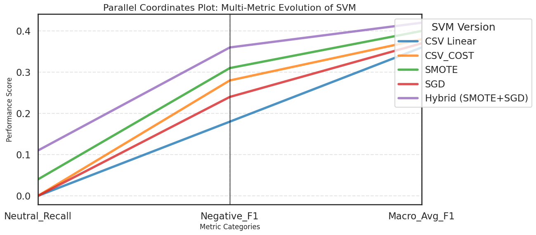
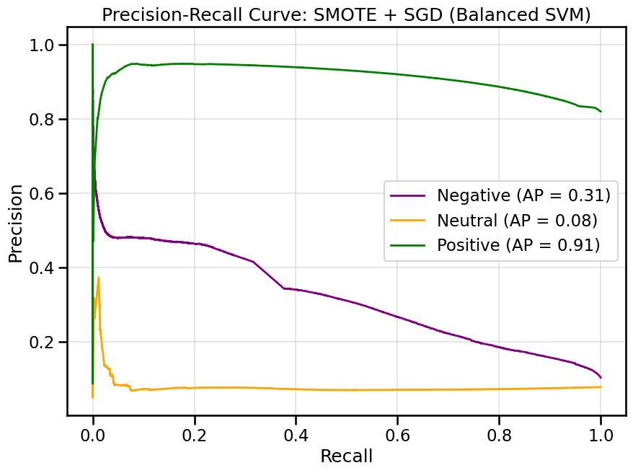
the performance of different sentiment classification models using Neutral Recall and Macro-F1 score,

Slide 44
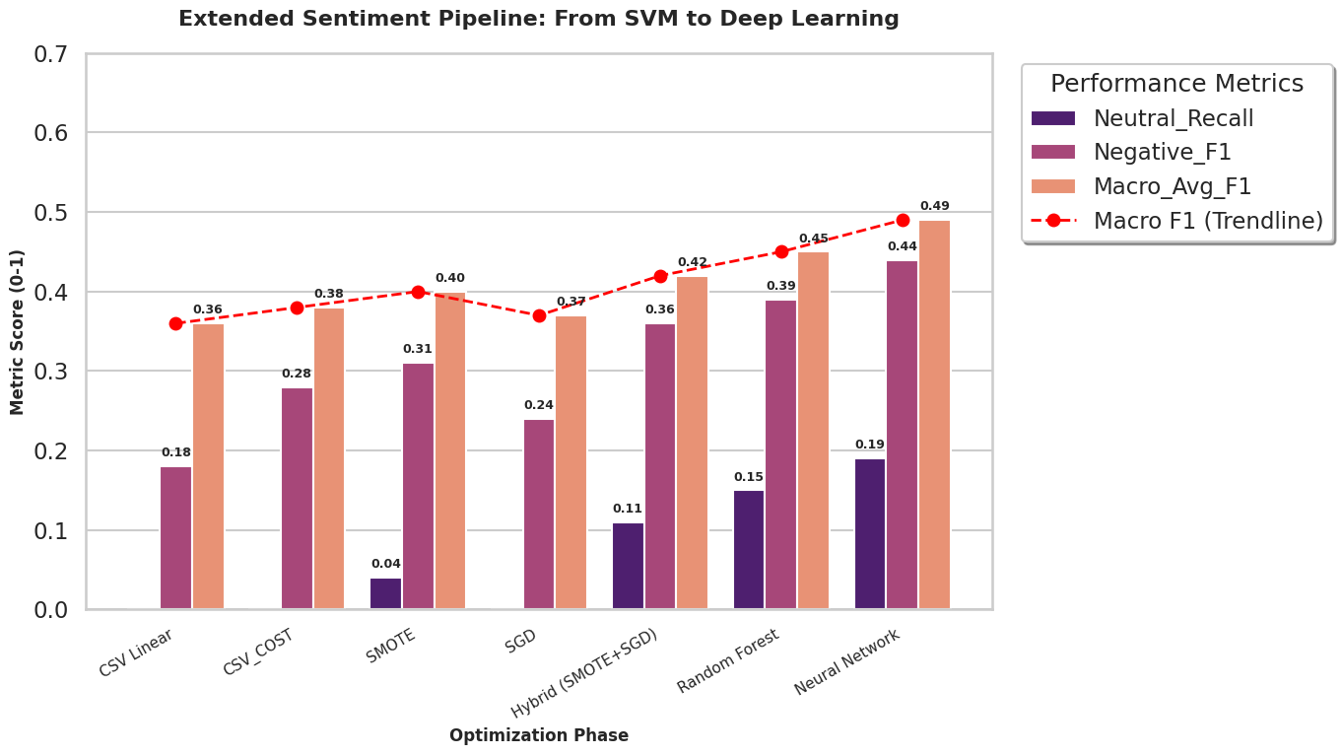
Extended Sentiment Pipeline :From SVM to Deep Learning

Slide 45
Evaluation Strategy
Focus on Fairness, Not Accuracy
Macro-Averaged F1 Score
Normalized Confusion Matrices
Prevents majority class dominance in evaluation

Slide 46
Standard SVM is blind to Neutral sentiment
SMOTE enables minority class visibility
SGD ensures scalability
Hybrid model balances:
Performance
Fairness
Computational efficiency
Key Findings

Slide 47
Conclusion
Class imbalance severely degrades sentiment models
Explicit balancing + scalable optimization is essential
Hybrid SMOTE + SGD:
Improves fairness
Maintains scalability
Strong alternative to deep learning for big data

Slide 48
Neural Networks and Ensemble Methods
05
Noha Ismail

Slide 49
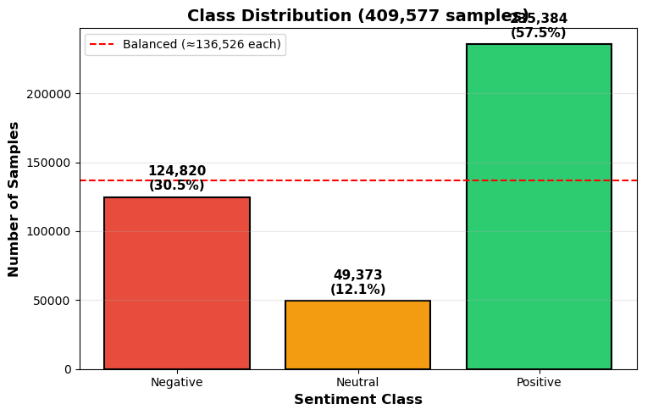
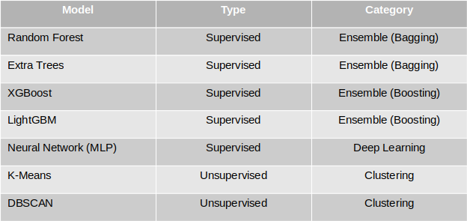
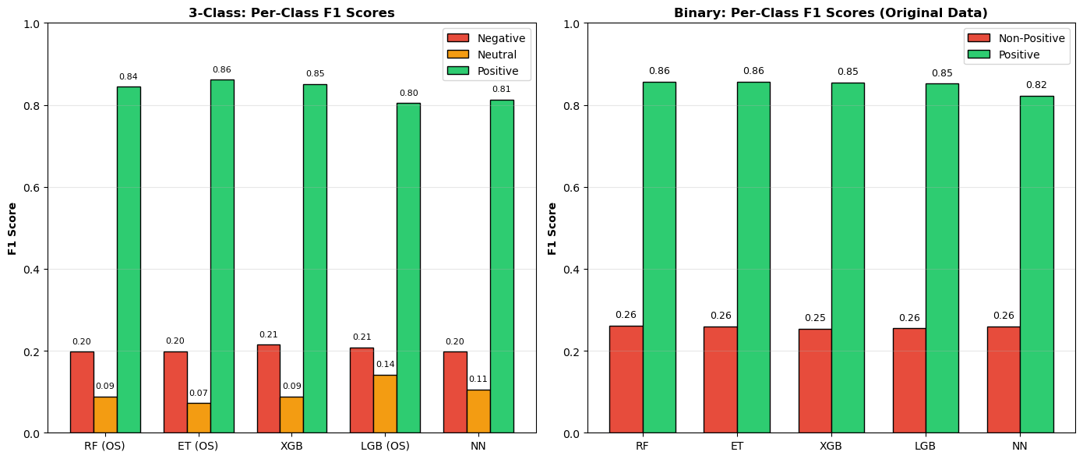
Methodology
Problem
Initial Results

Slide 50
(1) How do SBERT embeddings compare to TF-IDF features for sentiment classification? (2) Why do certain algorithms fail on imbalanced sentiment data? (3) Do sentiment classes form natural clusters in the embedding space?
Let's divide our problem

Slide 51
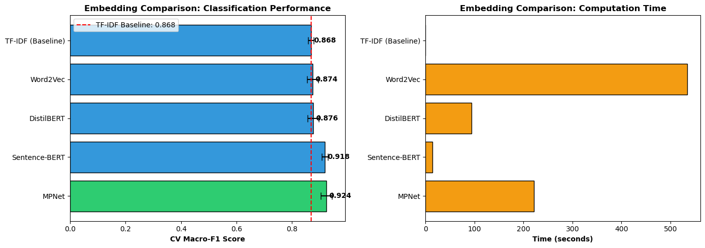
Transformer-based embeddings that capture contextual and semantic information
For computational resources these models were tested on subset of the dataset
Notes:
TF-IDF (Term Frequency-Inverse Document Frequency), which treat words as independent tokens without capturing semantic relationships
TF-IDF was configured with a maximum of 3,000 features, producing sparse 3,004-dimensional vectors
Sentence-BERT embeddings were generated using the 'all-MiniLM-L6-v2' model, which produces 384-dimensional dense vectors
pre-trained on over 1 billion sentence pairs and fine-tuned for semantic similarity tasks

Slide 52
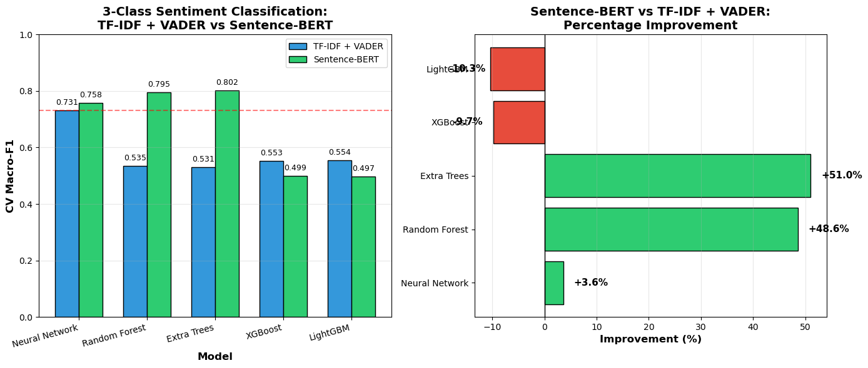
For computational resources these models were tested on subset of the dataset
Five classification algorithms were evaluated:
Extra Trees Classifier: n_estimators=100, max_depth=20, class_weight='balanced'
Random Forest: n_estimators=200, max_depth=30, class_weight='balanced'
Neural Network (MLP): hidden_layers=(512, 256, 128), early_stopping=True
XGBoost: n_estimators=200, GPU-accelerated
LightGBM: n_estimators=200, num_leaves=31

Slide 53
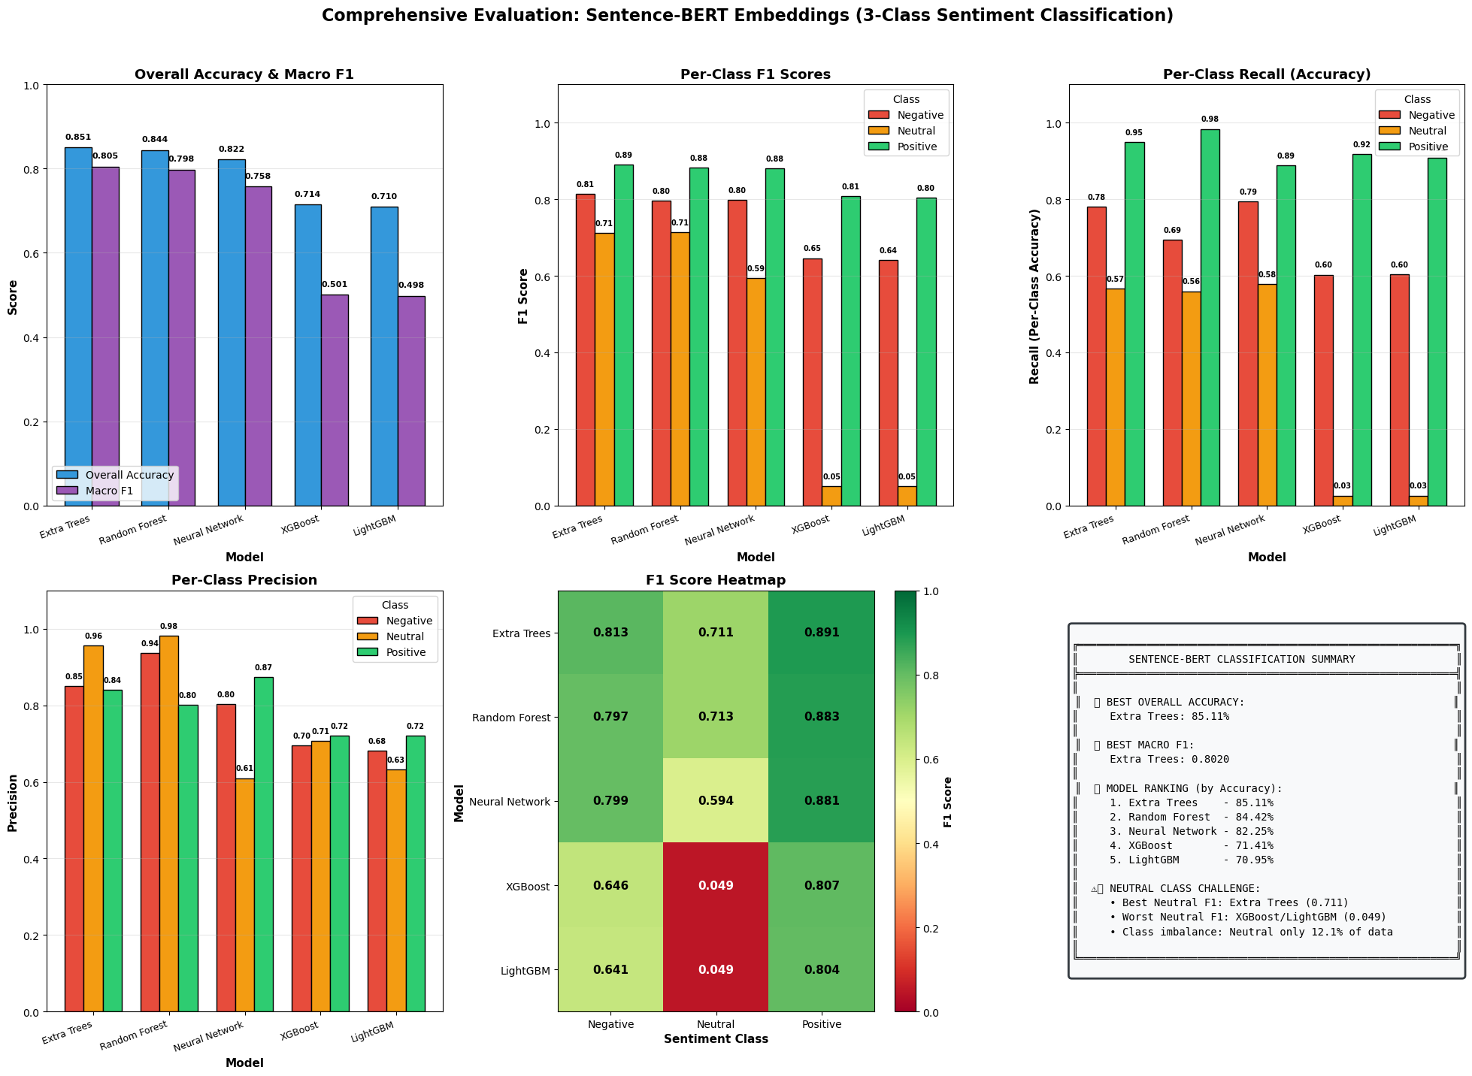

Slide 54
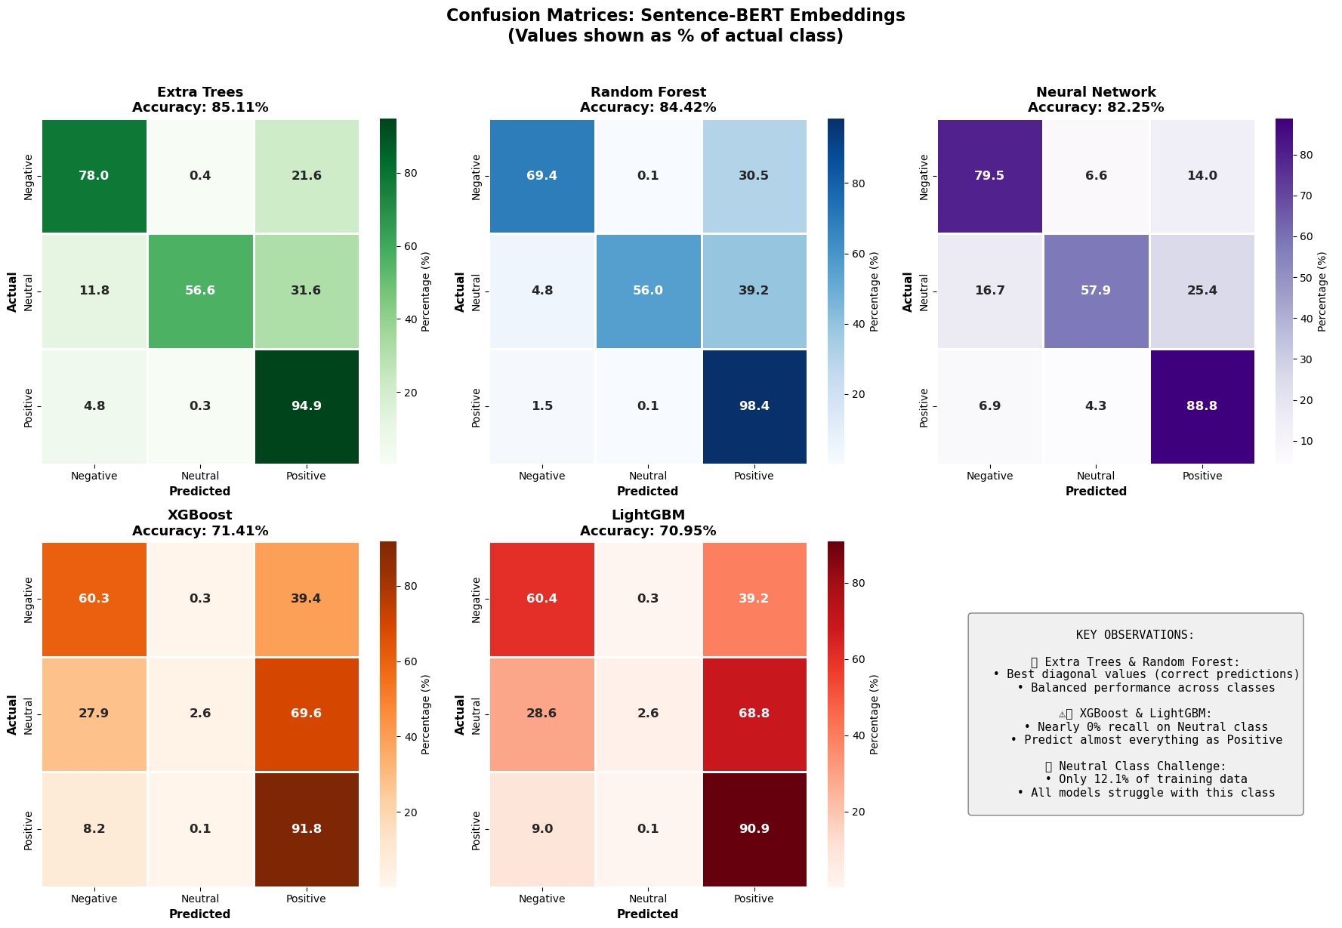
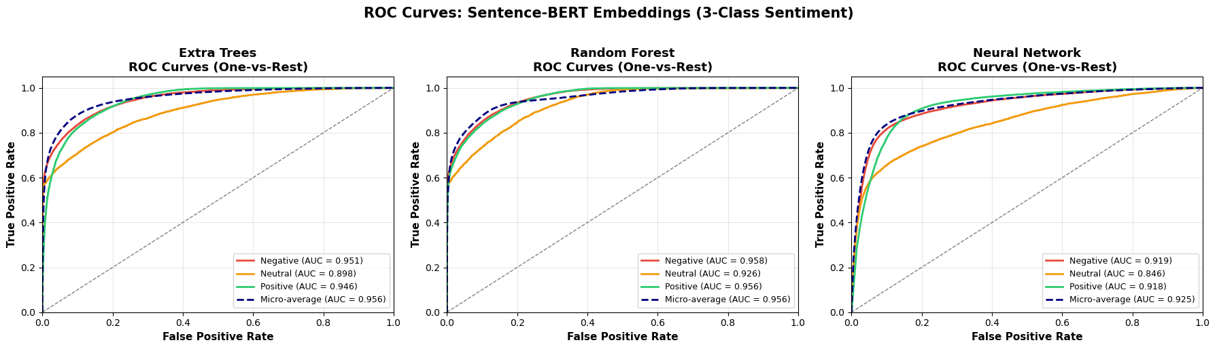

Slide 55
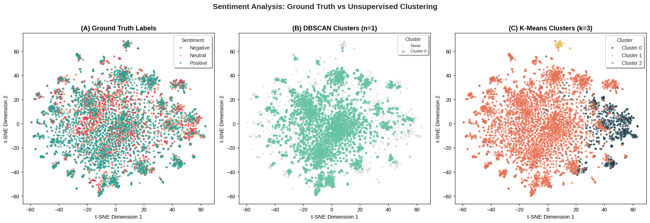
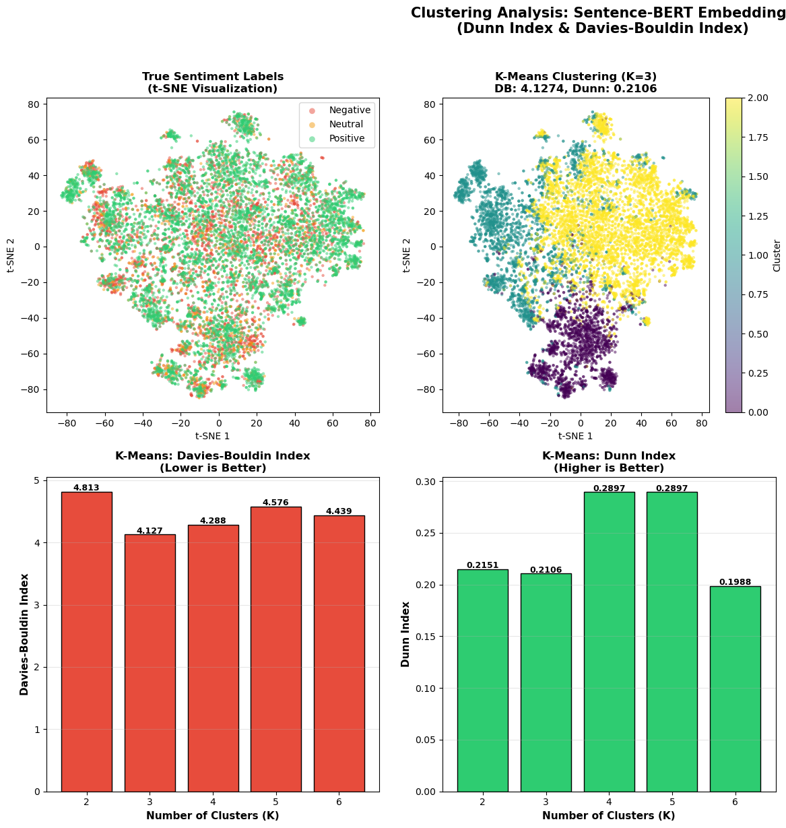
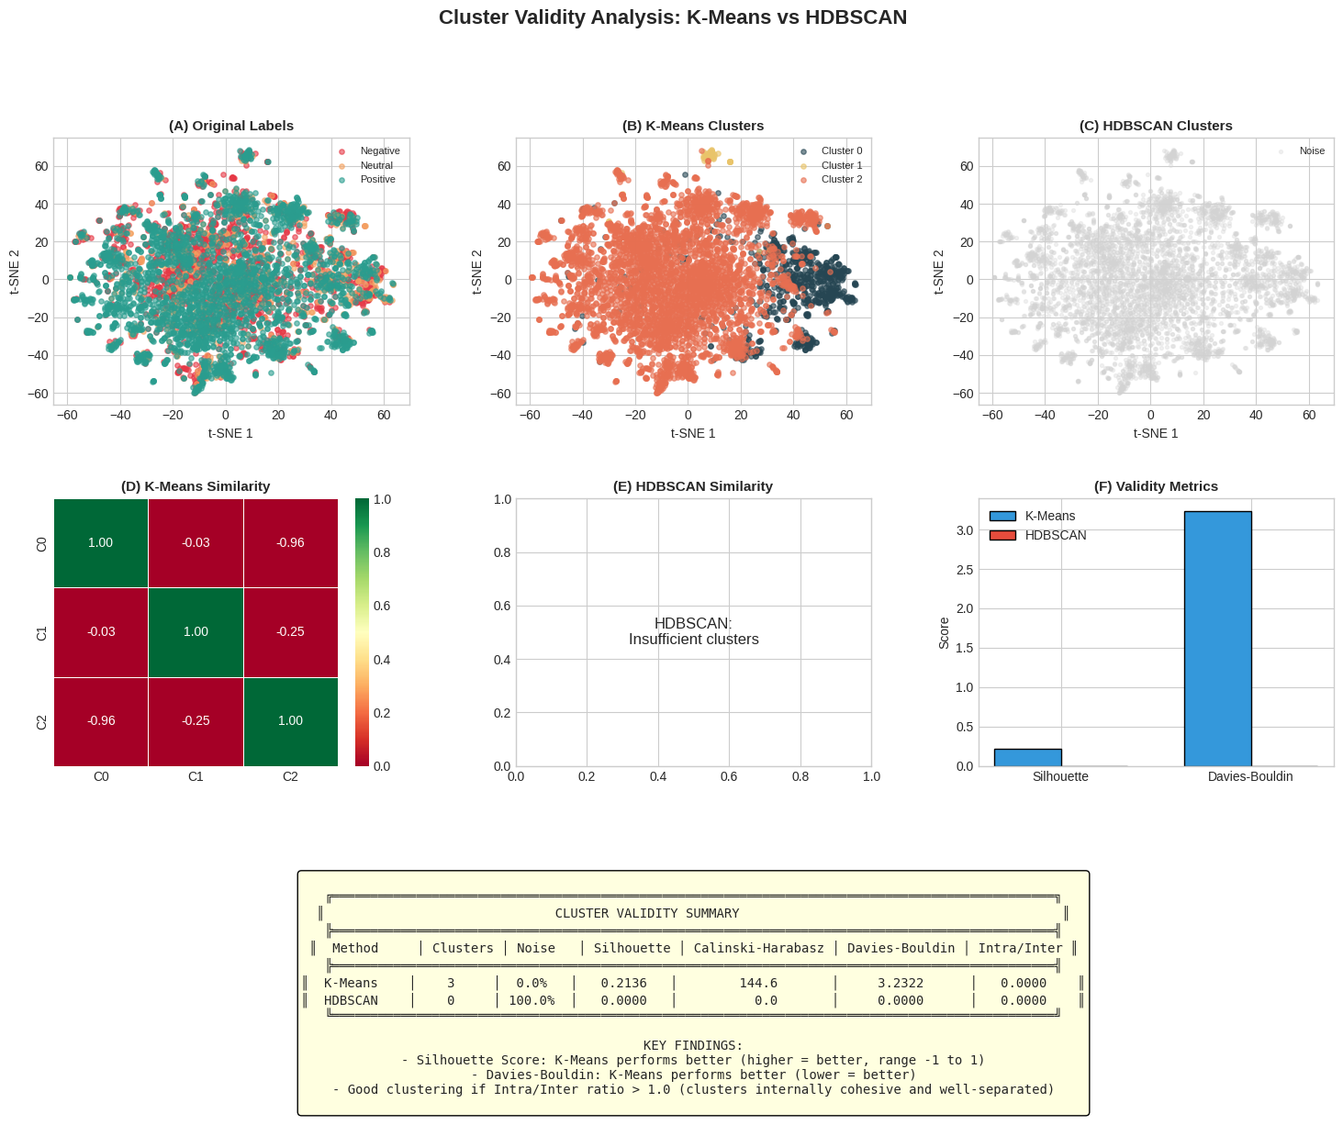
Using TF-IDF
Using Sentence BERT

Slide 56
Conclusion
This study demonstrates that Sentence-BERT embeddings with Extra Trees classifier achieve superior sentiment classification performance (85.11% accuracy, 0.8051 Macro F1) compared to traditional TF-IDF approaches. Key findings include:
Bagging methods (Extra Trees, Random Forest) showed dramatic improvement with SBERT embeddings (+48-51% over TF-IDF)
Gradient boosting algorithms (XGBoost, LightGBM) failed on the minority Neutral class due to sequential learning bias and class imbalance sensitivity
Dense semantic embeddings (384 dimensions) outperform sparse word-frequency vectors (3,004 dimensions) due to information density and contextual understanding
Sentiment classes do not form natural clusters in embedding space, confirming that sentiment is a semantic rather than geometric property

Slide 57
Team Members:
Noha Ismail
Mustafa Abou Khatwa
Mohamed Mourad
Amira Elshehaby
Ahmed Gomaa

Slide 58
THANKS!

