Slide 1

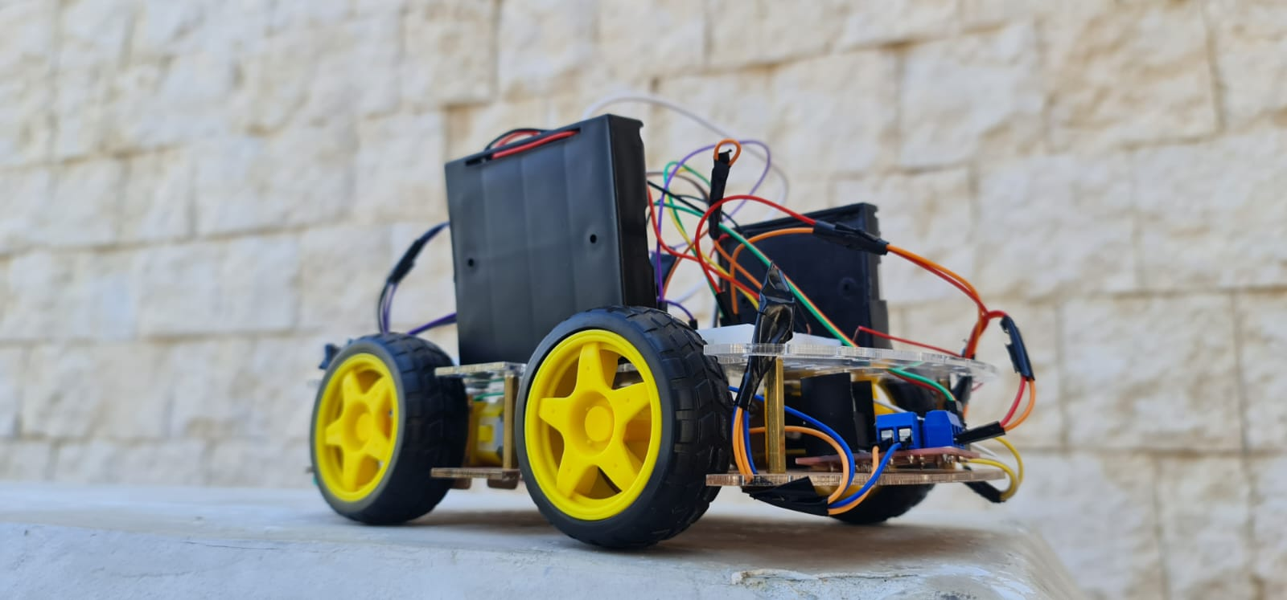
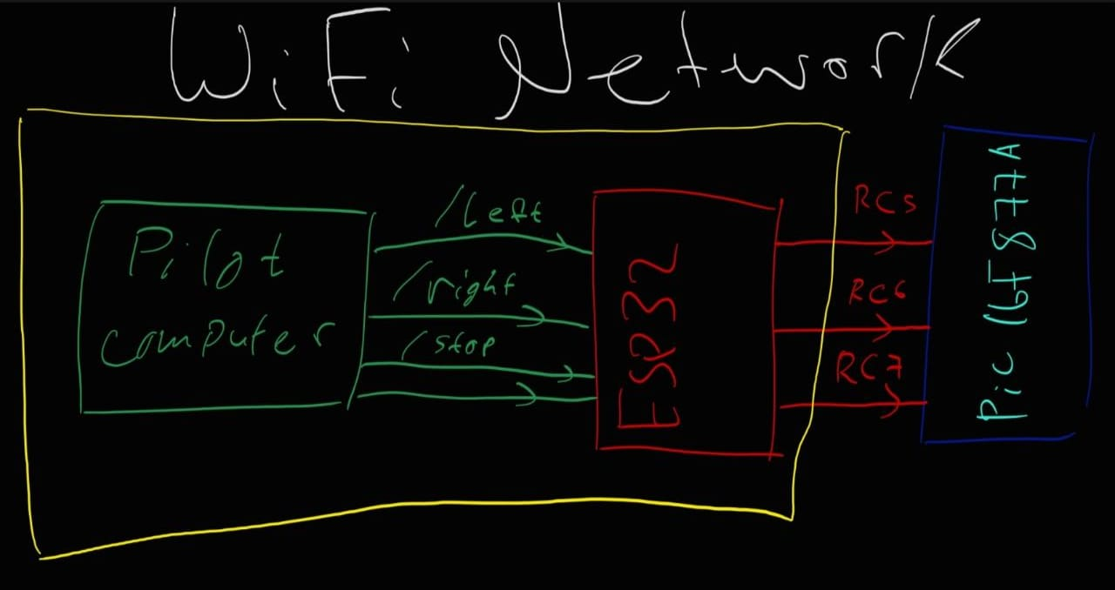
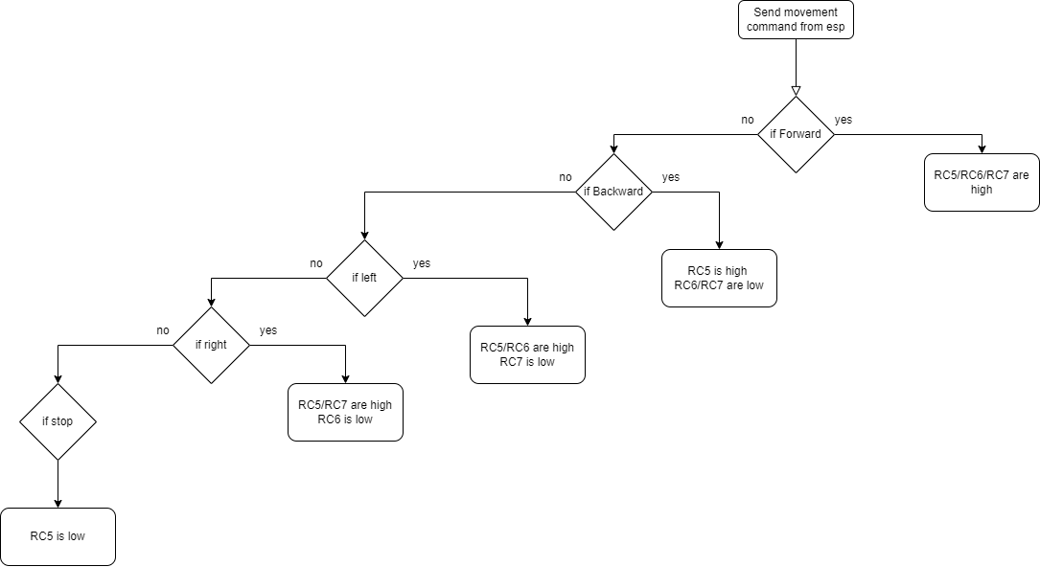
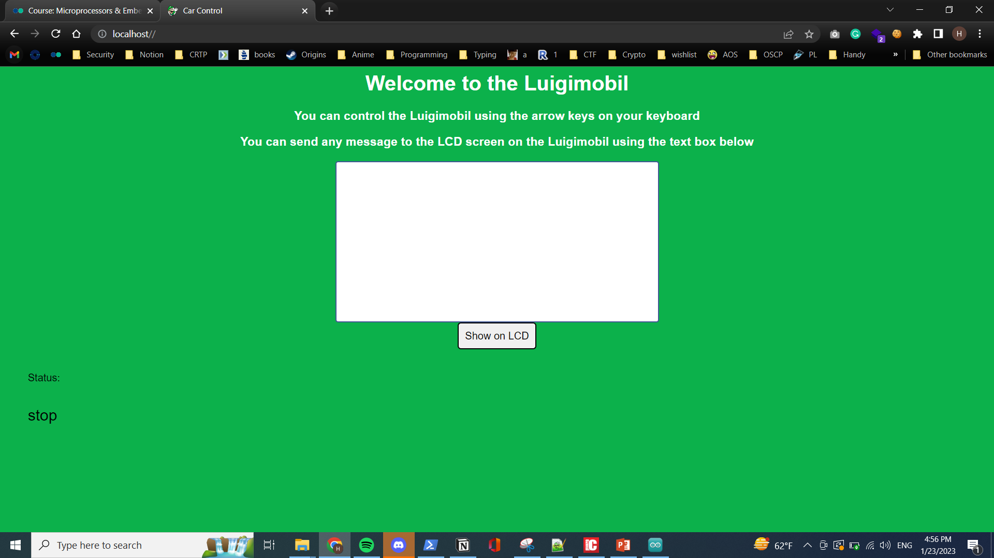
LuigiMobil: A remote controlled smart rover
O.Qtaishat, M. Shawwa, H. Saht
Supervisor: Dr. Belal Sababha
Embedded Systems Final Design Project, Fall 2023
King Abdullah II School of Engineering
Princess Sumaya University for Technology
Introduction
The market for RC cars is expanding, as they eleminate the human presence. The goal of the project is to create a rover that can be piloted and controlled using a web interface. Two microcontroller units (MCUs), an ESP32 and a PIC16F877A, and some fundamental web development brought this about. The ESP32 and the PC that handles the vehicle's controls exchange data over a Wi-Fi connection in this project. A basic diagram drawn at the start of the project showing the basic working principle of the project is shown below:
Results
After putting in effort on both the coding and the physical prototype, we were finally able to accomplish the objective of this project, which was to be able to control the vehicle wirelessly using IEEE 802.11. (WIFI).
The arrows on the laptop are used to control the car via a specialized Web-Server that was programmed to do so. The Web-Server was opened on port 80 on the LAN (Local Area Network) through the ESP MCU.
The vehicle moved in every direction, including forward, backward, to the right, and to the left. This will allow for a greater degree of flexibility when controlling the car via the Web-Server.
When an IR sensor detects an object, the car moves forward, and the TIM0 interrupt allows the car to give an organized buzzer when moving backward.
Figure 3 The Final Result for the LuigiMobil
Figure 1 WiFi Network Structure
Design
Our goal was to build a web-based interface for controlling a rover from far away. For our first step, we created a flowchart that would later come to represent the underlying software.
Because we wanted the rover's response to a key press to be instantaneous, we avoided using serial communication when developing a method for getting the 2 MCUs to communicate to each other. Instead, we've used three wires to send a signal to the PIC16F877A. There were five different signals for movement: forward, backward, left, right, and stop.
Figure 2 Flow Chart for the program
Figure 4 Web Server Interface we used
Conclusion
This project showed how different technologies work together. This project's rover shows how embedded systems, web development, and sensor technology can create autonomous machines that can navigate and perform tasks. A webserver and laptop can be used to remotely control the rover, and an IR sensor lets it detect and avoid obstacles while reversing. These technologies can make machines more efficient and useful. This project showed the potential of these technologies in robotics and embedded systems, opening new avenues for future development.

