Slide 1
Speech Recognition

Slide 2
Agenda
Speech Preprocessing
Text Preprocessing
Working Techniques
Feature Extraction
Model Building
Training

Slide 3

Audio Preprocessing
Noise remove
Truncate Silence

Slide 4
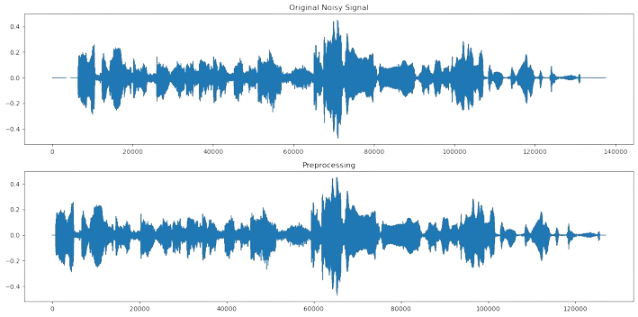
Remove noise from speech

Slide 5
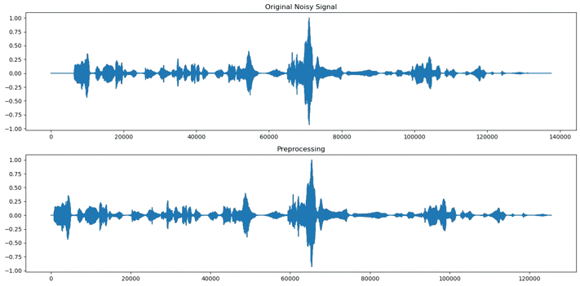
Trim audio to remove silence

Slide 6
Text Preprocessing
Remove non-Arabic Alphabet
Extract the Unique Alphabets

Slide 7
Remove non-Arabic Alphabet
remove the English alphabet or any symbol from the data
chars_to_ignore = ['>', ']', 'ل', 'ـ', '<', 'i', 'f', 'o', 'e', 'g', 'h', 'p', '=', '[', 'r', 'n', 'v', 'u', '÷'] # '١', '⁇', 'l', 'a'
After removing the symbols and English letters, the number of distinctive letters was reduced from 63 to 38

Slide 8
Extract the Unique Alphabets
['إ', 'ش', 'ك', 'ح', 'ت', 'ف', 'خ', 'د', 'ر', 'ؤ', 'ء', 'ج', ' ', 'ً', 'ن', 'ع', 'م', 'ص', 'ث', 'ذ', 'غ', 'ه', 'ط', 'ى', 'ة', 'ض', 'ق', 'آ', 'ي', 'ز', 'ب', 'l', 'أ', 'س', 'و', 'ا', 'ئ', 'ظ']
38 unique alphabet

Slide 9
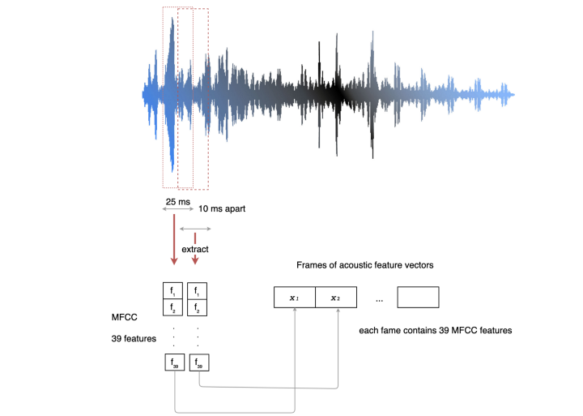
Prepare the data for training
Mel-frequency cepstral coefficients (MFCC)

Slide 10
Prepare the data for training
Chars tokenization (map every alphabet to a number)
{0: '<sos>', 1: 'ر', 2: 'l', 3: 'ً', 4: 'ا', 5: 'ب', 6: 'م', 7: 'ك', 8: 'ق', 9: 'ز', 10: 'ص', 11: 'آ', 12: 'ئ', 13: 'غ', 14: 'ى', 15: 'ط', 16: 'ؤ', 17: 'ت', 18: 'ظ', 19: 'ج', 20: 'ذ', 21: 'ش', 22: 'إ', 23: 'خ', 24: 'ن', 25: 'ة', 26: ' ', 27: 'ي', 28: 'ه', 29: 'ء', 30: 'ح', 31: 'و', 32: 'ث', 33: 'ع', 34: 'أ', 35: 'س', 36: 'ف', 37: 'د', 38: 'ض', 39: '<eos>'}

Slide 11
Building Model

Slide 12
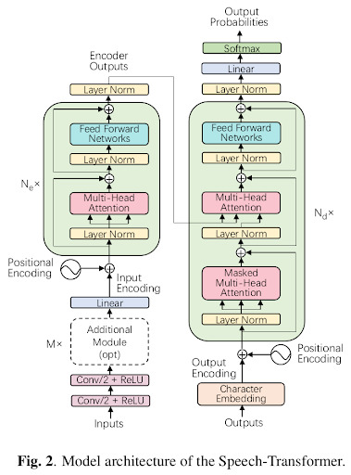
Speech-Transformer

Slide 13
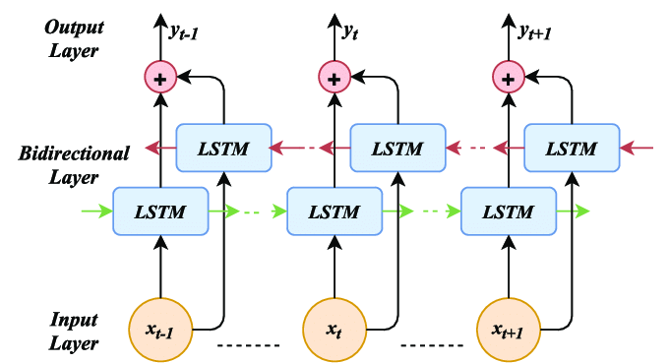
Bidirectional LSTM
The Bi-LSTM layer processes the input sequence in both forward and backward directions simultaneously. During the forward pass

Slide 14
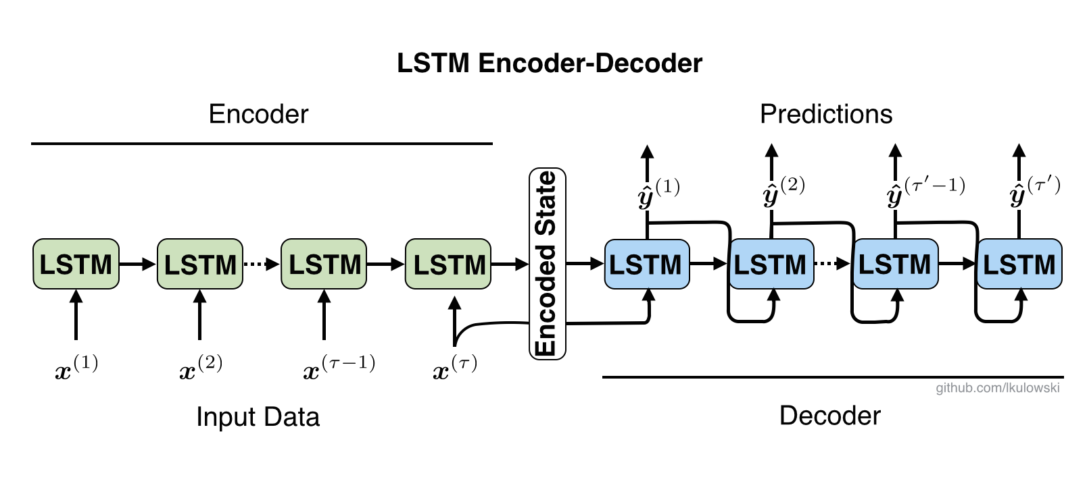
LSTM-Auto encoders

Slide 15
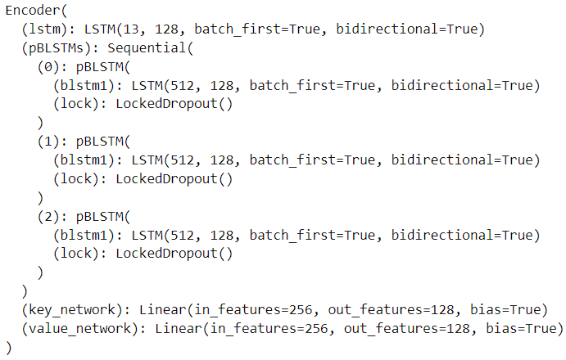
LSTM-Encoder

Slide 16
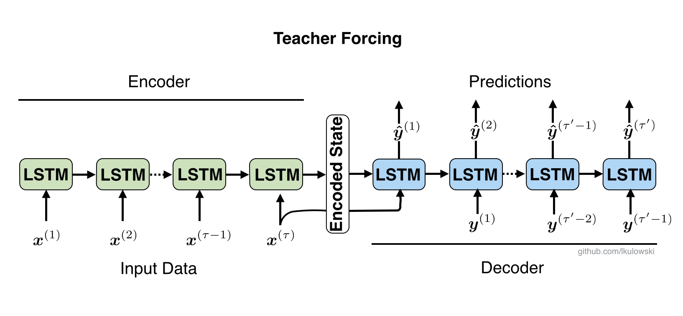
Teacher forcing
Teacher forcing acts like "training wheels." If the model makes a bad prediction, it is put back in place with the true value. Finally, we can make predictions using mixed teacher forcing.

Slide 17
Thank you
Voiceless voice

