Slide 1
Predicting Student Performance Based on Study Hours and Attendance

Slide 2
Project Overview
Goal: To predict student performance (exam scores) based on study hours and class attendance.
Significance:
Helps students understand how their study hours and attendance impact their grades.
Provides educators with insights for improving student performance.
Can be used to develop personalized learning plans for students.

Slide 3
Objectives
Primary Objective: Build a predictive model for exam scores based on study hours and attendance.
Additional Goals:
Analyze the relationship between study hours, attendance, and exam scores.
Evaluate the model’s performance using relevant metrics.
Provide actionable insights for educators to enhance teaching strategies.

Slide 4
Dataset
Contains 100 records with the following columns:
Student ID: Unique identifier for each student.
Study Hours: The number of hours a student spends studying.
Attendance (%): Percentage of classes attended by the student.
Exam Score: The student’s exam score.
Sample Data:
Student ID | Study Hours | Attendance (%) | Exam Score
1 | 5 | 80 | 75
2 | 10 | 90 | 85
3 | 15 | 70 | 65
4 | 12 | 85 | 80
5 | 8 | 60 | 70

Slide 5
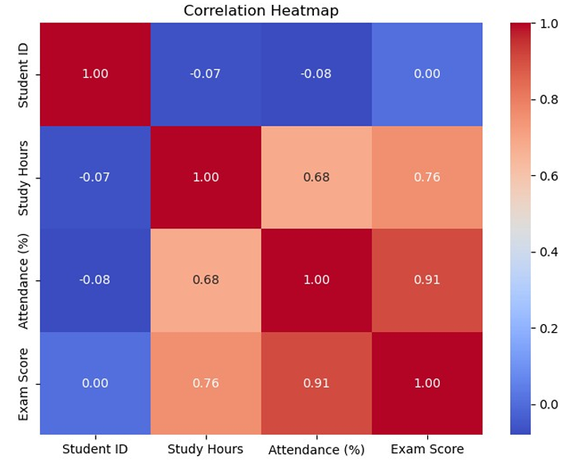

Slide 6
Methodology - Data Preprocessing
Model Choice: Multiple Linear Regression
Why Linear Regression?
It’s a simple, interpretable model for understanding relationships between features.
Effective for predicting continuous outcomes (like exam scores) ,based on independent variables (study hours, attendance).
Steps:
Split the data into training and testing sets.
Train the linear regression model on the training set.
Evaluate the model on the test set using appropriate metrics.

Slide 7
Model Evaluation
Evaluation Metrics:Mean Absolute Error (MAE): Measures the average magnitude of errors.
MAE = 1.96
Mean Squared Error (MSE): Gives more weight to larger errors.
MSE = 5.93
R-squared (R²): Indicates how well the model fits the data.
R² = 0.89 (89% of the variance in exam scores can be explained by study hours and attendance).

Slide 8
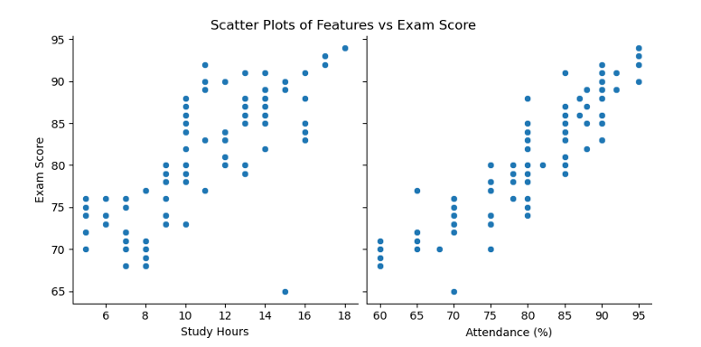

Slide 9
Results and Findings
Key Insights:
Study Hours and Attendance (%) are strongly correlated with Exam Scores.
The model indicates that for every additional study hour, the exam score increases by 0.47 points.
For every percentage point increase in attendance, the exam score increases by 0.56 points.
Performance:
The model has an R-squared value of 0.89, meaning it can predict 89% of the variance in student exam scores.

Slide 10
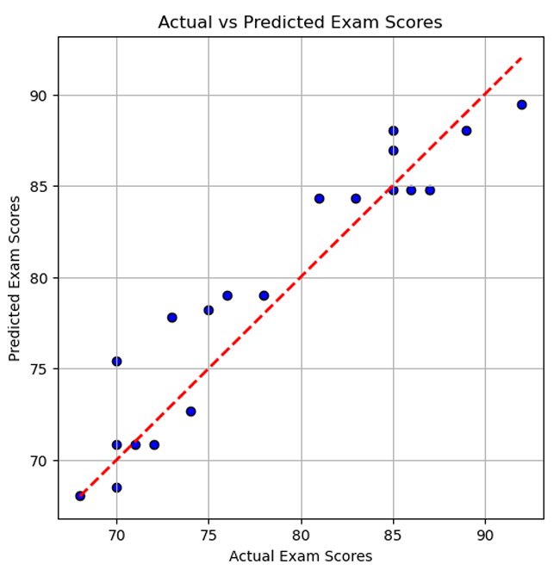

Slide 11
Conclusion
Findings:
Study hours and attendance have a significant impact on student performance.
The model is highly effective in predicting exam scores, with an R² of 0.89.
Insights:
Educators can use the model to identify students at risk of underperforming and provide additional support.
Students can use the model to track their study habits and improve performance.

Slide 12
Future Scope
Improvements:
Additional Features: Include more factors like participation, sleep hours, or prior academic performance.
Model Refinement: Explore non-linear models or deep learning techniques for better accuracy.
Deployment: Create an interactive dashboard for students and educators to visualize predictions and track progress over time.

