Slide 1
Data Description
Column Name | Description
Gender | male – female
Ever_Married | marriage status
Age | range from 18 to 90
Family_Size | the family member size from 1 to 9
Graduated | Graduation status
Var_1 | the category for each group from 0 to 6
Work_Experience | previous experience from 0 to 9
Profession | specialization of this person
Spending_Score | the amount of outcome

Slide 2
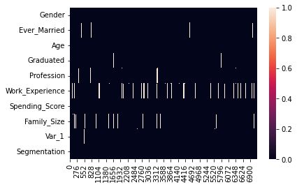
Check The Null Values and Duplicates
Check Null Values
Notes:
Gender ➔ 0
Ever_Married ➔ 121
Age ➔ 0
Graduated ➔ 69
Profession ➔ 105
Work_Experience ➔ 725
Spending_Score ➔ 0
Family_Size ➔ 301
Var_1 ➔ 64
Segmentation ➔ 0

Slide 3
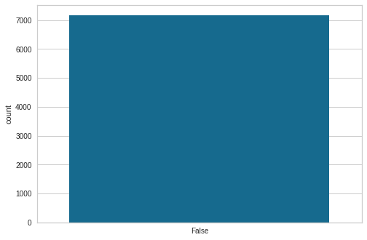
Check Duplicates
Notes:
There are no Duplicates

Slide 4
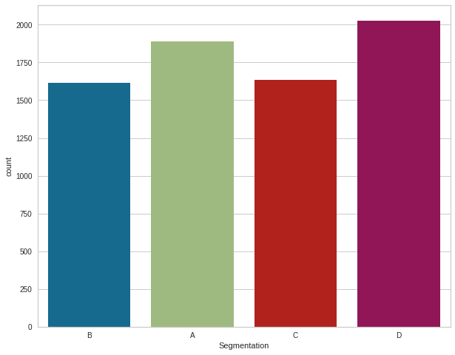
All Classes have approximately close range. The Data is balanced

Slide 5
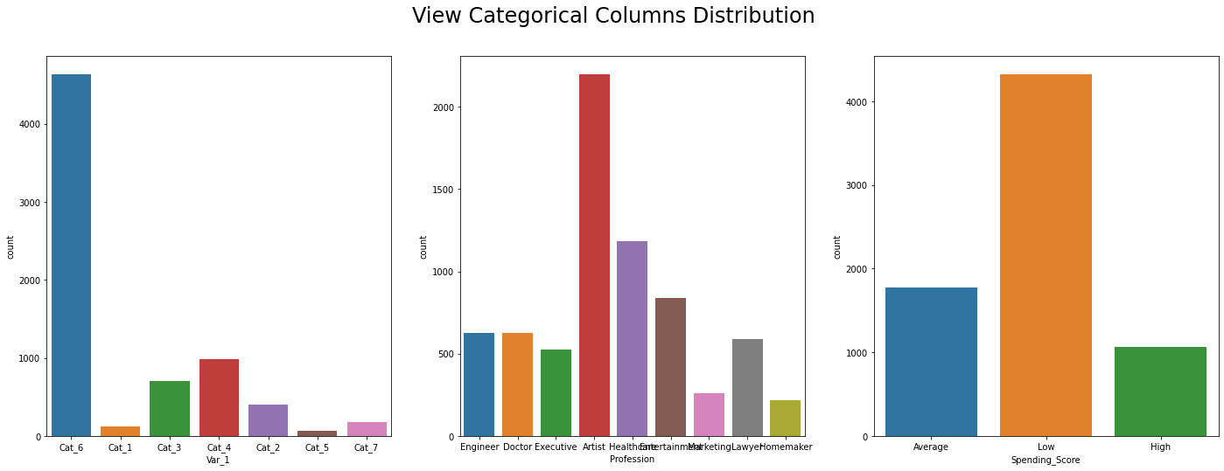
Categorical Columns Distribution
Most of people in Cat_6
Most of the people work as Artist
Most of People spend low money

Slide 6
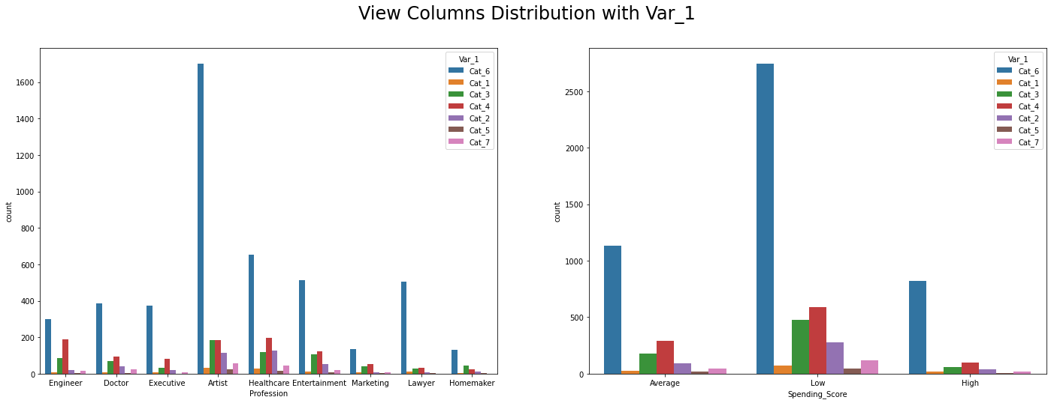
View Columns Distribution with Var_1
Most of Profession is from Cat_6
Most of Spending Score is from Cat_6

Slide 7
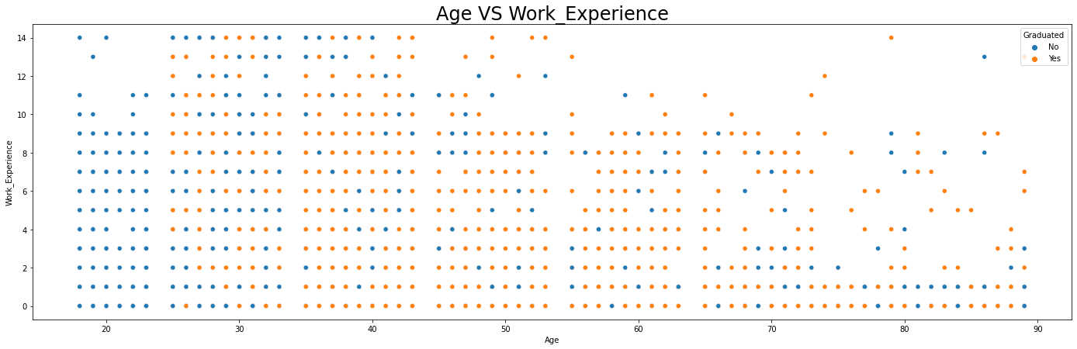
Age VS Work_Experience
This Data is unrealistic as we have people with age that less than 30 years old have work experience more than 10 years though they are not graduated, On other hand people with age more than 40 years old have work experience less than 3 years also some of them is not graduated.
Age is often positively related to work experience, older workers may have acquired more job-relevant knowledge than younger workers.
Ages (24, 34, 44, 54, 64) are missing.

Slide 8
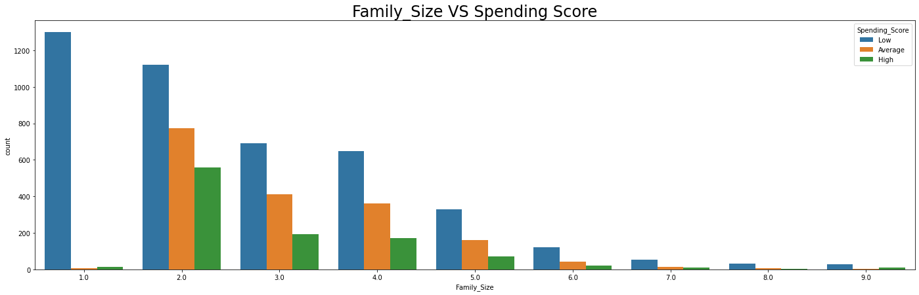
Family_Size VS Spending Score
People who have small family size most of them the Spending_Score are low as we would expected, but those who have larger family size they also have low Spending Score. The Spending Score should increase by increasing the family size.

Slide 9
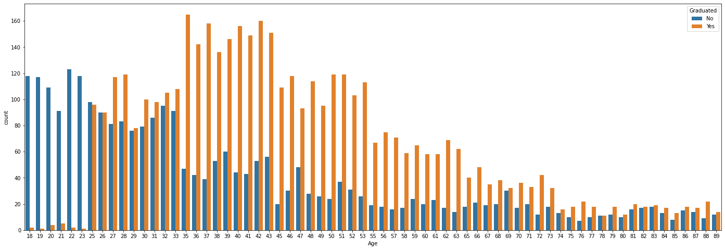
Graduation Column Analysis
We have some people are graduated though there ages are less than 20 years old, on other hand some people are not graduated though there ages are more than 30

Slide 10
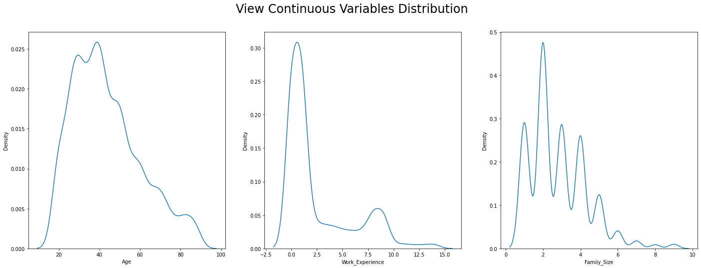
Continuous Variables Distribution
Age Column is moderate skewed to right
Work_Experience and Family_Size are highly skewed to right

Slide 11
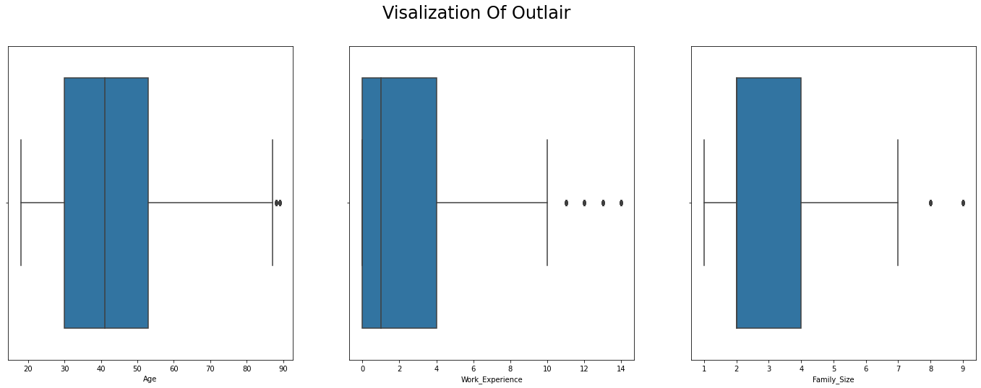
Visualization Of Outlier

Slide 12
Preprocessing Steps
ResetExp_col ➔ Assign working experience to corresponding age
Handel_Graduated ➔ check graduation status within the age
RemoveOutLair ➔remove outliers from age , working experience and family size
Make One Hot Encoder for (Profession, Spending_Score, Var_1 , Gender, Ever_Married, Graduated). Make drop first to avoid dummy trap
Split The Dataset into in train and test with ratio 0.8 training and 0.2 testing

Slide 13
Classification Techniques
Random Forest Classification
Support Vector Classification
LighGBM
XGBoost
CatBoost
Voting Classifier
Stacking Classifier
Logistic Regression

Slide 14
Classification Technique Results
Classification Models | Test Error
Logistic Regression | 42.65 %
Random Forest | 49.85 %
Support Vector Machine | 41.66 %
LighGBM | 47.10 %
XGBoost | 47.59 %
CatBoost | 49.15 %
Voting Classifier | 48.30 %
Stacking Classifier | 48.58 %

Slide 15
Hyper parameters Tuning
Apply Grid Search on Random Forest to find the optimal parameters which are ({criterion='entropy', max_depth=7, n_estimators=200, random_state=42}).
Apply Grid Search on XGBoost (max_depth=5, objective='multi:softprob')

Slide 16
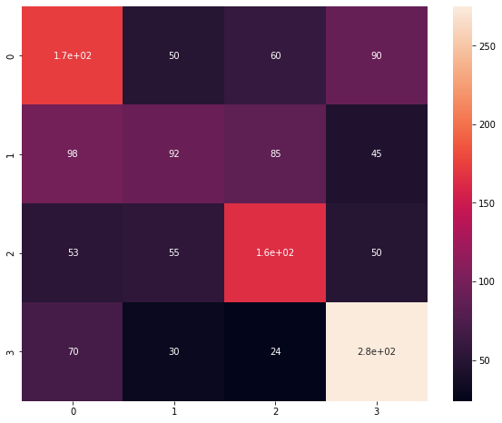
Confusion Matrix For Random Forest

Slide 17
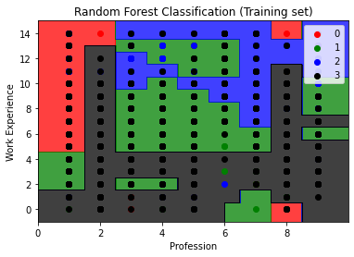
Decision Boundary for Random Forest

