Slide 1


CCNA 200-301 V2.0
03
Ethernet, Frames and Switching
Part I — Foundations
EXAM TOPICS
1.1
LECTURER
Dr. Mustafa Hameed
THE ISLAMIA UNIVERSITY OF BAHAWALPUR
Department of Information Technology
Notes:
Chapter 3: Ethernet, Frames and Switching. Blueprint topics: 1.1.

Slide 2
THE COURSE
Where this chapter sits
Part I
Foundations
chapters 1–7
Part II
Switching and Network Access
chapters 8–14
Part III
IP Routing
chapters 15–19
Part IV
Network Services and Security
chapters 20–26
Part V
Wireless, Virtualisation and Operations
chapters 27–32
Part VI
Sitting the Exam
chapters 33–34
CCNA 200-301 v2.0 · Chapter 3. Ethernet, Frames and Switching
CCNA 200-301 v2.0 · Chapter 3. Ethernet, Frames and Switching
1.1
1.1
Notes:
Ten seconds. Students meeting a chapter in week ten cannot place it without being shown.

Slide 3
LEARNING OUTCOMES
What you will be able to do
• Describe the Ethernet frame and the purpose of each field you will actually meet on a device.
• Explain how a switch learns, forwards, floods and ages MAC addresses — the algorithm behind every switching chapter that follows.
• Read the MAC address table and use it to prove where a device is physically connected.
• Predict what a switch does with a unicast, broadcast or unknown destination.
CCNA 200-301 v2.0 · Chapter 3. Ethernet, Frames and Switching
1.1
Notes:
Ethernet, Frames and Switching 1.1

Slide 4
ASSUMED KNOWLEDGE
Before we start
Chapter 1 for frames and broadcast domains; Chapter 2 for the link underneath.
CCNA 200-301 v2.0 · Chapter 3. Ethernet, Frames and Switching
1.1

Slide 5
KEY TERMS
Vocabulary for this chapter
Ethernet
MAC address
OUI
unicast
broadcast
multicast
CAM table
MAC address table
learning
flooding
filtering
ageing
unknown unicast
MTU
FCS
Each is defined where it first matters — not here.
CCNA 200-301 v2.0 · Chapter 3. Ethernet, Frames and Switching
1.1
Notes:
Do not define these now - they are defined as they arrive. This slide is for the students' notes.

Slide 6
Reading hexadecimal first
CCNA 200-301 v2.0 · Chapter 3. Ethernet, Frames and Switching
1.1

Slide 7
DEFINITION
Hexadecimal, and why it exists
Ordinary decimal counts in tens using ten symbols, 0 to 9. Hex counts in sixteens using sixteen symbols: 0 to 9, then a b c d e f for ten to fifteen.
It exists because one hex digit is exactly four bits, so two hex digits are exactly one byte. Writing a 48-bit MAC address in decimal would take fifteen digits with no relationship to the underlying bits; in hex it takes twelve, and each one maps to a nibble you can reason about.
CCNA 200-301 v2.0 · Chapter 3. Ethernet, Frames and Switching
1.1
Notes:
Everything in this chapter — and every MAC address, every IPv6 address and every frame type for the rest of the book — is written in hexadecimal. It is worth two minutes now, because nothing later makes sense without it.

Slide 8
CONCEPT
The three things you actually have to do with it
• Recognise it. A leading 0x means “what follows is hex” — 0x0800 is the number 2048, not eight hundred. Cisco also writes hex with no prefix at all, as in 00d0.58a1.0201.
• Expand one digit to four bits, using the table above. This is all that EUI-64 (Chapter 5) and the MAC address bits below require.
• Know that f is all ones. So ffff.ffff.ffff is forty-eight 1 bits — every bit set — which is exactly why that is the broadcast address.
You will never be asked to convert a long hex number to decimal in your head. You will regularly be asked what one digit means in bits.
CCNA 200-301 v2.0 · Chapter 3. Ethernet, Frames and Switching
1.1
Notes:
% Nine columns: the budget is about 12.8 cm, not the 15.78 of two.

Slide 9
WORKED EXAMPLE
What is the first byte of 00d0.58a1.0201 in bits?
The first byte is the first two hex digits, 00.
From the table, 0 is 0000. So 00 is 0000 0000 — eight zero bits.
That matters immediately: the conceptbox after the frame explains that the low-order bit of the first byte says unicast or multicast, and the next bit up says whether the address was assigned by a manufacturer. Both are zero here, so this is a unicast address burned in by its vendor. In Chapter 28 you will meet an address where the second bit is one, and that single bit is the whole diagnosis.
CCNA 200-301 v2.0 · Chapter 3. Ethernet, Frames and Switching
1.1

Slide 10
The frame
CCNA 200-301 v2.0 · Chapter 3. Ethernet, Frames and Switching
1.1

Slide 11
DEFINITION
The Ethernet frame, field by field
• Preamble — clock synchronisation. You will never see it.
• Destination MAC (6 bytes) — who this frame is for. The switch reads this to decide where to send it.
• Source MAC (6 bytes) — who sent it. The switch reads this to learn.
• Type/Length (2 bytes) — what is inside. 0x0800 is IPv4, 0x86DD is IPv6, 0x8100 means a VLAN tag follows (Chapter 10).
• Payload — 46 to 1500 bytes. Below 46 the frame is padded; this is why a frame under 64 bytes total is a runt.
CCNA 200-301 v2.0 · Chapter 3. Ethernet, Frames and Switching
1.1

Slide 12
DEFINITION
The Ethernet frame, field by field (continued)
• FCS (4 bytes) — a checksum. If it fails, the frame is counted as a CRC error and discarded (Chapter 2).
CCNA 200-301 v2.0 · Chapter 3. Ethernet, Frames and Switching
1.1

Slide 13
CONCEPT
Three kinds of destination
• Unicast — one specific device. The low-order bit of the first byte is 0.
• Broadcast — ffff.ffff.ffff, every device in the VLAN. This is what defines a broadcast domain.
• Multicast — a group. The low-order bit of the first byte is 1. OSPF (Chapter 17), HSRP and VRRP (Chapter 19) all use multicast.
CCNA 200-301 v2.0 · Chapter 3. Ethernet, Frames and Switching
1.1
Notes:
A MAC address is 48 bits, written as twelve hex digits. The first half is the OUI, assigned to the manufacturer; the second half is assigned by that manufacturer. Cisco writes them as 00d0.58a1.0201; almost everyone else writes 00:d0:58:a1:02:01. They are the same address, and you should be able to read both.

Slide 14
How a switch actually works
CCNA 200-301 v2.0 · Chapter 3. Ethernet, Frames and Switching
1.1

Slide 15
CONCEPT
Learn, then forward or flood
For every frame that arrives on a port:
• Learn. Record the source MAC address against the port it arrived on, in this VLAN. Reset the ageing timer if it is already there.
• Decide on the destination.
• Known unicast → forward out that one port.
• Unknown unicast → flood out every other port in the VLAN.
• Broadcast or multicast → flood.
CCNA 200-301 v2.0 · Chapter 3. Ethernet, Frames and Switching
1.1
Notes:
A switch runs one small algorithm, and everything in Part II is a modification of it.

Slide 16
CONCEPT
Learn, then forward or flood (continued)
• Destination is on the same port it arrived on → filter, that is, discard it.
A switch never modifies the addresses in a frame it forwards, and it never consults an IP address. Both of those are the router’s job.
CCNA 200-301 v2.0 · Chapter 3. Ethernet, Frames and Switching
1.1

Slide 17
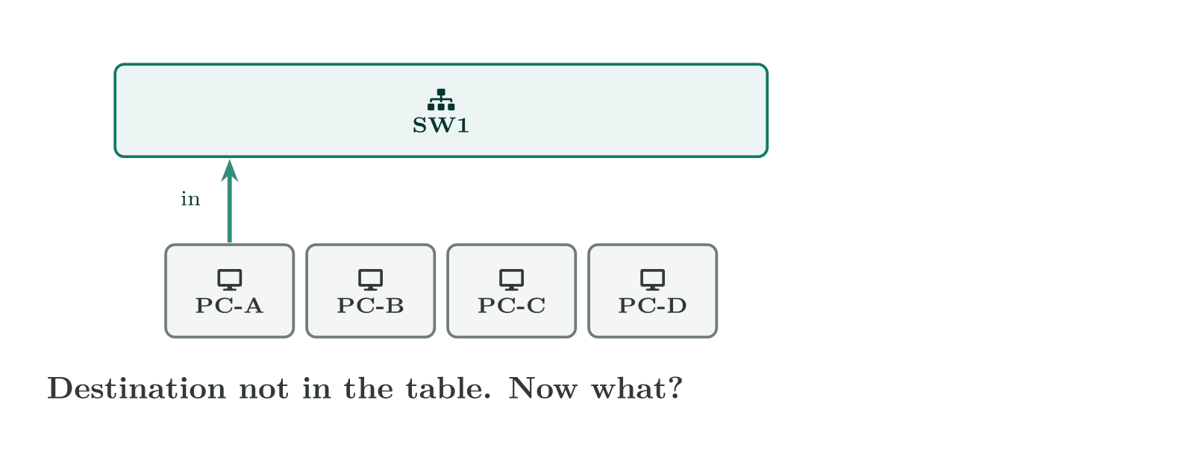
How a switch actually works
CCNA 200-301 v2.0 · Chapter 3. Ethernet, Frames and Switching
1.1
Notes:
The whole switching algorithm. Flooding is not a failure — it is how the table gets built, and the second frame between the same two hosts is already efficient.

Slide 18
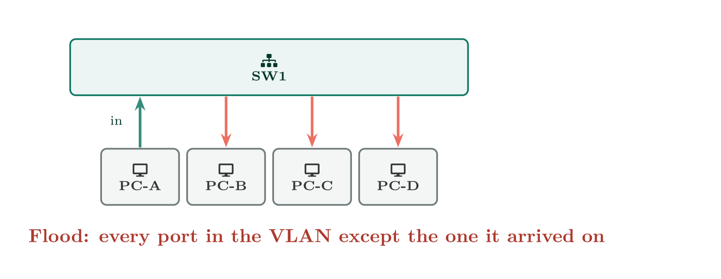
How a switch actually works
CCNA 200-301 v2.0 · Chapter 3. Ethernet, Frames and Switching
1.1

Slide 19
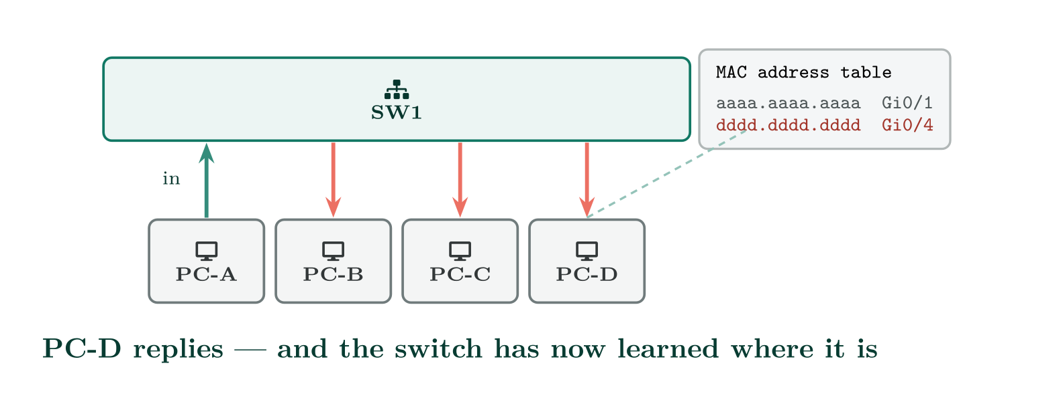
How a switch actually works
CCNA 200-301 v2.0 · Chapter 3. Ethernet, Frames and Switching
1.1

Slide 20
WATCH OUT
The consequence that matters: unknown unicast flooding
A switch floods a unicast frame when it does not know the destination. That is not a fault — it is how the network keeps working while the table is learned. But it means a full or wiped MAC table causes traffic to be sprayed to every port, which is both a performance problem and a security one. It is also the mechanism a MAC flooding attack abuses, which is why Chapter 25 exists and why topic 4.7 names port security.
CCNA 200-301 v2.0 · Chapter 3. Ethernet, Frames and Switching
1.1

Slide 21
VERIFY
show mac address-table
SW1#
Mac Address Table
-------------------------------------------
Vlan Mac Address Type Ports
---- ----------- -------- -----
1 00d0.58a1.0201 DYNAMIC Gi0/1
1 0060.5c2b.19a4 DYNAMIC Gi0/2
10 000a.f36e.7712 DYNAMIC Gi0/5
10 0002.1751.4c33 STATIC Gi0/6
20 00e0.b05f.2210 DYNAMIC Gi0/8
Total Mac Addresses for this criterion: 5
CCNA 200-301 v2.0 · Chapter 3. Ethernet, Frames and Switching
1.1
Notes:
Entries age out after five minutes of silence by default. A device that has been quiet longer than that has to be re-learned, and the first frame to it is flooded.

Slide 22
CONFIGURE
A static MAC entry, and a shorter ageing time
IOS · configuration mode
! Pin a known device to a known port. Rarely needed, but it survives
! ageing and cannot be moved by a spoofed frame.
mac address-table static 0002.1751.4c33 vlan 10 interface GigabitEthernet0/6
!
! Age entries out faster than the 300-second default.
mac address-table aging-time 120
CCNA 200-301 v2.0 · Chapter 3. Ethernet, Frames and Switching
1.1
Notes:
This table is the most useful single output on a switch. It answers “where is this device physically plugged in?”, and it does so by evidence rather than by documentation — which is exactly what topic 2.3 asks you to do when it says validate the accuracy of network documentation.

Slide 23
WORKED EXAMPLE
Following a frame across two switches
PC-A (00d0.58a1.0201) on SW1 Gi0/1 sends to PC-B (00e0.b05f.2210) on SW2 Gi0/3. Both switches have empty tables.
• The frame arrives at SW1 Gi0/1. SW1 learns 00d0.58a1.0201 on Gi0/1.
• SW1 does not know PC-B, so it floods — out its uplink and every other access port.
• SW2 receives it on its uplink and learns 00d0.58a1.0201 on that uplink port, not on Gi0/1. A switch only ever knows the direction, not the distance.
• SW2 does not know PC-B either, so it floods. PC-B receives it.
• PC-B replies. Now SW2 learns PC-B on Gi0/3, and because it already knows PC-A, it forwards rather than flooding.
CCNA 200-301 v2.0 · Chapter 3. Ethernet, Frames and Switching
1.1

Slide 24
WORKED EXAMPLE
Following a frame across two switches (continued)
• SW1 learns PC-B on its uplink. From here on the conversation is unicast in both directions.
Two floods to start a conversation, then none. That is the whole design.
CCNA 200-301 v2.0 · Chapter 3. Ethernet, Frames and Switching
1.1

Slide 25
COMMON PITFALLS · How a switch actually works
Common pitfalls
• Expecting a switch to know a distance. The table says which port, never how many hops. Five hundred devices can appear behind one uplink port and that is entirely normal.
• Reading a stale table. An entry can be up to five minutes old. If you have just moved a cable, the table may still show the old port.
• Confusing the MAC table with the ARP table. The MAC table maps MAC → port and lives on a switch. The ARP table maps IP → MAC and lives on any device with an IP address. The exam will test that you know which to look at.
• Forgetting the VLAN column. The same MAC address can legitimately appear in two VLANs. Learning is always per VLAN.
CCNA 200-301 v2.0 · Chapter 3. Ethernet, Frames and Switching
1.1

Slide 26
BREAK & FIX · SYMPTOM
Chapter 3
Two ports, one MAC address, and a flapping log.
Users on VLAN 10 report intermittent drops. The log shows:
CCNA 200-301 v2.0 · Chapter 3. Ethernet, Frames and Switching
1.1

Slide 27
BREAK & FIX · YOUR MOVE
Chapter 3
Two ports, one MAC address, and a flapping log.
What would you check first — and what do you expect to see?
CCNA 200-301 v2.0 · Chapter 3. Ethernet, Frames and Switching
1.1
Notes:
Pause here. Take two or three answers before advancing. The point is the prediction, not the command.

Slide 28
BREAK & FIX · EVIDENCE
Chapter 3
show logging | include MACFLAP
SW1#
%SW_MATM-4-MACFLAP_NOTIF: Host 000a.f36e.7712 in vlan 10 is flapping
between port Gi0/5 and port Gi0/12
CCNA 200-301 v2.0 · Chapter 3. Ethernet, Frames and Switching
1.1
Notes:
Read it aloud. Ask what single field decides the answer.

Slide 29
BREAK & FIX · YOUR MOVE
Chapter 3
What is the fault — and what does this output rule out?
CCNA 200-301 v2.0 · Chapter 3. Ethernet, Frames and Switching
1.1
Notes:
The elimination matters as much as the answer.

Slide 30
BREAK & FIX · DIAGNOSIS
Chapter 3
Why it is doing that
Diagnosis. The switch is learning the same source MAC on two ports in quick succession. A device cannot be in two places, so one of three things is true: there is a physical loop joining those ports (the same frame is arriving by two paths — see Chapter 12), a device is spoofing that address, or two devices have been given the same MAC by a bad clone or a virtualisation misconfiguration.
CCNA 200-301 v2.0 · Chapter 3. Ethernet, Frames and Switching
1.1

Slide 31
BREAK & FIX · THE FIX
Chapter 3
And the lesson
Fix. Check spanning tree first, because a loop is both the most likely cause and the most damaging: show spanning-tree vlan 10 and look for a port that should be blocking and is not. If the topology is loop-free, shut Gi0/12, confirm the flapping stops, and trace what is attached to it.
CCNA 200-301 v2.0 · Chapter 3. Ethernet, Frames and Switching
1.1

Slide 32
LAB · PACKET TRACER
Watching a switch learn
Topology. Two switches, uplinked; two PCs on SW1, one on SW2. All in VLAN 1 for now.
1. Power everything on and immediately run show mac address-table on both switches. Record what is there before any traffic.
2. Ping from PC-A to PC-C. Re-run the command on both switches and record which addresses each has learned, and against which port.
3. Explain, from your own capture, why SW2 shows PC-A against its uplink rather than against a host port.
4. Run clear mac address-table dynamic, then ping again and watch the table rebuild.
5. Set mac address-table aging-time 15. Leave a PC idle for thirty seconds and confirm its entry disappears.
CCNA 200-301 v2.0 · Chapter 3. Ethernet, Frames and Switching
1.1

Slide 33
LAB · PACKET TRACER
Watching a switch learn (continued)
6. Extension. Add a second cable between the two switches to create a loop. Observe what happens to the MAC table and the log before spanning tree settles — then read Chapter 12 to find out why the network survived.
CCNA 200-301 v2.0 · Chapter 3. Ethernet, Frames and Switching
1.1

Slide 34
CHECKPOINT 1 of 3
A switch receives a frame whose destination MAC is already in its table, against the same port the frame arrived on. What does it do, and what is that behaviour called?
Discuss · then advance
Notes:
Ask the room. Do not advance until somebody commits to an answer.

Slide 35
ANSWER
Checkpoint 1 of 3
A switch receives a frame whose destination MAC is already in its table, against the same port the frame arrived on. What does it do, and what is that behaviour called?
It drops it. The behaviour is called filtering: the destination is known to be reachable through the same port the frame arrived on, so forwarding it would send it back where it came from.
CCNA 200-301 v2.0 · Chapter 3. Ethernet, Frames and Switching
1.1

Slide 36
CHECKPOINT 2 of 3
Why does the first ping between two devices often show a longer round trip than the ones after it?
Discuss · then advance
Notes:
Ask the room. Do not advance until somebody commits to an answer.

Slide 37
ANSWER
Checkpoint 2 of 3
Why does the first ping between two devices often show a longer round trip than the ones after it?
Because the first one triggers an ARP request and possibly a MAC flood, and the round trip includes that resolution. Later pings use the cached entries.
CCNA 200-301 v2.0 · Chapter 3. Ethernet, Frames and Switching
1.1

Slide 38
CHECKPOINT 3 of 3
You need to prove which wall port a particular laptop is using. Which table do you consult, on which device, and what do you need to know first?
Discuss · then advance
Notes:
Ask the room. Do not advance until somebody commits to an answer.

Slide 39
ANSWER
Checkpoint 3 of 3
You need to prove which wall port a particular laptop is using. Which table do you consult, on which device, and what do you need to know first?
The MAC address table, on the switch the laptop is connected to. You need the laptop’s MAC address first — and note that on wireless it may be randomised (Chapter 28), so the MAC on the label may not be the one on the network.
CCNA 200-301 v2.0 · Chapter 3. Ethernet, Frames and Switching
1.1

Slide 40
CHAPTER SUMMARY
What to take away
• A switch learns from the source address and decides on the destination address. Everything else follows.
• Known unicast is forwarded, unknown unicast and broadcast are flooded, and a frame is never sent back out of the port it came in on.
• The MAC address table maps MAC to port, per VLAN, and ages entries out after five minutes by default.
• MAC table is not ARP table. One lives on a switch and maps to ports; the other maps IP to MAC and lives on anything with an IP address.
CCNA 200-301 v2.0 · Chapter 3. Ethernet, Frames and Switching
1.1

Slide 41
CHAPTER SUMMARY
What to take away (continued)
• A MAC address flapping between two ports means a loop, a spoof, or a duplicate — and you check for the loop first.
CCNA 200-301 v2.0 · Chapter 3. Ethernet, Frames and Switching
1.1

Slide 42
Where we got to
• A switch learns from the source address and decides on the destination address. Everything else follows.
• Known unicast is forwarded, unknown unicast and broadcast are flooded, and a frame is never sent back out of the port it came in on.
• The MAC address table maps MAC to port, per VLAN, and ages entries out after five minutes by default.
• MAC table is not ARP table. One lives on a switch and maps to ports; the other maps IP to MAC and lives on anything with an IP address.
NEXT
Chapter 4 — IPv4 Addressing and Subnetting

