Slide 1


CCNA 200-301 V2.0
12
Rapid PVST+ and the Protection Features
Part II — Switching and Network Access
EXAM TOPICS
2.5
LECTURER
Dr. Mustafa Hameed
THE ISLAMIA UNIVERSITY OF BAHAWALPUR
Department of Information Technology
Notes:
Chapter 12: Rapid PVST+ and the Protection Features. Blueprint topics: 2.5.

Slide 2
THE COURSE
Where this chapter sits
Part I
Foundations
chapters 1–7
Part II
Switching and Network Access
chapters 8–14
Part III
IP Routing
chapters 15–19
Part IV
Network Services and Security
chapters 20–26
Part V
Wireless, Virtualisation and Operations
chapters 27–32
Part VI
Sitting the Exam
chapters 33–34
CCNA 200-301 v2.0 · Chapter 12. Rapid PVST+ and the Protection Features
CCNA 200-301 v2.0 · Chapter 12. Rapid PVST+ and the Protection Features
2.5
2.5
Notes:
Ten seconds. Students meeting a chapter in week ten cannot place it without being shown.

Slide 3
LEARNING OUTCOMES
What you will be able to do
• Explain what a layer 2 loop does to a network, and why it is worse than any layer 3 failure.
• Predict the root bridge, root ports and designated ports for a given topology, and influence the outcome deliberately.
• Configure Rapid PVST+, root primary and secondary, PortFast, BPDU guard, root guard and loop guard.
• Diagnose an unexpected root bridge, an errdisabled port and a port that will not leave blocking.
CCNA 200-301 v2.0 · Chapter 12. Rapid PVST+ and the Protection Features
2.5
Notes:
Rapid PVST+ and the Protection Features 2.5

Slide 4
ASSUMED KNOWLEDGE
Before we start
Chapter 3 for flooding — which is what makes a loop catastrophic — and Chapter 10 for trunks between switches.
CCNA 200-301 v2.0 · Chapter 12. Rapid PVST+ and the Protection Features
2.5

Slide 5
KEY TERMS
Vocabulary for this chapter
BPDU
root bridge
bridge ID
bridge priority
root port
designated port
alternate port
path cost
Rapid PVST+
PortFast
BPDU guard
root guard
loop guard
errdisable
Each is defined where it first matters — not here.
CCNA 200-301 v2.0 · Chapter 12. Rapid PVST+ and the Protection Features
2.5
Notes:
Do not define these now - they are defined as they arrive. This slide is for the students' notes.

Slide 6
Why a layer 2 loop is fatal
CCNA 200-301 v2.0 · Chapter 12. Rapid PVST+ and the Protection Features
2.5

Slide 7
CONCEPT
Three things happen at once, and none of them stops
An IP packet carries a TTL that decrements at each router, so a routing loop eventually discards the packet. An Ethernet frame has no TTL. A frame caught in a switching loop circulates until somebody unplugs something.
• Broadcast storm. A single broadcast is flooded, arrives back, and is flooded again — multiplying without limit until the links saturate.
• MAC table instability. The same source address arrives on two ports repeatedly, so the table is rewritten constantly and unicast forwarding becomes unreliable (see the flap message in Chapter 3).
• Duplicate frame delivery. Hosts receive multiple copies, which breaks protocols that assume they will not.
The network does not degrade gracefully; it stops, usually within seconds. This is why spanning tree exists and why it is on by default.
CCNA 200-301 v2.0 · Chapter 12. Rapid PVST+ and the Protection Features
2.5

Slide 8
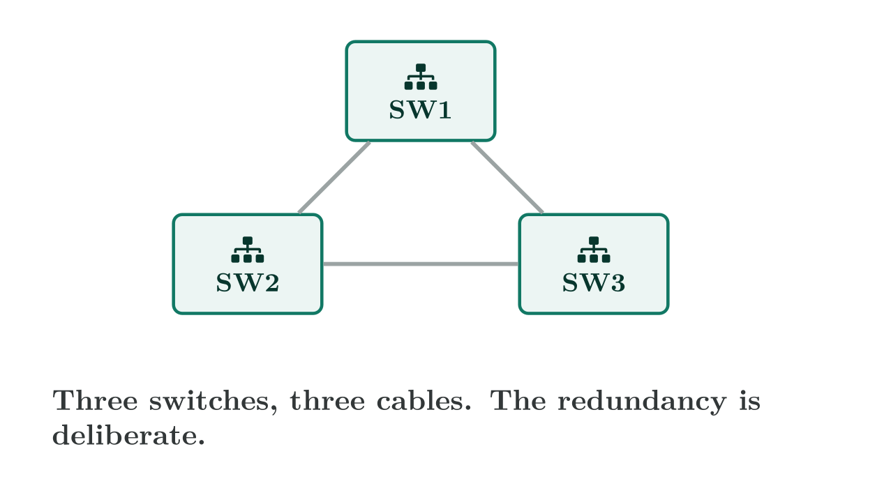
Why a layer 2 loop is fatal
CCNA 200-301 v2.0 · Chapter 12. Rapid PVST+ and the Protection Features
2.5
Notes:
Spanning tree does not remove the cable. It blocks one port, so the physical redundancy is still there and can be brought back automatically when a link fails.

Slide 9
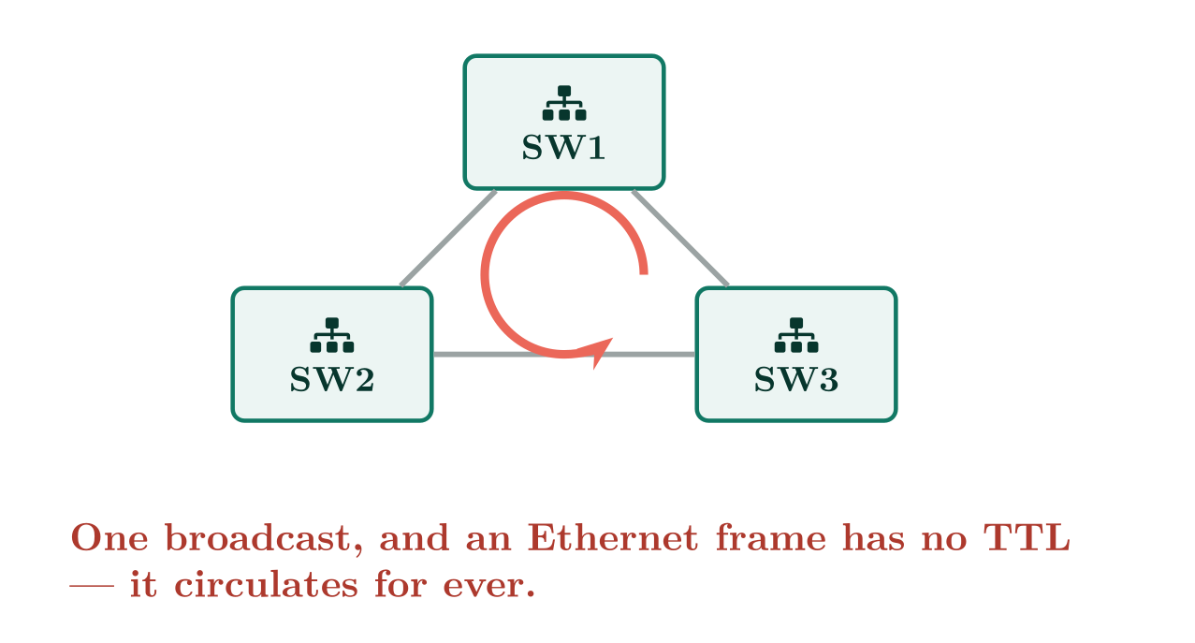
Why a layer 2 loop is fatal
CCNA 200-301 v2.0 · Chapter 12. Rapid PVST+ and the Protection Features
2.5

Slide 10
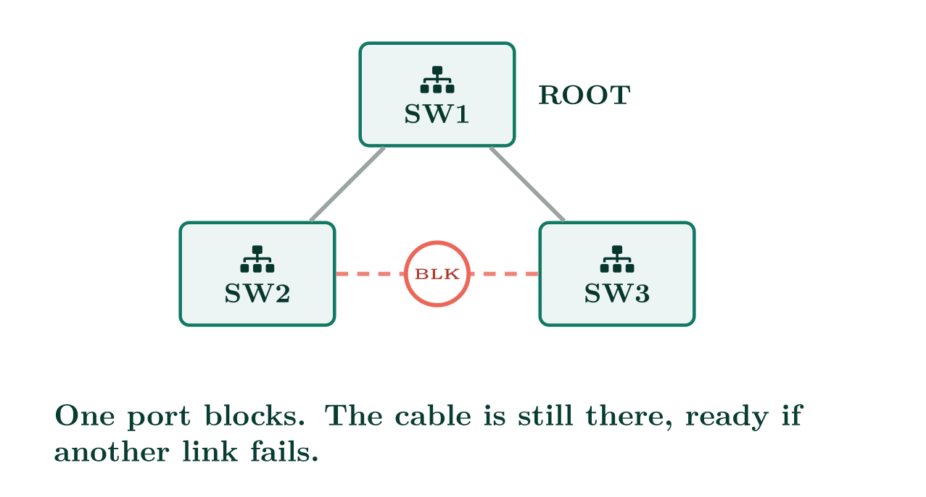
Why a layer 2 loop is fatal
CCNA 200-301 v2.0 · Chapter 12. Rapid PVST+ and the Protection Features
2.5

Slide 11
How the tree is chosen
CCNA 200-301 v2.0 · Chapter 12. Rapid PVST+ and the Protection Features
2.5

Slide 12
DEFINITION
Bridge ID and root election
Every switch has a bridge ID: a 4-bit priority, plus a 12-bit extended system ID carrying the VLAN number, plus its MAC address. The switch with the lowest bridge ID wins and becomes the root bridge.
Default priority is 32768. Because the extended system ID adds the VLAN number, the effective priority in VLAN 10 is 32768+10=32778. Priorities are configured in steps of 4096.
CCNA 200-301 v2.0 · Chapter 12. Rapid PVST+ and the Protection Features
2.5

Slide 13
WORKED EXAMPLE
Which of these three is the root, in VLAN 10?
Three switches, all left at defaults:
{@{}lll@{}} SW1 & priority 32768 & MAC 0011.2233.0100 SW2 & priority 32768 & MAC 0011.2233.0050 SW3 & priority 32768 & MAC 0011.2233.0200
Step 1 — compare priority. All three are 32768, and all three are in VLAN 10, so all three have the same effective priority of 32768+10 = 32778. No winner yet.
Step 2 — the tie-break is the MAC address, and lowest wins. Compare them left to right, as you would compare words alphabetically. The first eight digits are identical, so the decision comes down to the last four: 0100, 0050, 0200.
In hex, 0050 is the smallest of the three (Chapter 3 if the hex is not yet automatic — 0050 is 80 in decimal, 0100 is 256).
SW2 is the root bridge.
Now notice what just happened: nobody chose this. The winner is whichever switch happens to have the lowest MAC address, which correlates with nothing except manufacturing date. That is the point of the alert below.
CCNA 200-301 v2.0 · Chapter 12. Rapid PVST+ and the Protection Features
2.5

Slide 14
WATCH OUT
Left alone, the oldest switch wins
If every switch keeps the default priority, the election is decided by the lowest MAC address — which usually means the oldest device in the building becomes the root of your network. That is almost never where you want traffic to converge. Always set the root deliberately.
CCNA 200-301 v2.0 · Chapter 12. Rapid PVST+ and the Protection Features
2.5

Slide 15
CONCEPT
Then every port takes a role
Once the root is known:
• Each non-root switch picks its root port — the one port with the lowest cumulative path cost to the root. It forwards.
• Each segment picks a designated port — the port on that segment closest to the root. It forwards.
• Everything else becomes an alternate (or backup) port and blocks. That is the loop being broken.
Ties are broken by lowest sender bridge ID, then lowest sender port ID.
CCNA 200-301 v2.0 · Chapter 12. Rapid PVST+ and the Protection Features
2.5

Slide 16
Configuring Rapid PVST+
CCNA 200-301 v2.0 · Chapter 12. Rapid PVST+ and the Protection Features
2.5

Slide 17
CONFIGURE
Rapid PVST+ with a deliberate root
IOS · configuration mode
! Run rapid per-VLAN spanning tree.
spanning-tree mode rapid-pvst
!
! On the switch that SHOULD be root for these VLANs:
spanning-tree vlan 10,20,30 root primary
!
! On the switch that should take over if it fails:
! spanning-tree vlan 10,20,30 root secondary
!
! The macro above simply sets a priority. You can be explicit:
! spanning-tree vlan 10 priority 4096
CCNA 200-301 v2.0 · Chapter 12. Rapid PVST+ and the Protection Features
2.5
Notes:
Rapid PVST+ runs one rapid spanning tree instance per VLAN. It converges in seconds rather than the 30–50 of the original standard, and it is what the blueprint names.

Slide 18
VERIFY
show spanning-tree vlan 10
SW1#
VLAN0010
Spanning tree enabled protocol rstp
Root ID Priority 4106
Address 00d0.58a1.0200
This bridge is the root
Hello Time 2 sec Max Age 20 sec Forward Delay 15 sec
Bridge ID Priority 4106 (priority 4096 sys-id-ext 10)
Address 00d0.58a1.0200
Interface Role Sts Cost Prio.Nbr Type
------------------- ---- --- --------- -------- --------------------------------
Gi0/1 Desg FWD 4 128.1 P2p
Gi0/2 Desg FWD 4 128.2 P2p
CCNA 200-301 v2.0 · Chapter 12. Rapid PVST+ and the Protection Features
2.5

Slide 19
VERIFY
show spanning-tree vlan 10
SW2#
VLAN0010
Spanning tree enabled protocol rstp
Root ID Priority 4106
Address 00d0.58a1.0200
Cost 4
Port 1 (GigabitEthernet0/1)
Interface Role Sts Cost Prio.Nbr Type
------------------- ---- --- --------- -------- --------------------------------
Gi0/1 Root FWD 4 128.1 P2p
Gi0/2 Altn BLK 4 128.2 P2p
CCNA 200-301 v2.0 · Chapter 12. Rapid PVST+ and the Protection Features
2.5
Notes:
Two things to read first: This bridge is the root — is it the switch you intended? — and the priority, 4106, which is 4096+10 and confirms the extended system ID is doing what it should.

Slide 20
The protection features
CCNA 200-301 v2.0 · Chapter 12. Rapid PVST+ and the Protection Features
2.5

Slide 21
WATCH OUT
PortFast and BPDU guard belong together
PortFast on its own is a loop waiting to happen: it tells a port to forward immediately, so if somebody plugs a switch into it the loop is live before spanning tree can react. BPDU guard is the safety catch — the instant a BPDU arrives, the port is shut. Configure them as a pair, always.
CCNA 200-301 v2.0 · Chapter 12. Rapid PVST+ and the Protection Features
2.5
Notes:
Gi0/2 is Altn BLK — alternate, blocking. That is the loop being broken, and it is a healthy state, not a fault. Topic 2.5 names PortFast, root guard, loop guard and BPDU guard explicitly.

Slide 22
CONFIGURE
Protection, per port and globally
IOS · configuration mode
! Per access port.
interface range GigabitEthernet0/5 - 20
switchport mode access
switchport access vlan 10
spanning-tree portfast
spanning-tree bpduguard enable
!
! Or globally, which applies to every access port automatically --
! far harder to forget on the next port somebody configures.
spanning-tree portfast default
spanning-tree portfast bpduguard default
!
! On a trunk facing a downstream switch that must never be root:
interface GigabitEthernet0/23
spanning-tree guard root
!
! Loop guard, globally on all point-to-point links.
spanning-tree loopguard default
CCNA 200-301 v2.0 · Chapter 12. Rapid PVST+ and the Protection Features
2.5

Slide 23
VERIFY
show interfaces status err-disabled
SW1#
Port Name Status Reason Err-disabled Vlans
Gi0/7 err-disabled bpduguard
CCNA 200-301 v2.0 · Chapter 12. Rapid PVST+ and the Protection Features
2.5

Slide 24
CONCEPT
Recovering an errdisabled port
Manually: shutdown then no shutdown on the interface — after removing whatever caused it. Automatically:
Automatic recovery is a convenience, not a fix. If a rogue switch is still plugged in the port will simply errdisable again every five minutes.
CCNA 200-301 v2.0 · Chapter 12. Rapid PVST+ and the Protection Features
2.5

Slide 25
COMMON PITFALLS · The protection features
Common pitfalls
• Leaving the root election to chance. The oldest switch wins, and your traffic detours through the wiring closet nobody has visited in ten years.
• PortFast without BPDU guard. See above.
• PortFast on a trunk to another switch. It is for edge ports. There is a portfast trunk variant for specific cases, but the default answer is no.
• Treating a blocking port as broken. Altn BLK is spanning tree working.
• Forgetting spanning tree is per VLAN. A change to VLAN 10 does nothing for VLAN 20. Always name the VLANs.
CCNA 200-301 v2.0 · Chapter 12. Rapid PVST+ and the Protection Features
2.5

Slide 26
BREAK & FIX · SYMPTOM
Chapter 12
After a new switch was added, traffic takes a strange path.
An access switch was installed in a spare closet. Since then, throughput between two core switches has halved and show spanning-tree vlan 10 on the core reports that it is no longer the root.
CCNA 200-301 v2.0 · Chapter 12. Rapid PVST+ and the Protection Features
2.5

Slide 27
BREAK & FIX · YOUR MOVE
Chapter 12
After a new switch was added, traffic takes a strange path.
What would you check first — and what do you expect to see?
CCNA 200-301 v2.0 · Chapter 12. Rapid PVST+ and the Protection Features
2.5
Notes:
Pause here. Take two or three answers before advancing. The point is the prediction, not the command.

Slide 28
BREAK & FIX · EVIDENCE
Chapter 12
show spanning-tree vlan 10 | include Root ID|Priority|Address
CORE1#
Root ID Priority 32778
Address 0011.2233.4455
Cost 19
CCNA 200-301 v2.0 · Chapter 12. Rapid PVST+ and the Protection Features
2.5
Notes:
Read it aloud. Ask what single field decides the answer.

Slide 29
BREAK & FIX · YOUR MOVE
Chapter 12
What is the fault — and what does this output rule out?
CCNA 200-301 v2.0 · Chapter 12. Rapid PVST+ and the Protection Features
2.5
Notes:
The elimination matters as much as the answer.

Slide 30
BREAK & FIX · DIAGNOSIS
Chapter 12
Why it is doing that
Diagnosis. The root’s priority is 32778 — the default of 32768+10 — and the MAC address is not the core’s. The new access switch shipped with default priority and a lower MAC address than the core, so it won the election. Every VLAN’s traffic now converges on a small access switch connected by a 100 Mbps link, which is where the cost of 19 comes from and why throughput halved.
CCNA 200-301 v2.0 · Chapter 12. Rapid PVST+ and the Protection Features
2.5

Slide 31
BREAK & FIX · THE FIX
Chapter 12
And the lesson
Fix. Two steps, and do both. Set the intended root explicitly on the core: spanning-tree vlan 10,20,30 root primary, and the secondary on the other core switch. Then stop it happening again: apply spanning-tree guard root on the core ports facing access switches, so a switch advertising a superior BPDU is ignored rather than obeyed.
CCNA 200-301 v2.0 · Chapter 12. Rapid PVST+ and the Protection Features
2.5

Slide 32
LAB · PACKET TRACER
Steer the tree, then protect it
Topology. Three switches cabled in a triangle — deliberately looped — with PCs on two of them.
1. Cable the triangle with no spanning tree changes. Identify the root from show spanning-tree and explain why that switch won.
2. Record which port on which switch is blocking.
3. Set SW1 as root primary and SW2 as root secondary for VLAN 1. Re-check and record what moved.
4. Disconnect the link between SW1 and SW3. Time how long traffic takes to recover and note which port changed role.
5. Enable PortFast and BPDU guard on an access port, then plug a switch into it. Record the log message and the port status, then recover the port.
CCNA 200-301 v2.0 · Chapter 12. Rapid PVST+ and the Protection Features
2.5

Slide 33
LAB · PACKET TRACER
Steer the tree, then protect it (continued)
6. Enable spanning-tree guard root on SW1’s port to SW3, then try to make SW3 root by lowering its priority. Record what happens instead.
7. Extension. Time how long the network takes to recover from a link failure under spanning-tree mode pvst, then repeat under rapid-pvst and compare the two figures.
CCNA 200-301 v2.0 · Chapter 12. Rapid PVST+ and the Protection Features
2.5

Slide 34
CHECKPOINT 1 of 3
Three switches have default priorities and MAC addresses ending ...0100, ...0050 and ...0200. Which is root, and why?
Discuss · then advance
Notes:
Ask the room. Do not advance until somebody commits to an answer.

Slide 35
ANSWER
Checkpoint 1 of 3
Three switches have default priorities and MAC addresses ending ...0100, ...0050 and ...0200. Which is root, and why?
The one ending ...0050. With equal priorities the lowest MAC address wins the tie-break, and 0050 is numerically lowest.
CCNA 200-301 v2.0 · Chapter 12. Rapid PVST+ and the Protection Features
2.5

Slide 36
CHECKPOINT 2 of 3
A port shows Altn BLK. Is this a fault? Justify your answer.
Discuss · then advance
Notes:
Ask the room. Do not advance until somebody commits to an answer.

Slide 37
ANSWER
Checkpoint 2 of 3
A port shows Altn BLK. Is this a fault? Justify your answer.
No, it is correct and necessary. An alternate port blocking is spanning tree doing exactly its job — it has found a redundant path and is keeping it available without creating a loop.
CCNA 200-301 v2.0 · Chapter 12. Rapid PVST+ and the Protection Features
2.5

Slide 38
CHECKPOINT 3 of 3
Why must PortFast and BPDU guard be configured together?
Discuss · then advance
Notes:
Ask the room. Do not advance until somebody commits to an answer.

Slide 39
ANSWER
Checkpoint 3 of 3
Why must PortFast and BPDU guard be configured together?
Because PortFast removes the delay that would otherwise let spanning tree detect a loop before the port forwards. If somebody plugs a switch into that port, a loop forms immediately. BPDU guard restores the safety by err-disabling the port the instant a BPDU appears — which is the only thing that should never arrive on an access port.
CCNA 200-301 v2.0 · Chapter 12. Rapid PVST+ and the Protection Features
2.5

Slide 40
CHAPTER SUMMARY
What to take away
• An Ethernet frame has no TTL, so a layer 2 loop never self-clears. A broadcast storm takes the network down in seconds.
• Lowest bridge ID becomes root; bridge ID is priority plus VLAN plus MAC. Set it deliberately or the oldest switch wins.
• Root port per switch, designated port per segment, everything else blocks.
• Rapid PVST+ runs one rapid instance per VLAN. Configure it, and remember every command is per VLAN.
• PortFast with BPDU guard on access ports; root guard facing downstream switches; loop guard on trunks. Errdisable is recovered by shutdown/no shutdown after removing the cause.
CCNA 200-301 v2.0 · Chapter 12. Rapid PVST+ and the Protection Features
2.5

Slide 41
Where we got to
• An Ethernet frame has no TTL, so a layer 2 loop never self-clears. A broadcast storm takes the network down in seconds.
• Lowest bridge ID becomes root; bridge ID is priority plus VLAN plus MAC. Set it deliberately or the oldest switch wins.
• Root port per switch, designated port per segment, everything else blocks.
• Rapid PVST+ runs one rapid instance per VLAN. Configure it, and remember every command is per VLAN.
NEXT
Chapter 13 — CDP, LLDP and Documenting a Network

