Slide 1


CCNA 200-301 V2.0
20
DHCP: Client, Server and Relay
Part IV — Network Services and Security
EXAM TOPICS
1.7
LECTURER
Dr. Mustafa Hameed
THE ISLAMIA UNIVERSITY OF BAHAWALPUR
Department of Information Technology
Notes:
Chapter 20: DHCP: Client, Server and Relay. Blueprint topics: 1.7.

Slide 2
THE COURSE
Where this chapter sits
Part I
Foundations
chapters 1–7
Part II
Switching and Network Access
chapters 8–14
Part III
IP Routing
chapters 15–19
Part IV
Network Services and Security
chapters 20–26
Part V
Wireless, Virtualisation and Operations
chapters 27–32
Part VI
Sitting the Exam
chapters 33–34
CCNA 200-301 v2.0 · Chapter 20. DHCP: Client, Server and Relay
CCNA 200-301 v2.0 · Chapter 20. DHCP: Client, Server and Relay
1.7
1.7
Notes:
Ten seconds. Students meeting a chapter in week ten cannot place it without being shown.

Slide 3
LEARNING OUTCOMES
What you will be able to do
• Describe the four DHCPv4 messages and say which of them are broadcast and why that matters.
• Configure an IOS router in each of the three roles: client, server and relay agent.
• Interpret show ip dhcp binding, show ip dhcp pool and show ip dhcp conflict.
• Troubleshoot a host that has no address, has the wrong address, or has an address but no connectivity — and tell those three apart before touching anything.
CCNA 200-301 v2.0 · Chapter 20. DHCP: Client, Server and Relay
1.7
Notes:
DHCP: Client, Server and Relay 1.7

Slide 4
ASSUMED KNOWLEDGE
Before we start
Chapter 4 for addressing and subnet boundaries. Chapter 8 and Chapter 10 for SVIs — a DHCP fault is very often a VLAN fault wearing a disguise. Chapter 6 for UDP and for broadcast versus unicast.
CCNA 200-301 v2.0 · Chapter 20. DHCP: Client, Server and Relay
1.7

Slide 5
KEY TERMS
Vocabulary for this chapter
DORA
DHCPDISCOVER
lease
binding
relay agent
ip helper-address
giaddr
excluded address
APIPA
conflict
Each is defined where it first matters — not here.
CCNA 200-301 v2.0 · Chapter 20. DHCP: Client, Server and Relay
1.7
Notes:
Do not define these now - they are defined as they arrive. This slide is for the students' notes.

Slide 6
ON THE EXAM
The verb is troubleshoot, not configure
This is what the blueprint actually asks for
Topic 1.7 reads troubleshoot DHCPv4 client, server, and relay on IOS devices. It is worth reading twice. The exam is not primarily asking you to build a DHCP pool from nothing — it is asking you to be shown a pool, a relay and a client that between them are not working, and to say which of the three is at fault.
Note also DHCPv4. There is no DHCPv6 in this topic. IPv6 hosts in this course get their addresses by SLAAC (Chapter 5).
That is why this chapter spends more space on how to tell the three failure classes apart than on the pool syntax, which is four lines long.
CCNA 200-301 v2.0 · Chapter 20. DHCP: Client, Server and Relay
1.7

Slide 7
What DHCP is solving
CCNA 200-301 v2.0 · Chapter 20. DHCP: Client, Server and Relay
1.7

Slide 8
DEFINITION
DHCPv4
A client–server protocol that leases an IPv4 address and a set of configuration options — default gateway, DNS servers, domain name, lease time — to a host for a bounded period. The client runs on UDP port 68, the server on UDP port 67.
CCNA 200-301 v2.0 · Chapter 20. DHCP: Client, Server and Relay
1.7
Notes:
A host that has just booted knows its own MAC address and nothing else. It has no IP address, so it cannot be the destination of a routed packet; it does not know the address of a server, so it cannot ask one directly; and it does not know its own subnet, so it cannot even work out what a sensible address would be. Everything odd about DHCP follows from that opening position. The first message has to be a broadcast, because there is no unicast address to use in either direction. And broadcasts do not cross routers, which is the whole reason relay agents exist.

Slide 9
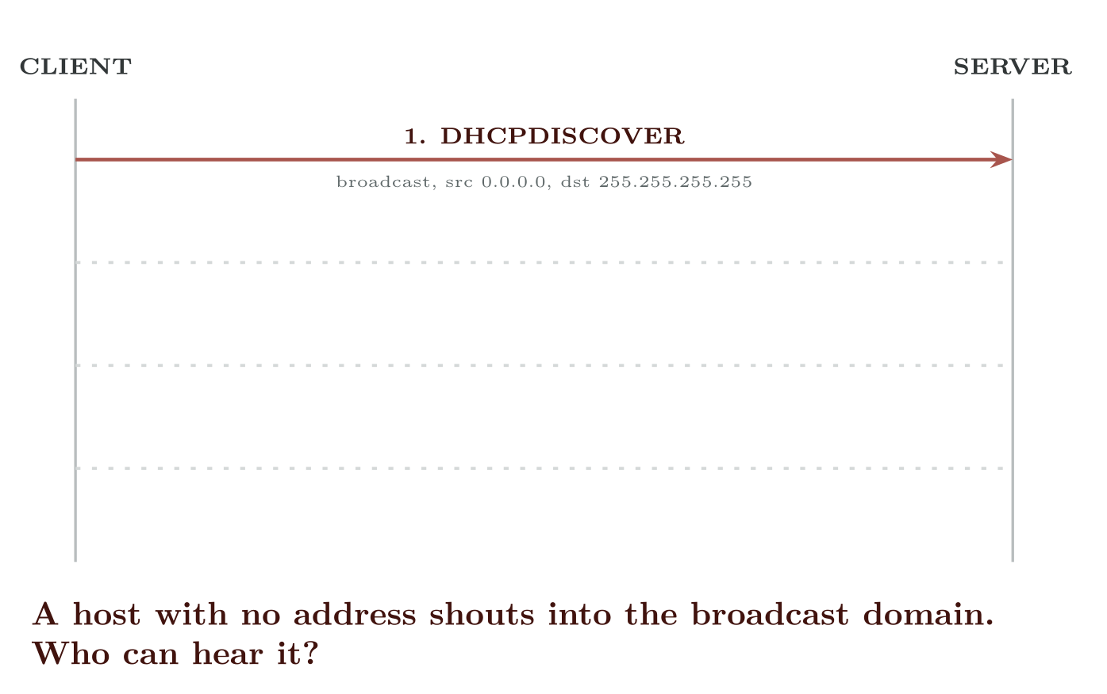
DORA
CCNA 200-301 v2.0 · Chapter 20. DHCP: Client, Server and Relay
1.7
Notes:
Four messages, in a fixed order, remembered as DORA.
DORA. Three of the four messages are broadcasts, which is why a router between client and server stops the process dead unless it is configured to relay.

Slide 10
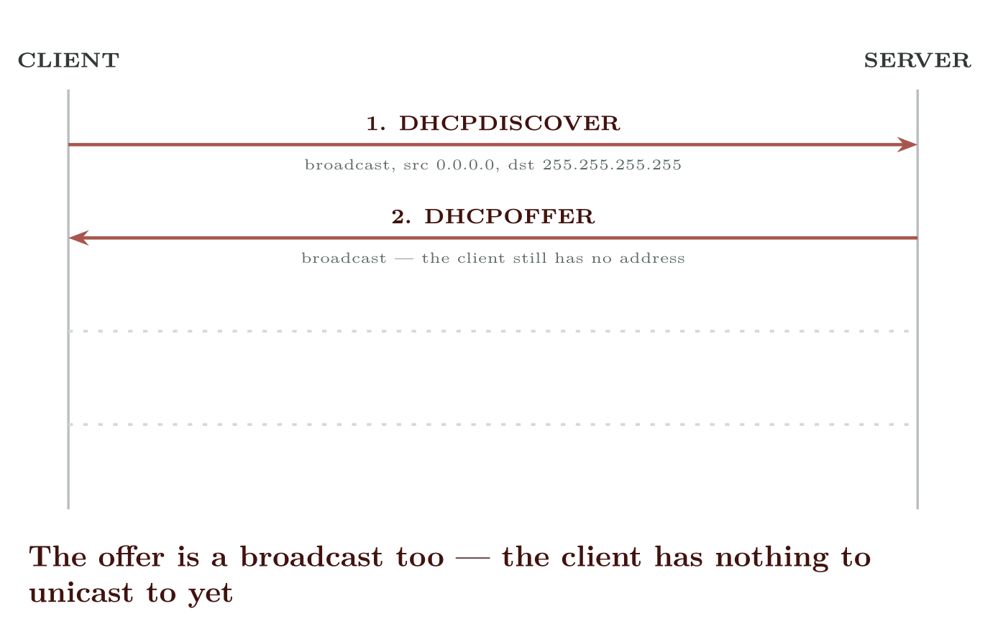
DORA
CCNA 200-301 v2.0 · Chapter 20. DHCP: Client, Server and Relay
1.7

Slide 11
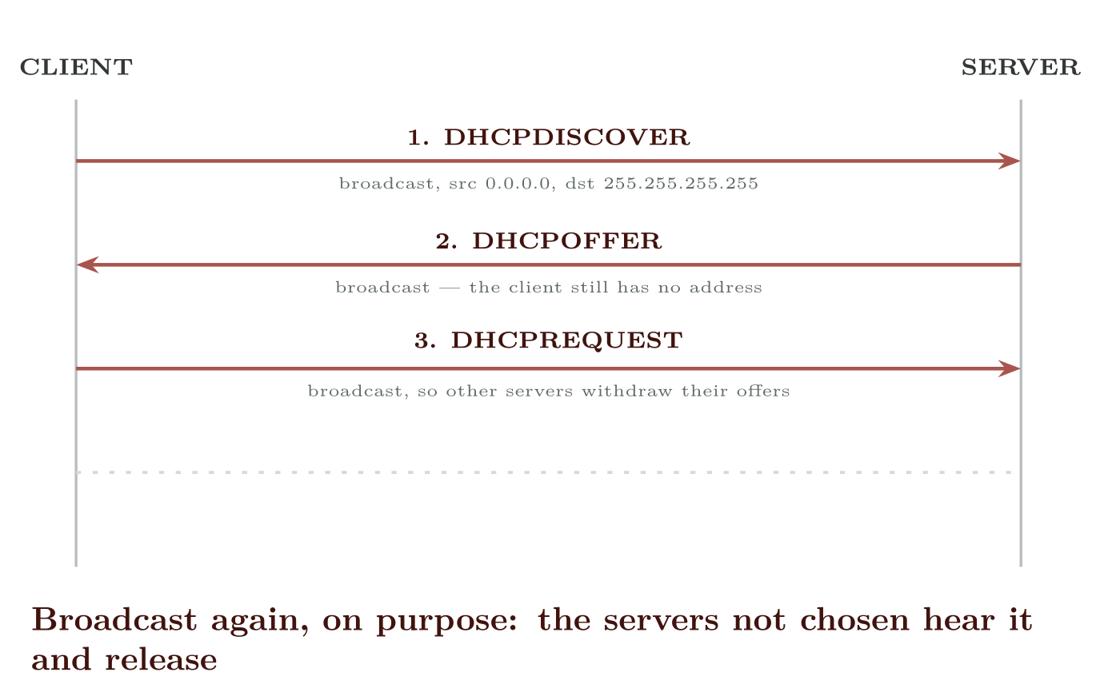
DORA
CCNA 200-301 v2.0 · Chapter 20. DHCP: Client, Server and Relay
1.7

Slide 12
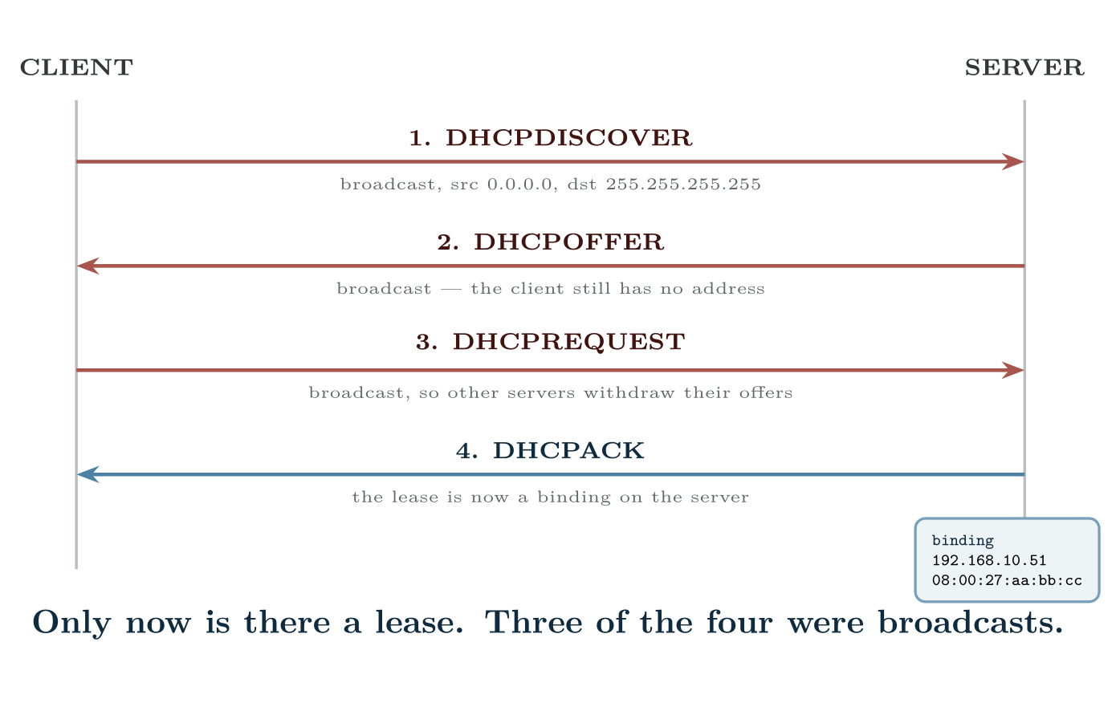
DORA
CCNA 200-301 v2.0 · Chapter 20. DHCP: Client, Server and Relay
1.7

Slide 13
CONCEPT
Renewal is not DORA
At half the lease time (T1), a client that already has an address sends a unicast DHCPREQUEST straight to its server and expects an ACK. There is no discover and no offer. This matters for troubleshooting: a fault that only breaks broadcast forwarding — a dead relay, a wrong VLAN — can leave existing hosts working perfectly for hours while every newly booted host fails. “It works for everyone except the machines that rebooted this morning” is a relay fault until proved otherwise.
CCNA 200-301 v2.0 · Chapter 20. DHCP: Client, Server and Relay
1.7
Notes:
Two details in that figure earn their place on the exam. The REQUEST is broadcast, not unicast. If two servers both offered, the request names the one the client accepted, and the other server sees it and returns its offered address to the pool. A unicast request would leave the second address reserved for nothing. The client is not finished at the OFFER. A host that receives an offer and then loses the server still has no address. “It got an offer” is not the same as “it is working”.

Slide 14
Role 1: IOS as a client
CCNA 200-301 v2.0 · Chapter 20. DHCP: Client, Server and Relay
1.7

Slide 15
CONFIGURE
A router that leases its own WAN address
IOS · configuration mode
interface GigabitEthernet0/0/0
description WAN to ISP
ip address dhcp
no shutdown
CCNA 200-301 v2.0 · Chapter 20. DHCP: Client, Server and Relay
1.7
Notes:
A router interface can take its address from DHCP. This is normal on the WAN interface of a small branch router.

Slide 16
VERIFY
show ip interface brief
R1#
Interface IP-Address OK? Method Status Protocol
GigabitEthernet0/0/0 203.0.113.24 YES DHCP up up
GigabitEthernet0/0/1 192.168.10.1 YES manual up up
CCNA 200-301 v2.0 · Chapter 20. DHCP: Client, Server and Relay
1.7

Slide 17
ON THE EXAM
Role 1: IOS as a client
This is what the blueprint actually asks for
A router that is a DHCP client normally also wants the default route the lease carries. It installs one automatically as a static default with an administrative distance of 254, so anything you configure yourself will win. Check with show ip route static if a branch router is reaching the internet by a path you did not expect.
CCNA 200-301 v2.0 · Chapter 20. DHCP: Client, Server and Relay
1.7
Notes:
The Method column is the whole point of that output. DHCP means the address was leased; manual means somebody typed it. A WAN interface showing unassigned with the line protocol up is a router that asked and got no answer.

Slide 18
Role 2: IOS as a server
CCNA 200-301 v2.0 · Chapter 20. DHCP: Client, Server and Relay
1.7

Slide 19
CONFIGURE
A DHCP pool for VLAN 10
IOS · configuration mode
! 1. Reserve the addresses that are already spoken for -- the gateway,
! the switch management SVIs, the printers, the servers.
! Do this FIRST. A pool created before the exclusions can hand out
! the gateway address in the seconds between the two commands.
ip dhcp excluded-address 192.168.10.1 192.168.10.20
ip dhcp excluded-address 192.168.10.250 192.168.10.254
!
ip dhcp pool VLAN10-STAFF
network 192.168.10.0 255.255.255.0
default-router 192.168.10.1
dns-server 192.168.20.10 192.168.20.11
domain-name campus.example.edu
lease 0 8 0
!
! lease is days hours minutes. "lease 0 8 0" is eight hours, which
! suits a teaching lab; "lease infinite" suits nothing.
CCNA 200-301 v2.0 · Chapter 20. DHCP: Client, Server and Relay
1.7
Notes:
Small sites often use the router itself rather than a dedicated server. Four things must be right, and they must be right together.

Slide 20
WATCH OUT
The network statement must match the interface’s subnet
The router decides which pool to use by looking at the address of the interface the request arrived on — or, for a relayed request, at the giaddr field. If VLAN 10’s SVI is 192.168.10.1/24 and the pool says network 192.168.10.0 255.255.255.0, they match and the pool is used.
If somebody later renumbers the SVI to /25 and leaves the pool at /24, the pool no longer matches, the router silently declines to serve, and the symptom is a host with no address at all — with a perfectly valid-looking pool sitting in the configuration.
CCNA 200-301 v2.0 · Chapter 20. DHCP: Client, Server and Relay
1.7

Slide 21
VERIFY
show ip dhcp binding
R1#
Bindings from all pools not associated with VRF:
IP address Client-ID/ Lease expiration Type State
Hardware address
192.168.10.21 0100.5079.6668.01 Aug 28 2026 06:14 AM Automatic Active
192.168.10.22 0100.5079.6668.22 Aug 28 2026 06:19 AM Automatic Active
CCNA 200-301 v2.0 · Chapter 20. DHCP: Client, Server and Relay
1.7

Slide 22
VERIFY
show ip dhcp pool
R1#
Pool VLAN10-STAFF :
Utilization mark (high/low) : 100 / 0
Subnet size (first/next) : 0 / 0
Total addresses : 254
Leased addresses : 2
Excluded addresses : 25
Pending event : none
1 subnet is currently in the pool:
Current index IP address range Leased/Excluded/Total
192.168.10.23 192.168.10.1 - 192.168.10.254 2 / 25 / 254
CCNA 200-301 v2.0 · Chapter 20. DHCP: Client, Server and Relay
1.7

Slide 23
Role 3: IOS as a relay agent
CCNA 200-301 v2.0 · Chapter 20. DHCP: Client, Server and Relay
1.7

Slide 24
CONFIGURE
Relaying VLAN 10’s requests to a central server
IOS · configuration mode
interface Vlan10
description Staff -- clients live here
ip address 192.168.10.1 255.255.255.0
ip helper-address 10.0.0.5
CCNA 200-301 v2.0 · Chapter 20. DHCP: Client, Server and Relay
1.7
Notes:
Leased addresses against Total addresses is the number to read when somebody reports that “DHCP has stopped working” at nine in the morning. A pool that is full does not log an error to anybody who is watching; it simply stops answering. The DISCOVER is a broadcast, and a router does not forward broadcasts. So when the server is on a different subnet from the client — which is the normal case in any site with more than one VLAN — the router on the client’s subnet has to pick the broadcast up and forward it as a unicast. h{(0,0)}{PC1} sw{(2.6,0)}{SW1} r{(6.0,0)}{R1} s{(9.6,0)}{DHCP10.0.0.5} h{sw}{VLAN 10} sw{r}{trunk} r{s}{Gi0/1} at (2.6,-1.15) {broadcast here}; at (7.8,-1.15) {unicast 10.0.0.5};

Slide 25
WATCH OUT
ip helper-address goes on the interface facing the clients
This is the single most common relay mistake and it is worth stating on its own. The command belongs on the SVI or interface in the subnet where the broadcasts are — the client side. Putting it on the interface facing the server does nothing at all, because no DISCOVER ever arrives there.
If a site has six client VLANs, the command goes on six SVIs.
CCNA 200-301 v2.0 · Chapter 20. DHCP: Client, Server and Relay
1.7

Slide 26
CONCEPT
What giaddr does, and why the server needs it
When the relay forwards the DISCOVER it fills in the gateway IP address field, giaddr, with its own address on the interface that received the broadcast — 192.168.10.1 in the example above.
That single field does two jobs. It tells the server which subnet the client is on, so the server knows which pool to draw from; and it gives the server a unicast address to send the OFFER back to, so the relay can broadcast it onward to the client.
The consequence for troubleshooting: if the central server has no pool for 192.168.10.0/24, the relay is working perfectly and the client still gets nothing. Do not conclude “the relay is broken” from “the client got no address”.
CCNA 200-301 v2.0 · Chapter 20. DHCP: Client, Server and Relay
1.7

Slide 27
ON THE EXAM
ip helper-address forwards more than DHCP
This is what the blueprint actually asks for
By default it relays eight UDP services, not one — among them TFTP (69), DNS (53), NetBIOS name service (137) and TACACS (49) as well as DHCP (67/68). That is occasionally useful and occasionally a surprise, and it is a fair exam question. Trim it with ip forward-protocol udp <port> if a site wants only DHCP relayed.
CCNA 200-301 v2.0 · Chapter 20. DHCP: Client, Server and Relay
1.7

Slide 28
Troubleshooting: three symptoms, three places to look
CCNA 200-301 v2.0 · Chapter 20. DHCP: Client, Server and Relay
1.7

Slide 29
WATCH OUT
The third row is the one people waste an afternoon on
“DHCP is broken” is reported when a user cannot reach the internet. Run ipconfig /all on the host. If it has an address in the right subnet, DHCP has done its job perfectly and the problem is elsewhere — routing, NAT, DNS or an ACL. Check the gateway and DNS values the lease carried, then leave DHCP alone.
CCNA 200-301 v2.0 · Chapter 20. DHCP: Client, Server and Relay
1.7
Notes:
This is the part the blueprint actually asks for. Almost every DHCP fault presents as one of three symptoms, and each points at a different part of the path. Establish which one you have before you start changing configuration.

Slide 30
VERIFY
show ip dhcp conflict
R1#
IP address Detection method Detection time
192.168.10.24 Ping Aug 27 2026 09:12 AM
192.168.10.31 Gratuitous ARP Aug 27 2026 09:41 AM
CCNA 200-301 v2.0 · Chapter 20. DHCP: Client, Server and Relay
1.7

Slide 31
COMMON PITFALLS · Conflicts
Common pitfalls
• Pool created before the exclusions. There is a real window in which the gateway address can be leased to a laptop. Exclude first.
• ip helper-address on the server-side interface. Does nothing. It goes on the client side.
• Pool network not matching the SVI’s subnet or mask. Silent refusal to serve.
• Assuming a working host proves DHCP works. Existing leases renew by unicast and survive faults that stop every new host dead.
• Forgetting the SVI must be up. An SVI with no access port in its VLAN in the up state is down, so the pool it serves is unreachable — a layer 2 fault presenting as a DHCP fault.
CCNA 200-301 v2.0 · Chapter 20. DHCP: Client, Server and Relay
1.7
Notes:
A conflict means the router offered an address and then found somebody already using it. Ping means the server tested the address before offering and got a reply; Gratuitous ARP means a client took the address and immediately heard another host claim it. Either way the cause is the same: a statically addressed device inside the pool range that nobody excluded. Conflicted addresses are removed from the pool and stay out, so a site that never clears them slowly runs out of addresses. Fix the exclusions first, then clear ip dhcp conflict *.

Slide 32
COMMON PITFALLS · Conflicts
Common pitfalls (continued)
• Reading 169.254.x.x as a server problem. It means nothing answered. Nine times in ten the fault is on the client’s own switch port.
CCNA 200-301 v2.0 · Chapter 20. DHCP: Client, Server and Relay
1.7

Slide 33
BREAK & FIX · SYMPTOM
Chapter 20
Every host in VLAN 30 gets 169.254 addresses. VLAN 10 and VLAN 20 are fine.
The DHCP server is a central router, R1, reached through a distribution switch. VLANs 10, 20 and 30 all have SVIs on DSW1, all three have pools on R1, and only VLAN 30 fails. Static addressing inside VLAN 30 works, and a statically addressed host in VLAN 30 can ping R1.
CCNA 200-301 v2.0 · Chapter 20. DHCP: Client, Server and Relay
1.7

Slide 34
BREAK & FIX · YOUR MOVE
Chapter 20
Every host in VLAN 30 gets 169.254 addresses. VLAN 10 and VLAN 20 are fine.
What would you check first — and what do you expect to see?
CCNA 200-301 v2.0 · Chapter 20. DHCP: Client, Server and Relay
1.7
Notes:
Pause here. Take two or three answers before advancing. The point is the prediction, not the command.

Slide 35
BREAK & FIX · EVIDENCE
Chapter 20
show run interface vlan 30
DSW1#
interface Vlan30
description Lab -- clients
ip address 192.168.30.1 255.255.255.0
!
CCNA 200-301 v2.0 · Chapter 20. DHCP: Client, Server and Relay
1.7
Notes:
Read it aloud. Ask what single field decides the answer.

Slide 36
BREAK & FIX · YOUR MOVE
Chapter 20
What is the fault — and what does this output rule out?
CCNA 200-301 v2.0 · Chapter 20. DHCP: Client, Server and Relay
1.7
Notes:
The elimination matters as much as the answer.

Slide 37
BREAK & FIX · DIAGNOSIS
Chapter 20
Why it is doing that
Diagnosis. There is no ip helper-address. VLAN 10 and VLAN 20 have one; VLAN 30 was added later and the line was missed. Everything else about VLAN 30 is correct, which is exactly why static addressing works and why the subnet is reachable — routing is fine, layer 2 is fine, and only the broadcast relay is absent.
The tell is that the fault is confined to one VLAN. A server fault or a routing fault would take out all three; a switch-port fault would take out one host. One whole VLAN failing while its neighbours work points at something configured per-SVI, and on this path there is only one such thing.
CCNA 200-301 v2.0 · Chapter 20. DHCP: Client, Server and Relay
1.7

Slide 38
BREAK & FIX · THE FIX
Chapter 20
Restoring the relay
IOS · configuration mode
interface Vlan30
ip helper-address 10.0.0.5
CCNA 200-301 v2.0 · Chapter 20. DHCP: Client, Server and Relay
1.7

Slide 39
BREAK & FIX · THE FIX
Chapter 20
And the lesson
Fix.
Then check the second half. Confirm R1 actually has a pool whose network statement matches 192.168.30.0/24. A relay pointing at a server with no matching pool produces the identical symptom, and fixing one half of a two-part fault and declaring victory is how faults come back the next morning.
CCNA 200-301 v2.0 · Chapter 20. DHCP: Client, Server and Relay
1.7

Slide 40
LAB · PACKET TRACER
DHCP in all three roles, then broken deliberately
Topology. SW1 carrying VLANs 10, 20 and 30; DSW1 holding the three SVIs; R1 as the central server on 10.0.0.0/24; two PCs per VLAN.
1. Address the SVIs and confirm inter-VLAN routing works with static host addresses before introducing DHCP at all. Do not skip this — it separates the layer 3 work from the DHCP work.
2. On R1, exclude the first twenty addresses of each subnet, then build three pools with gateway, DNS and an eight-hour lease.
3. Add ip helper-address to VLAN 10’s SVI only. Boot one PC in VLAN 10 and one in VLAN 20. Record what each receives, and explain the difference in terms of giaddr before adding the second helper.
4. Add the remaining helpers. Confirm all six PCs lease correctly and read show ip dhcp binding and show ip dhcp pool on R1.
CCNA 200-301 v2.0 · Chapter 20. DHCP: Client, Server and Relay
1.7

Slide 41
LAB · PACKET TRACER
DHCP in all three roles, then broken deliberately (continued)
5. Break 1. Change VLAN 20’s SVI mask to /25, leaving the pool at /24. Release and renew a VLAN 20 host. Explain the result.
6. Break 2. Give a PC a static address inside a pool range, then force new leases until a conflict is detected. Read show ip dhcp conflict, fix the exclusion, and clear it.
7. Break 3. Remove default-router from VLAN 30’s pool. Renew a host. It will lease successfully and reach its own VLAN only. Write down the exact test that distinguishes this from a routing failure.
8. Extension. Configure R1’s uplink as ip address dhcp against a second router acting as an ISP, and observe the default route that appears with distance 254.
CCNA 200-301 v2.0 · Chapter 20. DHCP: Client, Server and Relay
1.7

Slide 42
CHECKPOINT 1 of 5
Which of the four DORA messages are broadcast, and what would break if the REQUEST were unicast?
Discuss · then advance
Notes:
Ask the room. Do not advance until somebody commits to an answer.

Slide 43
ANSWER
Checkpoint 1 of 5
Which of the four DORA messages are broadcast, and what would break if the REQUEST were unicast?
Discover, Offer and Request are broadcast; only the Ack is unicast. If the Request were unicast, a second server that had also made an offer would never learn that its offer was declined, and would hold that address reserved for nothing until it timed out.
CCNA 200-301 v2.0 · Chapter 20. DHCP: Client, Server and Relay
1.7

Slide 44
CHECKPOINT 2 of 5
A host has 169.254.8.31. What single fact does that establish, and what does it not establish?
Discuss · then advance
Notes:
Ask the room. Do not advance until somebody commits to an answer.

Slide 45
ANSWER
Checkpoint 2 of 5
A host has 169.254.8.31. What single fact does that establish, and what does it not establish?
It establishes only that the host asked and nothing answered. It does not establish where the failure is — it could be the switch port, the VLAN, the SVI, the relay, or the server, and it says nothing about whether the server is healthy.
CCNA 200-301 v2.0 · Chapter 20. DHCP: Client, Server and Relay
1.7

Slide 46
CHECKPOINT 3 of 5
On which interface does ip helper-address belong, and what does the relay write into giaddr?
Discuss · then advance
Notes:
Ask the room. Do not advance until somebody commits to an answer.

Slide 47
ANSWER
Checkpoint 3 of 5
On which interface does ip helper-address belong, and what does the relay write into giaddr?
On the interface facing the clients — the SVI in the subnet where the broadcasts are. The relay writes its own address on that interface into giaddr, which tells the server which pool to use and gives it a unicast address to reply to.
CCNA 200-301 v2.0 · Chapter 20. DHCP: Client, Server and Relay
1.7

Slide 48
CHECKPOINT 4 of 5
Existing hosts work; every rebooted host fails. What class of fault does that pattern point to, and why?
Discuss · then advance
Notes:
Ask the room. Do not advance until somebody commits to an answer.

Slide 49
ANSWER
Checkpoint 4 of 5
Existing hosts work; every rebooted host fails. What class of fault does that pattern point to, and why?
A relay or broadcast-path fault. Existing hosts renew at T1 by unicast directly to the server, which needs no relay, so they survive. Only newly booting hosts need the broadcast path, so only they fail.
CCNA 200-301 v2.0 · Chapter 20. DHCP: Client, Server and Relay
1.7

Slide 50
CHECKPOINT 5 of 5
A host has the correct address and gateway but cannot browse the web. Is this a DHCP fault? Justify the answer.
Discuss · then advance
Notes:
Ask the room. Do not advance until somebody commits to an answer.

Slide 51
ANSWER
Checkpoint 5 of 5
A host has the correct address and gateway but cannot browse the web. Is this a DHCP fault? Justify the answer.
No. DHCP delivered a correct address and a correct gateway, which is its entire job. The fault is elsewhere — routing, NAT, an ACL, or DNS. Check the DNS servers the lease carried before looking further afield.
CCNA 200-301 v2.0 · Chapter 20. DHCP: Client, Server and Relay
1.7

Slide 52
CHAPTER SUMMARY
What to take away
• DORA: Discover, Offer, Request, Ack. The first three are broadcast, which is why routers block the process by default.
• Renewal at T1 is a unicast request with no discover, so existing hosts survive faults that kill every new one.
• As a client: ip address dhcp, and the Method column of show ip interface brief proves it.
• As a server: exclude first, then a pool whose network statement matches the serving interface’s subnet exactly.
• As a relay: ip helper-address on the client-side interface. It writes giaddr, which selects the pool and carries the reply back.
CCNA 200-301 v2.0 · Chapter 20. DHCP: Client, Server and Relay
1.7

Slide 53
CHAPTER SUMMARY
What to take away (continued)
• Three symptoms, three places: no address means nothing answered; wrong subnet means the wrong pool or a rogue server; right address but no connectivity is not a DHCP fault.
• Conflicts come from static addresses inside the pool range. Fix the exclusion, then clear ip dhcp conflict *.
CCNA 200-301 v2.0 · Chapter 20. DHCP: Client, Server and Relay
1.7

Slide 54
Where we got to
• DORA: Discover, Offer, Request, Ack. The first three are broadcast, which is why routers block the process by default.
• Renewal at T1 is a unicast request with no discover, so existing hosts survive faults that kill every new one.
• As a client: ip address dhcp, and the Method column of show ip interface brief proves it.
• As a server: exclude first, then a pool whose network statement matches the serving interface’s subnet exactly.
NEXT
Chapter 21 — DNS, and Diagnosing Records

