Slide 1


CCNA 200-301 V2.0
21
DNS, and Diagnosing Records
Part IV — Network Services and Security
EXAM TOPICS
4.4
LECTURER
Dr. Mustafa Hameed
THE ISLAMIA UNIVERSITY OF BAHAWALPUR
Department of Information Technology
Notes:
Chapter 21: DNS, and Diagnosing Records. Blueprint topics: 4.4.

Slide 2
THE COURSE
Where this chapter sits
Part I
Foundations
chapters 1–7
Part II
Switching and Network Access
chapters 8–14
Part III
IP Routing
chapters 15–19
Part IV
Network Services and Security
chapters 20–26
Part V
Wireless, Virtualisation and Operations
chapters 27–32
Part VI
Sitting the Exam
chapters 33–34
CCNA 200-301 v2.0 · Chapter 21. DNS, and Diagnosing Records
CCNA 200-301 v2.0 · Chapter 21. DNS, and Diagnosing Records
4.4
4.4
Notes:
Ten seconds. Students meeting a chapter in week ten cannot place it without being shown.

Slide 3
LEARNING OUTCOMES
What you will be able to do
• Trace a name resolution from a stub resolver to an authoritative server, and say which step a given failure is stuck at.
• Identify the six record types the blueprint names — A, AAAA, CNAME, MX, NS and PTR — and state what each is for.
• Use nslookup and dig to query a specific record type against a specific server.
• Diagnose the three failure classes the topic names: a host unreachable by name, a web application that half works, and mail that is rejected.
CCNA 200-301 v2.0 · Chapter 21. DNS, and Diagnosing Records
4.4
Notes:
DNS, and Diagnosing Records 4.4

Slide 4
ASSUMED KNOWLEDGE
Before we start
Chapter 6 for UDP, TCP and ports. Chapter 20 — the DNS server address usually arrives in a lease, so a DNS fault is sometimes a DHCP option fault. Chapter 5 for what an AAAA record contains.
CCNA 200-301 v2.0 · Chapter 21. DNS, and Diagnosing Records
4.4

Slide 5
KEY TERMS
Vocabulary for this chapter
resolver
recursion
authoritative
TTL
zone
A
AAAA
CNAME
MX
NS
PTR
NXDOMAIN
SERVFAIL
Each is defined where it first matters — not here.
CCNA 200-301 v2.0 · Chapter 21. DNS, and Diagnosing Records
4.4
Notes:
Do not define these now - they are defined as they arrive. This slide is for the students' notes.

Slide 6
ON THE EXAM
Read the topic wording carefully
This is what the blueprint actually asks for
Topic 4.4 is diagnose issues with DNS records (A, AAAA, CNAME, MX, NS, and PTR) to support host, web application, and mail server access by name.
Three things follow. The verb is diagnose, so you will be given a resolution that is wrong and asked why. The record types are enumerated, so those six and no others are examinable — there is no SOA, SRV or TXT question waiting for you. And the three purposes are enumerated too, which is a strong hint that questions will be framed as “the website works but mail bounces” rather than as “define a CNAME”.
You are not asked to configure a DNS server. You are asked to read one.
CCNA 200-301 v2.0 · Chapter 21. DNS, and Diagnosing Records
4.4

Slide 7
How a name becomes an address
CCNA 200-301 v2.0 · Chapter 21. DNS, and Diagnosing Records
4.4

Slide 8
DEFINITION
DNS
A distributed, hierarchical database mapping names to records. Queries normally travel over UDP port 53; responses too large for a datagram, and zone transfers between servers, use TCP port 53.
CCNA 200-301 v2.0 · Chapter 21. DNS, and Diagnosing Records
4.4

Slide 9
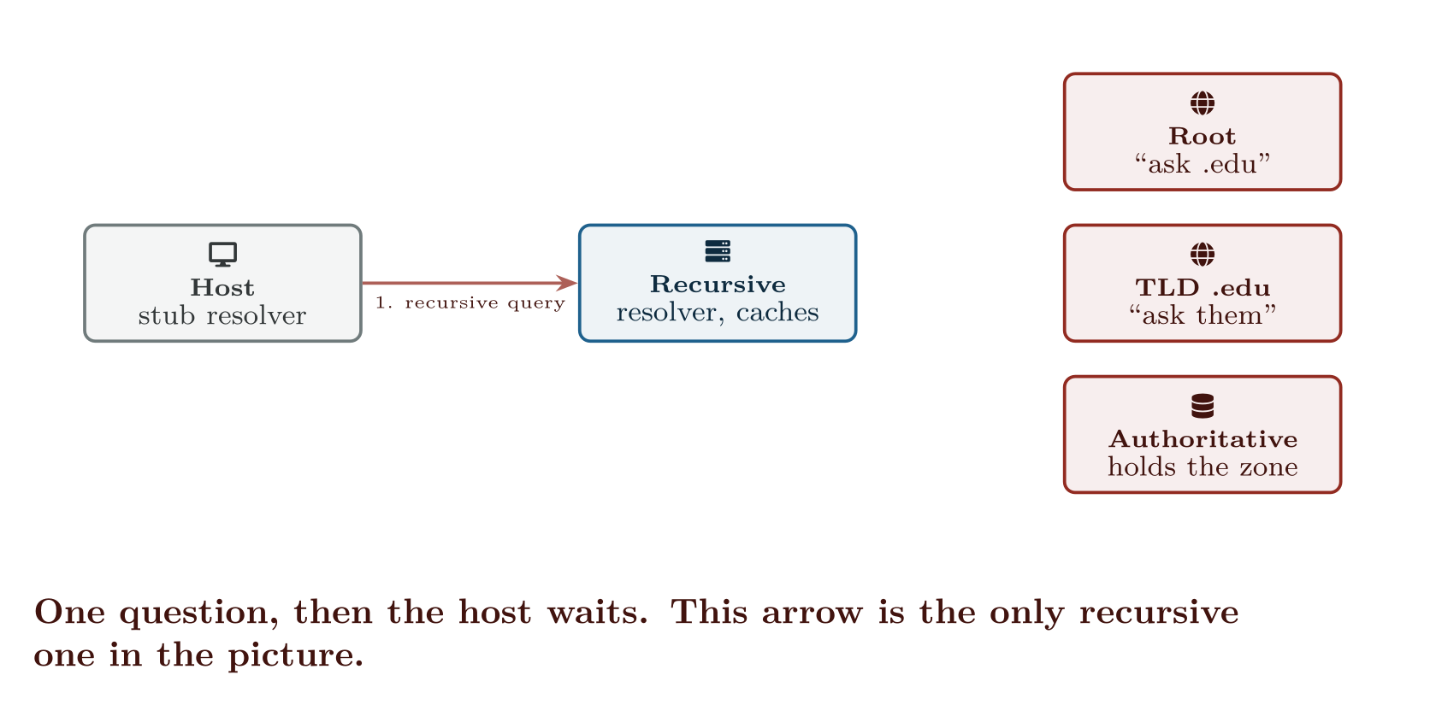
How a name becomes an address
CCNA 200-301 v2.0 · Chapter 21. DNS, and Diagnosing Records
4.4
Notes:
Only step 1 is recursive. The host asks one question and waits; the resolver does the walking and caches what it learns for the TTL.

Slide 10
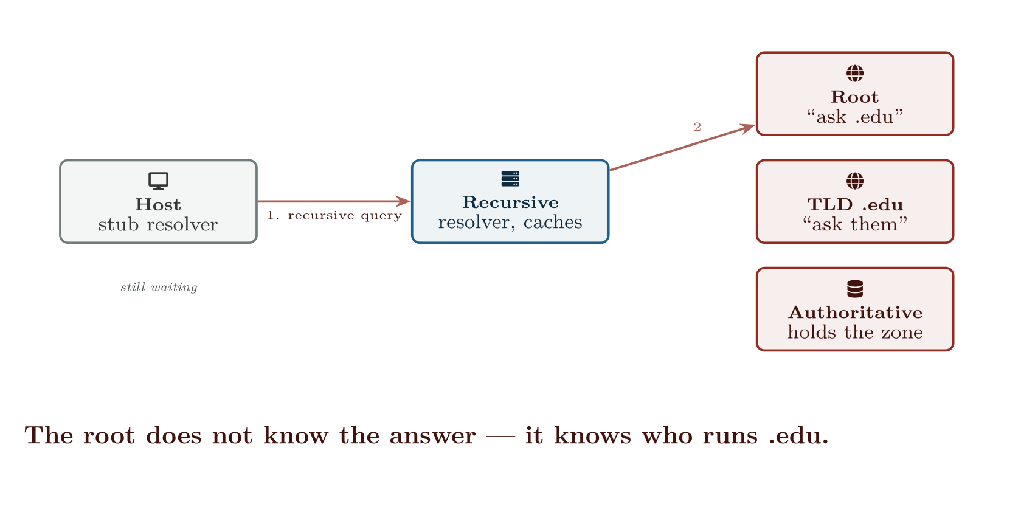
How a name becomes an address
CCNA 200-301 v2.0 · Chapter 21. DNS, and Diagnosing Records
4.4

Slide 11
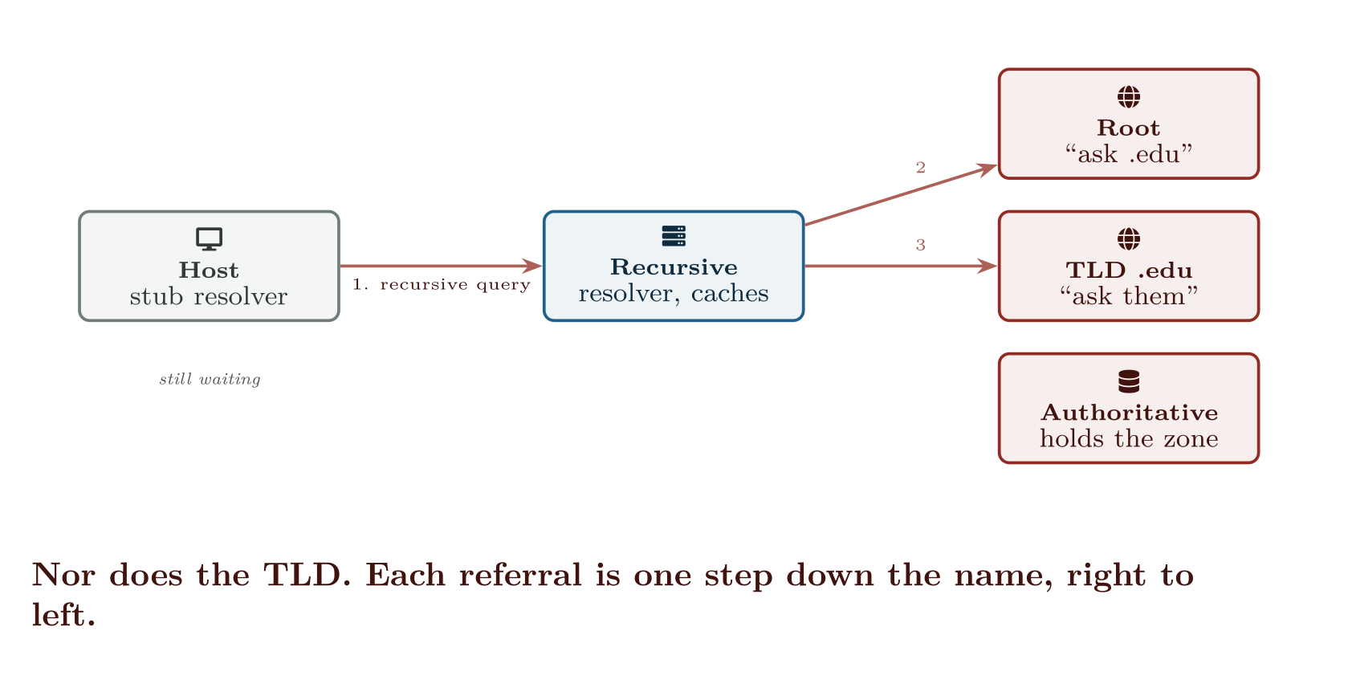
How a name becomes an address
CCNA 200-301 v2.0 · Chapter 21. DNS, and Diagnosing Records
4.4

Slide 12
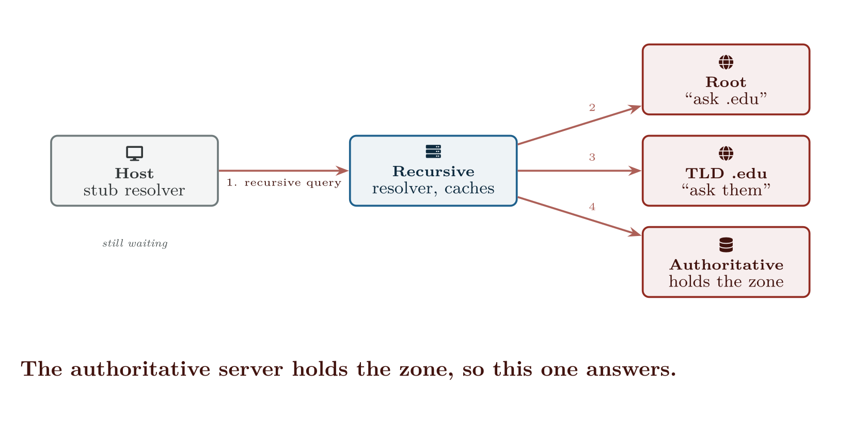
How a name becomes an address
CCNA 200-301 v2.0 · Chapter 21. DNS, and Diagnosing Records
4.4

Slide 13
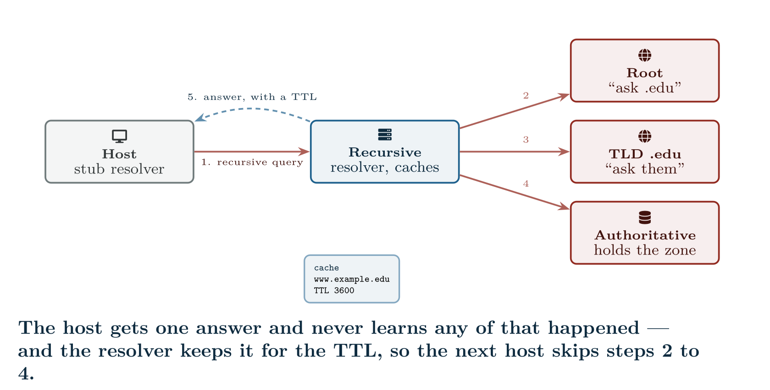
How a name becomes an address
CCNA 200-301 v2.0 · Chapter 21. DNS, and Diagnosing Records
4.4

Slide 14
CONCEPT
The stub resolver explains most “it works for me” arguments
Your host is not doing the work in that figure. It sends one query to whichever resolver DHCP gave it and waits for a complete answer. Everything downstream — which root it used, whether the TLD was slow, whether a cached record is stale — is invisible to the host and different for every resolver.
So when one user cannot reach a site and another can, the first question is not “what is wrong with the site” but “are they using the same resolver?”. ipconfig /all or resolvectl status answers it in one line, and the answer resolves the argument more often than not.
CCNA 200-301 v2.0 · Chapter 21. DNS, and Diagnosing Records
4.4

Slide 15
WATCH OUT
The practical consequence
Lower the TTL before a planned change, not after. Drop it to 300 seconds a day ahead, make the change, verify, then raise it again. Doing this in the right order is the difference between a five-minute cutover and a day of intermittent failure — and “why did the change take so long to appear” is a fair short-answer exam question.
CCNA 200-301 v2.0 · Chapter 21. DNS, and Diagnosing Records
4.4
Notes:
Every record carries a time to live in seconds. A resolver that answers from cache serves the record until the TTL expires, and it does not re-check early because somebody in another organisation changed something. This is the source of the single most common DNS complaint: “we fixed the record an hour ago and it is still wrong.” If the old record had a 24-hour TTL, it is still wrong for up to 24 more hours, for anyone whose resolver cached it. There is no remote command to flush somebody else’s cache.

Slide 16
CONCEPT
Reverse lookups are a separate tree, not a mirror
A PTR record does not live in your forward zone. It lives in in-addr.arpa for IPv4 (or ip6.arpa for IPv6), with the octets reversed, and it is delegated to whoever owns the address block — normally your ISP or cloud provider, not you.
That is why forward and reverse so often disagree. Adding an A record for a new mail server takes you thirty seconds; adding the matching PTR may require a support ticket to somebody else. The exam likes this asymmetry because it explains a real failure: mail that leaves cleanly and is rejected at the far end.
CCNA 200-301 v2.0 · Chapter 21. DNS, and Diagnosing Records
4.4

Slide 17
Querying: the two tools
CCNA 200-301 v2.0 · Chapter 21. DNS, and Diagnosing Records
4.4

Slide 18
VERIFY
nslookup -type=MX example.edu 8.8.8.8
Windows
Server: dns.google
Address: 8.8.8.8
Non-authoritative answer:
example.edu MX preference = 10, mail exchanger = mail1.example.edu
example.edu MX preference = 20, mail exchanger = mail2.example.edu
mail1.example.edu internet address = 203.0.113.25
mail2.example.edu internet address = 203.0.113.26
CCNA 200-301 v2.0 · Chapter 21. DNS, and Diagnosing Records
4.4

Slide 19
VERIFY
dig +noall +answer www.example.edu A
Linux or macOS
www.example.edu. 3600 IN CNAME web-lb.example.edu.
web-lb.example.edu. 300 IN A 203.0.113.10
CCNA 200-301 v2.0 · Chapter 21. DNS, and Diagnosing Records
4.4
Notes:
Three things in that command line, and all three matter when diagnosing. -type=MX asks for one record type. Without it you get A records and would wrongly conclude the MX records are missing. 8.8.8.8 at the end queries that server, bypassing the host’s configured resolver. This is how you prove whether a fault is local caching or genuinely upstream. Non-authoritative answer means it came from a cache. An authoritative answer comes only from a server that holds the zone.

Slide 20
ON THE EXAM
Read the status line first
This is what the blueprint actually asks for
When dig is run without +noall +answer, the header carries a status, and it narrows the fault immediately:
• NOERROR with an empty answer section — the name exists, but not with that record type. Very often the real answer in an exam question.
• NXDOMAIN — the name does not exist. A typo, or a record never created.
• SERVFAIL — the resolver could not complete. Broken delegation, an unreachable authoritative server, or a validation failure.
• REFUSED — the server will not answer you. Usually an access control, not a record problem.
NOERROR-with-no-answer and NXDOMAIN look identical to a user and mean completely different things to you.
CCNA 200-301 v2.0 · Chapter 21. DNS, and Diagnosing Records
4.4
Notes:
That two-line answer is worth studying. It shows a CNAME being followed: the name asked for is an alias, the alias points at another name, and the resolver returned both the alias and the address it eventually reached. The numbers 3600 and 300 are the two TTLs, and they are independent — the alias is cached for an hour, the address behind it for five minutes.

Slide 21
DNS on IOS itself
CCNA 200-301 v2.0 · Chapter 21. DNS, and Diagnosing Records
4.4

Slide 22
CONFIGURE
Name resolution on a router
IOS · configuration mode
ip domain lookup
ip name-server 192.168.20.10 192.168.20.11
ip domain name campus.example.edu
!
! A local override, no server needed. Useful in a lab and useful when
! you want a name to resolve even if DNS is the thing that is broken.
ip host CORE1 10.0.0.1
CCNA 200-301 v2.0 · Chapter 21. DNS, and Diagnosing Records
4.4
Notes:
A router resolving names is a convenience for you, not a service for users, but it appears in labs and it has one famous side effect.

Slide 23
WATCH OUT
The mistyped-command hang
Type a command wrong in EXEC mode — shwo ip route — and IOS assumes you meant to telnet to a host called shwo. With ip domain lookup enabled and no reachable server, the CLI freezes for tens of seconds on every typo.
On a lab device the fix is no ip domain lookup. On a production device, where you may want resolution, use line con 0 then transport preferred none, which stops the CLI from treating unknown words as hostnames without disabling DNS.
CCNA 200-301 v2.0 · Chapter 21. DNS, and Diagnosing Records
4.4

Slide 24
Diagnosing the three named failures
CCNA 200-301 v2.0 · Chapter 21. DNS, and Diagnosing Records
4.4

Slide 25
WATCH OUT
MX must point at a name with an A record, never at a CNAME
Two rules, both examinable. The value of an MX record must be a hostname, not an IP address. And that hostname must resolve by A or AAAA directly — pointing an MX at a CNAME is prohibited by the standards and rejected by some mail servers and tolerated by others, which produces the worst kind of fault: mail from some senders is delivered and from others is not.
CCNA 200-301 v2.0 · Chapter 21. DNS, and Diagnosing Records
4.4
Notes:
The blueprint names three purposes. Take them one at a time, because each has a characteristic record behind it. ping <name> fails, ping <address> works → it is DNS, not the network. This one test separates the two and should always be first. Both fail → it is not DNS. Stop here and go to Chapter 28. Name resolves to an address, but the wrong one → a stale cache or a stale A record. Query an authoritative server directly and compare. The characteristic web fault is partial: the site loads for some people, or loads slowly, or works on one machine and not another. Two causes account for most of it. An AAAA record pointing somewhere that does not answer. A dual-stack client prefers IPv6, tries the AAAA address, waits for a timeout, and only then falls back to IPv4. The site works — after a painful delay — for v6-capable clients and instantly for everyone else. A missing AAAA is harmless; a wrong AAAA is much worse than none. A CNAME where there should not be one. A name that is a CNAME cannot hold any other record. Putting a CNAME at a zone apex therefore conflicts with the zone’s own NS records, and resolvers behave inconsistently. www may safely be a CNAME; the bare domain may not. Mail exercises three of the six record types at once, and the exam knows it. Inbound fails → look at MX. Does it exist? Does the name it gives have an A record? An MX pointing at a name with no address is a common and completely silent fault. Outbound is rejected by the recipient → look at PTR. Receiving servers routinely check that the connecting IP reverse-resolves to a name, and that the name forward-resolves back to the same IP. If either half is missing, mail is rejected or scored as spam. Nothing about the domain resolves → look at NS. A delegation problem takes out MX, A and everything else simultaneously, which is how you tell it apart from a record-level fault.

Slide 26
COMMON PITFALLS · Mail server access
Common pitfalls
• Querying without -type=. You get A records, see them, and wrongly declare the MX or NS records missing.
• Not naming a server in the query. You test your own cache instead of the truth. Always query the authoritative server too.
• Treating NXDOMAIN and empty-NOERROR as the same. One means the name is absent; the other means the record type is.
• Forgetting TTL. A correct fix looks like a failed fix for as long as the old TTL.
• Assuming reverse DNS is yours to fix. PTR usually lives with whoever owns the address block.
CCNA 200-301 v2.0 · Chapter 21. DNS, and Diagnosing Records
4.4

Slide 27
COMMON PITFALLS · Mail server access
Common pitfalls (continued)
• Blaming DNS for a routing fault. If ping by address also fails, DNS is not involved.
CCNA 200-301 v2.0 · Chapter 21. DNS, and Diagnosing Records
4.4

Slide 28
BREAK & FIX · SYMPTOM
Chapter 21
The website works. Mail to the domain bounces with “no route to host”.
example.edu loads correctly in a browser from everywhere. Mail sent to staff@example.edu from outside is returned by the sender’s server. Mail between internal users is fine. The mail server itself is up, is listening on port 25, and can be reached by IP address from outside.
CCNA 200-301 v2.0 · Chapter 21. DNS, and Diagnosing Records
4.4

Slide 29
BREAK & FIX · YOUR MOVE
Chapter 21
The website works. Mail to the domain bounces with “no route to host”.
What would you check first — and what do you expect to see?
CCNA 200-301 v2.0 · Chapter 21. DNS, and Diagnosing Records
4.4
Notes:
Pause here. Take two or three answers before advancing. The point is the prediction, not the command.

Slide 30
BREAK & FIX · EVIDENCE
Chapter 21
dig +noall +answer example.edu MX
Linux#
example.edu. 3600 IN MX 10 mail.example.edu.
CCNA 200-301 v2.0 · Chapter 21. DNS, and Diagnosing Records
4.4
Notes:
Read it aloud. Ask what single field decides the answer.

Slide 31
BREAK & FIX · EVIDENCE
Chapter 21
dig +noall +answer mail.example.edu A
CCNA 200-301 v2.0 · Chapter 21. DNS, and Diagnosing Records
4.4
Notes:
Read it aloud. Ask what single field decides the answer.

Slide 32
BREAK & FIX · YOUR MOVE
Chapter 21
What is the fault — and what does this output rule out?
CCNA 200-301 v2.0 · Chapter 21. DNS, and Diagnosing Records
4.4
Notes:
The elimination matters as much as the answer.

Slide 33
BREAK & FIX · DIAGNOSIS
Chapter 21
Why it is doing that
Diagnosis. The MX record exists and is syntactically fine. The name it points at, mail.example.edu, has no A record — the answer section is empty. A sending server looks up the MX, gets a name, tries to resolve that name to an address, gets nothing, and has nowhere to connect to.
Everything else being healthy is what makes this hard to spot. The web works because www has its own A record. Internal mail works because internal clients are configured with the server’s address directly and never consult the MX. Only external inbound mail follows the full MX-then-A path, so only external inbound mail fails.
CCNA 200-301 v2.0 · Chapter 21. DNS, and Diagnosing Records
4.4

Slide 34
BREAK & FIX · DIAGNOSIS
Chapter 21
Why it is doing that
The tell is the shape of the failure: one direction, one protocol, one class of sender. Faults that broad in effect but that narrow in scope are almost always in a record that only one code path reads.
CCNA 200-301 v2.0 · Chapter 21. DNS, and Diagnosing Records
4.4

Slide 35
BREAK & FIX · THE FIX
Chapter 21
And the lesson
Fix. Add the missing A record for mail.example.edu pointing at the server’s public address, then re-query to confirm. Two further checks before closing it:
CCNA 200-301 v2.0 · Chapter 21. DNS, and Diagnosing Records
4.4

Slide 36
LAB · CML OR GNS3, WITH A BIND OR WINDOWS DNS SERVER
Diagnosing a zone you did not build
Platform note. Packet Tracer’s DNS server holds only A and CNAME records and cannot express MX, NS or PTR, so it cannot support this lab. Use a real resolver in CML or GNS3, or run BIND in a container alongside a virtual network.
Topology. One router with ip name-server configured, one DNS server holding example.edu, and two clients — one dual-stack, one IPv4 only.
1. Load the zone supplied with this lab. Do not read the zone file yet; diagnose from the client side first, as you would in practice.
2. For each of the six record types, run a query that returns it, using nslookup on one client and dig on the other. Record the exact command in each case.
3. Find every fault in the zone using queries alone. There are four. Write a one-line diagnosis for each before opening the zone file.
4. Open the zone file and check your diagnoses. Note any fault you missed and what query would have found it.
CCNA 200-301 v2.0 · Chapter 21. DNS, and Diagnosing Records
4.4

Slide 37
LAB · CML OR GNS3, WITH A BIND OR WINDOWS DNS SERVER
Diagnosing a zone you did not build (continued)
5. Break 1. Point www at a CNAME chain three deep, with the last entry pointing back at the first. Query it and describe the result.
6. Break 2. Add an AAAA record for www pointing at an unreachable IPv6 address. Browse from the dual-stack client and from the IPv4-only client. Time both. Explain the difference to somebody who has not read this chapter.
7. Break 3. Set the A record TTL to 3600, change the address, and observe how long the old value survives on a client that had already queried it. Then repeat with a TTL of 60.
8. Extension. Disable ip domain lookup on the router, mistype a command, and compare the behaviour with it enabled and no reachable server.
CCNA 200-301 v2.0 · Chapter 21. DNS, and Diagnosing Records
4.4

Slide 38
CHECKPOINT 1 of 5
ping www.example.edu fails and ping 203.0.113.10 succeeds. What has this proved, and what is the next command you run?
Discuss · then advance
Notes:
Ask the room. Do not advance until somebody commits to an answer.

Slide 39
ANSWER
Checkpoint 1 of 5
ping www.example.edu fails and ping 203.0.113.10 succeeds. What has this proved, and what is the next command you run?
That the network path and the server are fine and the fault is name resolution. Next, query the record explicitly and against a known server: nslookup -type=A www.example.edu 8.8.8.8, and compare with what your own resolver returns.
CCNA 200-301 v2.0 · Chapter 21. DNS, and Diagnosing Records
4.4

Slide 40
CHECKPOINT 2 of 5
What is the difference between NXDOMAIN and NOERROR with an empty answer section?
Discuss · then advance
Notes:
Ask the room. Do not advance until somebody commits to an answer.

Slide 41
ANSWER
Checkpoint 2 of 5
What is the difference between NXDOMAIN and NOERROR with an empty answer section?
NXDOMAIN means the name does not exist. NOERROR with an empty answer means the name exists but has no record of the type you asked for. They look identical to a user and mean entirely different things.
CCNA 200-301 v2.0 · Chapter 21. DNS, and Diagnosing Records
4.4

Slide 42
CHECKPOINT 3 of 5
Why can a name that is a CNAME not also hold an MX record?
Discuss · then advance
Notes:
Ask the room. Do not advance until somebody commits to an answer.

Slide 43
ANSWER
Checkpoint 3 of 5
Why can a name that is a CNAME not also hold an MX record?
Because a CNAME means “this name is an alias for that name”, and a name that is an alias cannot also carry data of its own. Standards prohibit other records alongside it, and mail servers differ in how they cope — which produces the worst symptom, where mail from some senders arrives and from others does not.
CCNA 200-301 v2.0 · Chapter 21. DNS, and Diagnosing Records
4.4

Slide 44
CHECKPOINT 4 of 5
A site is slow for some users and instant for others. Which record type would you check first, and why does it affect only some clients?
Discuss · then advance
Notes:
Ask the room. Do not advance until somebody commits to an answer.

Slide 45
ANSWER
Checkpoint 4 of 5
A site is slow for some users and instant for others. Which record type would you check first, and why does it affect only some clients?
AAAA. A dual-stack client prefers IPv6 and will try the AAAA address first; if it is wrong or unreachable the client waits for a timeout before falling back to IPv4. IPv4-only clients never see it, so the site is slow for some and instant for others.
CCNA 200-301 v2.0 · Chapter 21. DNS, and Diagnosing Records
4.4

Slide 46
CHECKPOINT 5 of 5
Whose responsibility is a PTR record for your public address, and what breaks when it is missing?
Discuss · then advance
Notes:
Ask the room. Do not advance until somebody commits to an answer.

Slide 47
ANSWER
Checkpoint 5 of 5
Whose responsibility is a PTR record for your public address, and what breaks when it is missing?
Usually whoever owns the address block — your ISP or cloud provider, not you, because reverse DNS is delegated separately in in-addr.arpa. Without it, outbound mail is commonly rejected or scored as spam, because receiving servers check that the connecting address reverse-resolves and forward-resolves back.
CCNA 200-301 v2.0 · Chapter 21. DNS, and Diagnosing Records
4.4

Slide 48
CHAPTER SUMMARY
What to take away
• A host runs a stub resolver: one query, one answer. All the recursion happens at the resolver, which caches for the TTL.
• Six examinable types: A and AAAA give addresses, CNAME gives another name, MX gives a mail exchanger with a preference, NS delegates a zone, PTR reverses an address into a name.
• Query a type and a server explicitly, or you are testing neither the record you meant nor the source you meant.
• NXDOMAIN is a missing name; empty NOERROR is a missing record type; SERVFAIL is usually a broken delegation.
CCNA 200-301 v2.0 · Chapter 21. DNS, and Diagnosing Records
4.4

Slide 49
CHAPTER SUMMARY
What to take away (continued)
• Host fault: does it ping by address? Web fault: suspect AAAA or an apex CNAME. Mail fault: MX inbound, PTR outbound, NS if everything is gone.
• MX must name a host that has an A record, and must not name a CNAME.
• TTL means a correct fix takes time to become visible. Lower it before a change, not after.
CCNA 200-301 v2.0 · Chapter 21. DNS, and Diagnosing Records
4.4

Slide 50
Where we got to
• A host runs a stub resolver: one query, one answer. All the recursion happens at the resolver, which caches for the TTL.
• Six examinable types: A and AAAA give addresses, CNAME gives another name, MX gives a mail exchanger with a preference, NS delegates a zone, PTR reverses an address into a name.
• Query a type and a server explicitly, or you are testing neither the record you meant nor the source you meant.
• NXDOMAIN is a missing name; empty NOERROR is a missing record type; SERVFAIL is usually a broken delegation.
NEXT
Chapter 22 — NAT and PAT on IOS XE

