Slide 1


CCNA 200-301 V2.0
22
NAT and PAT on IOS XE
Part IV — Network Services and Security
EXAM TOPICS
4.3
LECTURER
Dr. Mustafa Hameed
THE ISLAMIA UNIVERSITY OF BAHAWALPUR
Department of Information Technology
Notes:
Chapter 22: NAT and PAT on IOS XE. Blueprint topics: 4.3.

Slide 2
THE COURSE
Where this chapter sits
Part I
Foundations
chapters 1–7
Part II
Switching and Network Access
chapters 8–14
Part III
IP Routing
chapters 15–19
Part IV
Network Services and Security
chapters 20–26
Part V
Wireless, Virtualisation and Operations
chapters 27–32
Part VI
Sitting the Exam
chapters 33–34
CCNA 200-301 v2.0 · Chapter 22. NAT and PAT on IOS XE
CCNA 200-301 v2.0 · Chapter 22. NAT and PAT on IOS XE
4.3
4.3
Notes:
Ten seconds. Students meeting a chapter in week ten cannot place it without being shown.

Slide 3
LEARNING OUTCOMES
What you will be able to do
• Explain the four NAT address terms and identify each one in a translation table.
• Configure static NAT, dynamic NAT and PAT on an IOS XE router, including port forwarding.
• Interpret show ip nat translations and show ip nat statistics.
• Troubleshoot the four faults that account for almost every broken NAT: missing interface markers, a wrong ACL, an exhausted pool, and an order-of-operations misunderstanding.
CCNA 200-301 v2.0 · Chapter 22. NAT and PAT on IOS XE
4.3
Notes:
NAT and PAT on IOS XE 4.3

Slide 4
ASSUMED KNOWLEDGE
Before we start
Chapter 4 for private address ranges. Chapter 15 — NAT does not replace routing, and a router that cannot route to the internet will not be fixed by NAT. Chapter 6 for port numbers, which is what PAT actually manipulates.
CCNA 200-301 v2.0 · Chapter 22. NAT and PAT on IOS XE
4.3

Slide 5
KEY TERMS
Vocabulary for this chapter
inside local
inside global
outside global
outside local
static NAT
dynamic NAT
PAT
overload
translation table
port forwarding
Each is defined where it first matters — not here.
CCNA 200-301 v2.0 · Chapter 22. NAT and PAT on IOS XE
4.3
Notes:
Do not define these now - they are defined as they arrive. This slide is for the students' notes.

Slide 6
ON THE EXAM
IOS XE is named in the topic
This is what the blueprint actually asks for
Topic 4.3 is configure NAT/PAT on IOS XE routers. The NAT configuration syntax is the same on IOS and IOS XE, so nothing here is wasted on either platform — but the interface names differ (GigabitEthernet0/0/0 on XE against GigabitEthernet0/0 on classic IOS), and this chapter uses XE names throughout so that they look normal to you in the exam.
CCNA 200-301 v2.0 · Chapter 22. NAT and PAT on IOS XE
4.3

Slide 7
WATCH OUT
NAT is not a security feature
It is frequently described as one, and it is not. It happens to make unsolicited inbound connections difficult, because there is no translation entry to match them against — but that is a side effect of an address-conservation mechanism, not a policy. Anything you actually want blocked should be blocked by an ACL (Chapter 24) or a firewall, which can be audited and which says what it means.
The exam has been known to ask this directly. NAT conserves addresses.
CCNA 200-301 v2.0 · Chapter 22. NAT and PAT on IOS XE
4.3
Notes:
There are about 3.7 billion usable public IPv4 addresses and far more devices than that. RFC 1918 set aside three ranges — 10.0.0.0/8, 172.16.0.0/12 and 192.168.0.0/16 — that anyone may use internally and that no router on the internet will forward. NAT is what lets a network built from those addresses reach the internet anyway.

Slide 8
The four terms
CCNA 200-301 v2.0 · Chapter 22. NAT and PAT on IOS XE
4.3

Slide 9
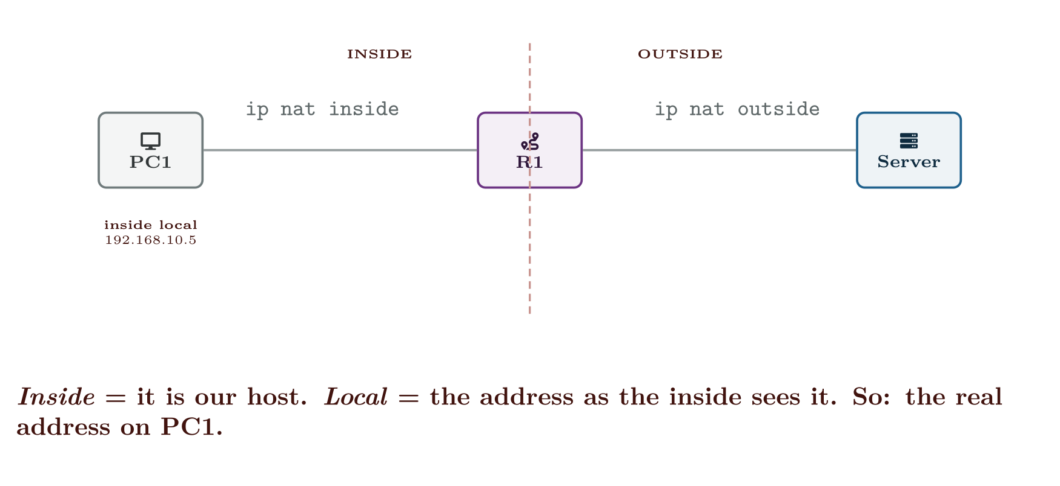
The four terms
CCNA 200-301 v2.0 · Chapter 22. NAT and PAT on IOS XE
4.3
Notes:
This is the part students get wrong, and it is worth slowing down for. There are two axes, not one. Inside and outside say which host you mean. Local and global say which side of the router you are standing on when you look at the address.
The same two hosts, four names. Inside and outside name the host; local and global name the viewpoint.

Slide 10
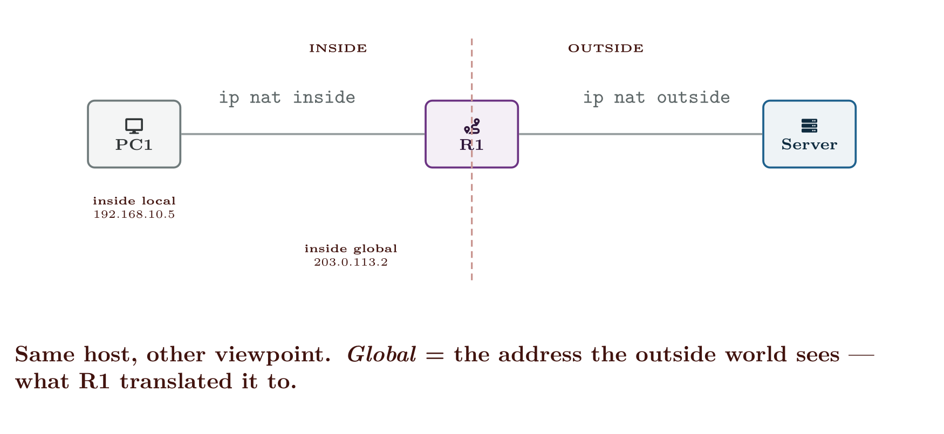
The four terms
CCNA 200-301 v2.0 · Chapter 22. NAT and PAT on IOS XE
4.3

Slide 11
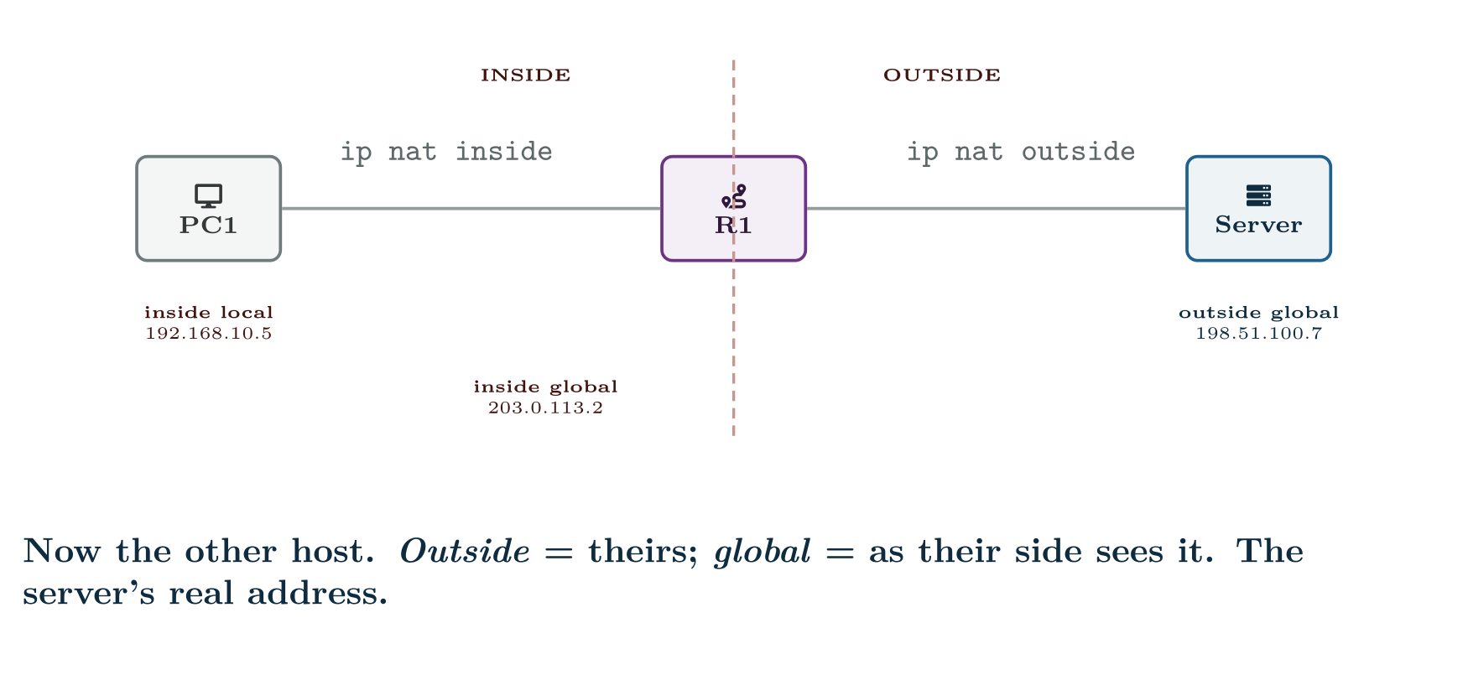
The four terms
CCNA 200-301 v2.0 · Chapter 22. NAT and PAT on IOS XE
4.3

Slide 12
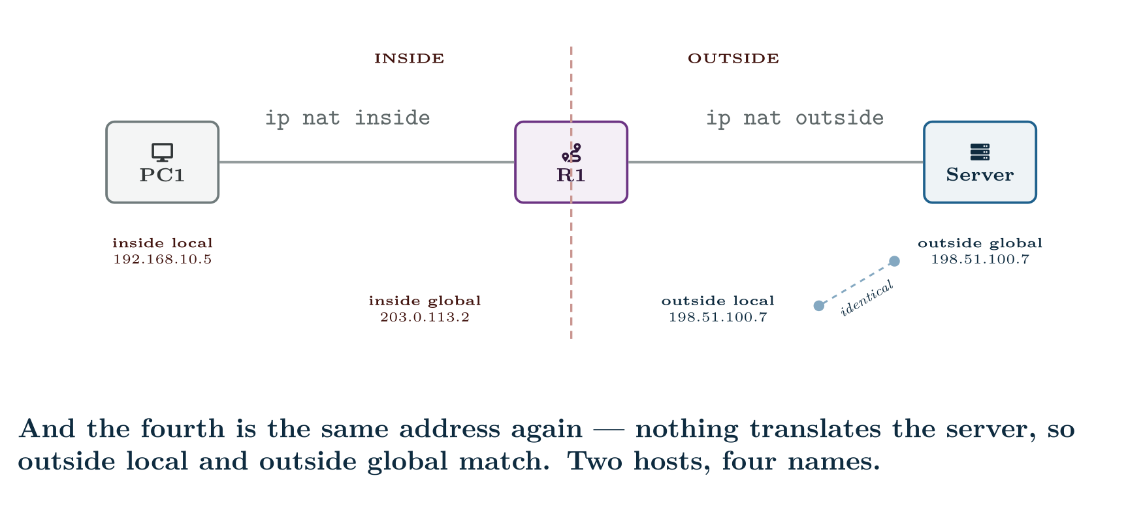
The four terms
CCNA 200-301 v2.0 · Chapter 22. NAT and PAT on IOS XE
4.3

Slide 13
CONCEPT
Why outside local usually equals outside global
Because plain NAT only rewrites the inside host’s address. The external server’s address is untouched in both directions, so both names describe the same number. The two differ only when you translate the outside side as well (ip nat outside source), which is rare and outside this exam.
That is good news: for CCNA purposes there are effectively three addresses to track, and the one that changes is the inside host’s.
CCNA 200-301 v2.0 · Chapter 22. NAT and PAT on IOS XE
4.3

Slide 14
Three kinds of NAT
CCNA 200-301 v2.0 · Chapter 22. NAT and PAT on IOS XE
4.3

Slide 15
CONFIGURE
Static NAT for an internal web server
IOS · configuration mode
! The mapping itself: inside local first, inside global second.
ip nat inside source static 192.168.10.50 203.0.113.50
!
! Without these two lines nothing is translated. This is the most
! commonly forgotten pair of commands in the whole topic.
interface GigabitEthernet0/0/1
description LAN
ip address 192.168.10.1 255.255.255.0
ip nat inside
!
interface GigabitEthernet0/0/0
description WAN to ISP
ip address 203.0.113.2 255.255.255.252
ip nat outside
CCNA 200-301 v2.0 · Chapter 22. NAT and PAT on IOS XE
4.3
Notes:
Used when an internal server must be reachable from outside at a fixed public address.

Slide 16
CONFIGURE
Dynamic NAT from a small pool
IOS · configuration mode
! 1. Which internal addresses are allowed to be translated.
access-list 1 permit 192.168.10.0 0.0.0.255
!
! 2. The public addresses available to lend.
ip nat pool BRANCH-POOL 203.0.113.10 203.0.113.20 netmask 255.255.255.0
!
! 3. Tie them together.
ip nat inside source list 1 pool BRANCH-POOL
CCNA 200-301 v2.0 · Chapter 22. NAT and PAT on IOS XE
4.3
Notes:
Internal hosts borrow a public address from a pool for the life of a conversation. When the pool is empty, further hosts get nothing.

Slide 17
WATCH OUT
Dynamic NAT fails silently when the pool runs out
Eleven addresses in that pool means the twelfth simultaneous host gets no translation and its packets are dropped. There is no message to the user and no log entry unless you asked for one. The symptom is “the internet works in the morning and stops after lunch”, and the evidence is one line of show ip nat statistics.
This is exactly why PAT exists, and why almost nobody deploys plain dynamic NAT.
CCNA 200-301 v2.0 · Chapter 22. NAT and PAT on IOS XE
4.3

Slide 18
CONFIGURE
PAT onto the WAN interface address
IOS · configuration mode
access-list 1 permit 192.168.10.0 0.0.0.255
!
! "interface" instead of a pool: use whatever address the WAN
! interface currently has. This survives a DHCP-assigned WAN address
! changing, which a pool would not.
ip nat inside source list 1 interface GigabitEthernet0/0/0 overload
!
interface GigabitEthernet0/0/1
ip nat inside
!
interface GigabitEthernet0/0/0
ip nat outside
CCNA 200-301 v2.0 · Chapter 22. NAT and PAT on IOS XE
4.3
Notes:
PAT (also called NAT overload) translates the port as well as the address, so a single public address serves thousands of internal hosts. Add one keyword.

Slide 19
ON THE EXAM
The word overload is the whole difference
This is what the blueprint actually asks for
ip nat inside source list 1 pool BRANCH-POOL is dynamic NAT. ip nat inside source list 1 pool BRANCH-POOL overload is PAT using a pool. ip nat inside source list 1 interface Gi0/0/0 overload is PAT using the interface address.
One keyword changes the behaviour from “runs out” to “does not run out”. Exam questions have been built on exactly that keyword being present or absent.
CCNA 200-301 v2.0 · Chapter 22. NAT and PAT on IOS XE
4.3

Slide 20
CONFIGURE
Publishing two internal services on one public address
IOS · configuration mode
ip nat inside source static tcp 192.168.10.50 80 203.0.113.2 80
ip nat inside source static tcp 192.168.10.60 22 203.0.113.2 2222
!
! The second line also changes the port: the outside world connects to
! 2222 and the internal host still listens on 22.
CCNA 200-301 v2.0 · Chapter 22. NAT and PAT on IOS XE
4.3
Notes:
A special case of static NAT that maps a single port rather than the whole address, so one public address can host several internal services.

Slide 21
Verifying
CCNA 200-301 v2.0 · Chapter 22. NAT and PAT on IOS XE
4.3

Slide 22
VERIFY
show ip nat translations
R1#
Pro Inside global Inside local Outside local Outside global
tcp 203.0.113.2:1055 192.168.10.5:1055 198.51.100.7:80 198.51.100.7:80
tcp 203.0.113.2:1056 192.168.10.6:1055 198.51.100.7:80 198.51.100.7:80
tcp 203.0.113.2:80 192.168.10.50:80 --- ---
CCNA 200-301 v2.0 · Chapter 22. NAT and PAT on IOS XE
4.3

Slide 23
VERIFY
show ip nat statistics
R1#
Total active translations: 3 (1 static, 2 dynamic; 2 extended)
Peak translations: 412, occurred 00:31:09 ago
Outside interfaces:
GigabitEthernet0/0/0
Inside interfaces:
GigabitEthernet0/0/1
Hits: 20481 Misses: 0
Expired translations: 1173
Dynamic mappings:
-- Inside Source
[Id: 1] access-list 1 interface GigabitEthernet0/0/0 refcount 2
CCNA 200-301 v2.0 · Chapter 22. NAT and PAT on IOS XE
4.3
Notes:
Read that output carefully, because it contains the whole idea of PAT in three lines. Rows one and two are two different internal hosts that both happened to choose source port 1055. The router gave the second one 1056 on the outside. That port rewrite is the reason one public address can serve a campus. The Pro column shows tcp, so these are PAT entries. A plain static or dynamic NAT entry has — in that column and no ports. Row three has dashes in both outside columns. That is a static mapping sitting ready with no conversation currently using it.

Slide 24
CONCEPT
The three lines to read first when NAT is broken
• Inside interfaces / Outside interfaces. If either list is empty, stop. Nothing else matters until both are populated.
• Misses. A non-zero and rising miss count on a dynamic mapping means packets arrived wanting translation and did not get one — an exhausted pool, or an ACL that did not match.
• Dynamic mappings. Confirms which ACL and which pool or interface are actually in force, which is not always the one you think you configured.
CCNA 200-301 v2.0 · Chapter 22. NAT and PAT on IOS XE
4.3

Slide 25
Order of operations, and why it catches people
CCNA 200-301 v2.0 · Chapter 22. NAT and PAT on IOS XE
4.3

Slide 26
WATCH OUT
The consequence you will be asked about
An inbound ACL on the outside interface is evaluated before the packet is un-translated. So it sees the inside global address — 203.0.113.50 — and not the private one. An ACL written against 192.168.10.50 on that interface will never match anything.
An inbound ACL on the inside interface is evaluated before translation too, so it sees the private address. Same rule, opposite result: ACLs always see the address that is on the wire at the interface they are attached to. If you can hold on to that sentence you never need to memorise the table.
CCNA 200-301 v2.0 · Chapter 22. NAT and PAT on IOS XE
4.3
Notes:
The order in which a router applies routing, NAT and ACLs is not symmetric, and one exam-favourite consequence falls out of it.

Slide 27
COMMON PITFALLS · Order of operations, and why it catches people
Common pitfalls
• No ip nat inside / ip nat outside. The single most common NAT fault. The translation rule is present, the interfaces are not marked, and nothing happens.
• Marking the wrong interface as inside. On a router with several LANs, only the marked ones are translated.
• A permit ip any any ACL used to select NAT traffic. It will translate traffic destined for other internal subnets too, breaking internal routing in ways that look like a routing fault.
• Forgetting overload. Works for the first few users and then does not.
CCNA 200-301 v2.0 · Chapter 22. NAT and PAT on IOS XE
4.3

Slide 28
COMMON PITFALLS · Order of operations, and why it catches people
Common pitfalls (continued)
• Expecting to ping the inside global address from inside. It usually does not work, and it does not mean NAT is broken. Test from outside.
• Editing a rule without clearing translations. Existing entries persist. clear ip nat translation * after every change, or you are testing the old configuration.
• Using an ACL number twice. The NAT selection ACL and a filtering ACL with the same number are the same ACL.
CCNA 200-301 v2.0 · Chapter 22. NAT and PAT on IOS XE
4.3

Slide 29
BREAK & FIX · SYMPTOM
Chapter 22
NAT is configured, the translation table is empty, and internal hosts cannot reach the internet.
R1 has a default route, can ping its ISP next hop, and can ping 8.8.8.8 from its own CLI. Internal hosts can ping R1’s LAN interface but nothing beyond it. show ip nat translations returns nothing at all.
CCNA 200-301 v2.0 · Chapter 22. NAT and PAT on IOS XE
4.3

Slide 30
BREAK & FIX · YOUR MOVE
Chapter 22
NAT is configured, the translation table is empty, and internal hosts cannot reach the internet.
What would you check first — and what do you expect to see?
CCNA 200-301 v2.0 · Chapter 22. NAT and PAT on IOS XE
4.3
Notes:
Pause here. Take two or three answers before advancing. The point is the prediction, not the command.

Slide 31
BREAK & FIX · EVIDENCE
Chapter 22
show run | include ip nat
R1#
ip nat inside source list 1 interface GigabitEthernet0/0/0 overload
ip nat inside
CCNA 200-301 v2.0 · Chapter 22. NAT and PAT on IOS XE
4.3
Notes:
Read it aloud. Ask what single field decides the answer.

Slide 32
BREAK & FIX · EVIDENCE
Chapter 22
show ip nat statistics
R1#
Total active translations: 0 (0 static, 0 dynamic; 0 extended)
Outside interfaces:
Inside interfaces:
GigabitEthernet0/0/1
Hits: 0 Misses: 0
CCNA 200-301 v2.0 · Chapter 22. NAT and PAT on IOS XE
4.3
Notes:
Read it aloud. Ask what single field decides the answer.

Slide 33
BREAK & FIX · YOUR MOVE
Chapter 22
What is the fault — and what does this output rule out?
CCNA 200-301 v2.0 · Chapter 22. NAT and PAT on IOS XE
4.3
Notes:
The elimination matters as much as the answer.

Slide 34
BREAK & FIX · DIAGNOSIS
Chapter 22
Why it is doing that
Diagnosis. Outside interfaces: is empty. The WAN interface was never marked ip nat outside. NAT needs a boundary, and a boundary needs two sides — with only one side declared, the router has no rule to apply and does not attempt translation at all.
Hits: 0 and Misses: 0 together are the confirming detail, and they are worth separating. Misses would mean packets arrived wanting translation and could not get one — a pool or ACL problem. Both counters at zero means no packet was ever considered for translation. That distinction points at the interface markers rather than at the rule.
CCNA 200-301 v2.0 · Chapter 22. NAT and PAT on IOS XE
4.3

Slide 35
BREAK & FIX · DIAGNOSIS
Chapter 22
Why it is doing that
The router itself reaching 8.8.8.8 is the red herring. Traffic the router originates is sourced from its own public interface and needs no translation, so it proves the WAN link and the default route are fine and says nothing about NAT.
CCNA 200-301 v2.0 · Chapter 22. NAT and PAT on IOS XE
4.3

Slide 36
BREAK & FIX · THE FIX
Chapter 22
Declaring the outside boundary
IOS · configuration mode
interface GigabitEthernet0/0/0
ip nat outside
CCNA 200-301 v2.0 · Chapter 22. NAT and PAT on IOS XE
4.3

Slide 37
BREAK & FIX · THE FIX
Chapter 22
And the lesson
Fix.
Then clear ip nat translation * and re-test from a host. Confirm entries appear and that Hits is climbing.
CCNA 200-301 v2.0 · Chapter 22. NAT and PAT on IOS XE
4.3

Slide 38
LAB · CML OR GNS3 WITH IOS XE
PAT for a branch, then a published server
Platform note. Packet Tracer supports this lab, but the topic names IOS XE and the interface naming differs. If you use Packet Tracer, translate the interface names as you go and note where they differ.
Topology. R1 as the branch router with 192.168.10.0/24 inside and 203.0.113.0/30 to ISP; ISP with a loopback of 198.51.100.7 standing in for the internet; three internal hosts and one internal server at 192.168.10.50.
1. Build and verify routing first, with no NAT. Confirm R1 can ping 198.51.100.7 and that internal hosts cannot. Explain precisely why the hosts fail, in terms of the ISP’s routing table.
2. Configure PAT using the WAN interface address. Verify from all three hosts and read show ip nat translations.
3. Generate connections from two hosts using the same source port (open the same service twice). Find the row where the router had to change the port and record both values.
4. Add a static NAT mapping for the server and confirm from ISP that it is reachable inbound.
CCNA 200-301 v2.0 · Chapter 22. NAT and PAT on IOS XE
4.3

Slide 39
LAB · CML OR GNS3 WITH IOS XE
PAT for a branch, then a published server (continued)
5. Change the static mapping to port forwarding on port 8080, and confirm the server still listens on 80.
6. Break 1. Remove ip nat outside. Predict what show ip nat statistics will show before you look, then look.
7. Break 2. Replace PAT with dynamic NAT from a two-address pool, no overload. Bring up three simultaneous sessions and observe the third fail. Find the miss counter.
8. Break 3. Apply an inbound ACL on the outside interface denying 192.168.10.50. Confirm it has no effect on inbound traffic to the server, and explain why using the order-of-operations table.
CCNA 200-301 v2.0 · Chapter 22. NAT and PAT on IOS XE
4.3

Slide 40
LAB · CML OR GNS3 WITH IOS XE
PAT for a branch, then a published server (continued)
9. Extension. Change the NAT selection ACL to permit ip any any, add a second internal LAN, and observe what breaks between the two internal subnets.
CCNA 200-301 v2.0 · Chapter 22. NAT and PAT on IOS XE
4.3

Slide 41
CHECKPOINT 1 of 5
Give the four NAT terms for a host 10.1.1.9 translated to 198.51.100.4 contacting a server at 203.0.113.80.
Discuss · then advance
Notes:
Ask the room. Do not advance until somebody commits to an answer.

Slide 42
ANSWER
Checkpoint 1 of 5
Give the four NAT terms for a host 10.1.1.9 translated to 198.51.100.4 contacting a server at 203.0.113.80.
Inside local 10.1.1.9; inside global 198.51.100.4; outside global 203.0.113.80; outside local 203.0.113.80 — the same, because plain NAT does not translate the outside host’s address.
CCNA 200-301 v2.0 · Chapter 22. NAT and PAT on IOS XE
4.3

Slide 43
CHECKPOINT 2 of 5
What single keyword turns dynamic NAT into PAT, and what failure does it prevent?
Discuss · then advance
Notes:
Ask the room. Do not advance until somebody commits to an answer.

Slide 44
ANSWER
Checkpoint 2 of 5
What single keyword turns dynamic NAT into PAT, and what failure does it prevent?
overload. It translates the port as well as the address, so one public address serves many hosts. Without it, dynamic NAT lends addresses one-to-one and silently fails when the pool is exhausted.
CCNA 200-301 v2.0 · Chapter 22. NAT and PAT on IOS XE
4.3

Slide 45
CHECKPOINT 3 of 5
show ip nat statistics shows Hits: 0 and Misses: 0. What does that rule out, and what does it point to?
Discuss · then advance
Notes:
Ask the room. Do not advance until somebody commits to an answer.

Slide 46
ANSWER
Checkpoint 3 of 5
show ip nat statistics shows Hits: 0 and Misses: 0. What does that rule out, and what does it point to?
It rules out a pool or ACL problem — misses would be non-zero if packets had been considered and refused. Both counters at zero means no packet was ever evaluated for translation, which points at the missing ip nat inside or ip nat outside interface markers.
CCNA 200-301 v2.0 · Chapter 22. NAT and PAT on IOS XE
4.3

Slide 47
CHECKPOINT 4 of 5
An inbound ACL on the outside interface must match a translated inside host. Which address does it have to name, and why?
Discuss · then advance
Notes:
Ask the room. Do not advance until somebody commits to an answer.

Slide 48
ANSWER
Checkpoint 4 of 5
An inbound ACL on the outside interface must match a translated inside host. Which address does it have to name, and why?
The inside global address, the translated one. An inbound ACL on the outside interface is evaluated before the packet is un-translated, so it sees the address that is on the wire at that interface.
CCNA 200-301 v2.0 · Chapter 22. NAT and PAT on IOS XE
4.3

Slide 49
CHECKPOINT 5 of 5
Why is NAT not a security control?
Discuss · then advance
Notes:
Ask the room. Do not advance until somebody commits to an answer.

Slide 50
ANSWER
Checkpoint 5 of 5
Why is NAT not a security control?
Because it is an address-conservation mechanism. It happens to make unsolicited inbound connections difficult, since no translation entry matches them, but that is a side effect rather than a policy — it cannot be audited, it states no intent, and it is trivially bypassed by anything the inside host initiates. Use an ACL or firewall for policy.
CCNA 200-301 v2.0 · Chapter 22. NAT and PAT on IOS XE
4.3

Slide 51
CHAPTER SUMMARY
What to take away
• Inside/outside names the host; local/global names the viewpoint. Outside local and outside global are normally the same address.
• Static NAT is a permanent one-to-one map. Dynamic NAT lends from a pool and fails silently when empty. PAT adds overload and translates ports too, so it does not run out.
• ip nat inside and ip nat outside on the interfaces are not optional. Without both, no translation is attempted.
• show ip nat translations for what is happening now; show ip nat statistics for whether the rule is even being reached.
CCNA 200-301 v2.0 · Chapter 22. NAT and PAT on IOS XE
4.3

Slide 52
CHAPTER SUMMARY
What to take away (continued)
• ACLs see the address on the wire at the interface they are attached to — translated on the outside, untranslated on the inside.
• clear ip nat translation * after every change, or you are testing stale entries.
• NAT conserves addresses. It is not a firewall.
CCNA 200-301 v2.0 · Chapter 22. NAT and PAT on IOS XE
4.3

Slide 53
Where we got to
• Inside/outside names the host; local/global names the viewpoint. Outside local and outside global are normally the same address.
• Static NAT is a permanent one-to-one map. Dynamic NAT lends from a pool and fails silently when empty. PAT adds overload and translates ports too, so it does not run out.
• ip nat inside and ip nat outside on the interfaces are not optional. Without both, no translation is attempted.
• show ip nat translations for what is happening now; show ip nat statistics for whether the rule is even being reached.
NEXT
Chapter 23 — Device Access, AAA and Secure File Transfer

