Slide 1


CCNA 200-301 V2.0
24
Access Control Lists
Part IV — Network Services and Security
EXAM TOPICS
4.6
LECTURER
Dr. Mustafa Hameed
THE ISLAMIA UNIVERSITY OF BAHAWALPUR
Department of Information Technology
Notes:
Chapter 24: Access Control Lists. Blueprint topics: 4.6.

Slide 2
THE COURSE
Where this chapter sits
Part I
Foundations
chapters 1–7
Part II
Switching and Network Access
chapters 8–14
Part III
IP Routing
chapters 15–19
Part IV
Network Services and Security
chapters 20–26
Part V
Wireless, Virtualisation and Operations
chapters 27–32
Part VI
Sitting the Exam
chapters 33–34
CCNA 200-301 v2.0 · Chapter 24. Access Control Lists
CCNA 200-301 v2.0 · Chapter 24. Access Control Lists
4.6
4.6
Notes:
Ten seconds. Students meeting a chapter in week ten cannot place it without being shown.

Slide 3
LEARNING OUTCOMES
What you will be able to do
• Calculate a wildcard mask for any subnet, and recognise the common ones on sight.
• Configure standard, extended, numbered and named IPv4 ACLs.
• Decide where to place an ACL and in which direction, and justify the choice.
• Read an existing ACL and predict exactly which traffic it permits — which is what the exam asks far more often than it asks you to write one.
CCNA 200-301 v2.0 · Chapter 24. Access Control Lists
4.6
Notes:
Access Control Lists 4.6

Slide 4
ASSUMED KNOWLEDGE
Before we start
Chapter 4 for subnet masks — a wildcard mask is meaningless without them. Chapter 6 for protocol numbers and well-known ports. Chapter 22 for the order of operations, which decides which address an ACL actually sees.
CCNA 200-301 v2.0 · Chapter 24. Access Control Lists
4.6

Slide 5
KEY TERMS
Vocabulary for this chapter
access control list
wildcard mask
implicit deny
standard ACL
extended ACL
named ACL
sequence number
ip access-group
access-class
established
Each is defined where it first matters — not here.
CCNA 200-301 v2.0 · Chapter 24. Access Control Lists
4.6
Notes:
Do not define these now - they are defined as they arrive. This slide is for the students' notes.

Slide 6
ON THE EXAM
IPv4 only, and all four kinds
This is what the blueprint actually asks for
Topic 4.6 reads configure IPv4 access control lists (standard, extended, numbered, and named ACLs). IPv6 ACLs are not on this blueprint.
All four named kinds are examinable, but note they are two axes, not four categories: an ACL is standard or extended by what it can match, and numbered or named by how you refer to it. All four combinations exist.
CCNA 200-301 v2.0 · Chapter 24. Access Control Lists
4.6

Slide 7
DEFINITION
Access control list
An ordered list of permit and deny statements. Each packet is tested against the entries from the top down; the first match wins and testing stops. A packet matching nothing hits an invisible deny any at the end and is dropped.
CCNA 200-301 v2.0 · Chapter 24. Access Control Lists
4.6

Slide 8
Wildcard masks
CCNA 200-301 v2.0 · Chapter 24. Access Control Lists
4.6

Slide 9
WORKED EXAMPLE
Wildcard for 172.16.8.0/21
The mask for a /21 is 255.255.248.0.
Subtract each octet from 255: 255-255=0, 255-255=0, 255-248=7, 255-0=255.
The wildcard is 0.0.7.255, and the ACL entry is permit ip 172.16.8.0 0.0.7.255 any. It matches 172.16.8.0 through 172.16.15.255 — eight consecutive /24s, which is what a /21 is.
CCNA 200-301 v2.0 · Chapter 24. Access Control Lists
4.6
Notes:
Three consequences follow from that definition, and between them they cause most ACL faults. Order is behaviour. Moving one line changes what the ACL does. A specific rule placed after a general one that already matched is dead configuration. The implicit deny is always there. An ACL that permits one thing denies everything else. There is no way to switch it off; if you want everything else through, end the list with permit ip any any. An unapplied ACL does nothing. Writing the list and applying it to an interface are two separate acts, and forgetting the second is common. A wildcard mask says which bits of an address must match. A 0 bit means “must match”; a 1 bit means “ignore”. That is the inverse of a subnet mask, and the arithmetic is: subtract each octet of the subnet mask from 255.

Slide 10
CONCEPT
The check that catches arithmetic slips
Add the wildcard to the network address. The result should be the last address in the range you meant. 172.16.8.0 + 0.0.7.255 = 172.16.15.255. If that is not the broadcast address of the block you intended, the wildcard is wrong.
Do this every time. It takes five seconds and it catches the off-by-one that otherwise costs you a lab.
CCNA 200-301 v2.0 · Chapter 24. Access Control Lists
4.6

Slide 11
Standard ACLs
CCNA 200-301 v2.0 · Chapter 24. Access Control Lists
4.6

Slide 12
CONFIGURE
A numbered standard ACL
IOS · configuration mode
! Order matters: the specific deny must precede the general permit,
! or the permit matches first and the deny is never reached.
access-list 10 remark Block the lab subnet, allow the rest of campus
access-list 10 deny 192.168.30.0 0.0.0.255
access-list 10 permit 192.168.0.0 0.0.255.255
!
interface GigabitEthernet0/0/1
ip access-group 10 out
CCNA 200-301 v2.0 · Chapter 24. Access Control Lists
4.6
Notes:
A standard ACL matches the source address only. Numbered 1–99 and 1300–1999.

Slide 13
WATCH OUT
Place a standard ACL close to the destination
Because it can only see the source address, a standard ACL cannot distinguish “traffic from this subnet to the finance server” from “traffic from this subnet to anywhere”. Applied near the source, it blocks the host from the entire network, not just from the thing you wanted protected.
So the rule is: standard ACLs go as close to the destination as possible; extended ACLs go as close to the source as possible, because they can be precise enough to be safe there and it saves carrying doomed traffic across the network.
CCNA 200-301 v2.0 · Chapter 24. Access Control Lists
4.6

Slide 14
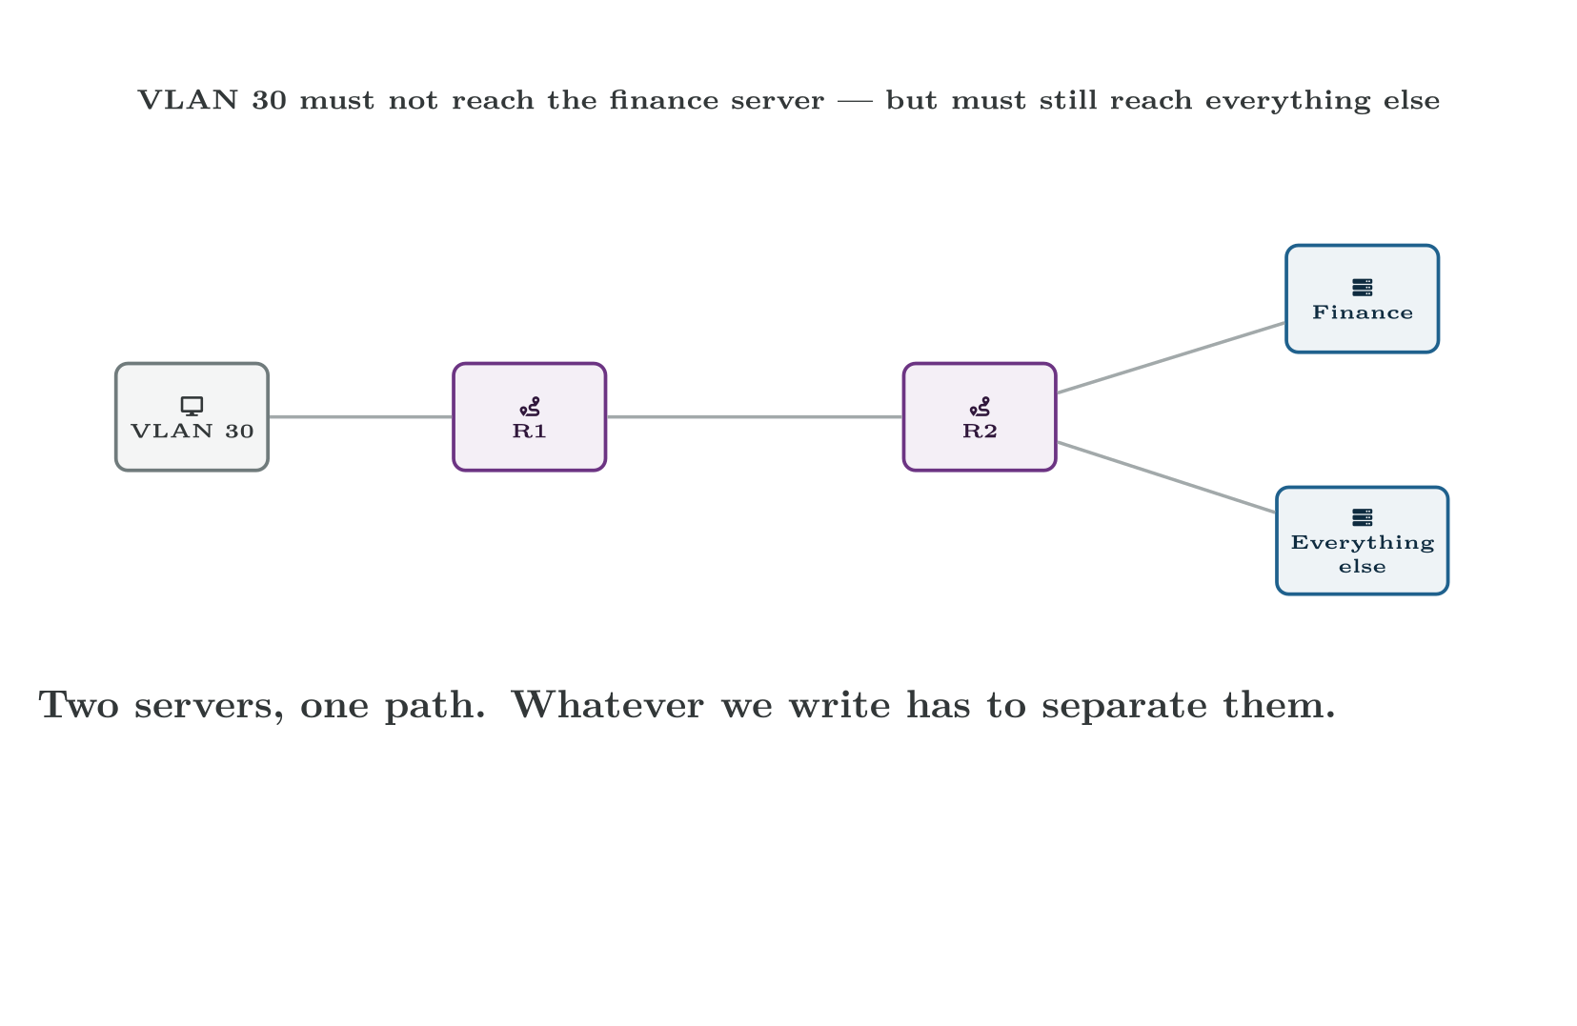
Standard ACLs
CCNA 200-301 v2.0 · Chapter 24. Access Control Lists
4.6
Notes:
Why placement is part of the design. The same ACL is correct in one place and an outage in the other.

Slide 15
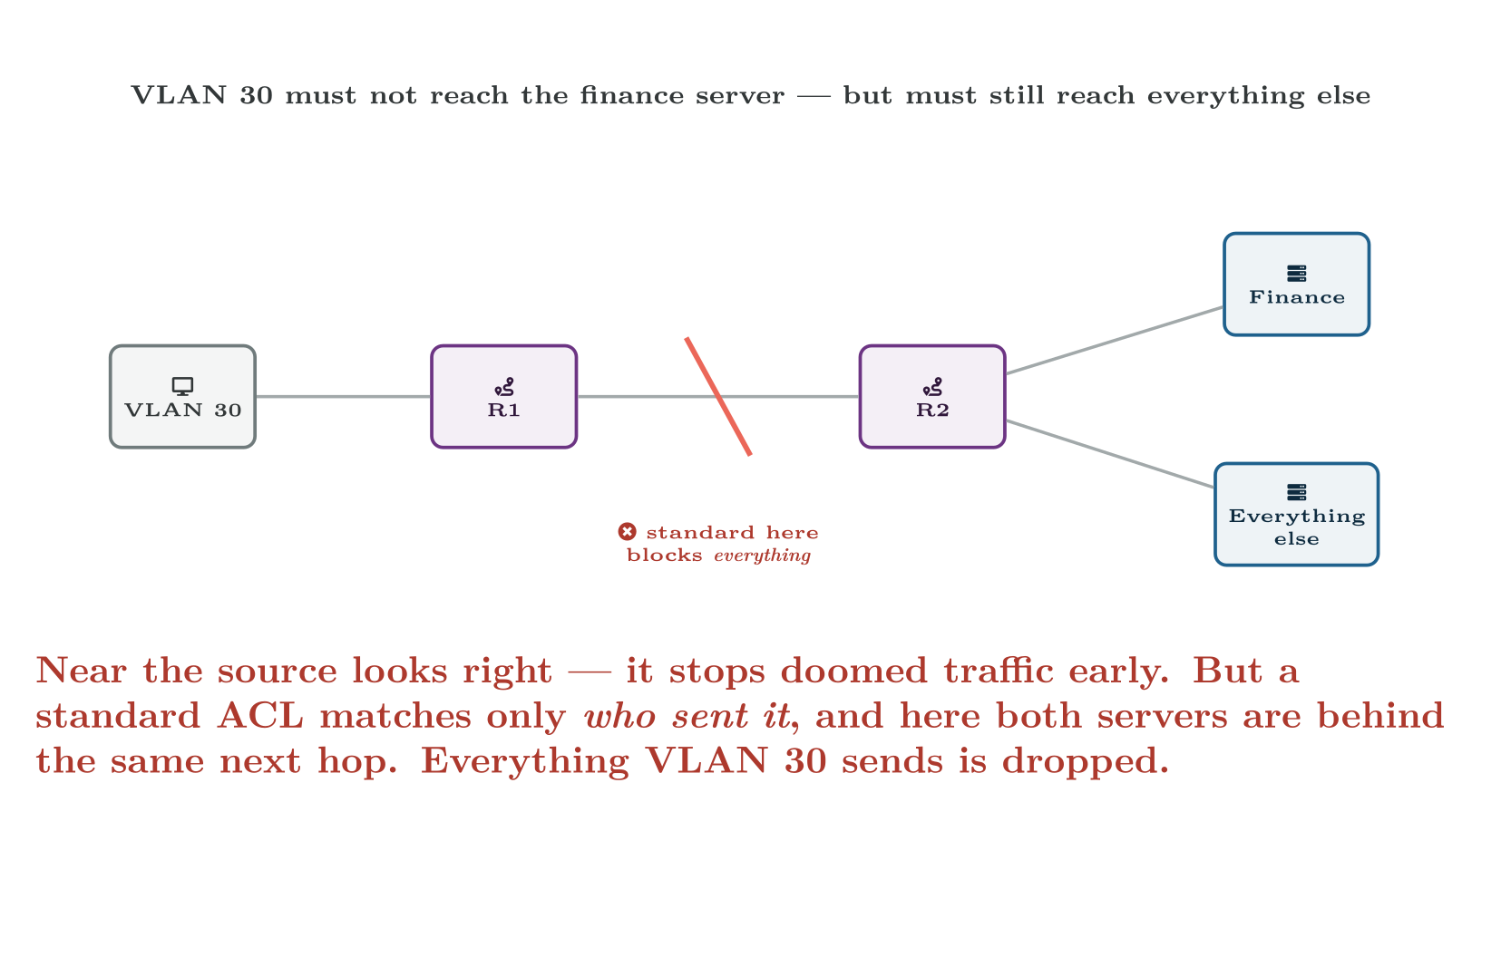
Standard ACLs
CCNA 200-301 v2.0 · Chapter 24. Access Control Lists
4.6

Slide 16
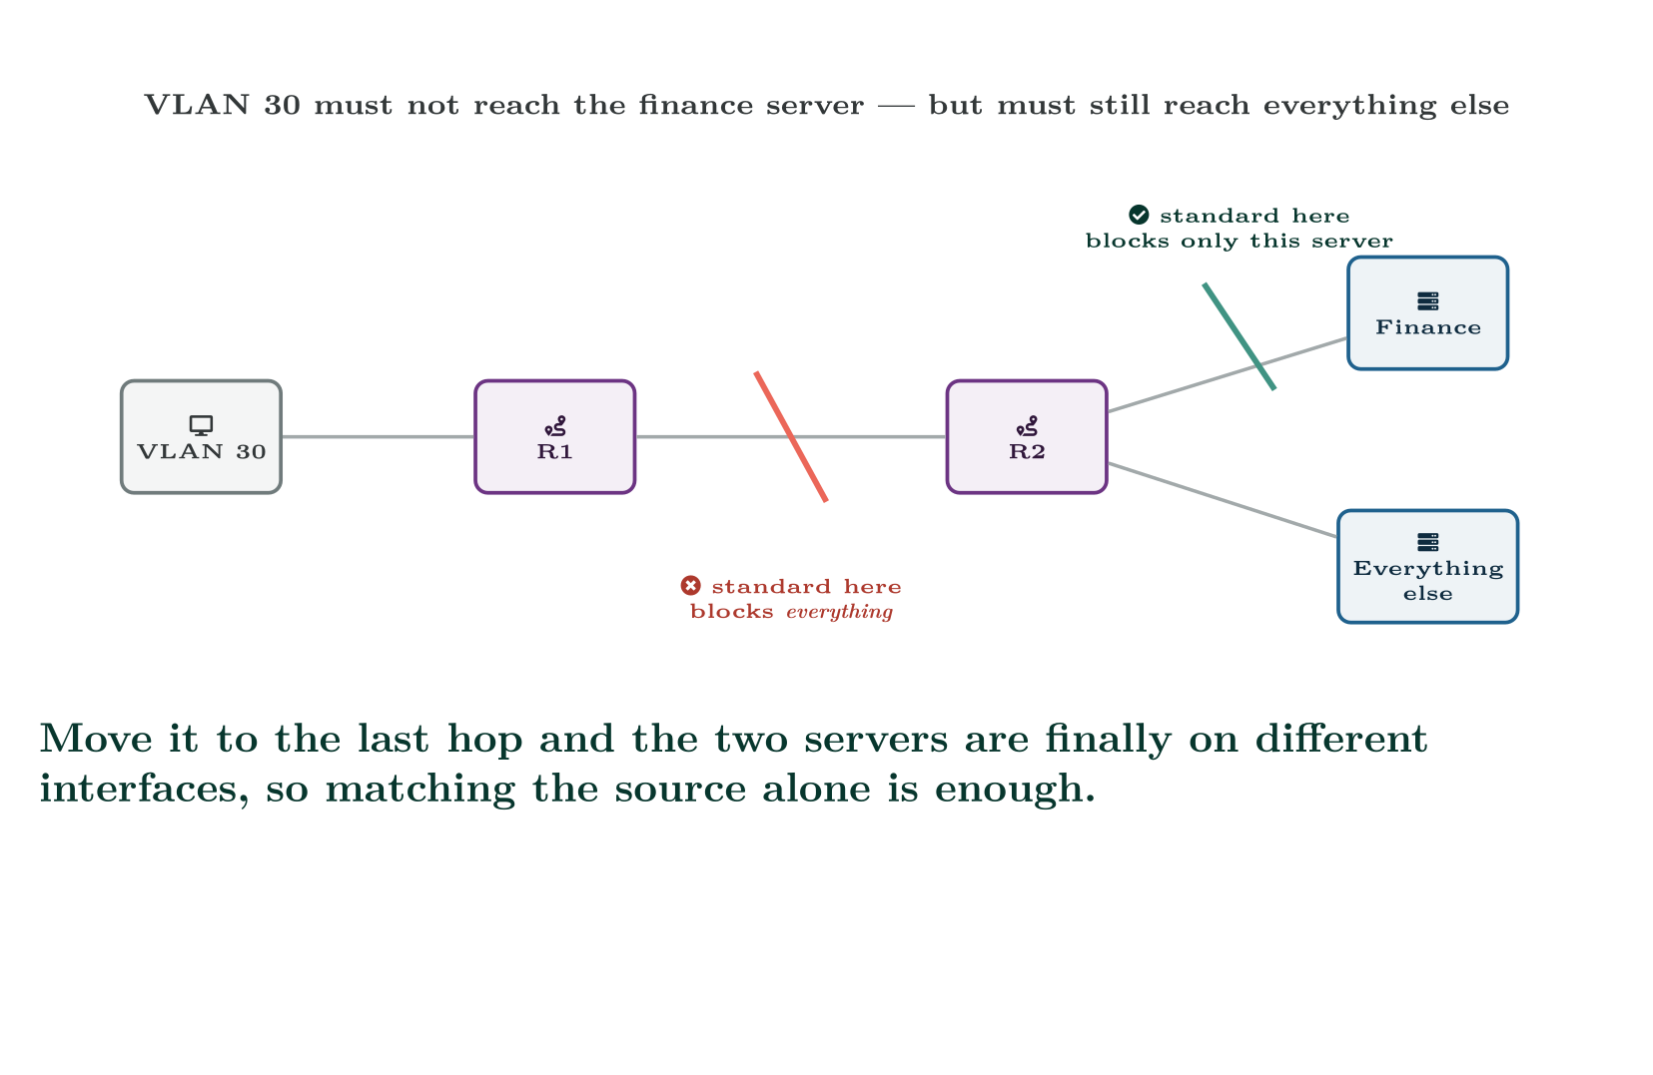
Standard ACLs
CCNA 200-301 v2.0 · Chapter 24. Access Control Lists
4.6

Slide 17
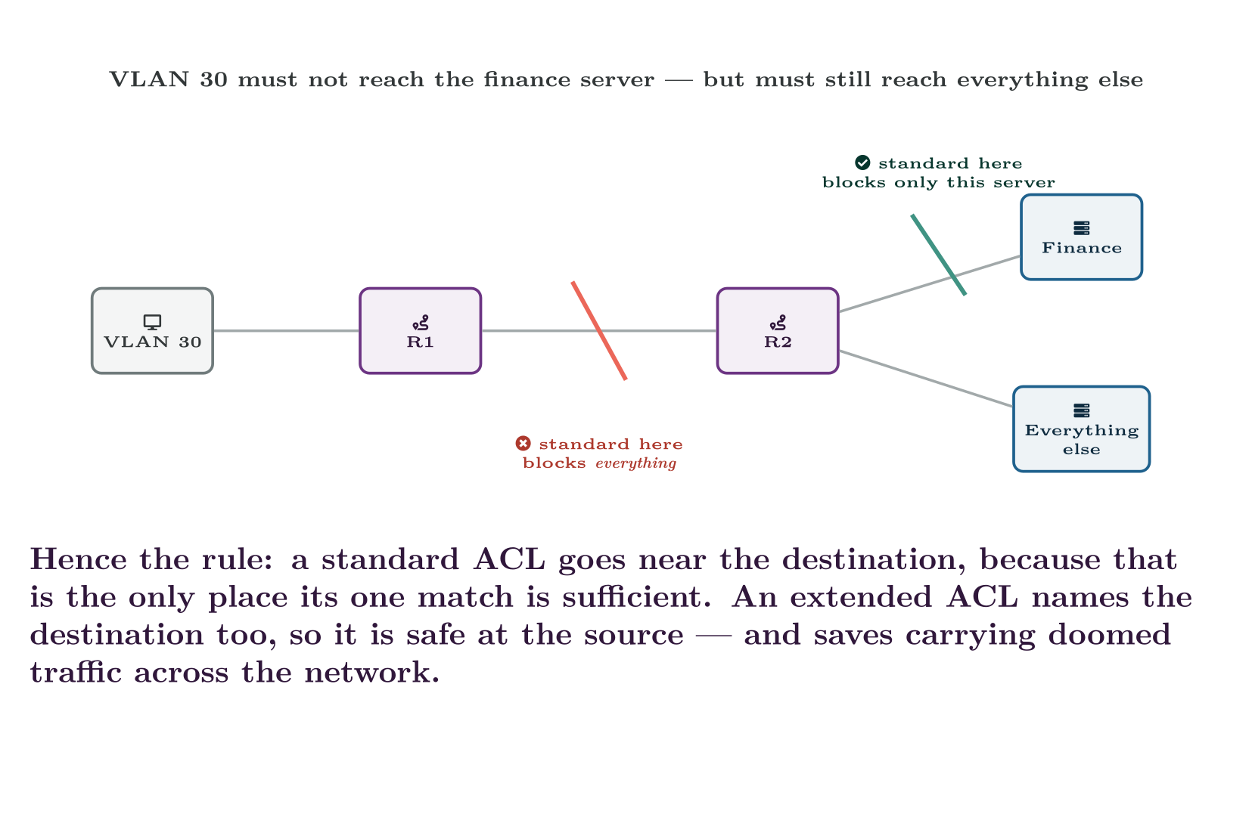
Standard ACLs
CCNA 200-301 v2.0 · Chapter 24. Access Control Lists
4.6

Slide 18
Extended ACLs
CCNA 200-301 v2.0 · Chapter 24. Access Control Lists
4.6

Slide 19
CONFIGURE
An extended ACL letting a subnet reach only what it needs
IOS · configuration mode
access-list 110 remark Guest VLAN -- web, DNS and nothing else
!
! DNS to the campus resolvers, both transports.
access-list 110 permit udp 192.168.40.0 0.0.0.255 host 192.168.20.10 eq 53
access-list 110 permit tcp 192.168.40.0 0.0.0.255 host 192.168.20.10 eq 53
!
! Web out to anywhere.
access-list 110 permit tcp 192.168.40.0 0.0.0.255 any eq 80
access-list 110 permit tcp 192.168.40.0 0.0.0.255 any eq 443
!
! Let guests get an address. Without this the implicit deny stops
! DHCP and the VLAN never works at all.
access-list 110 permit udp any host 255.255.255.255 eq 67
!
! Ping to the gateway only, so users can prove their own link.
access-list 110 permit icmp 192.168.40.0 0.0.0.255 host 192.168.40.1
!
! Everything else is dropped by the implicit deny, logged so that
! surprises are visible.
access-list 110 deny ip any any log
CCNA 200-301 v2.0 · Chapter 24. Access Control Lists
4.6
Notes:
An extended ACL matches source, destination, protocol and port. Numbered 100–199 and 2000–2699. The argument order is fixed and worth reciting until it is automatic: access-list <n> {permit|deny} <protocol> <source> <src-port> <dest> <dest-port>

Slide 20
CONFIGURE
An extended ACL letting a subnet reach only what it needs (continued)
IOS · configuration mode
!
interface GigabitEthernet0/0/2
description Guest VLAN
ip access-group 110 in
CCNA 200-301 v2.0 · Chapter 24. Access Control Lists
4.6

Slide 21
CONCEPT
eq 53 on the destination, not the source
In that list the port qualifier follows the destination address, because the guest is connecting to port 53 on the resolver. Its own source port is ephemeral and unpredictable, so it is left unspecified.
Getting this backwards — permit udp 192.168.40.0 0.0.0.255 eq 53 any — is a classic and produces an ACL that matches almost nothing. The position of the port in the line is the whole meaning.
CCNA 200-301 v2.0 · Chapter 24. Access Control Lists
4.6

Slide 22
ON THE EXAM
established
This is what the blueprint actually asks for
permit tcp any 192.168.10.0 0.0.0.255 established matches only TCP segments with the ACK or RST flag set — that is, packets belonging to a conversation that somebody inside already started. A pure connection attempt from outside has only SYN set and is not matched.
It is a cheap way to say “replies to our traffic may return, new connections may not.” It is not stateful — it inspects flags, not connections — and the exam likes that distinction.
CCNA 200-301 v2.0 · Chapter 24. Access Control Lists
4.6

Slide 23
Named ACLs, and why they are what you should write
CCNA 200-301 v2.0 · Chapter 24. Access Control Lists
4.6

Slide 24
CONFIGURE
The same policy, named and editable
IOS · configuration mode
ip access-list extended GUEST-OUT
remark Guest VLAN -- web, DNS and nothing else
10 permit udp 192.168.40.0 0.0.0.255 host 192.168.20.10 eq 53
20 permit tcp 192.168.40.0 0.0.0.255 host 192.168.20.10 eq 53
30 permit tcp 192.168.40.0 0.0.0.255 any eq 80
40 permit tcp 192.168.40.0 0.0.0.255 any eq 443
50 deny ip any any log
!
interface GigabitEthernet0/0/2
ip access-group GUEST-OUT in
CCNA 200-301 v2.0 · Chapter 24. Access Control Lists
4.6

Slide 25
WATCH OUT
This is the practical advantage, and it is a large one
With sequence numbers you can insert and delete single lines:
• ip access-list extended GUEST-OUT then 35 permit tcp ... eq 8080 inserts a rule between 30 and 40.
• no 40 removes one entry and leaves the rest standing.
With a numbered ACL on older IOS, no access-list 110 deletes the entire list — and if it is still applied to an interface, the interface now has an empty ACL, which denies everything. That is how a routine edit becomes an outage. Number your entries in tens so there is room to insert later, and prefer named ACLs.
CCNA 200-301 v2.0 · Chapter 24. Access Control Lists
4.6

Slide 26
Applying and verifying
CCNA 200-301 v2.0 · Chapter 24. Access Control Lists
4.6

Slide 27
CONFIGURE
Restricting management access
IOS · configuration mode
ip access-list standard MGMT-HOSTS
10 permit 10.0.0.0 0.0.0.255
20 permit host 192.168.99.14
!
line vty 0 15
access-class MGMT-HOSTS in
transport input ssh
CCNA 200-301 v2.0 · Chapter 24. Access Control Lists
4.6

Slide 28
VERIFY
show access-lists
R1#
Standard IP access list MGMT-HOSTS
10 permit 10.0.0.0, wildcard bits 0.0.0.255 (214 matches)
20 permit 192.168.99.14 (3 matches)
Extended IP access list GUEST-OUT
10 permit udp 192.168.40.0 0.0.0.255 host 192.168.20.10 eq domain (8841 matches)
20 permit tcp 192.168.40.0 0.0.0.255 host 192.168.20.10 eq domain (12 matches)
30 permit tcp 192.168.40.0 0.0.0.255 any eq www (40218 matches)
40 permit tcp 192.168.40.0 0.0.0.255 any eq 443 (338104 matches)
50 deny ip any any log (2277 matches)
CCNA 200-301 v2.0 · Chapter 24. Access Control Lists
4.6

Slide 29
CONCEPT
The match counters are the diagnostic
That output tells you more than the configuration does.
• A rule with zero matches is either unnecessary or unreachable — shadowed by an earlier line. Both are worth investigating.
• A rising counter on the final deny tells you the ACL is dropping things, and log tells you what. This is the first place to look when an application “sometimes” fails.
• Counters that do not move at all mean the ACL is not in the path. Check it is actually applied, and in the direction you think.
clear access-list counters before a test gives you a clean baseline.
CCNA 200-301 v2.0 · Chapter 24. Access Control Lists
4.6

Slide 30
VERIFY
show ip interface GigabitEthernet0/0/2 | include access list
R1#
Outgoing access list is not set
Inbound access list is GUEST-OUT
CCNA 200-301 v2.0 · Chapter 24. Access Control Lists
4.6

Slide 31
COMMON PITFALLS · Applying and verifying
Common pitfalls
• Forgetting the implicit deny. Permit what you need and everything else stops. This is the single biggest cause of ACL outages.
• A general permit above a specific deny. First match wins, so the deny never runs.
• A standard ACL applied near the source. Blocks the host from everything, not from the one destination you meant.
• Port qualifier on the wrong side. eq 80 belongs with the destination for a client reaching a web server.
• Writing the ACL and not applying it. No error, no effect.
CCNA 200-301 v2.0 · Chapter 24. Access Control Lists
4.6

Slide 32
COMMON PITFALLS · Applying and verifying
Common pitfalls (continued)
• Applying it in the wrong direction. in and out are relative to the interface, not to the building.
• no access-list 110 on a live numbered ACL. Deletes the whole list; the interface is left denying everything.
• Blocking your own management session. Think about vty before you press enter on a remote device.
• Forgetting supporting protocols. DHCP, DNS and ICMP all need explicit permits in a restrictive list, or the VLAN looks completely dead.
CCNA 200-301 v2.0 · Chapter 24. Access Control Lists
4.6

Slide 33
BREAK & FIX · SYMPTOM
Chapter 24
An ACL meant to stop one subnet reaching the finance server has cut that subnet off from everything.
The requirement was: hosts in 192.168.30.0/24 must not reach the finance server at 192.168.20.15. Everything else should be unaffected. After the change, VLAN 30 cannot reach the internet, the file server, or DNS. It can still reach hosts within its own VLAN.
CCNA 200-301 v2.0 · Chapter 24. Access Control Lists
4.6

Slide 34
BREAK & FIX · YOUR MOVE
Chapter 24
An ACL meant to stop one subnet reaching the finance server has cut that subnet off from everything.
What would you check first — and what do you expect to see?
CCNA 200-301 v2.0 · Chapter 24. Access Control Lists
4.6
Notes:
Pause here. Take two or three answers before advancing. The point is the prediction, not the command.

Slide 35
BREAK & FIX · EVIDENCE
Chapter 24
show access-lists 20
R1#
Standard IP access list 20
10 deny 192.168.30.0, wildcard bits 0.0.0.255 (18442 matches)
20 permit any (0 matches)
CCNA 200-301 v2.0 · Chapter 24. Access Control Lists
4.6
Notes:
Read it aloud. Ask what single field decides the answer.

Slide 36
BREAK & FIX · EVIDENCE
Chapter 24
show ip interface Vlan30 | include access list
R1#
Inbound access list is 20
Outgoing access list is not set
CCNA 200-301 v2.0 · Chapter 24. Access Control Lists
4.6
Notes:
Read it aloud. Ask what single field decides the answer.

Slide 37
BREAK & FIX · YOUR MOVE
Chapter 24
What is the fault — and what does this output rule out?
CCNA 200-301 v2.0 · Chapter 24. Access Control Lists
4.6
Notes:
The elimination matters as much as the answer.

Slide 38
BREAK & FIX · DIAGNOSIS
Chapter 24
Why it is doing that
Diagnosis. Two things are wrong and they compound.
First, this is a standard ACL, so it can only match the source. It has no way to express “to the finance server” — the destination is invisible to it.
Second, it is applied inbound on VLAN 30’s own SVI, which is as close to the source as it is possible to get. Every packet leaving VLAN 30 for anywhere hits line 10 and is dropped. Traffic within the VLAN still works because it is switched and never reaches the SVI at all — which is exactly why the symptom looks like a routing fault rather than an ACL.
The confirming detail is line 20: permit any has zero matches. Not one packet from anywhere got past line 10. An ACL whose last line never matches is dropping everything it sees.
CCNA 200-301 v2.0 · Chapter 24. Access Control Lists
4.6

Slide 39
BREAK & FIX · THE FIX
Chapter 24
An ACL that expresses the actual requirement
IOS · configuration mode
ip access-list extended VLAN30-POLICY
10 remark Deny only the finance server, permit the rest
20 deny ip 192.168.30.0 0.0.0.255 host 192.168.20.15
30 permit ip any any
!
interface Vlan30
no ip access-group 20 in
ip access-group VLAN30-POLICY in
CCNA 200-301 v2.0 · Chapter 24. Access Control Lists
4.6

Slide 40
BREAK & FIX · THE FIX
Chapter 24
And the lesson
Fix. The requirement names a destination, so it needs an extended ACL, and an extended ACL can safely sit near the source.
Note line 30. Without it the extended ACL would reproduce the original outage by a different route. Then clear access-list counters and re-test: line 20 should accumulate matches only when someone tries the finance server, and line 30 should carry everything else.
CCNA 200-301 v2.0 · Chapter 24. Access Control Lists
4.6

Slide 41
LAB · PACKET TRACER, OR CML
Writing, reading and repairing ACLs
Topology. R1 routing four VLANs — staff 10, servers 20, lab 30, guest 40 — with a server at 192.168.20.10 running DNS and HTTP, a finance server at 192.168.20.15, and an internet-facing link.
1. Confirm full connectivity between all four VLANs before applying any ACL. Record the tests you used; you will repeat them after every change.
2. Write and apply a numbered standard ACL restricting management access to the VTY lines to the staff VLAN only. Test from staff and from lab.
3. Convert it to a named ACL. Insert an additional permitted host between two existing lines without retyping the list.
4. Write an extended named ACL for the guest VLAN permitting only DNS to 192.168.20.10, HTTP and HTTPS anywhere, and DHCP. Apply it inbound. Verify each permitted service works and at least three others do not.
CCNA 200-301 v2.0 · Chapter 24. Access Control Lists
4.6

Slide 42
LAB · PACKET TRACER, OR CML
Writing, reading and repairing ACLs (continued)
5. Read the match counters after your tests. Identify any rule with zero matches and explain why.
6. Break 1. Remove the DHCP permit and release a guest host’s lease. Predict the result before testing.
7. Break 2. Move the permit tcp ... eq 443 line above the deny that follows it, then below it, and observe the counters in each case.
8. Break 3. Reproduce the Break & Fix above deliberately: use a standard ACL near the source to try to protect one server. Confirm the symptom, then repair it with an extended ACL.
CCNA 200-301 v2.0 · Chapter 24. Access Control Lists
4.6

Slide 43
LAB · PACKET TRACER, OR CML
Writing, reading and repairing ACLs (continued)
9. Break 4. Apply an ACL that blocks your own SSH session on a device you can still reach by console. Recover it, then write down the habit that would have prevented it.
10. Extension. Add permit tcp any 192.168.20.0 0.0.0.255 established to an internet-facing inbound ACL. Verify that internal hosts can browse out and that inbound connections are refused, and explain why this is not a stateful firewall.
CCNA 200-301 v2.0 · Chapter 24. Access Control Lists
4.6

Slide 44
CHECKPOINT 1 of 5
Give the wildcard mask for 10.20.16.0/20 and the range it matches.
Discuss · then advance
Notes:
Ask the room. Do not advance until somebody commits to an answer.

Slide 45
ANSWER
Checkpoint 1 of 5
Give the wildcard mask for 10.20.16.0/20 and the range it matches.
Mask 255.255.240.0, so the wildcard is 0.0.15.255. It matches 10.20.16.0 through 10.20.31.255 — sixteen consecutive /24s.
CCNA 200-301 v2.0 · Chapter 24. Access Control Lists
4.6

Slide 46
CHECKPOINT 2 of 5
Why is a standard ACL placed near the destination and an extended ACL near the source?
Discuss · then advance
Notes:
Ask the room. Do not advance until somebody commits to an answer.

Slide 47
ANSWER
Checkpoint 2 of 5
Why is a standard ACL placed near the destination and an extended ACL near the source?
Because a standard ACL can only match the source. Placed near the source it would block that host from everything, not just the one destination. An extended ACL can name the destination too, so it is precise enough to sit near the source, which saves carrying doomed traffic across the network.
CCNA 200-301 v2.0 · Chapter 24. Access Control Lists
4.6

Slide 48
CHECKPOINT 3 of 5
An ACL’s final permit any shows zero matches. What does that tell you?
Discuss · then advance
Notes:
Ask the room. Do not advance until somebody commits to an answer.

Slide 49
ANSWER
Checkpoint 3 of 5
An ACL’s final permit any shows zero matches. What does that tell you?
That everything is being dropped by an earlier line — no packet from anywhere reached the bottom of the list. An ACL whose final permit never matches is denying all traffic it sees.
CCNA 200-301 v2.0 · Chapter 24. Access Control Lists
4.6

Slide 50
CHECKPOINT 4 of 5
What does established match, and why is it not stateful?
Discuss · then advance
Notes:
Ask the room. Do not advance until somebody commits to an answer.

Slide 51
ANSWER
Checkpoint 4 of 5
What does established match, and why is it not stateful?
TCP segments with the ACK or RST flag set — replies within a conversation somebody inside already started. It is not stateful because it inspects flags on each packet independently and keeps no record of connections; a crafted packet with ACK set will match.
CCNA 200-301 v2.0 · Chapter 24. Access Control Lists
4.6

Slide 52
CHECKPOINT 5 of 5
Name three supporting protocols that a restrictive inbound ACL must explicitly permit, and give the symptom for each if it is missed.
Discuss · then advance
Notes:
Ask the room. Do not advance until somebody commits to an answer.

Slide 53
ANSWER
Checkpoint 5 of 5
Name three supporting protocols that a restrictive inbound ACL must explicitly permit, and give the symptom for each if it is missed.
DHCP — without it hosts get no address and the VLAN looks completely dead. DNS — everything works by IP and nothing by name. ICMP — users and you lose the ability to test anything, and troubleshooting becomes guesswork.
CCNA 200-301 v2.0 · Chapter 24. Access Control Lists
4.6

Slide 54
CHAPTER SUMMARY
What to take away
• Top down, first match wins, implicit deny any at the end. Order is behaviour.
• Wildcard mask = 255 minus each octet of the subnet mask. Check it by adding it to the network address.
• Standard (1–99, 1300–1999) matches source only — place near the destination. Extended (100–199, 2000–2699) matches source, destination, protocol and port — place near the source.
• Named ACLs with sequence numbers can be edited a line at a time. Numbered ones on older IOS cannot, and deleting one that is still applied denies everything.
• Apply with ip access-group in|out on an interface, or access-class in on the VTY lines.
CCNA 200-301 v2.0 · Chapter 24. Access Control Lists
4.6

Slide 55
CHAPTER SUMMARY
What to take away (continued)
• show access-lists match counters are the real diagnostic: a zero on the last line means everything is being dropped; a zero in the middle means a shadowed rule.
• Remember DHCP, DNS and ICMP, or a restrictive ACL makes a VLAN look dead.
CCNA 200-301 v2.0 · Chapter 24. Access Control Lists
4.6

Slide 56
Where we got to
• Top down, first match wins, implicit deny any at the end. Order is behaviour.
• Wildcard mask = 255 minus each octet of the subnet mask. Check it by adding it to the network address.
• Standard (1–99, 1300–1999) matches source only — place near the destination. Extended (100–199, 2000–2699) matches source, destination, protocol and port — place near the source.
• Named ACLs with sequence numbers can be edited a line at a time. Numbered ones on older IOS cannot, and deleting one that is still applied denies everything.
NEXT
Chapter 25 — Layer 2 Security

