Slide 1


CCNA 200-301 V2.0
25
Layer 2 Security
Part IV — Network Services and Security
EXAM TOPICS
4.7
LECTURER
Dr. Mustafa Hameed
THE ISLAMIA UNIVERSITY OF BAHAWALPUR
Department of Information Technology
Notes:
Chapter 25: Layer 2 Security. Blueprint topics: 4.7.

Slide 2
THE COURSE
Where this chapter sits
Part I
Foundations
chapters 1–7
Part II
Switching and Network Access
chapters 8–14
Part III
IP Routing
chapters 15–19
Part IV
Network Services and Security
chapters 20–26
Part V
Wireless, Virtualisation and Operations
chapters 27–32
Part VI
Sitting the Exam
chapters 33–34
CCNA 200-301 v2.0 · Chapter 25. Layer 2 Security
CCNA 200-301 v2.0 · Chapter 25. Layer 2 Security
4.7
4.7
Notes:
Ten seconds. Students meeting a chapter in week ten cannot place it without being shown.

Slide 3
LEARNING OUTCOMES
What you will be able to do
• Configure port security with an appropriate maximum, learning method and violation mode.
• Configure DHCP snooping, and explain which ports must be trusted and why.
• Configure dynamic ARP inspection, including the case it cannot handle without help.
• Configure storm control and IPv6 RA guard.
• Predict the outage each of these causes when deployed carelessly — which is how they are examined and how they fail in practice.
CCNA 200-301 v2.0 · Chapter 25. Layer 2 Security
4.7
Notes:
Layer 2 Security 4.7

Slide 4
ASSUMED KNOWLEDGE
Before we start
Chapter 3 for MAC learning. Chapter 8 for access ports. Chapter 20 — DHCP snooping is unintelligible without DORA. Chapter 5 for router advertisements, which RA guard exists to police.
CCNA 200-301 v2.0 · Chapter 25. Layer 2 Security
4.7

Slide 5
KEY TERMS
Vocabulary for this chapter
port security
sticky MAC
violation mode
err-disabled
DHCP snooping
trusted port
binding database
dynamic ARP inspection
ARP ACL
storm control
RA guard
Each is defined where it first matters — not here.
CCNA 200-301 v2.0 · Chapter 25. Layer 2 Security
4.7
Notes:
Do not define these now - they are defined as they arrive. This slide is for the students' notes.

Slide 6
ON THE EXAM
Five named sub-topics, all configure
This is what the blueprint actually asks for
Topic 4.7 enumerates them: 4.7.a DHCP snooping, 4.7.b dynamic ARP inspection, 4.7.c storm control, 4.7.d RA guard, 4.7.e port security.
Five features, one idea: the access port is where the network meets people it does not control, and each of these constrains one thing an attached device could otherwise do — claim many identities, answer as a DHCP server, lie in ARP, flood the segment, or claim to be an IPv6 router.
Learn them as that list of five abuses and the configuration follows.
CCNA 200-301 v2.0 · Chapter 25. Layer 2 Security
4.7

Slide 7
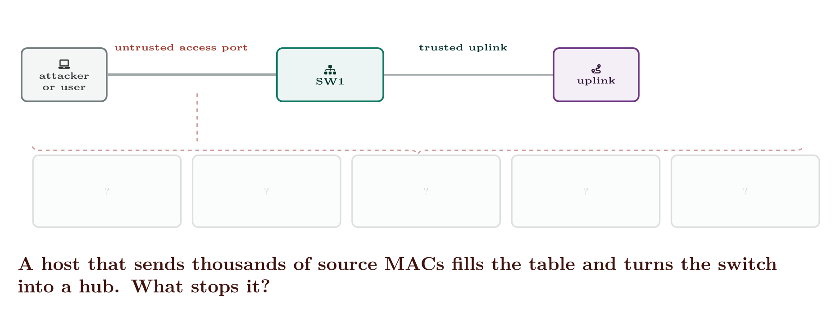
Layer 2 Security
CCNA 200-301 v2.0 · Chapter 25. Layer 2 Security
4.7
Notes:
Five features, five abuses, one port. The uplink is trusted; everything facing a user is not.

Slide 8
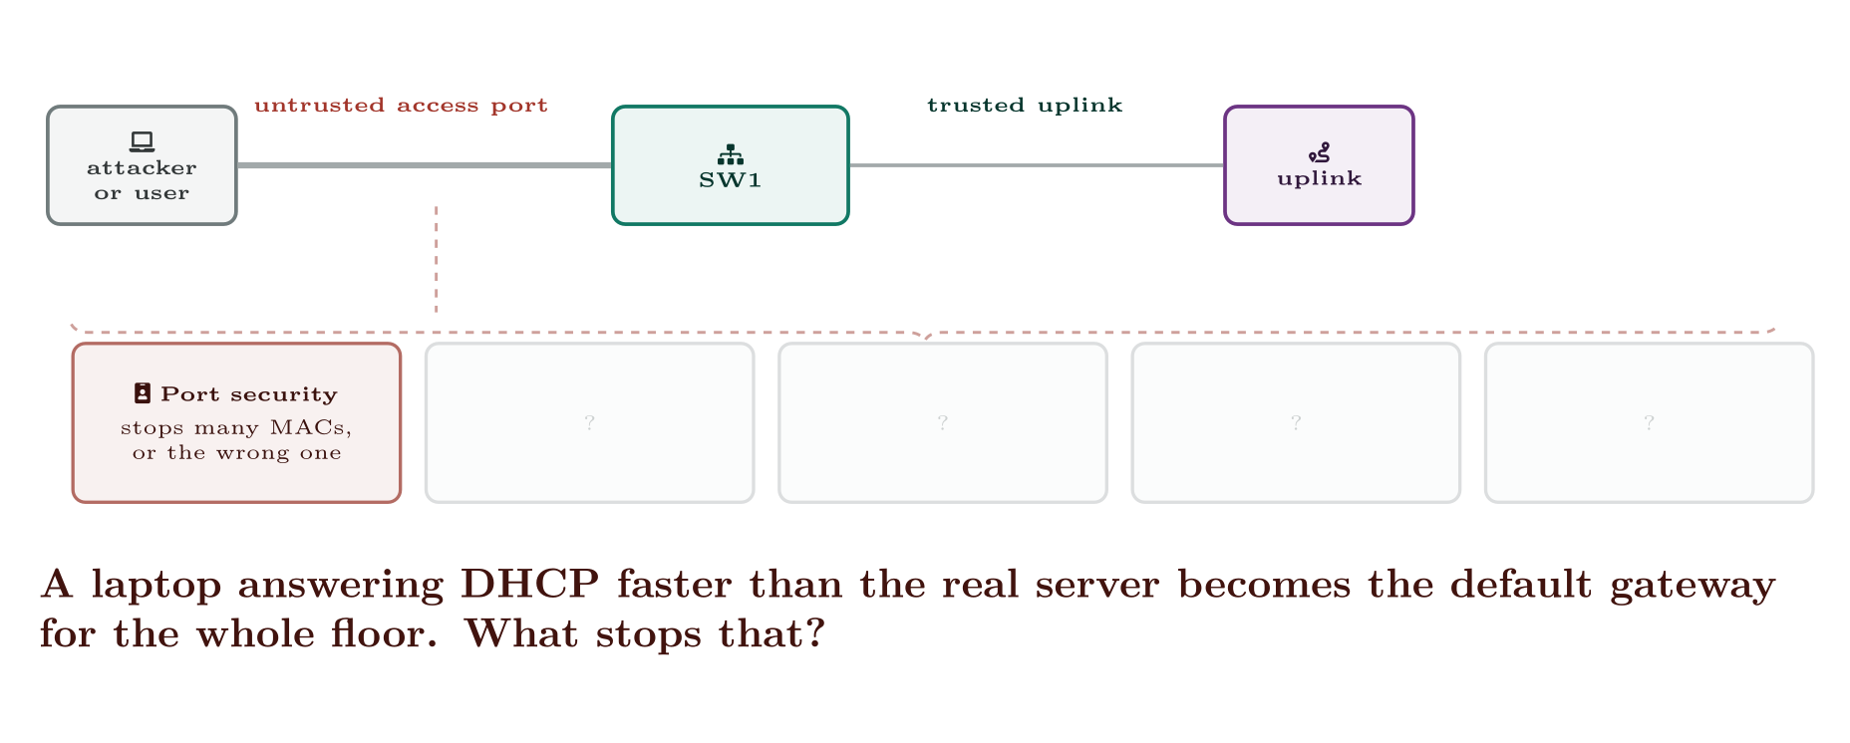
Layer 2 Security
CCNA 200-301 v2.0 · Chapter 25. Layer 2 Security
4.7

Slide 9
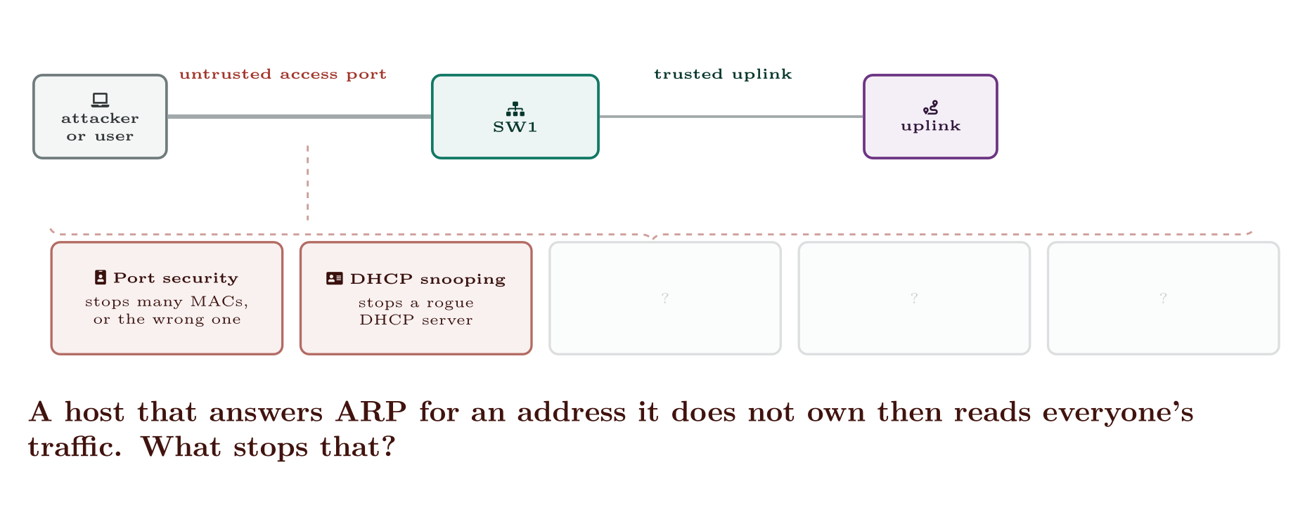
Layer 2 Security
CCNA 200-301 v2.0 · Chapter 25. Layer 2 Security
4.7

Slide 10
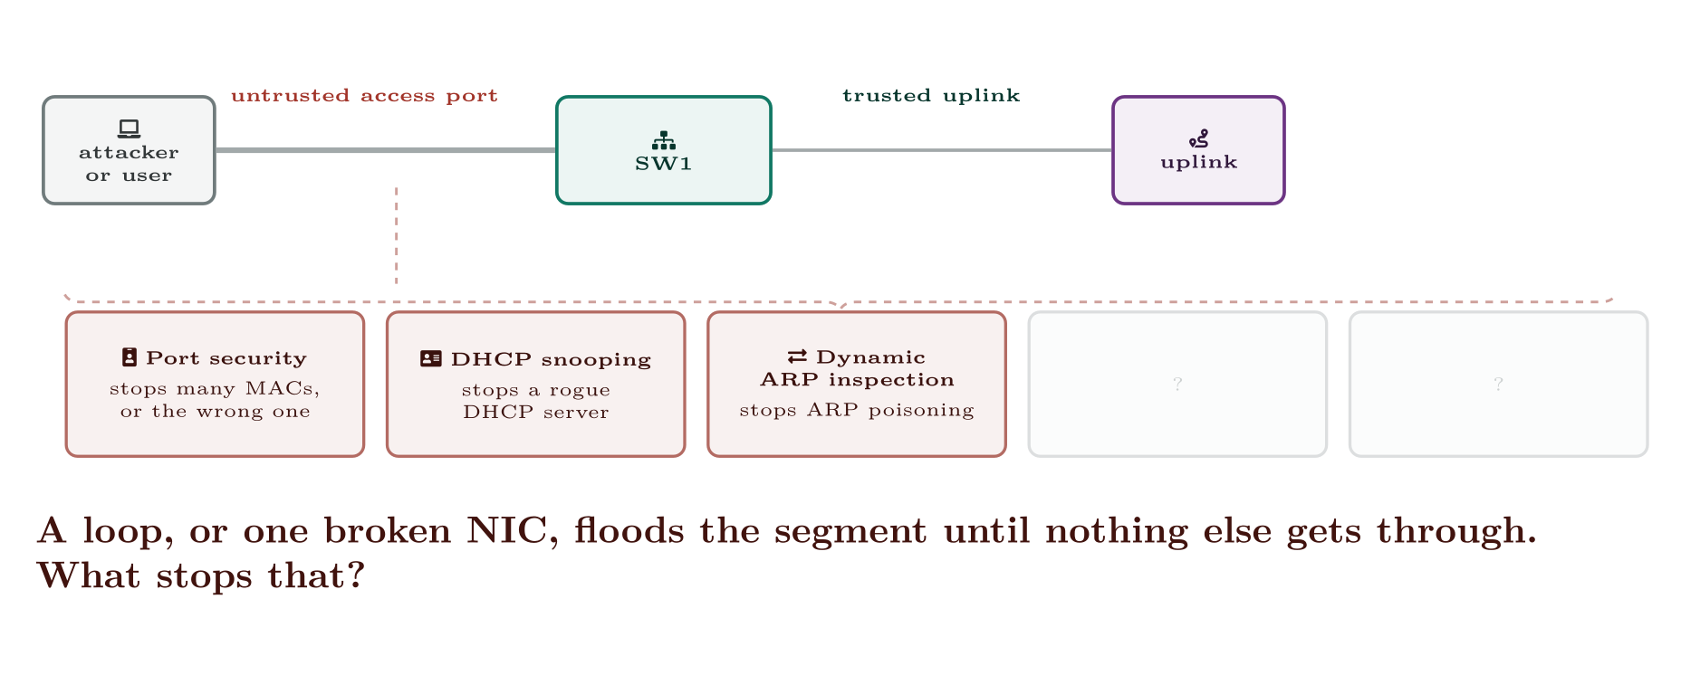
Layer 2 Security
CCNA 200-301 v2.0 · Chapter 25. Layer 2 Security
4.7

Slide 11
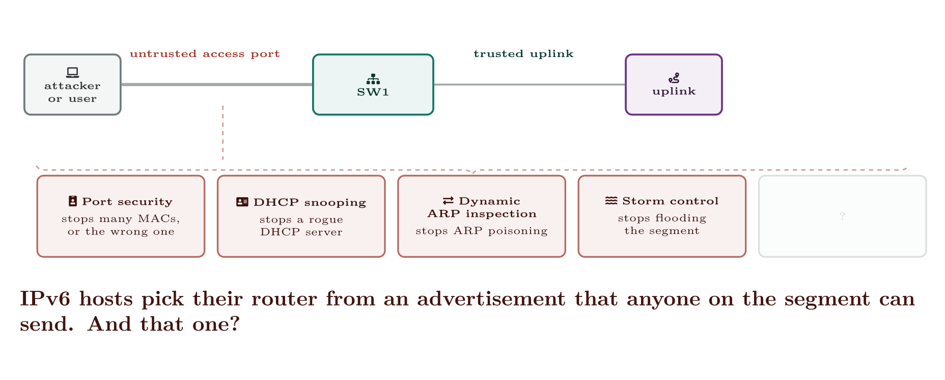
Layer 2 Security
CCNA 200-301 v2.0 · Chapter 25. Layer 2 Security
4.7

Slide 12
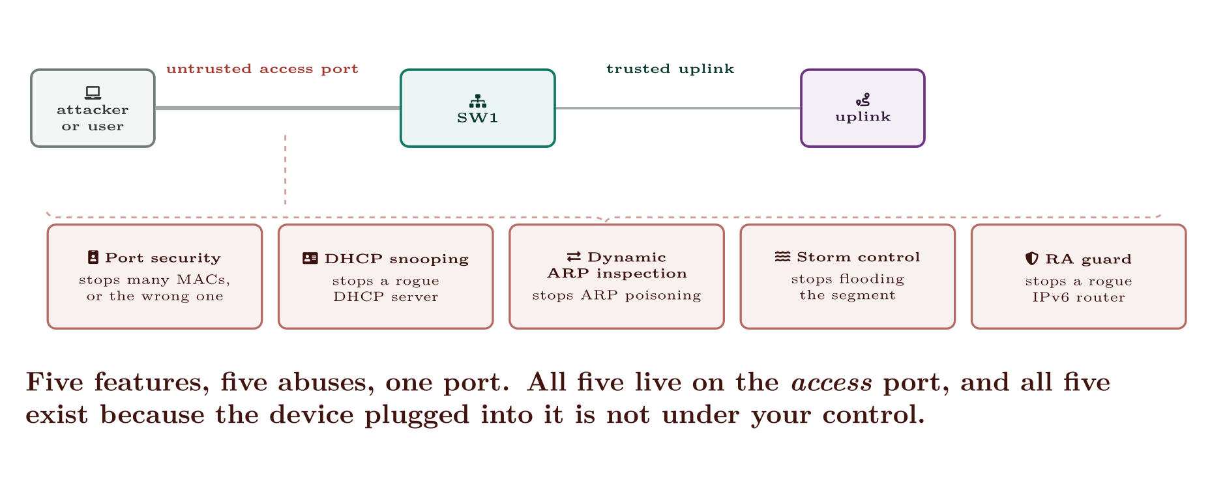
Layer 2 Security
CCNA 200-301 v2.0 · Chapter 25. Layer 2 Security
4.7

Slide 13
ON THE EXAM
Deploy them one at a time
This is what the blueprint actually asks for
Each of these can black-hole a floor on its own, and two of them — DHCP snooping and dynamic ARP inspection — will do so if the uplink is left untrusted. Turn one on, on one switch, and watch it before doing the next.
CCNA 200-301 v2.0 · Chapter 25. Layer 2 Security
4.7

Slide 14
Port security — limiting who may appear on a port
CCNA 200-301 v2.0 · Chapter 25. Layer 2 Security
4.7

Slide 15
CONFIGURE
A normal user access port
IOS · configuration mode
interface GigabitEthernet1/0/5
description Desk 5
switchport mode access
switchport access vlan 10
spanning-tree portfast
spanning-tree bpduguard enable
!
switchport port-security
switchport port-security maximum 2
switchport port-security mac-address sticky
switchport port-security violation restrict
switchport port-security aging time 60
switchport port-security aging type inactivity
CCNA 200-301 v2.0 · Chapter 25. Layer 2 Security
4.7

Slide 16
WATCH OUT
switchport mode access must come first
Port security cannot be enabled on a port still in dynamic negotiation mode. If you type switchport port-security on a default port, IOS rejects it. Set the mode, then secure it — the same command-order rule as VLAN assignment in Chapter 8.
CCNA 200-301 v2.0 · Chapter 25. Layer 2 Security
4.7

Slide 17
CONCEPT
protect is a trap, and the exam knows it
It sounds like the gentle, sensible option. It is the one mode that gives you no evidence whatsoever: a user whose traffic is being silently discarded reports “the network is slow”, and nothing anywhere records why.
Prefer restrict when you do not want to drop the port, and shutdown when you do.
CCNA 200-301 v2.0 · Chapter 25. Layer 2 Security
4.7
Notes:
The default is 1, which is almost never right. One device on the port: 1. A PC behind an IP phone: 3. The phone appears in the voice VLAN, the PC in the data VLAN, and the phone commonly registers a second address of its own. Setting 2 here produces violations that come and go with the phone’s firmware — a genuinely miserable fault to chase. A small unmanaged switch or a lab bench: count the devices and add headroom, or do not use port security on that port at all. A virtualisation host: port security is usually the wrong tool. Every VM has its own MAC.

Slide 18
CONFIGURE
Automatic recovery after five minutes
IOS · configuration mode
errdisable recovery cause psecure-violation
errdisable recovery cause bpduguard
errdisable recovery interval 300
CCNA 200-301 v2.0 · Chapter 25. Layer 2 Security
4.7
Notes:
Manual recovery is shutdown then no shutdown on the interface — both, in that order; no shutdown alone does nothing to a port in err-disabled. To recover automatically:

Slide 19
VERIFY
show port-security interface GigabitEthernet1/0/5
SW1#
Port Security : Enabled
Port Status : Secure-up
Violation Mode : Restrict
Aging Time : 60 mins
Aging Type : Inactivity
Maximum MAC Addresses : 2
Total MAC Addresses : 2
Configured MAC Addresses : 0
Sticky MAC Addresses : 2
Last Source Address:Vlan : 0050.7966.6800:10
Security Violation Count : 14
CCNA 200-301 v2.0 · Chapter 25. Layer 2 Security
4.7

Slide 20
WATCH OUT
Sticky addresses are learned, not saved
mac-address sticky converts dynamically learned addresses into running-configuration entries. They are not written to the startup configuration until you save. Reload without saving and the port relearns whatever is plugged in at that moment — which may be the wrong device, now permanently authorised.
If you use sticky, write memory is part of the procedure, not an afterthought.
CCNA 200-301 v2.0 · Chapter 25. Layer 2 Security
4.7
Notes:
A non-zero Security Violation Count on a Secure-up port is the useful signal here: the port is working, and something is repeatedly being refused. That is either an attack or — far more often — a maximum set too low.

Slide 21
DHCP snooping — stopping rogue servers
CCNA 200-301 v2.0 · Chapter 25. Layer 2 Security
4.7

Slide 22
DEFINITION
Trusted and untrusted
On an untrusted port, DHCP server messages (OFFER, ACK, NAK) are dropped. Client messages pass. On a trusted port everything passes.
Every port is untrusted once snooping is enabled on a VLAN. You must explicitly trust the path toward the legitimate server.
CCNA 200-301 v2.0 · Chapter 25. Layer 2 Security
4.7
Notes:
An attacker — or a helpful colleague with a home router — who answers DHCP first becomes the default gateway for everyone who believed them. DHCP snooping fixes this by deciding which ports are allowed to send server messages.

Slide 23
CONFIGURE
DHCP snooping on an access switch
IOS · configuration mode
ip dhcp snooping
ip dhcp snooping vlan 10,20,30
!
! Almost always required. The switch inserts option 82 into relayed
! requests; a router that is not configured to expect it discards the
! request, and every client fails. See the alert below.
no ip dhcp snooping information option
!
! The uplink carries the server's replies. Trust it.
interface GigabitEthernet1/0/48
description Uplink to distribution
ip dhcp snooping trust
!
! User ports stay untrusted, and are rate-limited so a single host
! cannot exhaust the pool by flooding requests.
interface range GigabitEthernet1/0/1-46
ip dhcp snooping limit rate 10
CCNA 200-301 v2.0 · Chapter 25. Layer 2 Security
4.7

Slide 24
WATCH OUT
The two faults that make snooping look broken
• The uplink is not trusted. The server’s OFFER arrives on an untrusted port and is dropped. Every client on the switch fails, and the DHCP server logs nothing wrong because it answered.
• Option 82. By default the switch adds option 82 to requests it forwards, but with a giaddr of 0.0.0.0. Cisco routers discard such packets unless told otherwise. Either no ip dhcp snooping information option on the switch, or ip dhcp relay information trust-all on the router.
Both produce the same symptom — a whole switch full of clients with no addresses, immediately after a change that “should have been transparent”.
CCNA 200-301 v2.0 · Chapter 25. Layer 2 Security
4.7

Slide 25
VERIFY
show ip dhcp snooping binding
SW1#
MacAddress IpAddress Lease(sec) Type VLAN Interface
------------------ --------------- ---------- ------------- ---- ---------------
00:50:79:66:68:00 192.168.10.21 27154 dhcp-snooping 10 GigabitEthernet1/0/5
00:50:79:66:68:22 192.168.10.22 27301 dhcp-snooping 10 GigabitEthernet1/0/7
CCNA 200-301 v2.0 · Chapter 25. Layer 2 Security
4.7

Slide 26
CONCEPT
The binding table is the point
Stopping rogue servers is useful. Building this table is what makes the next two features possible: it is the switch’s record of which MAC legitimately holds which IP on which port. Dynamic ARP inspection and IP source guard both consult it.
So DHCP snooping is not an optional extra you turn on afterwards. It is the foundation, and it has to go first.
CCNA 200-301 v2.0 · Chapter 25. Layer 2 Security
4.7

Slide 27
Dynamic ARP inspection — stopping ARP lies
CCNA 200-301 v2.0 · Chapter 25. Layer 2 Security
4.7

Slide 28
CONFIGURE
DAI on the same switch
IOS · configuration mode
! DHCP snooping must already be running on these VLANs.
ip arp inspection vlan 10,20,30
!
! Optional but recommended: also check that the Ethernet header
! addresses agree with the ARP payload, and that the IP is sane.
ip arp inspection validate src-mac dst-mac ip
!
! Trust the uplink, exactly as for snooping. Switch-to-switch links
! must be trusted or legitimate ARP is dropped between switches.
interface GigabitEthernet1/0/48
ip arp inspection trust
!
! Rate-limit user ports. The default is 15 packets per second, and
! exceeding it err-disables the port.
interface range GigabitEthernet1/0/1-46
ip arp inspection limit rate 15
CCNA 200-301 v2.0 · Chapter 25. Layer 2 Security
4.7
Notes:
ARP has no authentication. Any host can claim any address, and a host that claims to be the default gateway receives everyone’s traffic. DAI checks every ARP message on an untrusted port against the snooping binding table and drops anything that disagrees.

Slide 29
WATCH OUT
The case DAI cannot handle on its own
A statically addressed device — a server, a printer, a legacy controller — never asks for a DHCP lease, so it has no entry in the binding table. When DAI is enabled, its ARP replies match nothing and are dropped, and the device disappears from the network.
The fix is an ARP ACL naming the address and MAC explicitly:
Inventory your static devices before enabling DAI, not after the calls start.
CCNA 200-301 v2.0 · Chapter 25. Layer 2 Security
4.7

Slide 30
VERIFY
show ip arp inspection statistics vlan 10
SW1#
Vlan Forwarded Dropped DHCP Drops ACL Drops
---- --------- ------- ---------- ---------
10 88214 37 37 0
CCNA 200-301 v2.0 · Chapter 25. Layer 2 Security
4.7

Slide 31
Storm control — limiting flooding
CCNA 200-301 v2.0 · Chapter 25. Layer 2 Security
4.7

Slide 32
CONFIGURE
Storm control on user ports
IOS · configuration mode
interface range GigabitEthernet1/0/1-46
storm-control broadcast level 5.00 3.00
storm-control multicast level 10.00
storm-control action trap
CCNA 200-301 v2.0 · Chapter 25. Layer 2 Security
4.7
Notes:
A broadcast storm — from a loop, a faulty NIC or a deliberate flood — can saturate a segment. Storm control caps how much of a port’s bandwidth may be broadcast, multicast or unknown unicast.

Slide 33
VERIFY
show storm-control broadcast
SW1#
Interface Filter State Upper Lower Current
--------- ------------- ----------- ----------- ---------
Gi1/0/1 Forwarding 5.00% 3.00% 0.42%
Gi1/0/7 Blocking 5.00% 3.00% 6.11%
CCNA 200-301 v2.0 · Chapter 25. Layer 2 Security
4.7
Notes:
Two numbers on the first line: the port suppresses broadcast traffic when it exceeds 5% of bandwidth and resumes when it falls below 3%. The gap prevents the port oscillating on and off at the threshold. action trap sends a notification and keeps suppressing — the usual choice. action shutdown err-disables the port. Decisive, and it turns a performance problem into an outage, so reserve it for ports where that is the right trade. Levels can also be given in pps or bps where a percentage is awkward.

Slide 34
RA guard — the IPv6 equivalent
CCNA 200-301 v2.0 · Chapter 25. Layer 2 Security
4.7

Slide 35
CONFIGURE
RA guard on access ports
IOS · configuration mode
ipv6 nd raguard policy ACCESS-PORTS
device-role host
!
ipv6 nd raguard policy UPLINKS
device-role router
!
interface range GigabitEthernet1/0/1-46
ipv6 nd raguard attach-policy ACCESS-PORTS
!
interface GigabitEthernet1/0/48
ipv6 nd raguard attach-policy UPLINKS
CCNA 200-301 v2.0 · Chapter 25. Layer 2 Security
4.7
Notes:
Blocking on Gi1/0/7 means it is suppressing right now. Storm control treats the symptom; a port that blocks repeatedly is telling you to go and find the loop (Chapter 12). In IPv6 there is no DHCP server to impersonate for basic connectivity. Hosts learn their prefix and gateway from router advertisements, so a host that sends RAs — maliciously, or because someone enabled internet sharing on a laptop — becomes the default gateway for the segment. RA guard drops RAs arriving on ports that should not have any.

Slide 36
ON THE EXAM
Map each feature to the abuse it prevents
This is what the blueprint actually asks for
• Port security — one device claiming many MAC addresses, or an unauthorised device on a port.
• DHCP snooping — a rogue DHCP server handing out gateways.
• Dynamic ARP inspection — ARP poisoning, the on-path attack.
• Storm control — flooding, whether hostile or accidental.
• RA guard — a rogue IPv6 router. The v6 counterpart of DHCP snooping.
Matching questions on this list are close to free marks. Learn the five pairs.
CCNA 200-301 v2.0 · Chapter 25. Layer 2 Security
4.7

Slide 37
COMMON PITFALLS · RA guard — the IPv6 equivalent
Common pitfalls
• Not trusting the uplink for DHCP snooping or DAI. Takes out an entire switch.
• Option 82 left on with a Cisco relay that discards it. Same symptom, different cause.
• Enabling DAI before inventorying static hosts. Servers and printers vanish.
• Port security maximum of 2 on a phone port. Should be 3.
• Using protect. Silent drops and no evidence.
• Sticky MACs never saved. A reload re-learns whatever is plugged in.
• no shutdown alone on an err-disabled port. You must shutdown first.
CCNA 200-301 v2.0 · Chapter 25. Layer 2 Security
4.7

Slide 38
COMMON PITFALLS · RA guard — the IPv6 equivalent
Common pitfalls (continued)
• Storm control with action shutdown on user ports. Turns a transient into a truck roll.
• Enabling everything at once on a Friday. Each of these features can black-hole a floor. Deploy one at a time, on one switch, and watch.
CCNA 200-301 v2.0 · Chapter 25. Layer 2 Security
4.7

Slide 39
BREAK & FIX · SYMPTOM
Chapter 25
After a security rollout, two servers and every printer stop responding. PCs are fine.
DHCP snooping and DAI were enabled across the access layer overnight. In the morning, all DHCP clients work normally — addresses lease, browsing works. But two application servers and every network printer are unreachable from everywhere, including from hosts in their own VLAN. The devices themselves are powered on, their link lights are up, and their switch ports show connected.
CCNA 200-301 v2.0 · Chapter 25. Layer 2 Security
4.7

Slide 40
BREAK & FIX · YOUR MOVE
Chapter 25
After a security rollout, two servers and every printer stop responding. PCs are fine.
What would you check first — and what do you expect to see?
CCNA 200-301 v2.0 · Chapter 25. Layer 2 Security
4.7
Notes:
Pause here. Take two or three answers before advancing. The point is the prediction, not the command.

Slide 41
BREAK & FIX · EVIDENCE
Chapter 25
show ip arp inspection statistics vlan 20
SW1#
Vlan Forwarded Dropped DHCP Drops ACL Drops
---- --------- ------- ---------- ---------
20 4471 1902 1902 0
CCNA 200-301 v2.0 · Chapter 25. Layer 2 Security
4.7
Notes:
Read it aloud. Ask what single field decides the answer.

Slide 42
BREAK & FIX · EVIDENCE
Chapter 25
show ip dhcp snooping binding | include 192.168.20
CCNA 200-301 v2.0 · Chapter 25. Layer 2 Security
4.7
Notes:
Read it aloud. Ask what single field decides the answer.

Slide 43
BREAK & FIX · YOUR MOVE
Chapter 25
What is the fault — and what does this output rule out?
CCNA 200-301 v2.0 · Chapter 25. Layer 2 Security
4.7
Notes:
The elimination matters as much as the answer.

Slide 44
BREAK & FIX · DIAGNOSIS
Chapter 25
Why it is doing that
Diagnosis. The binding query returns nothing for the server subnet. The servers and printers are statically addressed, so they never leased anything and never appeared in the snooping binding table.
DAI validates every ARP message on an untrusted port against that table. With no entry, every ARP reply these devices send is dropped — so no other host can ever resolve their MAC address, and they become unreachable while remaining perfectly healthy. The DHCP Drops column confirms it: 1902 packets dropped specifically for having no binding, and zero ACL drops because no ARP ACL exists.
CCNA 200-301 v2.0 · Chapter 25. Layer 2 Security
4.7

Slide 45
BREAK & FIX · DIAGNOSIS
Chapter 25
Why it is doing that
Two details make the diagnosis clean. First, DHCP clients are unaffected — they have bindings, so this is not a general layer 2 fault. Second, the devices are unreachable within their own VLAN, which rules out routing entirely: ARP is the only thing that operates there.
CCNA 200-301 v2.0 · Chapter 25. Layer 2 Security
4.7

Slide 46
BREAK & FIX · THE FIX
Chapter 25
An ARP ACL for the static estate
IOS · configuration mode
arp access-list STATIC-HOSTS
permit ip host 192.168.20.15 mac host 0011.2233.4455
permit ip host 192.168.20.16 mac host 0011.2233.4456
permit ip host 192.168.20.30 mac host 00aa.bbcc.dd01
permit ip host 192.168.20.31 mac host 00aa.bbcc.dd02
!
ip arp inspection filter STATIC-HOSTS vlan 20
CCNA 200-301 v2.0 · Chapter 25. Layer 2 Security
4.7

Slide 47
BREAK & FIX · THE FIX
Chapter 25
And the lesson
Fix. Give the static devices explicit permission.
The process lesson. The rollout was not wrong, it was incomplete. DAI’s dependency on the binding table is documented and predictable, and the work that was skipped was the inventory: every statically addressed device, its address and its MAC, before the feature is enabled. On a site of any size, the alternative is DHCP reservations for those devices instead, so that they build bindings like everyone else — which is the better long-term answer.
CCNA 200-301 v2.0 · Chapter 25. Layer 2 Security
4.7

Slide 48
LAB · PACKET TRACER FOR TASKS 1–6; CML FOR RA GUARD
Securing an access switch, one feature at a time
Platform note. Packet Tracer supports port security, DHCP snooping, DAI and storm control. RA guard needs a real IOS image, so task 7 requires CML or GNS3.
Topology. SW1 with access ports in VLANs 10 and 20, an uplink to DSW1, a DHCP server beyond it, one statically addressed server in VLAN 20, a laptop you will use as the attacker, and an IP phone with a PC behind it.
1. Baseline: confirm every host has connectivity and can obtain a lease. Record the MAC address of every device — you will need them.
2. Configure port security on one access port with a maximum of 1 and violation shutdown. Move the cable to a second device and observe the err-disable. Recover it manually, then configure automatic recovery and repeat.
3. Set the phone port to a maximum of 2 and confirm the violation. Raise it to 3 and confirm it clears. Explain the third address.
4. Configure sticky learning, verify with show run interface, then reload without saving. Explain what you find.
CCNA 200-301 v2.0 · Chapter 25. Layer 2 Security
4.7

Slide 49
LAB · PACKET TRACER FOR TASKS 1–6; CML FOR RA GUARD
Securing an access switch, one feature at a time (continued)
5. Attach the laptop running a DHCP server to an access port and confirm it can poison a client. Then enable DHCP snooping — deliberately omitting the trust on the uplink — and record the resulting symptom before fixing it.
6. Enable DAI. Confirm the statically addressed server becomes unreachable, diagnose it from show ip arp inspection statistics, and repair it with an ARP ACL.
7. Configure storm control at 1% with action trap, generate broadcast traffic, and watch the filter state change. Then change to action shutdown and compare the consequences.
8. RA guard (CML). Enable IPv6 on the VLAN, confirm hosts get addresses by SLAAC, then advertise a rogue prefix from the laptop. Observe the hosts move to it. Apply RA guard and confirm the rogue RAs are dropped.
CCNA 200-301 v2.0 · Chapter 25. Layer 2 Security
4.7

Slide 50
LAB · PACKET TRACER FOR TASKS 1–6; CML FOR RA GUARD
Securing an access switch, one feature at a time (continued)
9. Extension. Write the deployment runbook you would actually use for this rollout: the order, the pre-checks, what you would verify after each step, and the rollback for each.
CCNA 200-301 v2.0 · Chapter 25. Layer 2 Security
4.7

Slide 51
CHECKPOINT 1 of 6
Name each of the five features and the specific abuse it prevents.
Discuss · then advance
Notes:
Ask the room. Do not advance until somebody commits to an answer.

Slide 52
ANSWER
Checkpoint 1 of 6
Name each of the five features and the specific abuse it prevents.
Port security — one device claiming many MAC addresses or an unauthorised device. DHCP snooping — a rogue DHCP server. Dynamic ARP inspection — ARP poisoning. Storm control — flooding. RA guard — a rogue IPv6 router.
CCNA 200-301 v2.0 · Chapter 25. Layer 2 Security
4.7

Slide 53
CHECKPOINT 2 of 6
Why must DHCP snooping be configured before DAI, and what does DAI consult?
Discuss · then advance
Notes:
Ask the room. Do not advance until somebody commits to an answer.

Slide 54
ANSWER
Checkpoint 2 of 6
Why must DHCP snooping be configured before DAI, and what does DAI consult?
Because DAI validates ARP against the DHCP snooping binding table, which records which MAC legitimately holds which IP on which port. Without snooping running there is no table, and DAI has nothing to validate against.
CCNA 200-301 v2.0 · Chapter 25. Layer 2 Security
4.7

Slide 55
CHECKPOINT 3 of 6
What is wrong with violation protect?
Discuss · then advance
Notes:
Ask the room. Do not advance until somebody commits to an answer.

Slide 56
ANSWER
Checkpoint 3 of 6
What is wrong with violation protect?
It drops offending traffic silently — no counter, no log, no trap. A user whose traffic is being discarded reports “the network is slow” and nothing anywhere records why. Prefer restrict, which drops and reports.
CCNA 200-301 v2.0 · Chapter 25. Layer 2 Security
4.7

Slide 57
CHECKPOINT 4 of 6
Why is 3 the right port-security maximum on a port with a phone and a PC?
Discuss · then advance
Notes:
Ask the room. Do not advance until somebody commits to an answer.

Slide 58
ANSWER
Checkpoint 4 of 6
Why is 3 the right port-security maximum on a port with a phone and a PC?
Because the phone appears in the voice VLAN, the PC in the data VLAN, and the phone commonly registers a second address of its own. A maximum of 2 produces violations that come and go with phone firmware.
CCNA 200-301 v2.0 · Chapter 25. Layer 2 Security
4.7

Slide 59
CHECKPOINT 5 of 6
A statically addressed printer stops responding after DAI is enabled. Explain the mechanism and give the fix.
Discuss · then advance
Notes:
Ask the room. Do not advance until somebody commits to an answer.

Slide 60
ANSWER
Checkpoint 5 of 6
A statically addressed printer stops responding after DAI is enabled. Explain the mechanism and give the fix.
It is statically addressed, so it never took a DHCP lease and has no entry in the snooping binding table. DAI therefore drops every ARP reply it sends, so nothing can resolve its MAC address and it becomes unreachable while remaining healthy. Fix with an ARP ACL naming its address and MAC, applied with ip arp inspection filter.
CCNA 200-301 v2.0 · Chapter 25. Layer 2 Security
4.7

Slide 61
CHECKPOINT 6 of 6
Which two ports on an access switch almost always need to be trusted, and for which two features?
Discuss · then advance
Notes:
Ask the room. Do not advance until somebody commits to an answer.

Slide 62
ANSWER
Checkpoint 6 of 6
Which two ports on an access switch almost always need to be trusted, and for which two features?
The uplink toward the distribution layer, for DHCP snooping and for dynamic ARP inspection. Untrusted uplinks take out the whole switch in both cases.
CCNA 200-301 v2.0 · Chapter 25. Layer 2 Security
4.7

Slide 63
CHAPTER SUMMARY
What to take away
• Five features, five abuses: port security (identity), DHCP snooping (rogue server), DAI (ARP poisoning), storm control (flooding), RA guard (rogue IPv6 router).
• Port security needs switchport mode access first. Maximum 3 for a phone plus PC. restrict for evidence without an outage, shutdown for enforcement, protect essentially never.
• Sticky addresses live in the running configuration only until you save.
• Recover an err-disabled port with shutdown then no shutdown, or configure errdisable recovery.
• DHCP snooping makes every port untrusted; trust the uplink, and expect to disable option 82 insertion.
CCNA 200-301 v2.0 · Chapter 25. Layer 2 Security
4.7

Slide 64
CHAPTER SUMMARY
What to take away (continued)
• Its binding table is what DAI validates against — which is why statically addressed devices need an ARP ACL.
• Storm control has a rising and a falling threshold; trap suppresses and reports, shutdown err-disables.
• RA guard classifies ports as host or router and drops RAs from hosts.
CCNA 200-301 v2.0 · Chapter 25. Layer 2 Security
4.7

Slide 65
Where we got to
• Five features, five abuses: port security (identity), DHCP snooping (rogue server), DAI (ARP poisoning), storm control (flooding), RA guard (rogue IPv6 router).
• Port security needs switchport mode access first. Maximum 3 for a phone plus PC. restrict for evidence without an outage, shutdown for enforcement, protect essentially never.
• Sticky addresses live in the running configuration only until you save.
• Recover an err-disabled port with shutdown then no shutdown, or configure errdisable recovery.
NEXT
Chapter 26 — IPsec VPNs

