Slide 1


CCNA 200-301 V2.0
26
IPsec VPNs
Part IV — Network Services and Security
EXAM TOPICS
4.5
LECTURER
Dr. Mustafa Hameed
THE ISLAMIA UNIVERSITY OF BAHAWALPUR
Department of Information Technology
Notes:
Chapter 26: IPsec VPNs. Blueprint topics: 4.5.

Slide 2
THE COURSE
Where this chapter sits
Part I
Foundations
chapters 1–7
Part II
Switching and Network Access
chapters 8–14
Part III
IP Routing
chapters 15–19
Part IV
Network Services and Security
chapters 20–26
Part V
Wireless, Virtualisation and Operations
chapters 27–32
Part VI
Sitting the Exam
chapters 33–34
CCNA 200-301 v2.0 · Chapter 26. IPsec VPNs
CCNA 200-301 v2.0 · Chapter 26. IPsec VPNs
4.5
4.5
Notes:
Ten seconds. Students meeting a chapter in week ten cannot place it without being shown.

Slide 3
LEARNING OUTCOMES
What you will be able to do
• Distinguish site-to-site from remote-access VPNs and say which suits a given requirement.
• Name the protocols in the IPsec suite — IKE, ESP and AH — and state what each contributes.
• Compare tunnel mode and transport mode, and say which is used where.
• Explain why AH is effectively unusable through NAT, and what is used instead.
CCNA 200-301 v2.0 · Chapter 26. IPsec VPNs
4.5
Notes:
IPsec VPNs 4.5

Slide 4
ASSUMED KNOWLEDGE
Before we start
Chapter 6 for ports and protocol numbers. Chapter 22 — the interaction between IPsec and NAT is most of what makes this topic interesting. Chapter 23 for the idea of authentication as distinct from encryption.
CCNA 200-301 v2.0 · Chapter 26. IPsec VPNs
4.5

Slide 5
KEY TERMS
Vocabulary for this chapter
IPsec
IKE
ISAKMP
ESP
AH
tunnel mode
transport mode
security association
NAT-T
site-to-site
remote access
GRE over IPsec
Each is defined where it first matters — not here.
CCNA 200-301 v2.0 · Chapter 26. IPsec VPNs
4.5
Notes:
Do not define these now - they are defined as they arrive. This slide is for the students' notes.

Slide 6
ON THE EXAM
The only describe topic in this part
This is what the blueprint actually asks for
Topic 4.5 is describe IPsec remote access and site-to-site VPNs (protocols and transport modes). There is no configuration verb, and no crypto map or IKEv2 proposal syntax is required of you.
That is why this chapter is short and has no lab: writing one would teach you something the exam does not ask for, at the cost of time you need elsewhere in this part. What it does ask for is in the parenthesis — the protocols and the transport modes — so those two lists are what this chapter drills.
If you go on to CCNP Security, this chapter is the vocabulary you will build on. For now, know the names, the jobs and the trade-offs.
CCNA 200-301 v2.0 · Chapter 26. IPsec VPNs
4.5

Slide 7
DEFINITION
The four services IPsec provides
• Confidentiality — encryption, so the payload cannot be read. Normally AES.
• Integrity — a keyed hash, so alteration is detectable. Normally SHA-2.
• Authentication — proof that the peer is who it claims to be. A pre-shared key or a digital certificate.
• Anti-replay — sequence numbers, so a captured packet cannot be re-sent later to useful effect.
Underpinning all four is key management: Diffie–Hellman, which lets two peers agree a shared secret over a channel an eavesdropper is watching.
CCNA 200-301 v2.0 · Chapter 26. IPsec VPNs
4.5
Notes:
Two campus sites need to exchange traffic and the only path between them is the internet, which is shared with everyone and trusted by nobody. Anything sent in clear can be read; anything read can be altered; anything altered can be replayed. A virtual private network makes that shared path behave like a private one. IPsec is the standard suite of protocols that does it at the network layer — which is the useful part, because it means applications need no changes and know nothing about it.

Slide 8
Two deployment models
CCNA 200-301 v2.0 · Chapter 26. IPsec VPNs
4.5

Slide 9
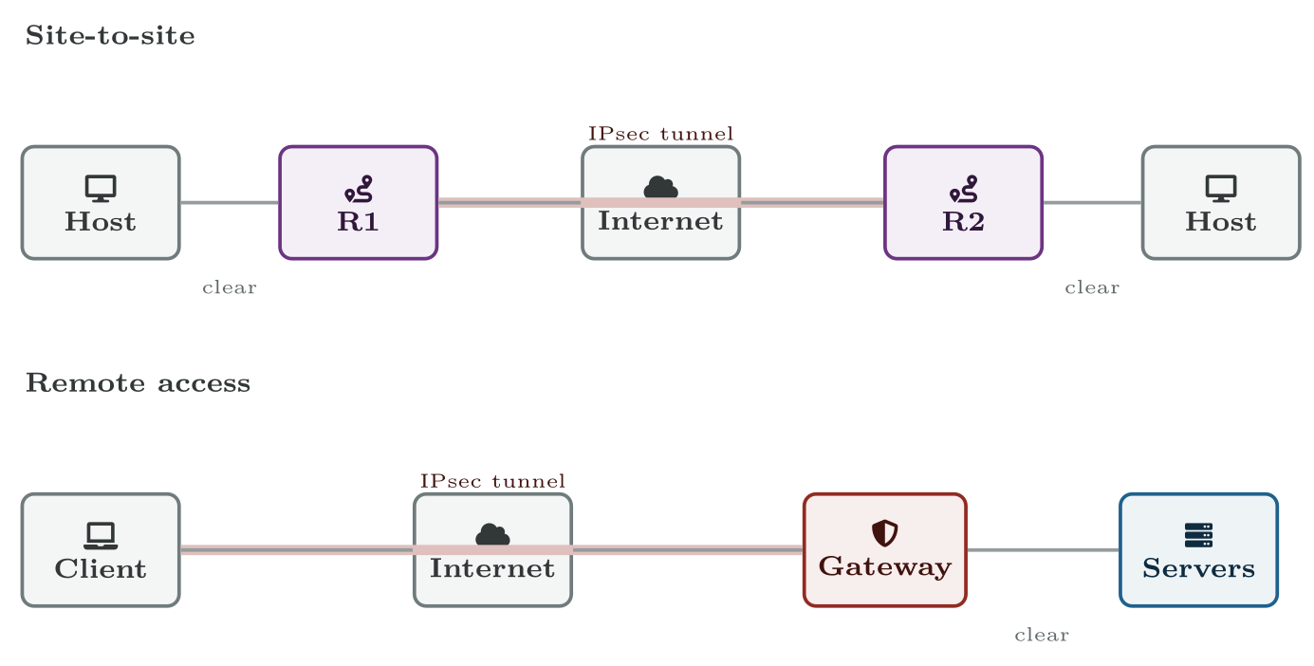
Two deployment models
Where the tunnel starts decides the model. Site-to-site protects gateway to gateway; remote access protects all the way to the user’s device.
CCNA 200-301 v2.0 · Chapter 26. IPsec VPNs
4.5

Slide 10
CONCEPT
Traffic is only protected inside the tunnel
In the site-to-site diagram, traffic between the host and its own gateway is in clear. IPsec protects the internet crossing, not the LAN at either end. That is usually the right trade — but it means a VPN is not an answer to a threat already inside the building.
CCNA 200-301 v2.0 · Chapter 26. IPsec VPNs
4.5

Slide 11
The protocols
CCNA 200-301 v2.0 · Chapter 26. IPsec VPNs
4.5

Slide 12
WATCH OUT
Two facts that are asked directly
ESP encrypts; AH does not. If a question asks which protocol provides confidentiality, the answer is ESP, every time.
ESP and AH are not TCP or UDP. They are IP protocols in their own right, numbered 50 and 51, sitting at the same layer as TCP (6) and UDP (17). This is why a firewall rule that permits “UDP 500” alone will let the tunnel negotiate and then carry no data — a memorable and very common real fault.
CCNA 200-301 v2.0 · Chapter 26. IPsec VPNs
4.5
Notes:
Three names, and the exam expects you to know which does what.

Slide 13
DEFINITION
Security association
A one-directional agreement covering the algorithms, keys and lifetimes for one flow. Because it is one-directional, a working tunnel has two — one in each direction. Asymmetric failures, where traffic passes one way only, are usually a phase 2 mismatch.
CCNA 200-301 v2.0 · Chapter 26. IPsec VPNs
4.5
Notes:
Phase 1 builds a secure, authenticated channel between the two peers — the ISAKMP or IKE security association. The peers prove their identity (pre-shared key or certificate) and run Diffie–Hellman. Phase 2 uses that channel to negotiate the security associations that will actually protect user traffic, including which traffic is to be protected at all. IKEv2, the current version, does the same work in fewer exchanges, and adds built-in NAT traversal and liveness checking. New deployments use it.

Slide 14
Transport mode and tunnel mode
CCNA 200-301 v2.0 · Chapter 26. IPsec VPNs
4.5

Slide 15
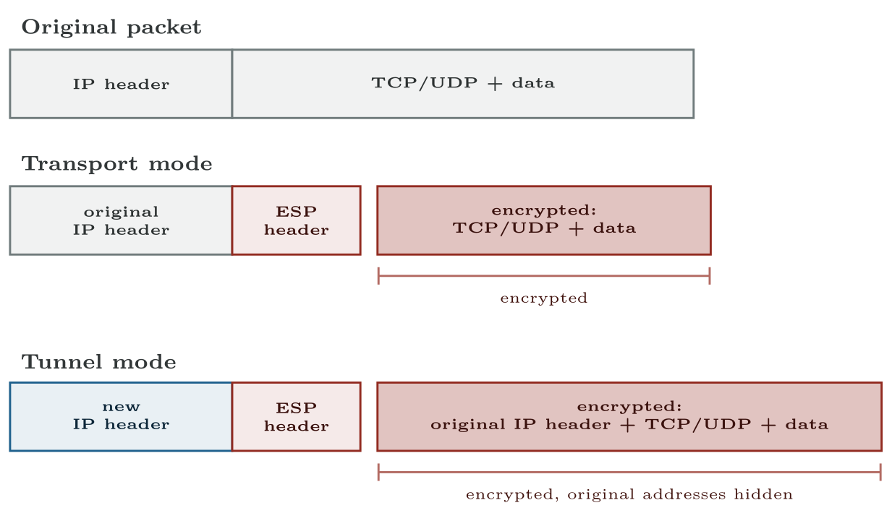
Transport mode and tunnel mode
Transport mode keeps the original IP header. Tunnel mode encrypts it and adds a new one, which is what lets private addresses cross a public network.
CCNA 200-301 v2.0 · Chapter 26. IPsec VPNs
4.5
Notes:
This is the second half of the topic’s parenthesis, and the distinction is entirely about what gets encrypted and what IP header the packet travels under.

Slide 16
ON THE EXAM
If the question does not say otherwise, it is tunnel mode
This is what the blueprint actually asks for
Tunnel mode is the default for the VPNs this topic names. The single sentence to remember: tunnel mode encrypts the original IP header and adds a new one; transport mode does not. Every other difference in the table follows from that.
CCNA 200-301 v2.0 · Chapter 26. IPsec VPNs
4.5

Slide 17
IPsec and NAT
CCNA 200-301 v2.0 · Chapter 26. IPsec VPNs
4.5

Slide 18
WATCH OUT
Why AH is dead
AH authenticates the entire packet, including the source and destination addresses in the IP header. NAT’s whole job is to rewrite those addresses. So a NAT device on the path invalidates AH’s integrity check by definition, and the far end discards the packet.
There is no configuration that fixes this; the two mechanisms are logically incompatible. Since almost every internet path involves NAT somewhere, AH has been left behind, and ESP — which does not protect the outer header — is what everyone uses.
CCNA 200-301 v2.0 · Chapter 26. IPsec VPNs
4.5

Slide 19
CONCEPT
GRE over IPsec, in one paragraph
IPsec tunnel mode carries unicast IP and nothing else — no multicast, and therefore no routing protocols. A site-to-site VPN that needs OSPF between the sites wraps the traffic in a GRE tunnel first, which can carry multicast, and then protects the GRE with IPsec.
You will meet the phrase “GRE over IPsec”. For this exam, know why it exists: GRE brings the ability to run a routing protocol, IPsec brings the security, and neither does both.
CCNA 200-301 v2.0 · Chapter 26. IPsec VPNs
4.5
Notes:
ESP has a milder version of the same problem: PAT needs port numbers to multiplex, and ESP is not a port-based protocol. NAT traversal solves it by detecting NAT on the path during IKE and wrapping ESP inside UDP port 4500, which PAT can then handle normally. It is automatic in IKEv2.

Slide 20
When things do not work
CCNA 200-301 v2.0 · Chapter 26. IPsec VPNs
4.5

Slide 21
COMMON PITFALLS · When things do not work
Common pitfalls
• Saying AH encrypts. It does not. Only ESP does.
• Calling ESP and AH “TCP” or “UDP”. They are IP protocols 50 and 51.
• Mixing up the modes. Tunnel mode adds a new IP header; transport mode keeps the original.
• Assuming a VPN protects the whole path. It protects the tunnel.
• Expecting a routing protocol to run over plain IPsec. It cannot — multicast needs GRE.
• Treating a successful ping as a working tunnel. Test with something large enough to expose an MTU problem.
CCNA 200-301 v2.0 · Chapter 26. IPsec VPNs
4.5
Notes:
Not examined as a configuration task, but these four explain most real failures and make the mechanics concrete. Phase 1 never completes. Mismatched pre-shared key, mismatched IKE proposal, or UDP 500 blocked. Nothing at all passes. Phase 1 completes, phase 2 does not. Mismatched transform set, or the two ends disagree about which traffic should be protected. The peers can talk; user traffic cannot. Tunnel establishes, large packets fail. The extra headers push packets past the path MTU. Small pings and SSH work, file transfers and web pages hang. A classic, and a good reminder that “it pings” is not “it works”. Everything negotiates and no data flows. A firewall permitting UDP 500 but not IP protocol 50.

Slide 22
BREAK & FIX · SYMPTOM
Chapter 26
The tunnel is up and shows both peers established. No user traffic crosses it.
A site-to-site VPN between R1 and R2. Both routers report an established IKE session with the other. Users at either site cannot reach the other site at all.
CCNA 200-301 v2.0 · Chapter 26. IPsec VPNs
4.5

Slide 23
BREAK & FIX · YOUR MOVE
Chapter 26
The tunnel is up and shows both peers established. No user traffic crosses it.
What would you check first — and what do you expect to see?
CCNA 200-301 v2.0 · Chapter 26. IPsec VPNs
4.5
Notes:
Pause here. Take two or three answers before advancing. The point is the prediction, not the command.

Slide 24
BREAK & FIX · EVIDENCE
Chapter 26
show crypto isakmp sa
R1#
IPv4 Crypto ISAKMP SA
dst src state conn-id status
198.51.100.9 203.0.113.2 QM_IDLE 1004 ACTIVE
CCNA 200-301 v2.0 · Chapter 26. IPsec VPNs
4.5
Notes:
Read it aloud. Ask what single field decides the answer.

Slide 25
BREAK & FIX · EVIDENCE
Chapter 26
show crypto ipsec sa | include pkts|local ident|remote ident
R1#
local ident (addr/mask/prot/port): (192.168.10.0/255.255.255.0/0/0)
remote ident (addr/mask/prot/port): (192.168.20.0/255.255.255.0/0/0)
#pkts encaps: 0, #pkts encrypt: 0, #pkts digest: 0
#pkts decaps: 0, #pkts decrypt: 0, #pkts verify: 0
CCNA 200-301 v2.0 · Chapter 26. IPsec VPNs
4.5
Notes:
Read it aloud. Ask what single field decides the answer.

Slide 26
BREAK & FIX · YOUR MOVE
Chapter 26
What is the fault — and what does this output rule out?
CCNA 200-301 v2.0 · Chapter 26. IPsec VPNs
4.5
Notes:
The elimination matters as much as the answer.

Slide 27
BREAK & FIX · DIAGNOSIS
Chapter 26
Why it is doing that
Diagnosis. Read the two outputs as a pair, because together they locate the fault precisely.
QM_IDLE and ACTIVE mean phase 1 succeeded: the peers found each other, agreed on IKE parameters and authenticated. So the pre-shared key is right, UDP 500 is reaching both ends, and the peer addresses are correct. All of that is now ruled out.
But every counter is zero — in both directions. Nothing has been encrypted and nothing decrypted. Traffic is not being selected for the tunnel, or is being selected and then dropped before it is sent.
CCNA 200-301 v2.0 · Chapter 26. IPsec VPNs
4.5

Slide 28
BREAK & FIX · DIAGNOSIS
Chapter 26
Why it is doing that
The identities are the place to look. R1 intends to protect 192.168.10.0/24 to 192.168.20.0/24. If R2’s definition is not the exact mirror — a different mask, a wider or narrower range — phase 2 cannot agree on what the tunnel is for, and no traffic qualifies.
The class of fault, which is the point here. Phase 1 up with phase 2 idle is always a policy disagreement rather than a connectivity or credential one: the crypto ACL, the transform set, or the mode. Knowing which half of IKE succeeded halves the search before you have looked at anything.
CCNA 200-301 v2.0 · Chapter 26. IPsec VPNs
4.5

Slide 29
BREAK & FIX · DIAGNOSIS
Chapter 26
Why it is doing that
The other candidate, if the identities do match, is a firewall permitting UDP 500 — which is why phase 1 worked — while dropping IP protocol 50. Symptoms are identical; the discriminator is whether #pkts encaps is zero (traffic never selected) or climbing while #pkts decaps stays at zero (sent, never arriving).
CCNA 200-301 v2.0 · Chapter 26. IPsec VPNs
4.5

Slide 30
CHECKPOINT 1 of 6
Which IPsec protocol provides confidentiality, and what is its IP protocol number?
Discuss · then advance
Notes:
Ask the room. Do not advance until somebody commits to an answer.

Slide 31
ANSWER
Checkpoint 1 of 6
Which IPsec protocol provides confidentiality, and what is its IP protocol number?
ESP, IP protocol 50. AH provides integrity and authentication but no encryption.
CCNA 200-301 v2.0 · Chapter 26. IPsec VPNs
4.5

Slide 32
CHECKPOINT 2 of 6
State the difference between tunnel mode and transport mode in one sentence, and say which a site-to-site VPN uses.
Discuss · then advance
Notes:
Ask the room. Do not advance until somebody commits to an answer.

Slide 33
ANSWER
Checkpoint 2 of 6
State the difference between tunnel mode and transport mode in one sentence, and say which a site-to-site VPN uses.
Tunnel mode encrypts the entire original packet and adds a new IP header; transport mode keeps the original header and encrypts only the payload. A site-to-site VPN uses tunnel mode.
CCNA 200-301 v2.0 · Chapter 26. IPsec VPNs
4.5

Slide 34
CHECKPOINT 3 of 6
Why can AH not survive a NAT device on the path?
Discuss · then advance
Notes:
Ask the room. Do not advance until somebody commits to an answer.

Slide 35
ANSWER
Checkpoint 3 of 6
Why can AH not survive a NAT device on the path?
Because AH authenticates the entire packet including the source and destination addresses in the IP header, and NAT’s whole function is to rewrite them. The integrity check therefore fails by definition and the far end discards the packet. No configuration fixes this.
CCNA 200-301 v2.0 · Chapter 26. IPsec VPNs
4.5

Slide 36
CHECKPOINT 4 of 6
What does phase 1 of IKE accomplish, and what does phase 2 accomplish?
Discuss · then advance
Notes:
Ask the room. Do not advance until somebody commits to an answer.

Slide 37
ANSWER
Checkpoint 4 of 6
What does phase 1 of IKE accomplish, and what does phase 2 accomplish?
Phase 1 authenticates the peers and builds a secure channel between them — the IKE security association. Phase 2 uses that channel to negotiate the security associations that protect user traffic, including which traffic is protected.
CCNA 200-301 v2.0 · Chapter 26. IPsec VPNs
4.5

Slide 38
CHECKPOINT 5 of 6
Why is GRE needed if a site-to-site VPN must carry OSPF?
Discuss · then advance
Notes:
Ask the room. Do not advance until somebody commits to an answer.

Slide 39
ANSWER
Checkpoint 5 of 6
Why is GRE needed if a site-to-site VPN must carry OSPF?
Because plain IPsec tunnel mode carries unicast IP only, and OSPF depends on multicast. GRE can carry multicast, so the routing protocol runs inside a GRE tunnel, which IPsec then protects.
CCNA 200-301 v2.0 · Chapter 26. IPsec VPNs
4.5

Slide 40
CHECKPOINT 6 of 6
A tunnel is established and small pings succeed while file transfers hang. What is the likely cause?
Discuss · then advance
Notes:
Ask the room. Do not advance until somebody commits to an answer.

Slide 41
ANSWER
Checkpoint 6 of 6
A tunnel is established and small pings succeed while file transfers hang. What is the likely cause?
Path MTU. The added headers push large packets past the MTU somewhere on the path, so small packets pass and large ones are dropped or fragmented badly. A good reminder that “it pings” is not “it works”.
CCNA 200-301 v2.0 · Chapter 26. IPsec VPNs
4.5

Slide 42
CHAPTER SUMMARY
What to take away
• IPsec provides confidentiality, integrity, authentication and anti-replay, with Diffie–Hellman for key agreement.
• Site-to-site joins two gateways and is invisible to hosts; remote access runs from a user’s device to a gateway and authenticates the user.
• IKE (UDP 500, or 4500 with NAT-T) negotiates. ESP (IP protocol 50) protects data and encrypts. AH (IP protocol 51) authenticates but does not encrypt.
• Phase 1 builds the secure channel between peers; phase 2 builds the security associations that protect user traffic. SAs are one-directional, so a working tunnel has two.
CCNA 200-301 v2.0 · Chapter 26. IPsec VPNs
4.5

Slide 43
CHAPTER SUMMARY
What to take away (continued)
• Tunnel mode encrypts the whole original packet and adds a new IP header — the normal case. Transport mode keeps the original header.
• AH is incompatible with NAT because it authenticates the header NAT rewrites. ESP with NAT-T (UDP 4500) is the working combination.
• Plain IPsec carries no multicast, so a VPN needing a routing protocol uses GRE over IPsec.
CCNA 200-301 v2.0 · Chapter 26. IPsec VPNs
4.5

Slide 44
Where we got to
• IPsec provides confidentiality, integrity, authentication and anti-replay, with Diffie–Hellman for key agreement.
• Site-to-site joins two gateways and is invisible to hosts; remote access runs from a user’s device to a gateway and authenticates the user.
• IKE (UDP 500, or 4500 with NAT-T) negotiates. ESP (IP protocol 50) protects data and encrypts. AH (IP protocol 51) authenticates but does not encrypt.
• Phase 1 builds the secure channel between peers; phase 2 builds the security associations that protect user traffic. SAs are one-directional, so a working tunnel has two.
NEXT
Chapter 27 — Wireless Principles

